Slide 1

RURAL WATER FINANCING AGENCY
UTILITY LEADERSHIP CONFERENCE
NOVEMBER 4, 2022
An Interim Financing Alternative

Slide 2
Table of contents
SECTION A | Rural Water Financing Agency
SECTION B | Rural Water Financing Agency - Program Purposes & Process
SECTION C | Rural Water Financing Agency – Finance Team Information

Slide 3
SECTION A
Rural Water Financing Agency

Slide 4
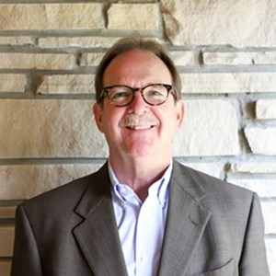
RURAL WATER FINANCING AGENCY
The Rural Water Financing Agency (the “Agency”) is an interlocal agency designed to allow participants of the Agency to join together for the purposes of financing water and wastewater projects on a pooled basis
  Allows for participants of the Agency to come from all 50 states
  The Agency’s Interim Loan Program can fund USDA projects and possibly SRF projects. The Agency is in the process of developing a long-term lending program to provide joint financing along with USDA, SRF and other lending partners.
The Agency was created with the assistance of the Kentucky Rural Water Association and is headquartered in Bowling Green, KY
The Agency has a nine member Board of Directors, comprised of a variety of water and wastewater professionals
  Gary Larimore serves as President/CEO of the Rural Water Financing Agency and is the former Executive Director of the Kentucky Rural Water Association (40+ years)
Gary Larimore
President/CEO of RWFA
Former Executive Director of KRWA
Bowling Green, KY
270.843.2291
g.larimore@krwa.org

Slide 5
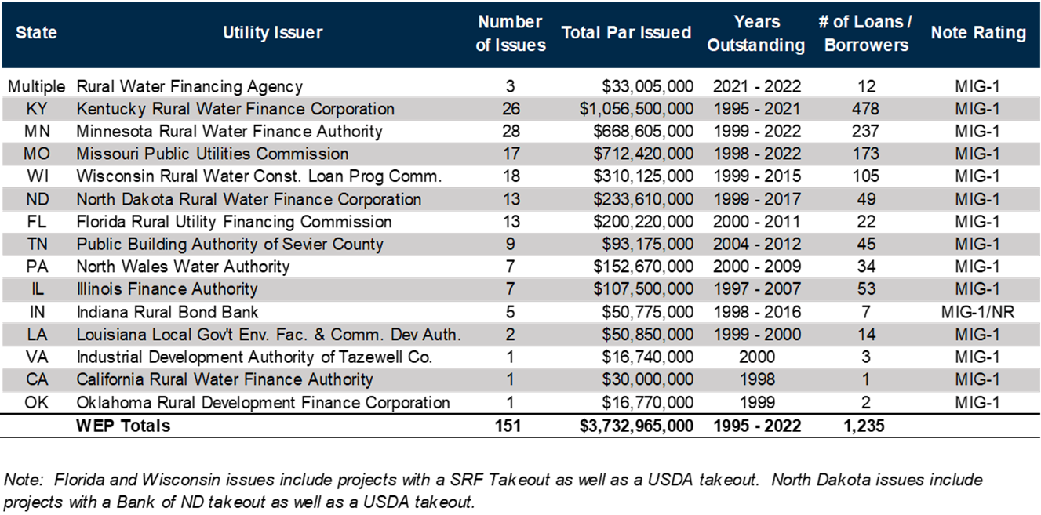
RURAL WATER FINANCING AGENCY - Interim Loan History
RWFA and it’s predecessor, the Kentucky Rural Water Finance Corporation (KRWFC) has provided over $1.5 billion in capital for over 700 projects (Interim & Long-Term Financing Programs)
These Programs have successfully served the Kentucky Rural Water Association’s (KRWA) members for over 25 years.
KRWA has assisted many fellow state associations around the country in setting up similar USDA Interim Loan Programs, to the total of over $3.7 billion nationally

Slide 6
Rural water financing agency – finance team
RURAL WATER FINANCING AGENCY | Issuer of Notes, program oversight and approval
TENNESSEE ASSOCIATION OF UTILITY DISTRICTS | Sponsor, coordinate with borrowers, engineers, counsels, etc.
RAYMOND JAMES | Underwriter, program management, financials & cashflows, lead continuing disclosure, rating presentations, borrower coordination, investor coordination
RUBIN & HAYS | Bond Counsel, provide tax-exempt opinion, draft RWFA legal docs, review underlying loans
REGIONS BANK | Trustee
LOCAL COUNSEL | Borrower’s Counsel, draft loan agreement and other borrower documents

Slide 7
SECTION B
Rural Water Financing Agency - Program Purposes & Process

Slide 8
Program PURPOSES
Offer competitive construction financing
  Competitive interest rate that includes ALL RWFA costs (underwriting, RWFA bond counsel, rating, etc.)
  Fixed interest rate for the term of construction
Generate economies of scale and provide a standardized and consistent loan process, which will benefit borrowers, counsels, USDA and others.
Meet USDA regulations
Serve as an interest rate hedge
Enable the borrower to defer its principal

Slide 9
RWFA Loan rate

Slide 10
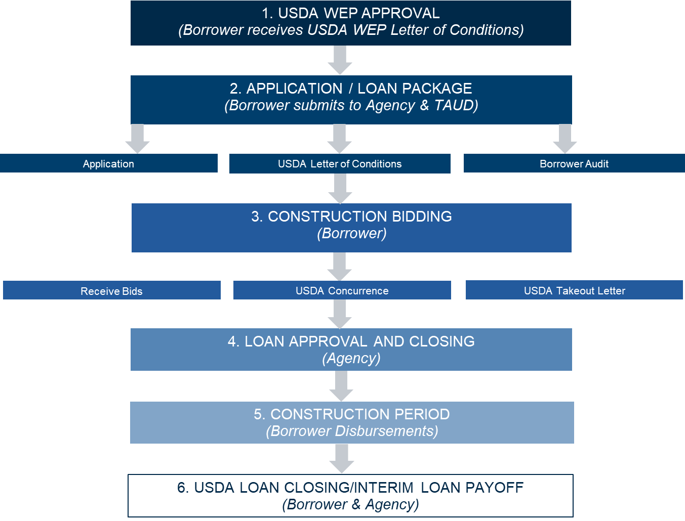
Interim loan PROCESS

Slide 11
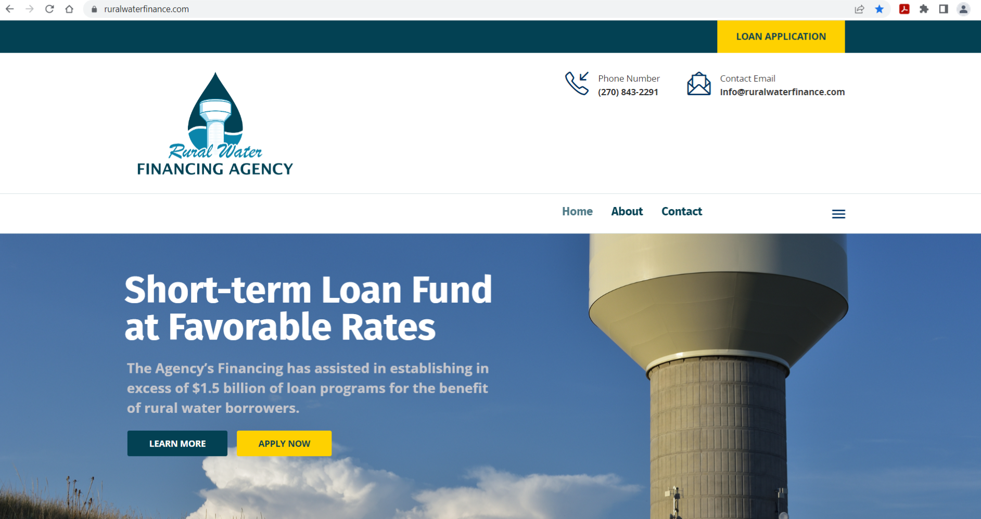
Interim loan PROCESS
Borrower uses RWFA Website (www.ruralwaterfinance.com) to submit application, to include:
  Borrower Finance Team contact information
  USDA Letter of Conditions
  Latest audit

Slide 12
Interim loan PROCESS
Loan Approval and Closing - Borrower checklist
A) Resolution approving borrowers’ participation in the Agency (only completed one time, repeat borrowers can skip this item)
B) Loan Agreement and Note (prepared by borrower counsel)
1. Exhibit A – lists all the terms, rates, dates, etc. of the loan
2. Exhibit B – Disbursement Requisition Form to request funds from Trustee
3. Exhibit C – Borrower’s counsel opinion
4. Exhibit D – USDA Commitment Takeout Letter
C) Trustee Bank Forms
1. Bank Disbursement Instructions (for wires to the borrower’s bank)
2. Incumbency Certificate (authorized signers)

Slide 13
Additional Program details
Loan agreements - between Borrower and Agency
Security - loans will be secured by the proceeds of the USDA loan. If the USDA does not close, the loan will be secured by revenues of the system, or in some cases a general obligation of the borrower
Qualification – governmental borrowers are eligible; non-governmental borrowers will not be able to borrow directly from the Agency
Maturity – generally 18-36 months, fixed rate
Loan Size – no Minimum, No Maximum
Optional Call – @ par after approximately 9 months
Interest Payments – capitalized from loan proceeds
Investment of Proceeds – loan proceeds are invested on behalf of Borrower
USDA Oversight – approves all disbursements, onsite monthly during construction and provides oversight throughout the process
Rating – the Agency’s issues have all been rated MIG-1 (highest short term rating from Moodys)
Underwriting - Raymond James has been underwriting notes with water/sewer USDA takeouts since 2003 and has developed a substantial group of institutional investors comfortable with this product
Frequency – anticipated market issuances of 4-6 times per year

Slide 14
KEY CONSIDERATIONS
What are the obstacles?
In the event of a borrower default or USDA does not complete takeout (has not occurred in over 1,200 USDA interim loans that the Agency’s Finance Team has completed), the Agency will work with the borrower to find another takeout source.

Slide 15
SECTION C
Rural Water Financing Agency – Finance Team Information

Slide 16
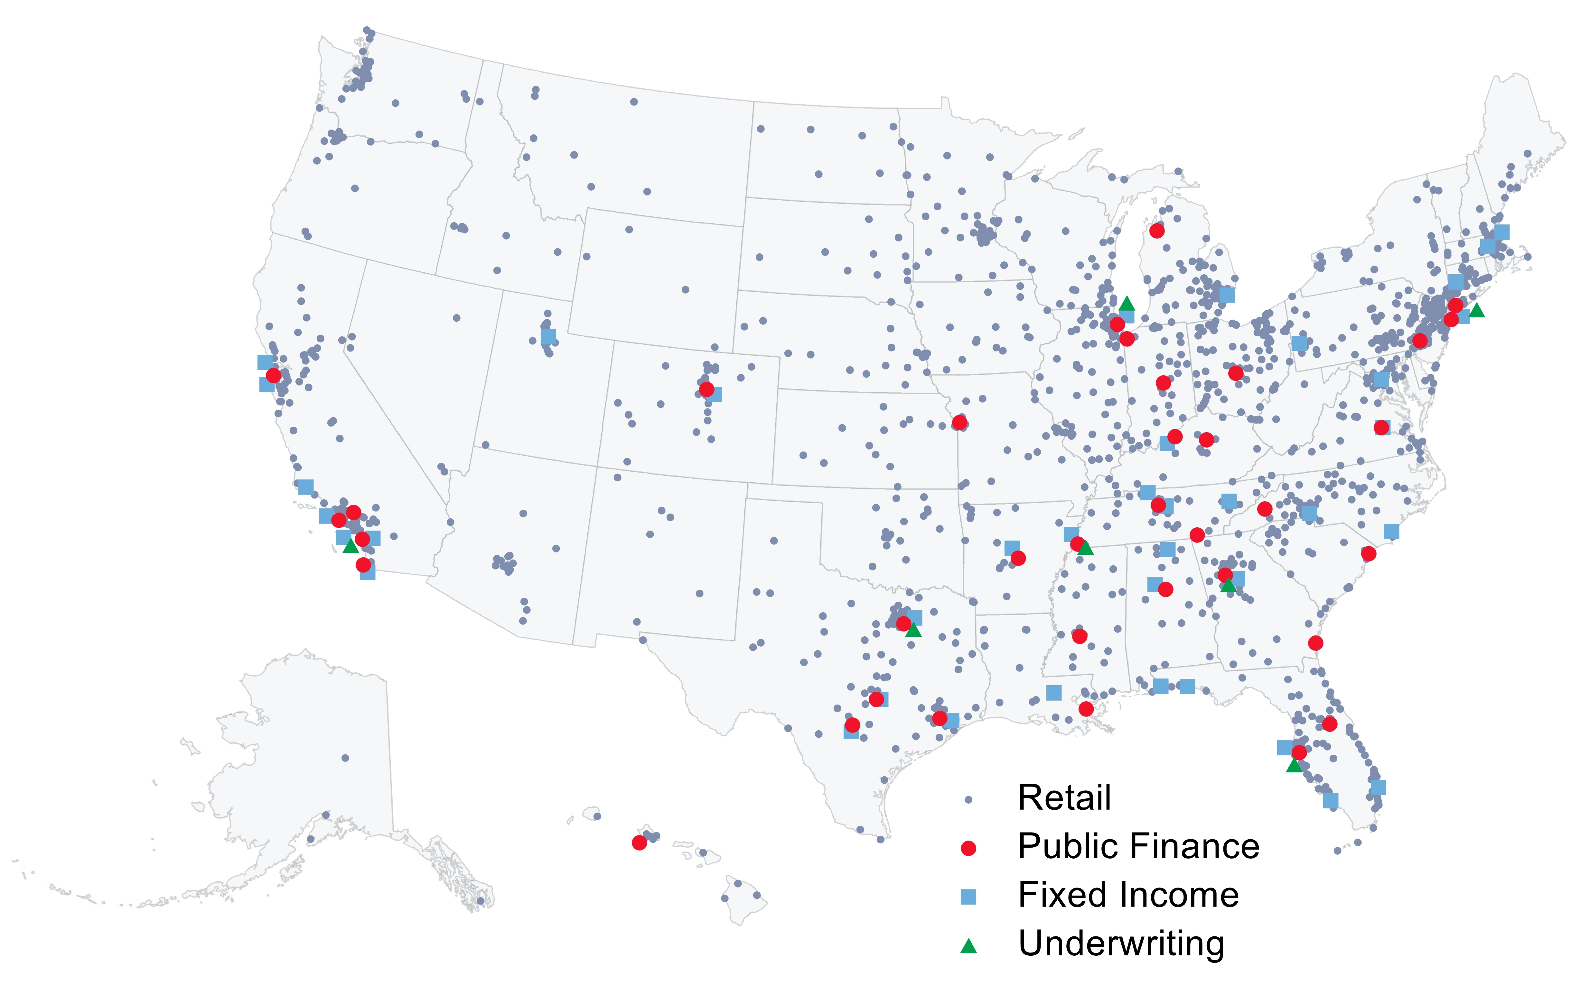
Raymond james - underwriter
Full-service securities firm founded in 1962 and public since 1983 (“RJF” on NYSE)
Fiscal 2020 record net revenue of $7.99 billion; annual net income $818 million
Total market capitalization of approximately $13.1 billion; client assets under administration $1.02 trillion
Over 19,500 employees and independent contractors
132 consecutive quarters of profitability
NATIONAL PRESENCE
BY THE NUMBERS
170 | Public Finance professionals
36 | Office locations nationwide
300+ | Institutional Fixed Income sales and trading professionals
8,200 | Financial advisors
Raymond James Public Finance is consistently ranked as a Top 10 senior managing underwriter nationally*
*Source: Bloomberg, based on total par amount (2015-2020)

Slide 17
Raymond james - underwriter
The Rural Water Financing Agency utilizes the vast Capital Marketplace to provide program funding
Raymond James is an underwriter ranked in the top ten nationally
Raymond James Public Finance Bankers structure Bonds and Notes to be purchased in the marketplace
Raymond James Institutional Sales Professionals sell the Bonds and Notes to investors
Investor proceeds are utilized to fund projects
The Underwriter makes a fair and reasonable market acceptable to the Borrower and the Investor

Slide 18
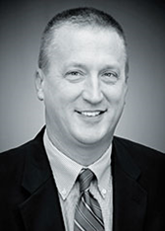
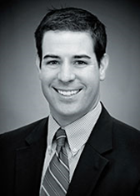
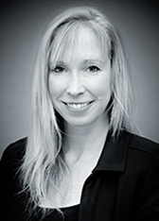
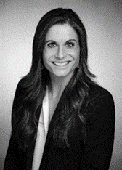
Raymond James - USDA BANKING TEAM
Over 1,300 USDA projects
Approximately $8 billion in USDA business
Over 90 years combined USDA team experience
Kristen Millard
Director
Lexington, Kentucky
Telephone: (859) 232-8249
kristen.millard@raymondjames.com
Bob Pennington
Managing Director
Lexington, Kentucky
Telephone: (859) 232-8211
bob.pennington@raymondjames.com
Nick Roederer
Managing Director
Louisville, Kentucky
Telephone: (502) 741-3686
nick.roederer@raymondjames.com
Kelly Schachleiter
Associate
Lexington, Kentucky
Telephone: (859) 232-8246
kelly.schachleiter@raymondjames.com

Slide 19
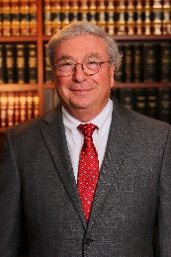
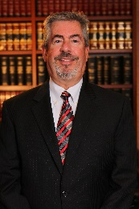
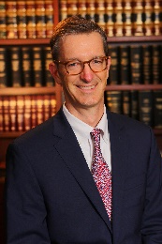
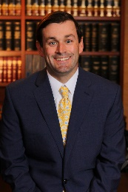
Rubin & Hays – bond counsel
Concentrates its practice in public finance law and is nationally recognized for its innovative approach to managing complex transactions
Has over 95 years of combined experience in public finance law
Structured deals to utilize revenue-backed debt, tax-supported obligations, lease-appropriation debt, and interest rate swaps
Worked with a number of state rural water associations to establish both interim and long-term financing programs to provide communities with cost-effective funds to finance water and sewer projects
Participated in the issuance of more than $5 billion worth of bonds and notes benefitting the construction of water and wastewater facilities
Charles S. Musson Louisville, Kentucky (502) 569-7530 csmusson@rubinhays.com | W. Randall Jones Louisville, Kentucky (502) 569-7534 wrjones@rubinhays.com | Christian L. Juckett Louisville, Kentucky (502) 569-7532 cljuckett@rubinhays.com | Nicholas J. Lococo Louisville, Kentucky (502) 569-7531 njlococo@rubinhays.com
* Advertisement Material

Slide 20
Regions bank – CORPORATE TRUSTee
Corporate Trust Snapshot
The Regions Advantage
One of the largest trustee banks in the nation*
Full-service provider of bond and escrow administration services
Extensive experience handling all types of debt issuances and financing structures
Our model focuses on delivering personalized service through a Relationship Consultant who handles all aspects of the Corporate Trust relationship
Single point of contact
Tailored service
Investment options
Comprehensive reporting
Online account access
Dedicated Escrow Services Group
In-house documents
10 locations each in 16 states
40+ associates averaging 20 years of experience
Regions Service Model
Our service model consists of a single point of contact, acting as the distinct resource for any needs that arise
Client
Relationship Consultant
Trust Assistant
Backup Relationship Consultant
Backup Trust Assistant
Operations
*Source: Thomson Reuters (AT9 League Table)

Slide 21
RURAL WATER FINANCING AGENCY
QUESTIONS?

