Slide 1
Building a Stronger Utility
Leon Shields

Slide 2
Foundation
Shifting the culture
Developing people and teams
Cross-generational learning
Finding the right fit
Communications
Community Outreach

Slide 3
Shifting the Culture
That’s the way we have always done it!

Slide 4
Developing People & Teams
Recognize Outstanding Leaders
Promotions / Salary Increases
Promote Communication within the Utility
Create Organizational Structures Showing Advancement Possibilities

Slide 5
Cross- Generational Learning
Design Systems
Customer Service Programs
GIS Systems
ARI / AMI Meter Systems
Reporting Standards

Slide 6
Finding the Right Fit
Conduct One on One Interviews with Employees getting their personal candid comments and ideas.
Work Evaluations
Experience
Personal Dedication

Slide 7
Financial Modeling
Income Statements
Balance Sheets
Cash Flow Statements
Debt Schedule

Slide 8
Capitalizing on New Technologies & Trends
Metering
Accounting
Engineering
GPS
Website / Social Media

Slide 9
Expand Your Service Territory
Increase of Service Territory
Increase of Customers
Increase of Revenues
Increase of Jobs
Increase of Community Contributions

Slide 10
Communications
Establish Relationships with Area Media Outlets
Public Information Officer
Build an Informative and Functioning Website
Continue to use Social Media Platforms for Immediate Releases
Educate Employees to Promote Services and Answer Questions in the Field

Slide 11
Community Outreach
Network with Area Organizations
Participate with Charities and Organizations
Support & Sponsor Community Events
Maintain Visual Presence

Slide 12
Utilizing Resources
Tennessee Association Utility Districts
Tennessee Utility Assistance
American Water Works Association
American Public Gas Association
Tennessee Gas Association
Tennessee Valley Power Provider Association
Tennessee Municipal Electric Power Association
Tennessee 811

Slide 13
Legislative Involvement
Build Relationships with Area Legislators
Harmonize Utility Priorities with State and Federal Policies
Utilize Possible Funding Opportunities for Utility Projects
Participate in Legislative Updates and Conferences

Slide 14
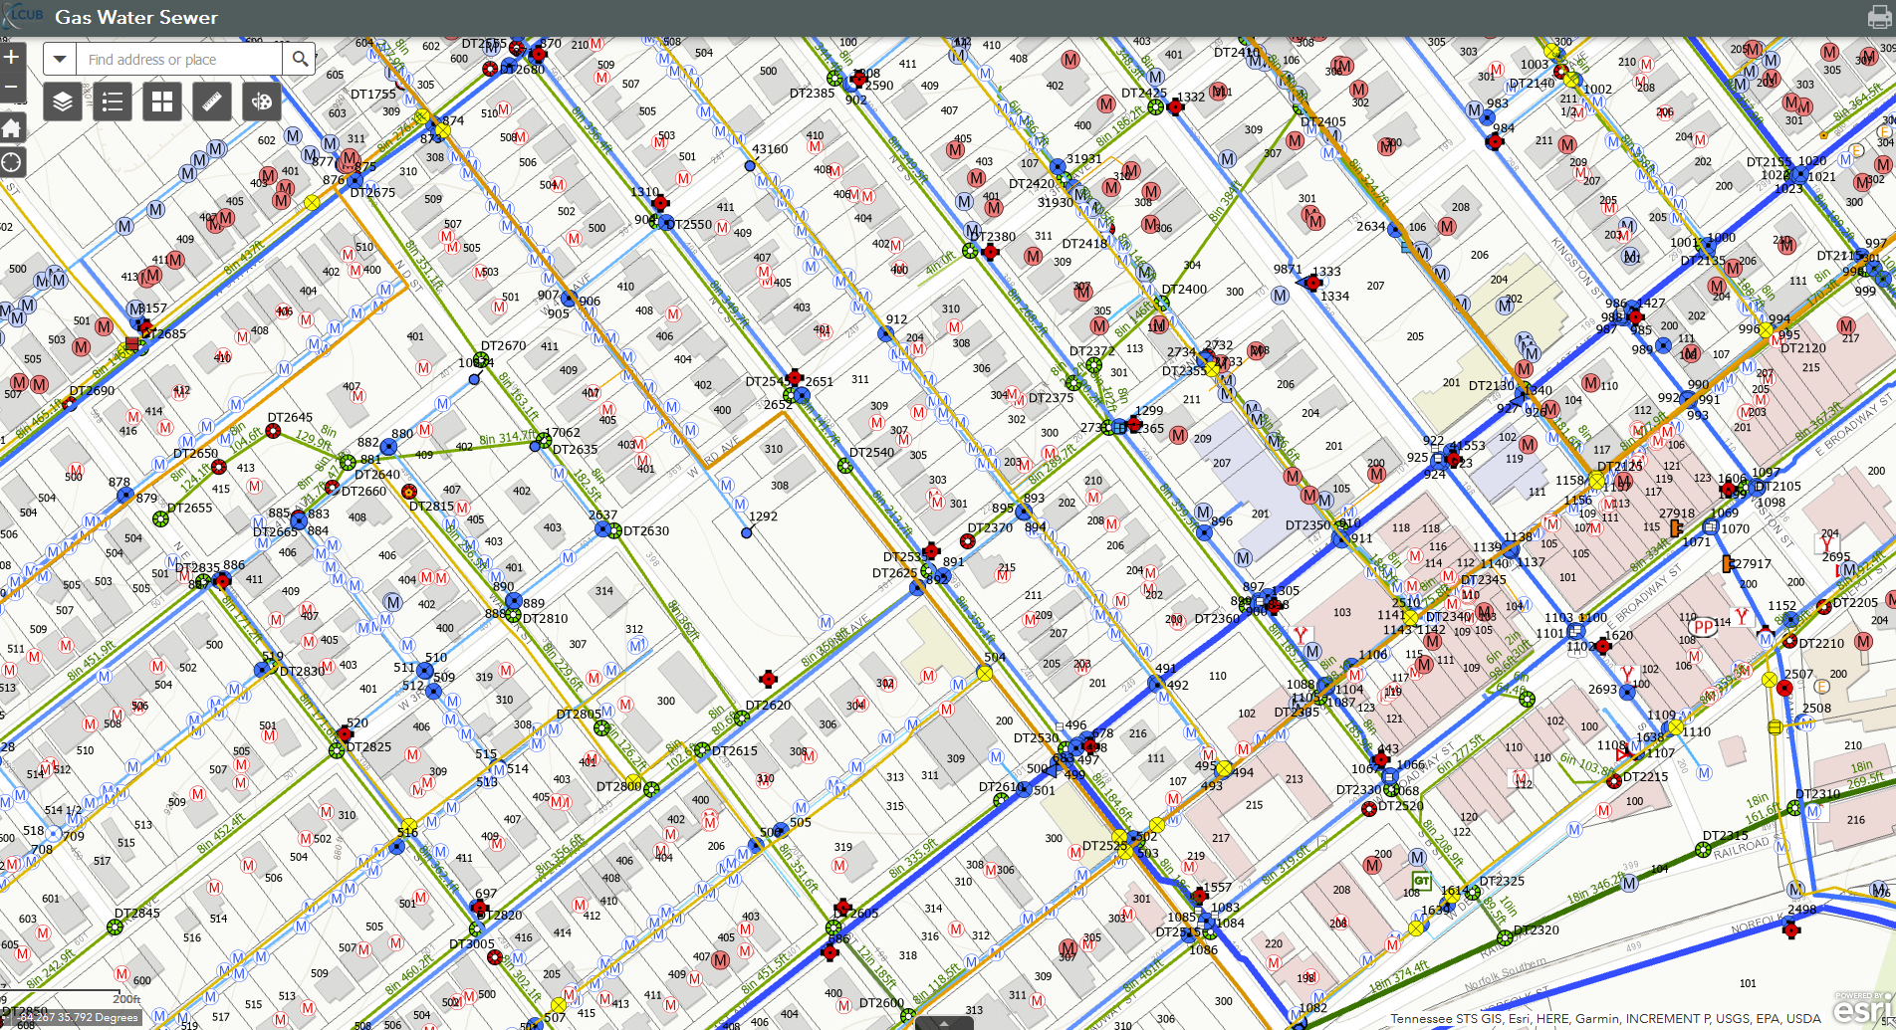
Building System Maps

Slide 15
Be a Mentor / Host
Allow Organizations and Utilities to come to your Facilities for Meetings and Training Classes.
Share Learning Experiences and Goals to Utilities that are sharing the same Issues you have faced.
Partner with Area Utilities to Promote Public Awareness.

