Slide 1
Leon Shields

Slide 2
Forbes
A survey examining the philosophies, attitudes and activities of entrepreneurs related to their communities found that 91% of entrepreneurs are currently engaging their communities outside of their business responsibilities, and 44% say their businesses have grown as a result of engaging their communities.

Slide 3
Volunteer Tennessee
A study on volunteerism found that 92% of employees believe volunteer activities through work develop their people and teamwork skills, and 77% believe they strengthen relationships.

Slide 4
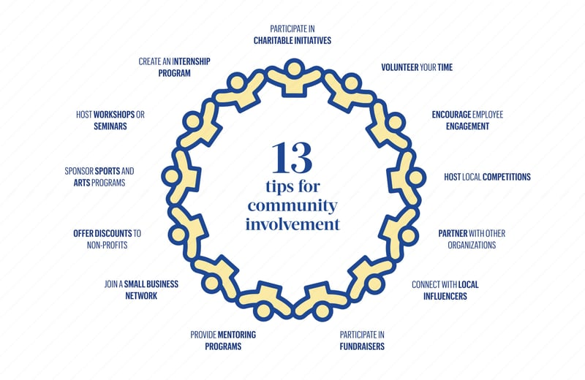
Bizjournals

Slide 5
Why Community Involvement?
Promotes the utility in the community
Builds trust and establishes a relationship from the utility
Easy way of promoting new services and public education
Allows the community to get to know your employees
Attracts and Retains Talent
Helps Community Thrive
Promotes Positive Culture
It’s Easy

Slide 6
When customers believe that a utility is truly invested in the community, they become more connected to that utility.

Slide 7
Usually, online communities are much larger and have a much stronger influence than geographic communities—which is why online community engagement is vitally important. Furthermore, if you engage with your online community, the members of the community will remember you when they engage in their own communities.

Slide 8
Social Media Program
Usually, online communities are much larger and have a much stronger influence than geographic communities—which is why online community engagement is vitally important. Furthermore, if you engage with your online community, the members of the community will remember you when they engage in their own communities.

Slide 9
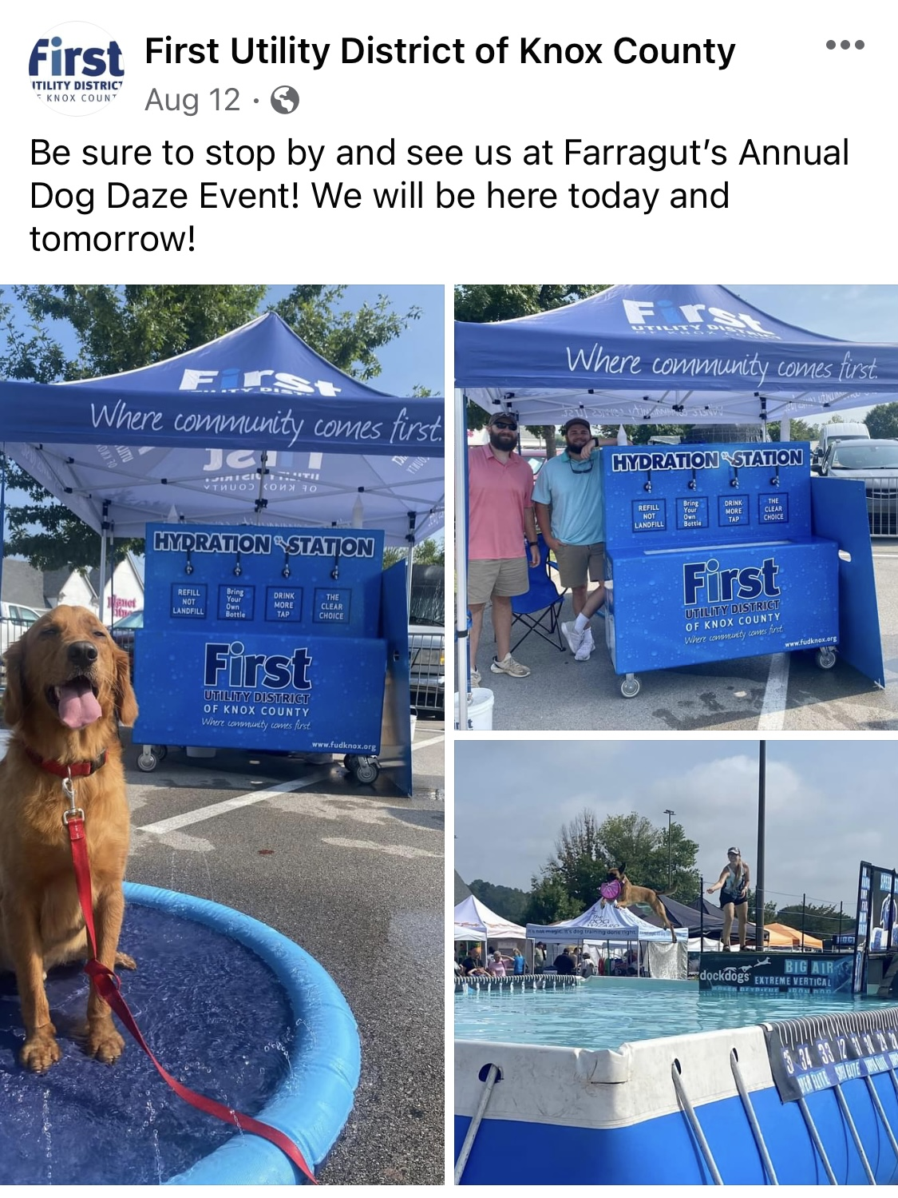
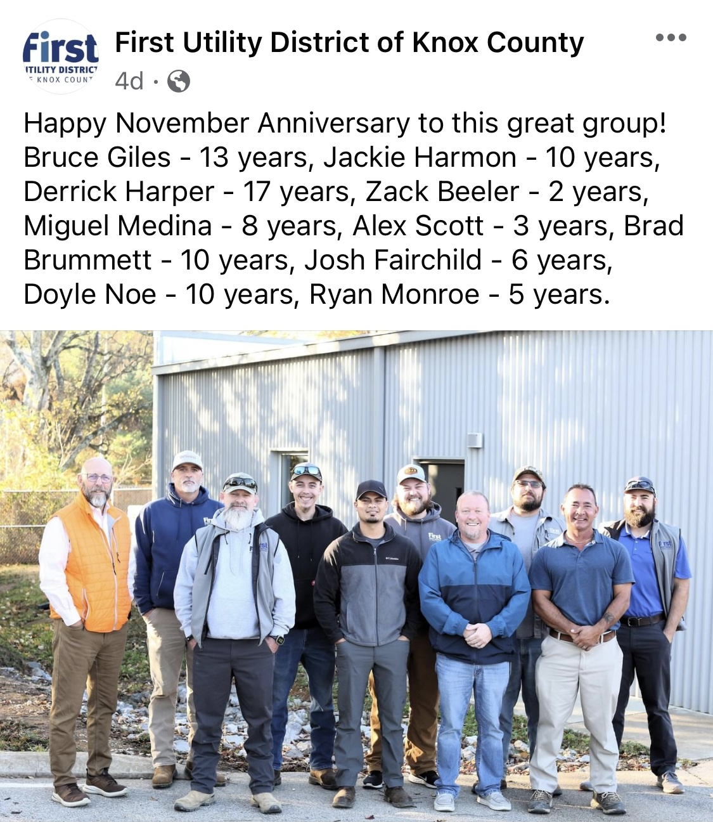
First Utility District 1.9K Followers

Slide 10
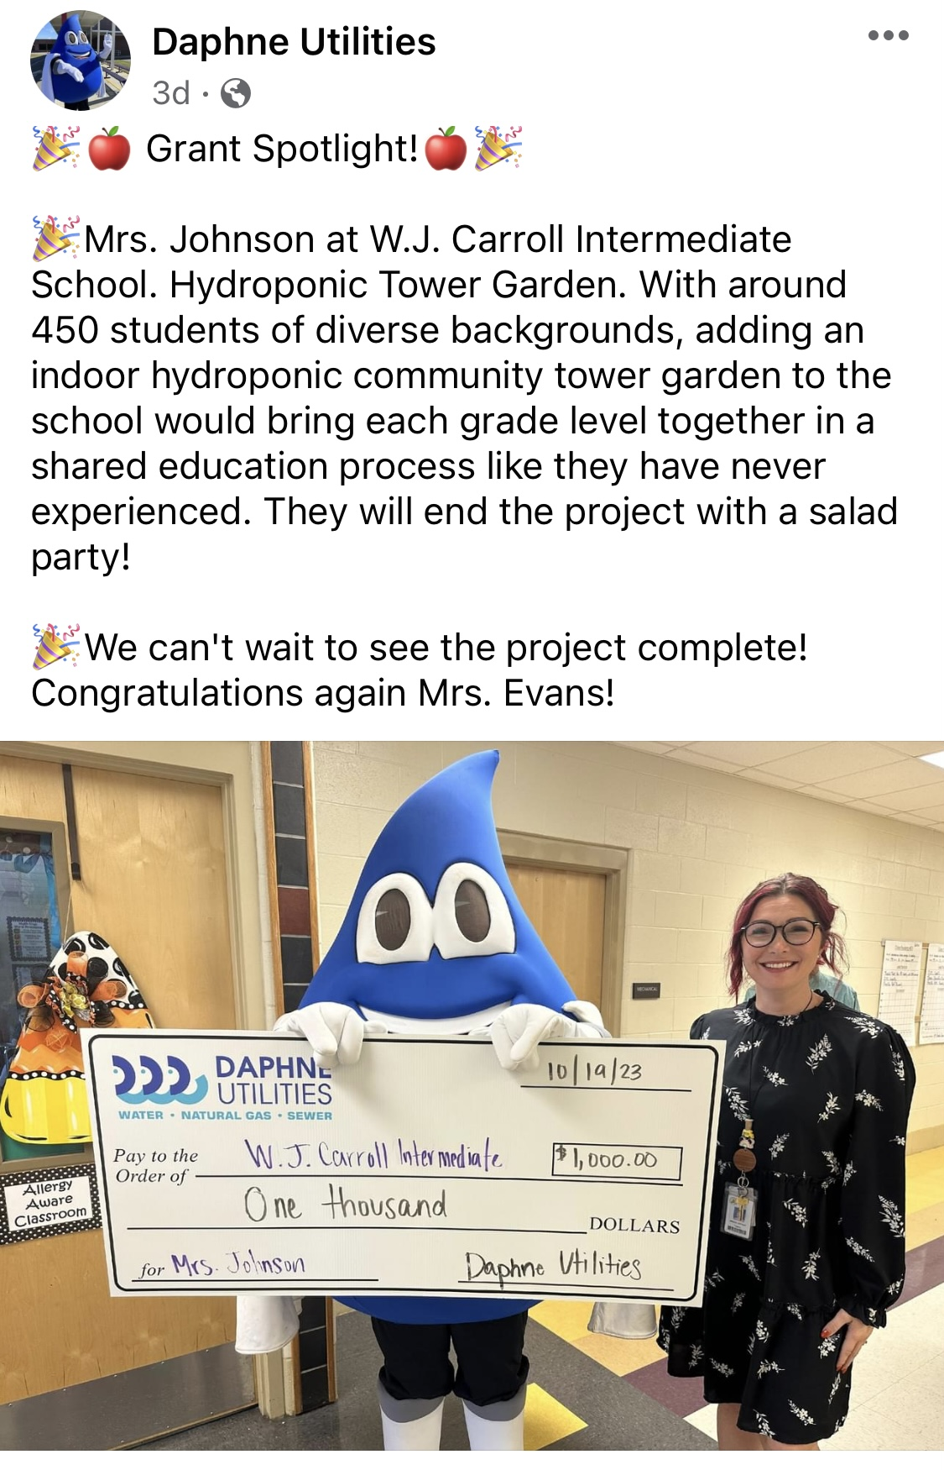
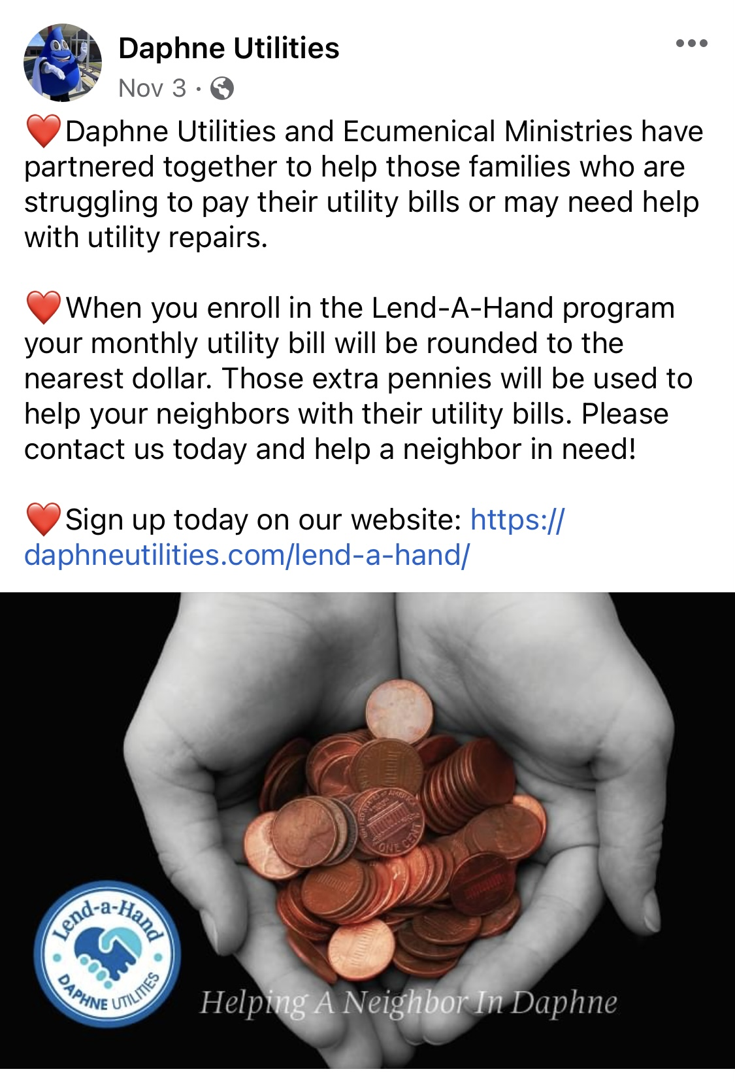
Daphne Utilities 2.6K Followers

Slide 11
Knoxville Utilities Board 14K Followers

Slide 13
Community Charities
Down Syndrome Awareness Group
United Way
Alzheimer's of Tennessee
St Jude Childrens Hospital
Boys & Girls Club of Tennessee
Food Pantries
Empty Stocking Fund
Angel Tree
Other Area Charities

Slide 14
Community Involvement Examples
Parades
Host Community Meetings
Booth at Local Festivals /Fairs
Chamber of Commerce Participation
School Function Involvement
Habitat for Humanity
Community Trash Pick Up Day
Placement of Park Benches
Veteran Affairs
Seasonal Community Events

Slide 15
Bingo? It’s Community Involvement!

Slide 16
Verify donations and charitable involvement with utility policies and State of Tennessee Comptroller’s Office

Slide 17
Utility Employee Engagement Examples
Volunteering of employee’s time
Employee participation on public boards or committees
Charity Events / Food Drives / Toy for Tots
Golf Tournaments
tnAchieves
Other Community Events

Slide 18
Negative Reactions
Unprofessional Employees
Lack of Participation
Unfair Practices

Slide 19
EMPLOYEE CONCERNS
Do I have to?
What do I get out of it?
Do I get paid to do it? Overtime?

Slide 20
Utility Slogans
Going the Extra Mile
Where Community Comes First
#1 Through Excellence and Innovation
Your Neighbor / Your Utility

