Slide 1

Tennessee Board of Utility Regulation
Ross Colona
Assistant Director
Local Government Finance

Slide 2
Roadmap
TBOUR Introduction
TBOUR Regulatory Oversight
Financial Distress
Mergers and the Utility Revitalization Fund
Customer Complaints
Water Loss
New System Creation
Administrative Review

Slide 3
Utility Staff
East Tennessee: Ben Johnson
Email: benjamin.s.johnson@cot.tn.gov
Phone: 615.747.8831
Middle Tennessee: Meghan Huffstutter
Email: meghan.huffstutter@cot.tn.gov
Phone: 615.747.5379
West Tennessee: Nate Fontenot
Email: nate.fontenot@cot.tn.gov
Phone: 615.747.5238

Slide 4
Tennessee Board of Utility Regulation
PC0463 combined the:
Water and Wastewater Financing Board
Roughly 280 Utilities
Municipal, County, Authority Systems
Utility Management Review Board
Roughly 170 Utility Districts

Slide 5
Who makes up the Board?
Greg Moody, Chair- Comptroller or Comptroller Designee
Tom Moss, Vice-Chair- TDEC Commissioner or Designee
Edwin Carter, Comptroller Appointee
Steve Stone, Middle TN Natural Gas UD, House Speaker Appointee
David Purkey, Morristown Utility System, Senate Speaker Appointee
6 Governor Appointees

Slide 6
Who makes up the Board?
Governor Appointees
Candace Vannasdale, Harriman Utility Board
Michael Adams, Water Authority of Dickson County
Bruce Giles, First UD of Knox
Eugene Hampton, Metro Nashville
Nick Newman, Memphis Light, Gas, and Water
Anthony Pelham, Warren County Utility District

Slide 7
What do we regulate?
Water, Sewer, and Natural Gas Local Government Utility Compliance with State Laws surrounding:
Financial Distress
Water Loss
Training
Managerial, Technical, and Financial Capacities

Slide 8
Enforcement Authority
TBOUR sends orders.
Can impose “Reasonable Sanctions”
Orders enforceable through Chancery Court.
Subpoenas can be issued for utility officials to be present at TBOUR meetings.

Slide 9
Training
12 Hours in One Year
From the Date of the Initial Election or Appointment
12 Hours every 3 years following

Slide 10
Financial Distress
Two Years of Loss
Deficit Net Position
Default on Debt
2 Years of Delinquent Audits*
Illicit Transfer of Funds*

Slide 11
Illicit Transfer of Funds
An employee or governing body member of a utility under the TBOUR has 15 days to report an unauthorized transfer after they become aware of the unauthorized transaction.
Board staff reviews audits to find transfers that have not been authorized.

Slide 12
Merger Authority
UMRB could order mergers.
Previously limited to only utility districts.
TBOUR can order mergers to any type of utility.

Slide 13
Merger Process
Board orders feasibility study
Board staff conducts a public hearing in the area of the utility
Board staff brings study and hearing results back to TBOUR
TBOUR orders the utilities to enter into negotiations
If negotiations don’t go accordingly, matter is taken to Chancery Court

Slide 14
Utility Revitalization Fund
TBOUR can provide grants to subsidize mergers.
Can be annuity payments.
Can be counted as operating revenue in determining statutory change in net position.

Slide 15
Financial Distress Process
Questionnaire
Order Rate Study and Policy Review
Order Implementation
Update Cycle- 40 Entities

Slide 16
Customer Complaints
Must first be heard by the local board.
Board staff receives complaint first.
Complainant and Utility present case to TBOUR.
TBOUR can order corrective actions.

Slide 17
Informal Hearings
Justness and reasonableness of a utility’s rates and fees.
Justness and reasonableness of a utility’s requirements on developers or customers to build infrastructure.
Absence or inadequacy of a utility’s policies and procedures.
Utility’s refusal to extend service (to a certain extent).

Slide 18
Water Loss
Water Produced or Purchased
Water Supplied
Water Loss % must be under 40%

Slide 19
Water Loss
Referred to TBOUR
AWWA 6.0 Submission
Plan to mitigate water loss
Board staff reviews for improvement

Slide 20
New System Creation
Formation of new Utility Districts
Approval for local governments to start a new service
Approval for current utilities to start a new service
Financial Sufficiency

Slide 21
Administrative Review
Financial, Managerial, Technical Capabilities
Board staff will travel to the utility to conduct interviews.
Staff brings recommendations to the board to remedy issues.
Can order a merger as a result of the findings.

Slide 22
DOI Investigation- Delta Utility
DOI received several allegations leading to a lengthy investigation into a utility.
This utility offers electricity, broadband, water, and sewer.

Slide 23
DOI Investigation- Delta Utility
Finding 1: Utilities management breached their power contract and exceeded their authorized interfund loan agreement by roughly $4.6 million.
Utility was authorized for an interfund loan of up to $3.3 million.
Utility paid an accounting firm $65,000 to determine the actual amount of the excess in spending.

Slide 24
DOI Investigation- Delta Utility
Finding 2: Utility management failed to create a separate accounting unit for its broadband fund.
The manager advised investigators he was aware a separate broadband division had not been set up under his watch. Board members stated they were unaware a separate accounting unit had not been established until the external auditors advised them on August 27, 2019.

Slide 25
DOI Investigation- Delta Utility
Finding 3: The Board’s employment decisions resulted in avoidable settlements totaling $900,000.
Original Manager Left
Utility Hired a New Manager
Original Manager Sued
Utility Fired New Manager, paid Original Manager $125,000 in back pay and damages
New Manager sued and was awarded $775,000.

Slide 26
DOI Investigation- Delta Utility
Finding 4: Manager approved work outside of grant scope for roughly $160,000.
Finding 5: Utility paid inflated rental fees and avoidable admin fees totaling at least $102,000.

Slide 27
DOI Investigation- Delta Utility
Finding 5 (continued): $102,000 misspent in admin fees.
Utility began paying a company $1,500 a month to use as a warehouse.
Company began charging the utility $2,000 per month for warehouse rent.
Company began charging the utility $1,500 per month for a “warehouse admin fee”.

Slide 28
DOI Investigation- Delta Utility
Finding 5 (continued): “Between the months of July 2018 and October 2019, the utilities paid an additional $10,000 more in rent to the installation company than if it had paid the landlord directly. Furthermore, the utilities paid the installation company $92,175 for warehouse administrative fees for tasks that could have been, and eventually were, performed by utilities employees.”

Slide 29
DOI Investigation- Delta Utility
Finding 6: The Board approved and paid questionable leave to the manager totaling $93,768.95.
Between July 2018 to December 2019, the Manager did not use any leave.
Records indicated the Manager had taken time off, but didn’t record it.
“I always work more than 40 hours a week.”

Slide 30
DOI Investigation- Delta Utility
Finding 6 (continued): Roughly $93,000 in Leave Pay
Utility policy allowed for payment of unused leave periodically and upon an employee terminating employment.
On November 23, 2018, the manager requested and was paid for 400 hours of vacation leave totaling $28,844. When the manager resigned from his position with the board in January 2020, he requested and was paid for 379.72 hours of vacation leave totaling $31,433.22 and 403.5 hours of sick leave totaling $33,401.73.

Slide 31
DOI Investigation- Delta Utility
Finding 7: The manager made questionable purchases totaling at least $9,914.18.
The credit card agreement which was signed by the manager stated “I understand that I may not use this card to make personal purchases.”
Purchases were made during times in which the manager’s time reporting did not reflect working during those hours.
Based on documentation, investigators could not determine if the purchases derived any benefit for the utility.

Slide 32
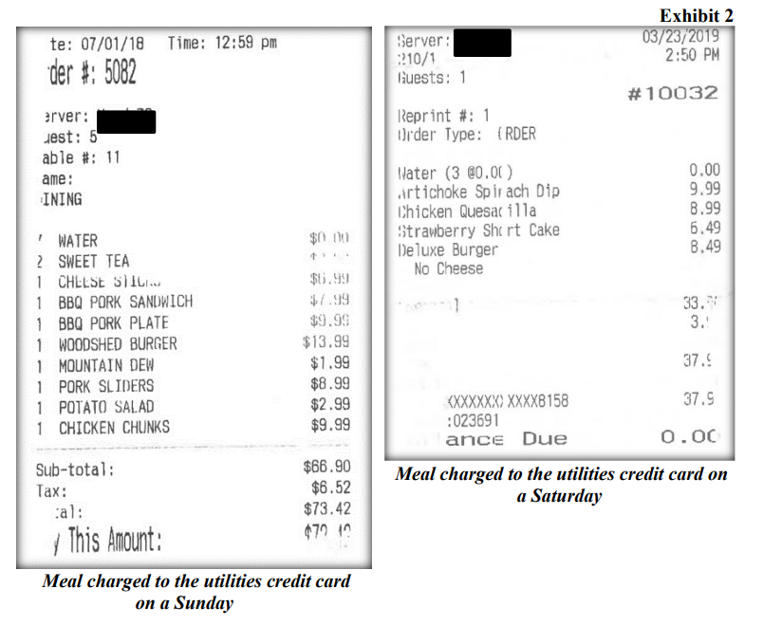
DOI Investigation- Charlie Utility

Slide 33
DOI Investigation- Delta Utility
Finding 7: The manager made payments of about $3,000 for painting and landscaping a privately owned building without Board approval.
“The building was an eyesore to the employees.”

Slide 34
DOI Investigation- Delta Utility
Finding 8: Management did not document proper competitive bids regarding broadband projects.
The “last mile” company ordered fiber and installation supplies from a vendor of their choosing; however, this vendor billed the utilities directly. During the broadband installation, the utilities paid this vendor at least $519,545.80. A subsequent analysis performed by the utilities concluded this vendor charged more than double the price of its competitors in some instances.

Slide 35
DOI Investigation- Delta Utility
Finding 8: Management did not document proper competitive bids regarding broadband projects.
The manager contracted with an individual to provide tracking of the broadband critical path installation progress without soliciting bids. During the broadband installation, the utilities paid this individual $126,427.61. The manager told investigators the board had given him authority to procure any service contract without competitive bids.
Utilities do have certain exemptions for bidding professional services, but tracking of a broadband project did not meet that criteria.

Slide 36
DOI Investigation- Delta Utility
Deficiency 1: “The Board did not sufficiently oversee broadband projects, manager decisions, and expenses.”
Deficiency 2: “The manager did not present the annual financial audit to the Board in a timely fashion.”
What could have prevented this?
The Board could have done its job and employees could have spoken up.

Slide 37
Conclusion
TBOUR Authority
Orders, Chancery Court, Subpoenas, Reasonable Sanctions
Financial Distress
Customer Complaints
Water Loss
New System Creation
Administrative Review

