Slide 1

ARP Updates, Milestones and Additional Funding Opportunities
November 1, 2024
Notes:
Jovanni

Slide 2
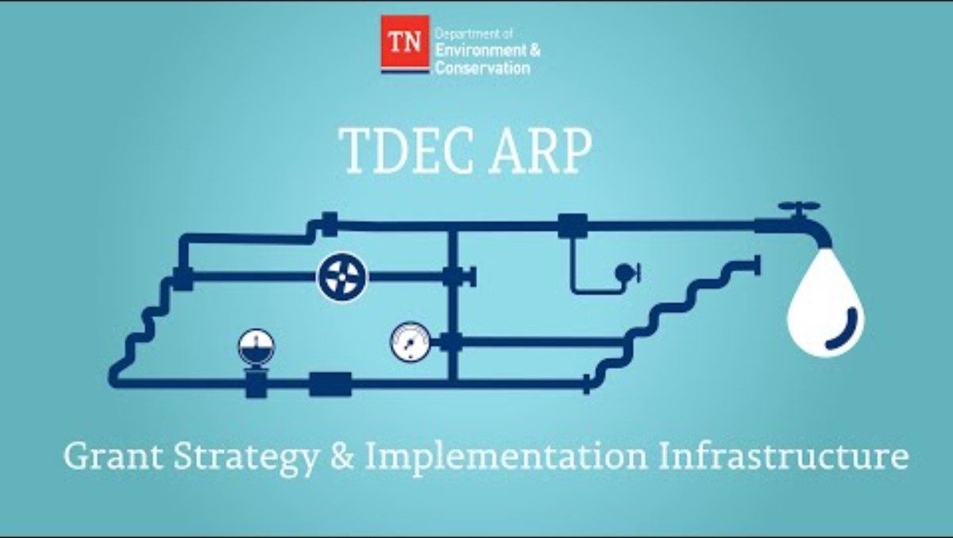
ARP Grant Strategy & Implementation
Notes:
Karen

Slide 3
ARP Grant Program Overview as of October 25, 2024
Grant Programs | Amount Allocated | Amount Obligated¹ |  | % of Projects Started² | Funds Available for Disbursement (approved procurements) |  | Funds Disbursed
Non-Competitive Grants | $997,409,600 | $997,409,600 | 100.0% | 98.6% | $471,579,328 | 47.3% | $134,933,526 | 13.5%
Competitive Grants | $214,862,453 | $214,626,911 | 99.9% | 55.1% | $8,394,405 | 3.9% | $852,570 | 0.4%
State Strategic Projects – State Grants³ | $57,600,000 | $58,458,600 | 101.5% | 90.0% | $8,025,815 | 13.9% | $0 | 0.0%
State Strategic Projects – Local Grants⁴ | $36,550,092 | $26,750,092 | 73.2% | 20.0% | $350,000 | 1.0% | $0 | 0.0%
Administration | $46,000,000 | $46,000,000 | 100.0% | 100.0% | $46,000,000 | 100.0% | $22,675,737 | 49.3%
TOTAL | $1,352,422,145 | $1,343,245,203 | 99.3% | 96.8% | $534,349,548 | 39.5% | $158,461,833 | 11.7%
Amount obligated includes all executed contracts
Percentage of all projects started includes all projects with a procurement submission
State Strategic Projects - State Grants include grants for TDOT and TSP
State Strategic Projects - Local Grants include grants for Erwin Utilities, Duck River Utility Commission, Tipton County, and Grundy County (2)
This metric includes projects with procurements submitted. Noncompetitive has 1407 projects; 70 remain “not started”. When comparing this to the at-risk population of 3% (97% not at risk), the difference is due to 30 projects noted as AMP or with a valid exception.
Notes:
Karen

Slide 4
Current Fund ARP Grant Distribution Status
October 28, 2024
1
Total Funds Obligated to Grantees
$1.3B
42% of obligated funds have an associated
procurement submitted
2
Total Procurements Submitted (Awarded Vendor Contract)
$542M
3
96% are approved
(1,447 procurements approved)
Total Procurements Approved (Awarded Contract)
$523M
Optional Pre-Award Reviews
4
37% of approved procurement dollars have submitted for reimbursement
Pre-Award Submitted | $63.6M
Pre-Award Approved | $53.9M
Submitted for Reimbursement
$189M
5
Total Paid
$137M
75% of requested reimbursements
*Does not include administrative expenses.
Notes:
Paula

Slide 5
Procurement Status Update as of October 28, 2024
1670 Approved Procurements
339 Grants
1291 Projects
Text
Text
Text
Engineering Procurements
Construction Procurements
Professional Services Procurements
922
474
274
Notes:
Paula

Slide 6
Reimbursement Status Update as of November 1, 2024
Text
Text
Text
Grantees with Submitted Reimbursements
Reimbursement Requests Received
Reimbursement Requests Approved
262
602
500
Total reimbursements requested: $189,002,174
Total reimbursements paid: $136,998,778
Notes:
Paula

Slide 7

Milestones Update
Notes:
Paula

Slide 8
TDEC ARP Grant Lifecycle
Planning and Design - Solicitation and Contracting (~93 - 125 days)
Planning and Design - Project Execution (~255 - 285 days)
Construction - Bidding and Contracting (~86 - 118 days)
Final deliverables and reimbursement requests submitted
Securing contracts for planning and design work
Grant administration and planning funds available for reimbursement
Development of planning and design deliverables
Planning and design funds available for reimbursement
Construction - Project Execution (~264 days)
Project Closeout (~60 days)
Securing contracts for construction work
Construction work occurs
Construction funds available for reimbursement
All funds available for reimbursement
Mile-stones 1 & 2
Mile-stone 3
Mile-stone 4
Mile-stone 5
Mile-stone 6
* Milestone 7 is a final catch all for any remaining work to be completed under ARP projects.
Notes:
Vena

Slide 9
Overview of Milestones
Non-competitive Grantees
Milestone 1:
April 30, 2024
Contract Procurement Requirement
Milestone 2:
May 30, 2024
Project Procurement Requirement
Milestone 3:
Sept. 30, 2024
Awarded Contract Requirement
Sept. 30, 2024
End of Scope Modification Requests
ALL Grantees
Milestone 4:
January 30, 2025
Plans and Specifications Requirement (60%)
Milestone 5:
May 30, 2025
Plans and Specifications Requirement
Milestone 6:
August 30, 2025
Construction Start Requirement
Milestone 7:
Dec. 15, 2025
Remaining Procurement Requirement
Notes:
Paula

Slide 10
Milestones Update (Non-Competitive) as of October 25
All non-competitive grantees were required to meet Milestones 1-3 by September 30, 2024.
337 (100%)
Grantees Met Milestone 1
316 (94%)
Grantees Met Milestone 2
312 (93%)
Grantees Met Milestone 3
Grantees missing milestones have received communications indicating which milestones are still missed. Reminder notifications will be ongoing until grantees meet the milestone.
Notes:
Paula

Slide 11
Milestone 3: Sept. 30, 2024
Awarded Contract Requirement
NON-COMPETITIVE GRANTEES
TDEC allowed non-competitive grantees to meet the May 30, 2024 milestone by submitting a pre-bid or pre-award procurement for each project.
All projects that submitted pre-bid or pre-award documentation to meet the May 30, 2024, milestone must have submitted an awarded contract for those projects by September 30, 2024.
Projects that missed Milestone 2 (May 30, 2024) are still expected to move projects to the awarded contract stage in a timely manner. Projects that met Milestone 2 late, must catch up by December 31,2024 or those projects will be placed on the list for termination.
Notes:
Karen

Slide 12
Exceptions and Missed Milestone Risk Process
Exceptions
  TDEC recognizes that project types and extenuating circumstances can create barriers to meeting milestones. As a result, some projects received an exception for Milestone 2 and will receive an exception to Milestone 3. Exceptions include:
    Asset Management Plan Only Projects​
    Associated Procurement Projects​
    Active Modifications and Amendments (in progress for the past 30 days)
Missed Milestone Risk Process
  TDEC sent critical warning letters noting the project is at risk for termination of funding for missing milestones to grant administrators, mayors, and legislators.
  Grantees were required to meet with TDEC leadership to discuss the project(s) at risk.
  Weekly warning letters are being shared until project issues are resolved.
  Grantees are required to adhere to a strict timeline for getting back on track and provide justification for not being on track or risk funding.
Notes:
Karen

Slide 13
Milestone Risk Consequence
TDEC continues to evaluate all grants and all projects that are unable to meet each milestone against known risk factors.
We urge Grantees to take immediate and decisive action to ensure Milestones 2 AND 3 (submitted awarded contracts for all projects) are met by December 31, 2024.
Failure to do so will result in consequences that could include the termination of the project and the loss of funding.
Notes:
Karen

Slide 14
Ongoing – Voluntary Opt-Out
(No Reimbursement Paid to Date)
Grantees may choose to terminate their grant contract voluntarily by submitting a written request for contract termination to TDEC.ARP@tn.gov.
Requests must be submitted on letterhead and signed by an authorized representative for the grant contract. TDEC will engage those who start this process with additional guidance.
Grantees may request voluntary termination if no reimbursement requests have been paid on the grant contract.
Notes:
Karen

Slide 15
Next Milestone 4: January 30, 2025
Plans and Specifications Requirement (60%)
ALL GRANTEES
Grantees and engineers working on planning, design, and construction (PDC) projects must attest to being at least 60% complete with their design and specification deliverables.
Meeting Milestone 4
  In order for Grantees to meet this milestone:
    Engineers must attest to plans and specifications being 60% complete in the project annual reporting activity in GMS
    Projects must have, at a minimum:
      Draft specifications and calculations
      Preliminary construction scheduled
      Phasing plan
      Logistics, supplies, and mobilization plan
      Applying for necessary permits
    OR have submitted complete plans and specifications to ESU
    OR have SWIG-reviewed plans and specifications in GMS
Tracking
  TDEC will monitor annual reporting activity responses, ESU's review queue, and the status of deliverable activities for applicable projects in GMS to track progress at the project level. Grantees who are not on track for Milestone 4 will receive monthly communications.
  Exceptions
  Non-construction planning, design, and construction (PDC) projects (asset management plans (AMPs), studies, etc.)
Notes:
Paula

Slide 16
Milestone 5: May 30, 2025
Plans and Specifications Requirement (Full)
ALL GRANTEES
All grantees with planning, design, and construction (PDC) projects must submit final design and specification deliverables to TDEC. Projects requiring ESU review must submit their plans and specifications to MyTDEC Forms for ESU approval. Projects not subject to ESU review must submit their plans and specifications to GMS for SWIG review.
Meeting Milestone 5
  In order for Grantees to meet this milestone:
    Projects must have, at a minimum, submitted plans and specifications to ESU or GMS
Tracking
  TDEC will monitor the status of deliverable activities for applicable projects in GMS and ESU’s review queue to track progress at the project level. Grantees who are not on track for Milestone 5 will receive monthly communications.
  Exceptions
  Non-construction projects classified as PDC (AMPs, studies, etc.)
Notes:
Karen

Slide 17
Milestone 6: August 30, 2025
Construction Start Requirement
ALL GRANTEES
Construction activity must start for all projects that include construction.
Meeting Milestone 6
  All projects with construction must submit a Pre-Award procurement bid package by August 30, 2025.
  Projects must have received an Authority to Award letter for a contractor procurement and schedule an initial site inspection by November 30, 2025.
To verify construction starts, each construction project must have an initial site inspection scheduled by November 30, 2025.
Tracking
  TDEC will monitor site inspection requests, reimbursements for capital purchase expenditures, and the status of procurement activities for capital purchase vendor contracts in GMS to track progress at the project level. Grantees who are not on track for Milestone 6 will receive monthly communications.
  Exceptions
  Considered on case-by-case basis (small-scale replacements, minor rehab, etc.).
Notes:
Karen

Slide 18
Milestone 7: December 15, 2025
Remaining Procurement Requirement
ALL GRANTEES
ALL projects should have started, and all Grantees must submit any remaining awarded contracts for third-party work to TDEC. This milestone applies to all project types, including Asset Management Plans.
Meeting Milestone 7
  All procurements for services or construction will need to be submitted in earnest no later than December 15, 2025.
Tracking
  TDEC will monitor the status of projects in GMS and monitor procurement documentation, as well as project starts, as indicated in Milestone 6 with initial site inspections.
Exceptions
  No exceptions unless in extreme cases.
Notes:
Karen

Slide 19
Milestone Risk Consequence
TDEC continues to evaluate all grants and all projects that are unable to meet each milestone against known risk factors.
We urge Grantees to take immediate and decisive action to ensure Milestones 2 AND 3 (submitted awarded contracts for all projects) are met by December 31, 2024.
Failure to do so will result in consequences that could include the termination of the project and the loss of funding.
Notes:
Paula

Slide 20
How Should Commissioners and Mayors Support?
Meet regularly with grant administrators and project owners to ensure timely progress on projects
Support navigating local approval processes for procurement activities
As available, attend TDEC ARP Monthly Town Halls
Notes:
Karen

Slide 21
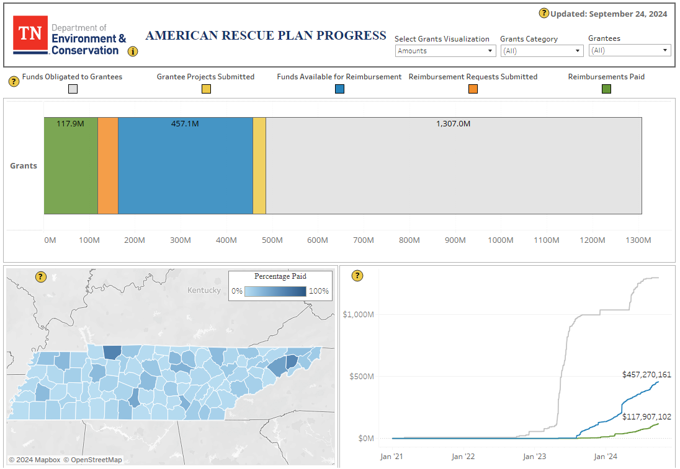
Now Live! Online Dashboard
Dashboard (tn.gov)
Notes:
Paula

Slide 22
Emergency Management Resources
Notes:
Jaamal/Sarah

Slide 23
FEMA - Overview
The Federal Emergency Management Agency (FEMA) Public Assistance (PA) is a program that offers financial and direct assistance to states, tribes, and territories when authorized as part of a presidential declaration under the Robert T. Stafford Disaster Relief and Emergency Assistance Act.
A state, tribe, or territory with an applicable Stafford Act declaration serves as the PA primary grant Recipient. State, tribal, territorial, and local governments (SLTTs), as well as eligible nonprofit entities, may then apply for funding as “Applicants.”
PA reimburses for the cost of disaster-related debris removal, emergency protective measures to protect life and property, and permanent repair work to damaged or destroyed infrastructure.
PA reimburses no less than 75% of eligible costs of specific types of disaster response and recovery work completed by eligible applicants. FEMA may recommend that the President increase the federal cost share, where warranted.
Notes:
Jaamal/Sarah

Slide 24
FEMA – Overview
TEMA as Recipient: The Tennessee Emergency Management Agency (TEMA) acts as the grantee or recipient for FEMA funds. TEMA is responsible for disbursing the funds to local governments, state agencies, and certain non-profits that are the sub-recipients.
FEMA's Role in Project Approvals: FEMA is more involved in the approval of project scopes and costs (obligations) than the U.S. Treasury. FEMA reviews and approves the detailed project worksheets that outline the scope of work and associated costs for each project.
Compliance Oversight: FEMA also provides oversight to ensure compliance with federal regulations, including environmental and historic preservation laws, procurement standards, and other applicable federal requirements.

Slide 25
FEMA - Overview
FEMA PA includes assistance for both short-term “Emergency Work” and long-term “Permanent Work” to recover from a major disaster. Applicants are expected to complete Emergency Work within 6 months and Permanent Work within 18 months of a declaration, though extensions may be granted.
Emergency Work
  Category A: Debris removal
  Category B: Emergency protective measures
Permanent Work
  Category C: Roads and bridges
  Category D: Water control facilities
  Category E: Public buildings and contents
  Category F: Public utilities
  Category G: Parks, recreation, and other facilities
Administrative Costs – Category Z
Notes:
Jaamal/Sarah

Slide 26
FEMA - Overview
FEMA works with the applicants to develop a damage inventory, scopes of work and cost estimates with supporting documentation.
  FEMA also encourages protection of these damaged facilities by providing additional funding assistance for hazard mitigation measures to protect them from future damage.
FEMA reviews and validates information and documentation submitted by an applicant to ensure compliance with federal regulations for: insurance, contracts, procurement policies, permits, and environmental and historical preservation.
  Once all reviews are complete, applicants then agree to the funding terms and sign off and obligate the projects.
The state is the official recipient of FEMA federal assistance. The state is then responsible for disbursing the money to applicants. It is a generally reimbursement program and documentation of completed work will need to be supplied.
Notes:
Jaamal/Sarah

Slide 27
Resources and Requests
Notes:
Shari

Slide 28
Grant Point of Contact Request
As grant administrators and individual leaders undergo transitions and changes, it is essential to keep grant contact information current in the grant management system (GMS). This ensures that communications are directed to the appropriate contacts.
If there have been any changes in grant administrators, leaders, or other stakeholders associated with grants or projects, please send the updated contact details to TDEC.ARP@tn.gov. Please include:
  Name
  Email
  Phone Number
  Title
  Organization
Notes:
Shari

Slide 29
ARP Resources - Implementation Resources
Implementation Guide: This guide outlines contract, state, and federal requirements for grantees to ensure compliance when executing projects using ARP grant funding.
Grant Management System (GMS) User Guide: This guide provides submittal guidance and step-by-step instructions on procurement, reimbursement, deliverables, and site inspections as well as links to additional implementation resources.
Recording: TDEC ARP Grant Management System (GMS) Demo - August 2023: This workshop guided grantees through the procurement, reimbursement, deliverables, and site inspections processes in GMS. Please note, certain aspects of the GMS process may have changed. Please refer to the GMS User Guide for the most up to date steps.
Notes:
Shari

Slide 30
ARP Resources – Quick Reference Guides
Contract Conditions: This guide highlights the provisions required for Non-Federal entity contracts. These provisions are fully detailed in Appendix II of 2 CFR 200.327 (§200.327 Contract provisions). Contracts must also comply with all applicable Federal Law, Regulations, and Executive Orders.
Deliverables: This guide provides information on the deliverables and requirements needed for each project type. (updated October 2024)
PER: This guide provides information on the preliminary engineering report (PER) submission and expected approval processes. (updated October 2024)
Reimbursement: This guide provides information on reimbursement prerequisites and requirements needed for each grant. (updates coming November 2024)
Site Inspections: This guide provides information on the site inspection process including requirements, timing, process, and evaluation. (updated October 2024)
Notes:
Shari

Slide 31
ARP Resources – Manuals & Asset Management Plan (AMP) Resources
Non-Competitive Grant Manual: This grant manual describes components of the non-competitive grant program including non-collaborative and collaborative grants.
Competitive Grant Manuals
  Regionalization: This grant manual describes the regionalization grant program.
  Water Reuse: This grant manual describes the water reuse grant program.
  Resource Protection: This grant manual describes the resource protection grant program.
AMP Resources
  AMP Guide: This guide outlines basic asset management plan components and is designed to meet the minimum criteria for Water Infrastructure Investment Plan (WIIP) American Rescue Plan (ARP) grants.
  AMP Minimum Requirements Checklist: This checklist may assist Grantees in evaluating their AMP to meet the minimum requirements outlined in the TDEC AMP Guide.
  AMP Frequently Asked Questions (FAQs): These FAQs cover different AMP questions including submission, certification, and requirements.
Notes:
Jovanni

Slide 32
ARP Resources – Workshops and Webinars
Recording: ARP Non-Competitive Grant Implementation Workshop – March 2023: This workshop focused on the general ARP grant implementation process.
  Presentation: March 2023 Non-Competitive Grant Workshop: This presentation was used for the above workshop.
Recording: Proper Procurement for ARP Non-Competitive Grant Applicants: This workshop focused on additional details related to the procurement process for ARP grants. Please note, the recorded presentation misspeaks about "baby Davis-Bacon" compliance. ARP legislation states that Davis-Bacon applies for contracts greater than $10,000,000, not less than. The guidance also states that although you do not have a Davis-Bacon clause in contracts funded by ARP for less than $10M, if you combine ARP funds with other federal funds on prime construction contracts above $2,000, Davis-Bacon may be triggered if the rule is applicable for that source of funding.
  Presentation: Proper Procurement for ARP Non-Competitive Grant Applicants: This presentation was used for the above workshop.
Notes:
Jovanni

Slide 33

Additional Resources
The TDEC ARP website is updated frequently with new information related to all ARP Grant Programs
The resources page includes many implementation materials for grant recipients, including:
  Implementation Guidance (updates coming November 2024)
  AMP Guidance (updated workbooks September 2024)
  Quick Reference Guides (updated October 2024)
  Workshop and Webinar Materials
  Demonstrations and Tutorials
https://www.tn.gov/environment/arp.html
Notes:
Shari

Slide 34
Water Infrastructure Funding Assistance
Notes:
Shari

Slide 35
TDEC's Water Infrastructure Funding Assistance Programs
The Division of Water Resources (DWR) has three primary water infrastructure funding assistance programs for drinking, waste, and stormwater projects
These programs assist utilities in meeting compliance requirements of the Safe Drinking Water Act, Clean Water Act, and TN statute and rules for water infrastructure
DWR provides water infrastructure grants and loans to public or private entities that provide public water and sewer services
State Revolving Fund Loan Program (SRF)
State Water Infrastructure Grant Program (SWIG)
American Rescue Plan (ARP) Competitive and Non-Competitive Grants
Notes:
Paula

Slide 36
Drinking Water SRF
DWSRF Capitalization Grants | Available Funding
Traditional drinking water projects | $ 134,488,437
Lead service line replacement | $138,999,000
Emerging contaminants, including PFAS | $25,722,000
Loan forgiveness for traditional projects | ~$40,000,000
Loan forgiveness on lead service line funding | ~$70,000,000
Notes:
DWSRF LSL - TN needs to demonstrate significantly more demand for this funding by March 30, 2025, otherwise we will forfeit $84,997,000 of FFY 2024 funds. The last day for TDEC to apply to EPA for these funds is May 1, 2025. So we have to cut off any interest by March 30th. According to 7th DW Infrastructure Needs Survey, TN is #7 in the US for lead lines. Why aren't entities applying?
Nearly $70M in loan forgiveness for disadvantaged communities. This can include forgiveness for entities that are replacing lead lines in disadvantaged neighborhoods even if the utility itself isn't in a disadvantaged municipality or county.
0.5% interest on LSL for EVERY loan borrower regardless of ATPI.
EC - 100% loan forgiveness for any entity for work specifically addressing EC

Slide 37
Lead Service Line Replacement Loans
Opens November 5th through December 20th
$139 million available
Up to 50% loan forgiveness for disadvantaged communities
Low-interest rate of 0.05%
Supports inventories, planning, design, and construction
Full service line replacement

Slide 38
DWSRF IUP: Eligible Projects
Eligible Drinking Water Project Categories
Water Quality Issues
Source or Capacity Challenges
Water Storage
Leakage Problems
Pressure Issues
Replacement or Rehabilitation Needs
Water Line Extensions
Regional Drinking Water Consolidation
New Drinking Water Systems
Projects and activities not eligible for funding and primarily intended for the following:
Future growth
Economic development
Fire protection
Laboratory fees for monitoring
Operation and maintenance expenses

Slide 39
Clean Water SRF
CWSRF Capitalization Grants | Available Funding
Traditional wastewater, stormwater and green infrastructure projects | $239,988,273
Emerging contaminants, including PFAS | $6,240,000
Loan forgiveness on traditional projects | > $39,000,000

Slide 40
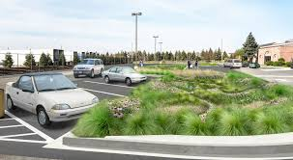
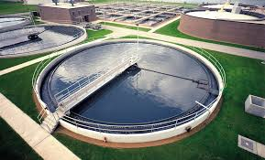
CWSRF IUP: Eligible Projects
Eligible Clean Water Project Categories
Construction of municipal wastewater facilities
Control non-point source pollution
Decentralized wastewater treatment systems
Green infrastructure projects
Water quality projects
Stormwater management
Brownfields
Consolidation
Water reuse
Asset management
Capacity management

Slide 41
State Water Infrastructure Grants (SWIG)

Slide 42
Grant Opportunities
Solicitation Opening | Grant Programs | Available Funding
November 2024 | Lead Service Line Inventory and Planning | $8,500,000
November 2024 | Sewer Overflow and Stormwater Reuse (OSG) | $1,500,000
February 2025 | Asset Management Planning (AMP) | $5,000,000
February 2025 | Small, Underserved, and Disadvantaged Communities (SUDC) | $800,000
April 2025 | Emerging Contaminants Funding for Small and Disadvantaged Communities (EC-SDC) | $39,800,000
 | Total Available for State FY 2025 | $55,600,000
SWIG Website: https://www.tn.gov/environment/program-areas/
wr-water-resources/srfp/srf-home/swig.html
Notes:
All Competitive Grants
LSLI and OSG – November 2024
SUDC and AMP – February 2025
EC-SDC – April 2025

Slide 43

Program Highlight: Lead Service Line Inventory and Planning Grants
SFY 2024 Lead Service Line Inventory (LSLI) grant
  59 awards, most grant contracts are fully executed
    If you haven’t submitted a signed contract, please do so now
  Scopes of work are being implemented
  Procurements and grant reimbursements are underway
100% compliance with inventory submissions, which were due October 16, 2024
Notes:
January 1, 2024 – December 31, 2025

Slide 44
Lead Service Line Inventory Grants
Opens November 5th through December 20th
$8.5 million available
Up to $250,000 in funding
15-25% match, based on Ability to Pay Index
Supports utilities in updating lead service line inventories or creating comprehensive replacement plans
Helps utilities achieve compliance with the Lead and Copper Rule Revision

Slide 45
Emerging Contaminants Grants or Loans
Opens November 5th through December 20th
$32 million available
100% loan forgiveness or grants to communities
Funding can be used for clean water or drinking water projects to address emerging contaminants like PFAS, microplastics, and pharmaceuticals in clean and drinking water

Slide 46
Stormwater Reuse Municipal Grants
Opens November 5th through December 20th
$1.2 million available
UP to $500,000 in funding
0-20% match, based on Ability to Pay Index
Supports green infrastructure and natural hydrology restoration for stormwater management

Slide 47
Questions?
Notes:
Vena

Slide 48
Upcoming Milestones
Notes:
Vena

Slide 49
Milestone 4: January 30, 2025
Plans and Specifications Requirement (60%)
ALL GRANTEES
Grantees and engineers working on planning, design, and construction (PDC) projects must attest to being at least 60% complete with their design and specification deliverables.
Meeting Milestone 4
  In order for Grantees to meet this milestone:
    Engineers must attest to plans and specifications being 60% complete in the project annual reporting activity in GMS
    Projects must have, at a minimum:
      Draft specifications and calculations
      Preliminary construction scheduled
      Phasing plan
      Logistics, supplies, and mobilization plan
      Applying for necessary permits
    OR have submitted complete plans and specifications to ESU
    OR have SWIG-reviewed plans and specifications in GMS
Tracking
  TDEC will monitor annual reporting activity responses, ESU's review queue, and the status of deliverable activities for applicable projects in GMS to track progress at the project level. Grantees who are not on track for Milestone 4 will receive monthly communications.
  Exceptions
  Non-construction planning, design, and construction (PDC) projects (asset management plans (AMPs), studies, etc.)
Notes:
Vena

Slide 50
Milestone 5: May 30, 2025
Plans and Specifications Requirement (Full)
ALL GRANTEES
All grantees with planning, design, and construction (PDC) projects must submit final design and specification deliverables to TDEC. Projects requiring ESU review must submit their plans and specifications to MyTDEC Forms for ESU approval. Projects not subject to ESU review must submit their plans and specifications to GMS for SWIG review.
Meeting Milestone 5
  In order for Grantees to meet this milestone:
    Projects must have, at a minimum, submitted plans and specifications to ESU or GMS
Tracking
  TDEC will monitor the status of deliverable activities for applicable projects in GMS and ESU’s review queue to track progress at the project level. Grantees who are not on track for Milestone 5 will receive monthly communications.
  Exceptions
  Non-construction projects classified as PDC (AMPs, studies, etc.)
Notes:
Vena

Slide 51
Milestone 6: August 30, 2025
Construction Start Requirement
ALL GRANTEES
Construction activity must start for all projects that include construction.
Meeting Milestone 6
  In order for Grantees to meet this milestone, projects must have received an Authority to Award letter for a contractor procurement and schedule an initial site inspection by November 30, 2025.
To verify construction starts, each construction project must have an initial site inspection scheduled by November 30, 2025.
Tracking
  TDEC will monitor site inspection requests, reimbursements for capital purchase expenditures, and the status of procurement activities for capital purchase vendor contracts in GMS to track progress at the project level. Grantees who are not on track for Milestone 6 will receive monthly communications.
  Exceptions
  Considered on case-by-case basis (small-scale replacements, minor rehab, etc.).
Notes:
Vena

Slide 52
Milestone 7: December 15, 2025
Remaining Procurement Requirement
ALL GRANTEES
ALL projects should have started, and all Grantees must submit any remaining awarded contracts for third-party work to TDEC. This milestone applies to all project types, including Asset Management Plans.
Meeting Milestone 7
  In order for Grantees to meet this milestone, all procurements for services or construction will need to be submitted in earnest no later than December 2025.
Tracking
  TDEC will monitor the status of projects in GMS and monitor procurement documentation, as well as project starts, as indicated in Milestone 6 with initial site inspections.
Exceptions
  No exceptions unless in extreme cases.
Notes:
Vena

