Slide 1
Tennessee infrastructure scorecard Post-Project Scorecard

Slide 2
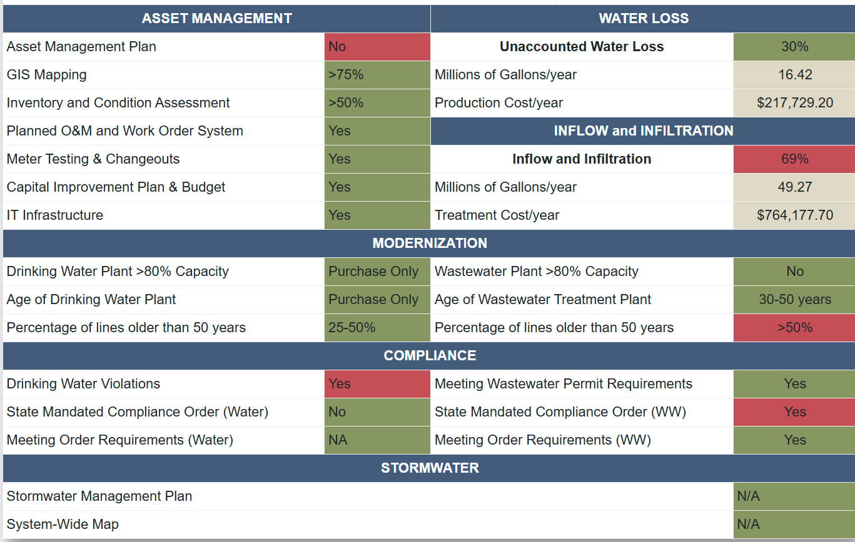
Agenda
Scorecard BACKGROUND
American Rescue plan (ARP) contract requirements
Scorecard overview and changes
Scorecard elements and submission process

Slide 3
background

Slide 4
Background
Developed in partnership with TAUD and TDEC SRF-SWIG
Useful tool for drinking water, wastewater, and stormwater systems to benchmark a system’s:
Financial capacity
Managerial capacity
Technical capacity
Identifies opportunities and challenges for system improvements
Particularly useful for small and disadvantaged systems:
Pinpointing cost-effective areas of focus
Analyzing yearly trends
Reaching financial balance

Slide 6
ARP contract requirements

Slide 7
ARP Contract requirements
All drinking water, wastewater, and stormwater systems completed a pre-project scorecard assessment for ARP grants.
At project closeout, Section A of the grant contract requires grantees to complete a final scorecard for review and approval by the Tennessee Association of Utility Districts (TAUD).
A.7. Grantee shall complete a final Tennessee infrastructure scorecard (“scorecard”) and provide the scorecard summary for review and approval according to the approved individual project schedule for each water infrastructure system executing a project under this grant contract. The final scorecard(s) shall:
Include three years of data from audited financial statements; and
Demonstrate that a minimum of two critical needs were addressed to the standard or threshold set in the critical needs matrix, or if two critical needs were not fully met, the grantee shall provide a justification for any critical needs not resolved.
The final post-project scorecard submittal only applies to non-competitive projects. Competitive and state strategic contracts DO NOT have this contract language or requirement.

Slide 8
ARP Contract requirements continued
Project owners must submit a post-project scorecard assessment for TAUD’s review and approval.
The approved scorecard must be uploaded to TDEC’s grants management system for final approval.
Project owners who do not demonstrate that a minimum of two critical needs were addressed by the thresholds set by the grant contract and/or grant manual must provide a written justification for any critical needs that were unresolved. This document would be an additional submittal with the TAUD-approved scorecard.
TDEC may request additional information during their approval processes.
The maximum allowable reimbursement is 90% of the individual project budget until all required deliverables are received and approved by TDEC. The post-project scorecard is one of the required deliverables.

Slide 9
Scorecard overview and changes

Slide 10
Scorecard overview and changes
TDEC worked with TAUD to update the scorecard database and improve the customer experience.
Much of the scorecard database remains unchanged; however, one question was removed, and others were updated for clarity.
Grantees may begin updating their scorecard summaries as utility ID codes have remained the same.
For questions related to the scorecard database (utility ID codes, etc.), please contact Ethan Carter at ethancarter@taud.org.
Link: https://ams.Taud.Org/scorecard%20v2/login.Aspx

Slide 11
Scorecard elements and submission process

Slide 12
Version 2.0 indicates Post-Project Scorecard

Slide 13
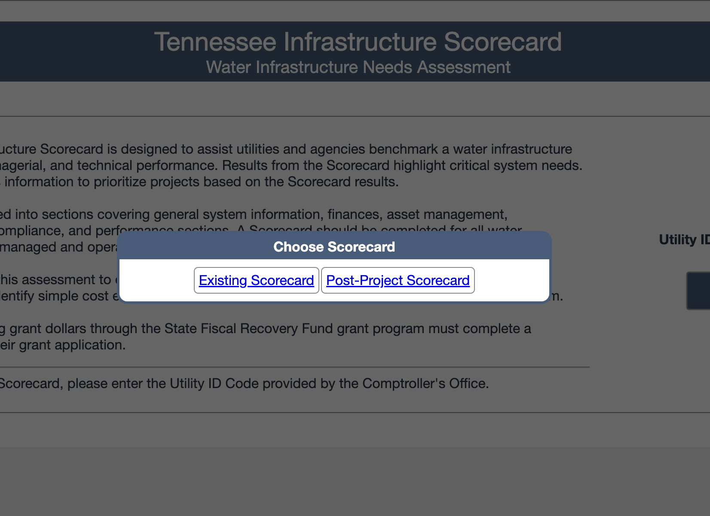
Upon entering the utility's Utility ID Code, you will be prompted for the Post-Project Scorecard or the Existing Scorecard.
utilities can now alternate between the two to help with data submission.

Slide 14
Once logged into the scorecard, utilities can use the “Switch to Existing Card” button to alternate between post-project and original scorecard.

Slide 15
General tab review & updates

Slide 16
Prior card had water and wastewater separated. This caused confusion as most customers who have wastewater, have water. Therefore, connections were being counted twice.
Connections has been altered to “Total Connections.”

Slide 17
Consistent issues were found on the “Notes” during original scorecard submittals.
Many utilities answered “No” to Adverse Audit Findings when, in fact, there were findings on their audits.

Slide 18
Findings can be found on the last pages of the utility’s Financial Audit.
If the utility has findings, a statement should be placed in the Comments section of the General Tab that indicates the page number where the adverse findings can be located in the Audit.

Slide 19
Financial tab review & updates

Slide 20
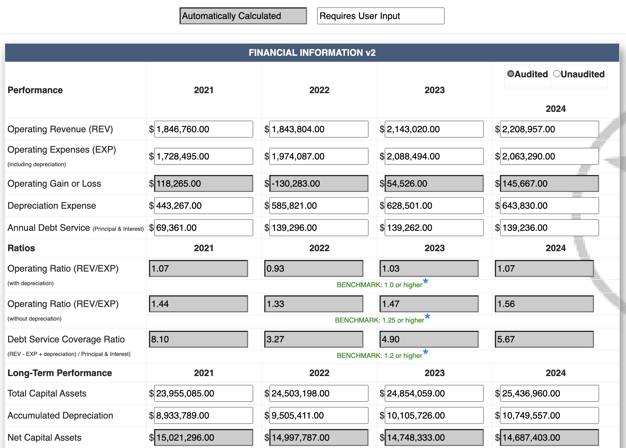
AREAS IN THE FINANCIAL FIELD ARE LARGELY UNCHANGED, WITH THE EXCEPTION OF THE YEARS. ALL DATA CAN BE LOCATED IN THE UTILITIES FISCAL AUDIT.
utility's SHOULD SELECT AUDITED IF THEY HAVE RECEIVED THEIR FISCAL AUDIT AND UNAUDITTED IF THEY ARE USING INTERNAL DATA PRIOR TO THE RETURN OF THEIR OFFICIAL FISCAL AUDIT.

Slide 22
reserves
RESERVES ARE TYPICALLY ACCOUNTS WHERE CASH IS KEPT WITHIN THE UTILTIY.
MOST RESERVED ACCOUNTS ARE “RESTRICTED” OR ACCOUNTS THAT CASH CAN ONLY BE USED FOR SPECIFIC ITEMS
DEBT SERVICE RESERVES ARE CASH ACCOUNTS THAT ARE RESTRICTED FOR USE ONLY ON THE UTILTIES DEBT.
REPAIR/REPACEMENT OR DEPRECIATION RESERVES ARE CASH ACCOUNTS RESTRICTED ONLY FOR USE ON THE UTILITIES DEPRECIABLE ASSETS.
NOTE: DEPRECIATION RESERVES AND ACCUMULATED DEPRECIATION ARE NOT THE SAME!

Slide 23
LONG-TERM DEBT & COSTS
Long term debt is defined as debt with a maturity of longer than 12 months.
Long-term debt can be found under the debt and liabilities section in the footnotes of the audit.

Slide 25
Asset Management Tab

Slide 26
No changes have been made to the asset management tab.
utilities will need to fill out all information, with any changes since the original scorecard being updated.
Utilities are required to show a comprehensive asset management plan at 80% of project completion to receive any additional reimbursements. Categories are as follows:
investigation and planning;
investigation, planning, and design;
Planning, design, and construction.
Utilities are required to show a comprehensive asset management plan at 90% of project completion to receive any additional reimbursements if the utilities falls under the category of construction only.

Slide 27
Water Assessment tab

Slide 28
Enforcement Targeting Tool scores can be accessed through contacting your local Compliance Office Inspector.

Slide 29
utilities now required to submit the “annual information report” to the comptroller's office.
Line 14 and 15 will use the information from the “AIR”.
Line 16 will need to be found using internal data the utility should have.

Slide 30
Wastewater Assessment tab

Slide 31
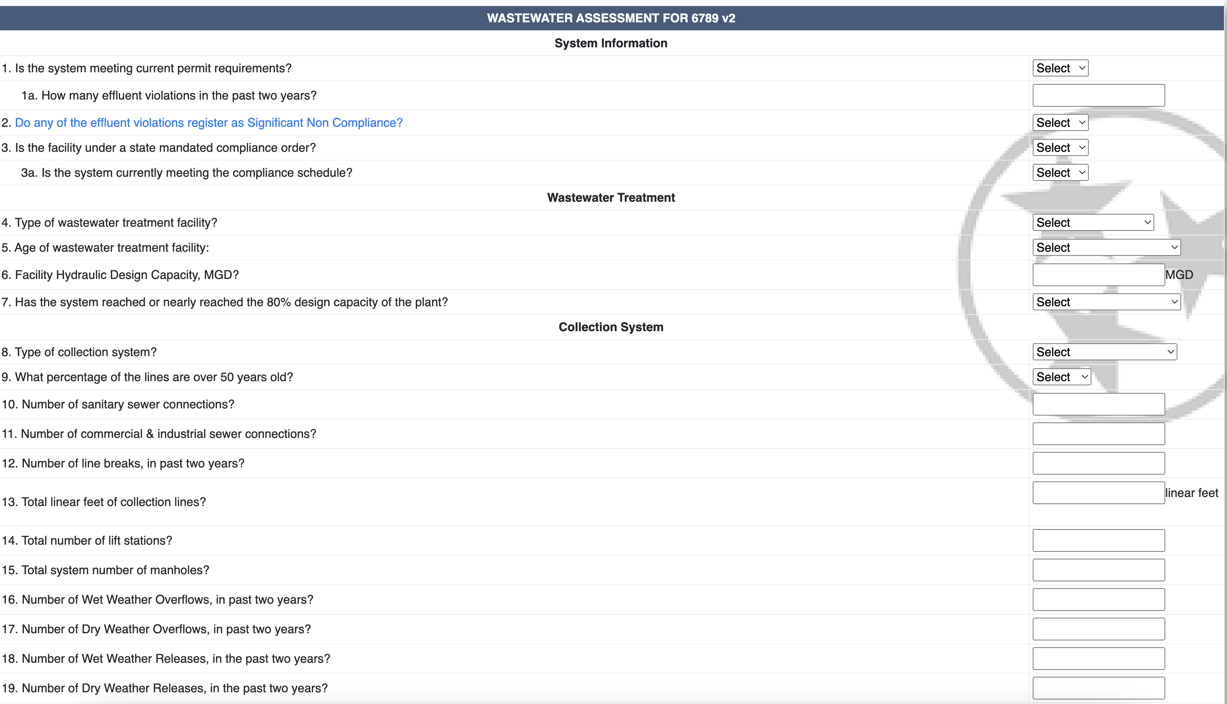
Wastewater tab remains unchanged.
UTILITIES struggled in certain areas during original scorecard submission.
UTILITIES should correlate high wet weather overflows with higher i/i.
Example: a ww system with 70 wet weather overflows and a 10% i/I should recalculate i/I numbers. i/I will typically be higher with a system that has increased amounts of wet weather overflows.

Slide 32
UTILTIES STRUGGLED WITH UNDERSTANDING CALCULATIONS FOR I/I DURING ORIGINAL SCORECARD SUBMISSION PROCESS.
TO SHOW POSITIVE CHANGES FROM THE ORIGINAL SCORECARD SUBMISSION, IT IS IMPERRITIVE UTILTITIES CALCULATE THESE NUMBERS CORRECTLY.
FORMULAS ARE SIMPLE TO UNDERSTAND WITH AVAILABLE DATA THAT THE WW OPERATOR IS RESPONSIBLE FOR.

Slide 33
THE FIRST CACLULATION IS CALLED AVERAGE DAILY DRY WEATHER FLOW (ADDWF).
ADDWF IS THE LOWEST 7-DAY CONSECUTIVE FLOW WITHIN THE CURRENT YEAR.
TO CALCULATE THIS NUMBER, UTILTIES WILL NEED FLOW DATA THAT CAN BE FOUND ON THE WW PLANTS MONTHLY OPERATING REPORT (MOR).
REVIEWING ALL FLOW DATA FOR A YEAR CAN BE TASKING. PERSONNEL CAN SPEED UP THIS PROCESS BY REVIEWING THE MONTHS THAT ARE TYPICALLY THE DRYEST OF THE YEAR.
FINDING THE APPROXIMATE LOWEST 7-DAYS, THE SYSTEM WILL AVERAGE THE FLOWS USING THE FOLLOWING CALCULATION:
ADDWF = SUM OF ALL FLOWS DURING THE WEEK
7 DAYS

Slide 34
AVERAGE DAILY FLOW (ADF) IS THE SECOND CALCULATION.
UTILTIES CAN FIND THIS NUMBER USING THE FOLLOWING CALCULATION:
ADF= SUM OF ALL TOTAL FLOWS FOR THE YEAR
365 DAYS

Slide 35
DRINKING WATER OPTIMIZATION, WASTEWATER OPTIMIZATION, AND RISK & RESILENCY
REMAINING TABS ON THE POST-PROJECT SCORECARD HAVE BEEN LEFT UNCHANGED.
UTILITIES SHOULD FILL THESE OUT, UPDATING ANY CHANGES FROM THE ORIGINAL SCORECARD THAT HAVE BEEN IMPLEMENTED.

Slide 36
TDEC Submission Process

Slide 37
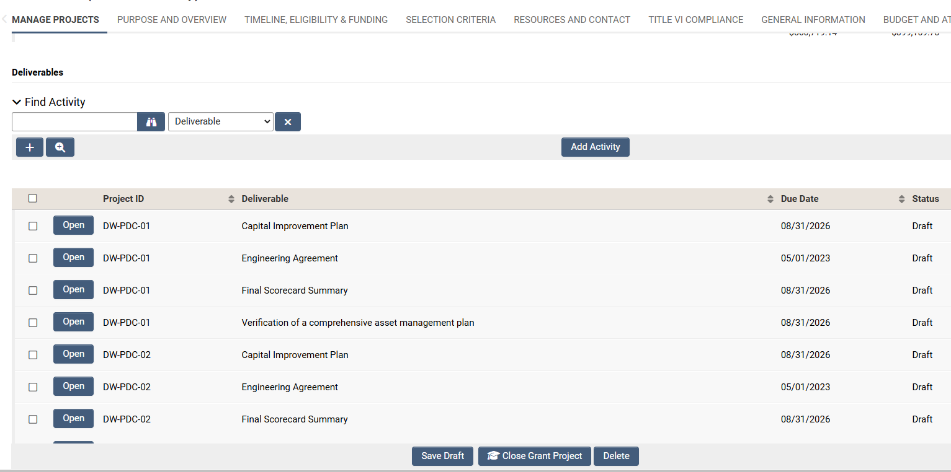
Tdec submission process

Slide 38
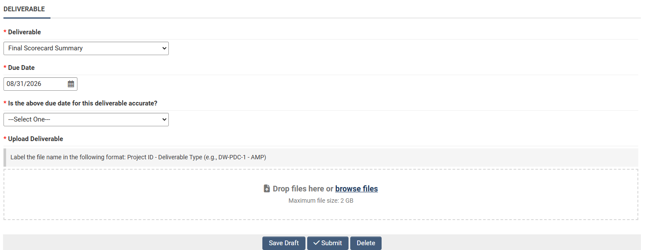
Tdec submission process

Slide 39
resources
American rescue plan: https://www.tn.gov/environment/arp.html
American Rescue plan implementation guide: https://www.tn.gov/content/dam/tn/environment/arp/documents/arp_implementation-guide.pdf
Grant Management System User Guide: https://www.tn.gov/content/dam/tn/environment/arp/documents/arp_gms-user-guide.pdf
American Rescue plan progress dashboard: https://www.tn.gov/environment/arp/dashboard.html
Deliverables checklist: https://www.tn.gov/content/dam/tn/environment/arp/documents/arp_implementation-guide_deliverables-quick-reference-guide.pdf

Slide 40
QUESTIONS…?

