Slide 1
Commissioner Roles
Nick Newman/Lloyd
Executive Director
Tennessee Association of Utility Districts
Notes:
Some of your boards could be different but I tried to not discuss too may specifics and more general

Slide 2
Experience with Boards
MLGW
Five Member Board
Thirteen Member City Council
TAUD
Thirteen-member Board

Slide 3
Experience on Boards
Habitat for Humanity
YMCA Millington and Metro
Water Wastewater Financing Board
Tennessee Board of Utility Regulation
Tennessee 811 Board
TAUD Board
Surf Club
Notes:
Nick what the heck you know about being on a board

Slide 4
Audience Survey
Board Members?
Utility Leaders?
TAUD Board Members?
Early for Lunch?

Slide 5
-----------Disclaimer------------
Notes:
Gonna try and have a little fun with this. Please don’t take any of this personal. Pretty straight forward information but want feedback and tell some stories from my experience

Slide 6
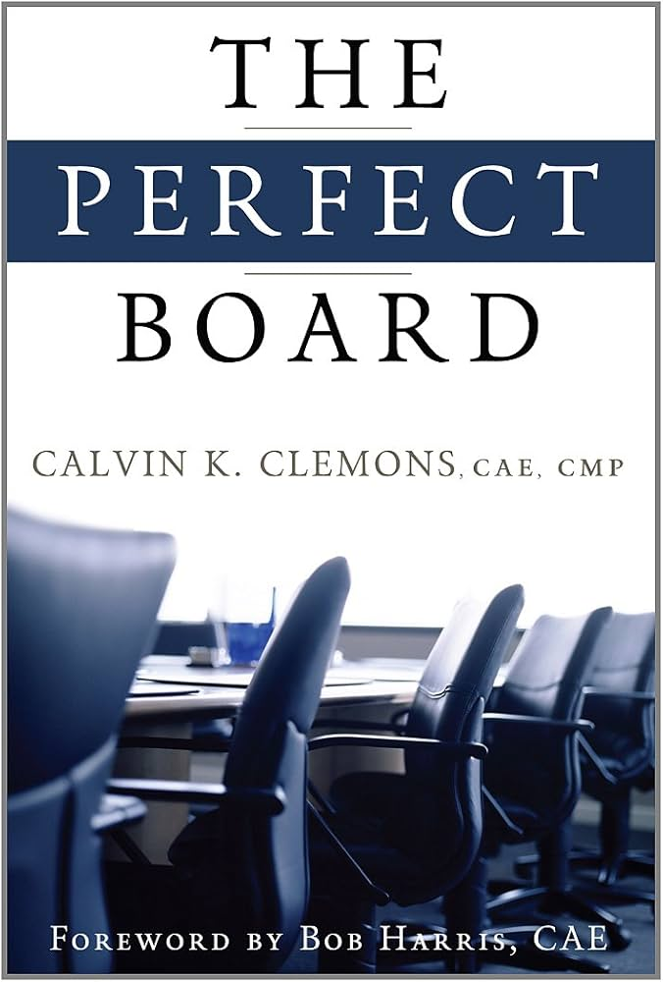
The Perfect Board
By Calvin K Clemons
Written in 2011
TN811 – Bill Turner
Notes:
Reference, Short concise information
Was going to buy them but you cant
Audiobook on amazon

Slide 7
Organizations and Boards
Organizations fail sometimes to realize their potential because of the individuals elected or appointed to lead just plain don’t know how.
No one goes to school for this
Most people have good intentions but really not sure how to react with leadership
Being a board member is a job. Proper preparation is a must.
Notes:
When I was placed on the Board for TAUD in 2011 Bob came to me and said you are on the board.

Slide 8
The Perfect Board Manual
A set of precepts and ideas that enable people to work together Effectively, Efficiently and harmoniously to achieve the goals of the organization.
There are 50 in the book.
Notes:
Good quick and easy to read descriptions and definitions of the 50 topics
Were gonna run through all 50, 2 minutes per topic should be good.

Slide 9
Topics Not Covered Today
Do It Right
Leadership
Conflict of Interest
Delegation
Care of Property
Honesty
Quorum
Board Size
Rules of Order
The Ayes Have It
Voting
Ballot
Consensus
Minutes
Bylaw
Tax Exempt Organizations
Compensation
Excess Compensation
Reimbursement
Recognition
Indemnification
Director Insurance
Antitrust Consideration
Volunteer Protection
Audit Committee
Forbidden Fruit
Executive Committee
Orientation
Resources
Report Card
Notes:
Honesty
Compensation
Additional competition
Board size
Forbidden Fruit

Slide 10
Topics Covered Today
Loyalty
Obedience
Care
Obligation
Confidentially
Competency
Respect
Unity
Willingness
Open Minded
Paradox of Leadership
Diversity
Meetings
Meeting Attendance
Public Scrutiny
Sarbanes-Oxley Act
Lawyers
Executive Committees
The Abilene Paradox
Strategic Planning
Technology
Notes:
21 we will cover. If we get to the all. I did my favorites first

Slide 11
Loyalty
Director must put aside individual’s interests: this includes consideration for the Director’s family, friends, associates, other organizations and all above, the Directors employer.
Must put on the hat of the organization and all other hats should be removed
Notes:
Now I know this is can be a tough one to start out on. Board members are typically tied to a community and there are a lot of influences on them
GM’s: What is the most embarrassing thing that has happened in a Board Meeting

Slide 12
Loyalty
Board member pulled out a water design of a water main extension my team designed to a church.
Tried to redesign it in the meeting.
Electric Restoration Procedure
Notes:
He was a very connected lawyer in Memphis. Very influential church,. Turned into a circus pretty quickly

Slide 13
Obedience
Must know and follow the letter and spirit of its governing documents
Articles of Incorporation
Bylaws
Policies
Special orders

Slide 14
Care
Must attend meeting, be informed, make reasonable decisions, and see to it things get done.
It’s your duty to be fully aware of the Board’s issues and actions.
Directors need to read, review and study materials pertaining to each issue.
Decisions must be correctly and filed
Notes:
Just must be informed
Board members must be prepared
Nothing tougher for a organization to try to get things done if board is not up to speed
Inversly as a GM you need to have your stuff together when going to a board meeting

Slide 15
Obligation
Lead and care for the Organization.
Must use sound judgement, prudence and diligence
Fiduciary responsibility is extremely important
Spend money like it is their own
Ensure the sound operation of the organization
Notes:
Its all about the berjamines
It is the boards responsibility to help equip a organization to ensure sound operation of the organization as a whole

Slide 16
Confidentiality
Discussions, votes and sensitive data must be protected.
Executive Session
Keep the issues in the boardroom
Revealing confidential information can damage relationships and erode the board’s ability to act.
Notes:
Public boards and is public information
At MLGW the Joke was that the union leadership knew the boards decisions in Executive Session before the meeting was over

Slide 17
Competency
The Selection of competent persons begins with leadership development or nominating committee learning about potential members abilities, background, experience and skills before they become directors.
Get experience of smaller boards prior to larger ones
Not very often a rookie is in the staring lineup on an MLB team
Notes:
Now this does not mean they need to know utilities. I have worked with very successful boards that come from all sorts of backgrounds where their strengths are utilized. Only need one lawyer on there though.

Slide 18
Respect
The human relations equation is critical to working in a successful board.
Respecting others and they will respect you ( most of the time)
Listen
Take notes
Be interested
Sidebar Conversations
Notes:
Sidebar conversations took on a whole new role for me in Memphis, Walking around talking to other members while I was presenting
GM’s What is the ugliest thing a board member has said to you?

Slide 19
Respect (GM)
You are an environmental terrorist, killing the inner-city kids of Memphis
No sir I am killing all of them because we put fluoride in all the water in Shelby County
We are following the city referendum voted on by the citizens in Memphis. It would take another vote to change that.
Notes:
Board Members: What is the funniest or ugliest thing said to you as a board member?

Slide 20
Respect (Board)
Contractor charged 4 hours to replace an electric receptacle in a home.
Mr. Newman you obviously are not informed of electric standards and the amount of work it takes to do electrical work. I do not have time to teach you.
He might should have done some research
Notes:
Habitat for humanity

Slide 21
Unity
Board must act as a unit.
If not it will erode and undermine the boards effectiveness.
Debate/Vote in the meeting
Once a decision is made move on.
Each member should be comfortable expressing their opinion
Notes:
Don’t take it out of the board meeting

Slide 22
Willingness
Willingness to serve.
Put in the time
Preparation prior to meetings
Notes:
I have had board members who have obviously not reviewed the material. Its frustrating. Now I completely understand the delima behind this. Some board packets can get huge really quickly.
TBOUR

Slide 23
Open Minded
Become blinded by their own issue or belief.
Unable to let another person to be heard.
Closed minded individuals stifle ideas and suppress innovation.
Opposing conversations should be encouraged.
Notes:
Surf Club. Board member came in late and said. I didn’t hear what he said but it’s a lie.

Slide 24
Paradox of Leadership
Both the general manager and the board are both expected to lead the organization.
Conflict between those two can doom relationships
General manager is hired to lead the organization
Conflict can occur because board members can wish to assert their authority or make their mark on the organization.
How to resolve it:
Understanding the expectations of both parties
Both must know what is expected
Nothing can destroy an organization more than ugly relation between a board and leadership.
Notes:
In most situations who is the employees of the board? Written and reviewed
JENNA
Now if the leader is not performing and the employees are not being supported the board needs to act.
Needs to be set guidelines on how it done.
Union shop – employees opportunity

Slide 25
Diversity
Board of directors represents the members of the organization.
Bylaws are usually silent on diversity
Important to get different views from different cultures, sexes, races, heritages, and religions.
Notes:
Can be difficult to do in a diverse population
Rule of thumb: Your board should look like the community they serve.
TAUD Board with 3 females

Slide 26
Meetings
Should be organized, structured, open, and smooth flowing.
Aware of the total time commitment
Drive time, preparation, and follow up
Should keep on schedule and be considerate of everyone’s time
Notes:
4- 5 hour board meetings. Board member would get on his soap box. Lost respect from other board members.

Slide 27
Meeting Attendance
If occurs often other board members with question if the missing board member is serious about serving.
Should have bylaws to be able to deal with board members that do not regularly attend meetings
Notes:
Rules on meeting attendance Missing 2 or more consecutive meetings can be removed.

Slide 28
Public Scrutiny
Due to transgressions of a few and greed of a few boards are no longer held in the same as in previous generations.
If board members aren’t being open and honest it can put them in a position that could result in an unfortunate posture
Notes:
TBOUR, Anthony, Bruce, Phillip, and Ross.
People look closer at boards due to the issues
People asking me to be on a board and they lead with how much money I can make.

Slide 29
Sarbanes-Oxley Act (SOX)
Federal criminal penalties and auditing requirements
Proper maintenance and retention of documents and records pertaining to the specifics of auditing the organizations finances
Cannot be altered, destroyed, concealed or mutilated.
Whistle Blower protection provision.
Notes:
2002
Fines and imprisonament can be administered
Don, Carol and Mel can probably go all day about this one.

Slide 30
Lawyers
Legal should attend all board meetings
Review and approve all agendas
Review and approve all minutes
Other advice
Needs to be available to the board at meeting to ensure their decisions are legal and to the organizations policies.
Notes:
Necessary evil
Who Hissed?
Dons favorite thing,

Slide 31
Executive Sessions
Closed to Staff
Discussion of confidential topics
Do not keep minutes
Topic and conversation must stay in the meeting
Only confidential topics should be discussed
Notes:
Must be careful Suspecion and misunderstanding can happen for the staff and ones not allowed in the meeting.,
Will encourage rumors and unrest

Slide 32
The Abilene Paradox
Board members can get caught up that lose sight of where they are going and for that matter why they are going there.
Boards make decisions that individually they would never make.
Individuals go along because they do not want to be left out or be called laggers.
Can be ridiculed, disparaged or humiliated
Board members need to be able to speak freely and openly.
Notes:
Cant see the forrest for the trees.
Best case I have for this is the decision of whether to leave TVA or not in Memphis. It wasn’t pretty and agendas and politics got in the way of the decision. Fortunately they got back on track and made the correct decision.

Slide 33
Strategic Planning
Roadmap for the future
Guide for the board, committees and staff.
Makes for a coordinated effort.
Notes:
Got to have it
Does not have to be all that complicated
Need buy in from your team.

Slide 34
Technology
Project a different board environment.
Technology should save a task, time and money.
Better communication.
More transparency.
Better record keeping
Notes:
Important not to leave board members behind with technology, Can be a lot for a senior board member to keep up.
So technolory is sometimes my friend and sometimes not

Slide 35
Wrap Up
Perfect Board is probably a goal that will never be reached.
Due to the way people work with one another it is doubtful that consistent harmony can be achieved.
Board can take these 50 principles and use them as a guide to have better board-leader relationships
Notes:
It wouldn’t be much fun without some drama and conflict

Slide 36
Wrap Up
Boards are consumed with the business of today. They rarely explore the underlying principles and ideas of Character.
Placing a topic like integrity, leadership or competency on the agenda could offer a truly rewarding experience
Notes:
Sometimes it’s a good idea to add some of the character topics could provide some good communication and help grow the board closer.

Slide 37
Questions?
Nick Newman
Executive Director, TAUD
NickNewman@TAUD.org
901-907-9266
Notes:
Sometimes it’s a good idea to add some of the character topics could provide some good communication and help grow the board closer.

