Slide 1
Commissioner Terms and Vacancies
Don Scholes, General Counsel
Tennessee Association of Utility Districts
©2024. Tennessee Association of Utility Districts
Notes:
Beth asked me to do a session on Commissioner Terms and Vacancies due to lots of questions received
Determined by the legislature since utility district boards and other utility boards are established by the legislature
A lot of this session will deal with utility district commissioners but some apply to all utility boards

Slide 2
Utility District Commissioner – Length of Term
All utility district commissioner terms should be 4 years except
Vacancies filled due to resignation or death are appointments to fill out the unexpired term of the predecessor
The legislature has provided otherwise

Slide 3
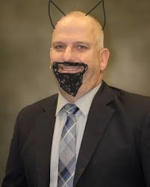
Utility District Commissioner – Length of Term
Commissioner Nick Newman’s term of office is June 15, 2022 to June 14, 2026

Slide 4
Utility District Commissioner – Length of Term
Mr. Newman resigns effective November 30, 2024.
County Mayor appoints Beth Hardiman to fill this vacancy on January 20, 2025.
What is Ms. Hardiman’s term of office?
January 20, 2025 through June 14, 2026
Notes:
If commissioner resigns 4 months before his or her term ends, what do you do

Slide 5
Other Utility Board Members – Length of Term
What about the terms of office of other utility boards in Tennessee?
Terms of office are prescribed by the legislature – may be different based upon the type of utility board
Notes:
Even if appointments are made late

Slide 6
Other Utility Board Members – Length of Term
County boards of public utilities – 3 years - TCA 5-16-103(c)
Utility authorities
Created under Water and Wastewater Treatment Authority Act – 5 years - TCA 68-221-605 (c)
Created by Private Acts – Depends on the Private Act
Notes:
Even if appointments are made late

Slide 7
Other Utility Board Members – Length of Term
Anderson County Water Authority 4 years
(2007 Tenn. Priv. Acts Chapter 40)
Water Authority of Dickson County 4 years, except at-large board member 2 years (2001 Tenn. Priv. Acts Chapter 51)
Tullahoma Utility Authority 5 years except member appointed by Mayor 1 year (2016 Tenn. Priv. Acts Chapter 54)
Notes:
Even if appointments are made late

Slide 8
Other Utility Board Members – Length of Term
Municipal Water and Sewer Board 5 years - TCA 7-35-408
Municipal Electric Power Board 4 years, except CEO appointee – TCA 7-52-108
Water and Sewer Board created by Municipal Charter
Tracy City Board Public Utilities 6 years
Notes:
Even if appointments are made late

Slide 9
Utility District Commissioner – Term Beginning
Commissioner Phillip Combs’ term ended on April 30, 2024. The District let this date slip by and only realized that in August. The District’s Board of Commissioners submitted three names to the County Mayor on September 25, 2024. The County Mayor signed an order re-appointing Mr. Combs to another four-year term on October 2, 2024.
When did Mr. Combs new four-year term begin?

Slide 10
Utility District Commissioner – Term Beginning
May 1, 2024
Why?
To maintain the staggering scheme the legislature put in place for utility district commissioners
Notes:
Even if appointments are made late

Slide 11
Utility District Commissioner – Term Beginning
Vacancies filled by term expiration of office
Re-appointment of incumbent – Term begins on date of expiration
Appointment of new commissioner - Term begins on date of expiration of predecessor
Notes:
Even if appointments are made late

Slide 12
Utility District Commissioner – Term Ending
Term Ending Events
Term expiration
Death
Resignation
Disability
Failure to meet office qualifications
Removal by TBOUR or ouster suit
Notes:
Even if appointments are made late

Slide 13
Utility District Commissioner – Term Ending
Expiration of term of office
TCA 7-82-307(a)(3) provides:
“Each member, upon expiration of such member’s term, shall continue to hold office until a successor is appointed or elected and qualified.”
Same is generally true for public officers who are appointed
Notes:
Even if appointments are made late

Slide 14
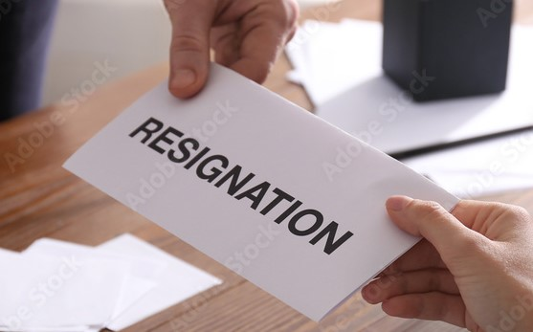
Utility District Commissioner – Term Ending
Death – Date of Commissioners death
Resignation
Date of resignation unless later effective date is stated
Resignation not required to be in writing but preferred

Slide 15
Utility District Commissioner – Term Ending
Commissioner Joe Cooper has been at odds with the other commissioners and General Manager of Orange Utility District for several months. Exasperated, Mr. Cooper submits his resignation the day after a contentious board meeting in May. Everyone is relieved.
Two weeks later Mr. Cooper changes his mind and withdraws his resignation in writing. He shows up for the June board meeting.

Slide 16
Utility District Commissioner – Term Ending
Is Mr. Cooper still a commissioner?
Yes. A resignation can be withdrawn at any time until it is accepted by the board of commissioners which has responsibility to initiate the process to fill a vacancy.
Notes:
County board of public utilities – County Mayor
Private act – Whoever does the appointing
Municipal utility board – Whoever does the appointing

Slide 17
Utility District Commissioner – Term Ending
Failure to meet qualification for office
What happens when a commissioner moves outside of the boundaries of the utility district?
The commissioner’s office become vacant when he or she no longer resides within the utility district’s boundaries.

Slide 18
Utility District Commissioner – Term Ending
Removal from office by TBOUR or court in ouster proceeding
Entry of Final Order in contested case hearing by TBOUR
Entry of final judgment by a court in a public official ouster proceeding

Slide 19
Utility District Commissioner – Term Ending
TBOUR can hold contested case hearing on removal of utility district commissioner
Filing of petition for removal by 20% of customers
Investigative audit by Comptroller’s Office of utility district
Utility district is under jurisdiction of TBOUR for any reasons

Slide 20
Utility District Commissioner – Suspension from Office
Upon indictment for misconduct in office, utility district commissioner is suspended from office until
Disposition of criminal proceeding or expiration of term of office
Whichever occurs first

Slide 21
Utility District Commissioner – Suspension from Office
County Mayor makes an interim appointment last until
Commissioner is found guilty for misconduct, then office become vacant
If indictment is dismissed or commissioner found not guilty, then commissioner resumes office if term has not expired

Slide 22
What happens when no names are submitted timely?
Allows county mayor to make interim appointment under TCA § 7-82-307(d)
Interim commissioner serves until board “takes the proper actions required” to fill a vacancy
Sitting commissioner continues to serve as a “holdover” commissioner until proper appointment is made

Slide 23
Why is it important to follow statutory appointment procedures?
Failure to follow statutory procedure allows county mayor to make interim appointment under TCA § 7-82-307(d)
Failure to follow statutory procedure may create an uncertainty as to who is the legitimate commissioner
Want to ensure board action is not challenged due to commissioner being improperly appointed

Slide 24
Commissioner Terms of Office
Know the beginning and ending dates of commissioner terms
Don’t depend upon the County Mayor to know

Slide 25
Commissioner Terms of Office
State the term dates in board minutes when three nominees are selected
State the term dates in the Certification of Nominees submitted to County Mayor

Slide 26
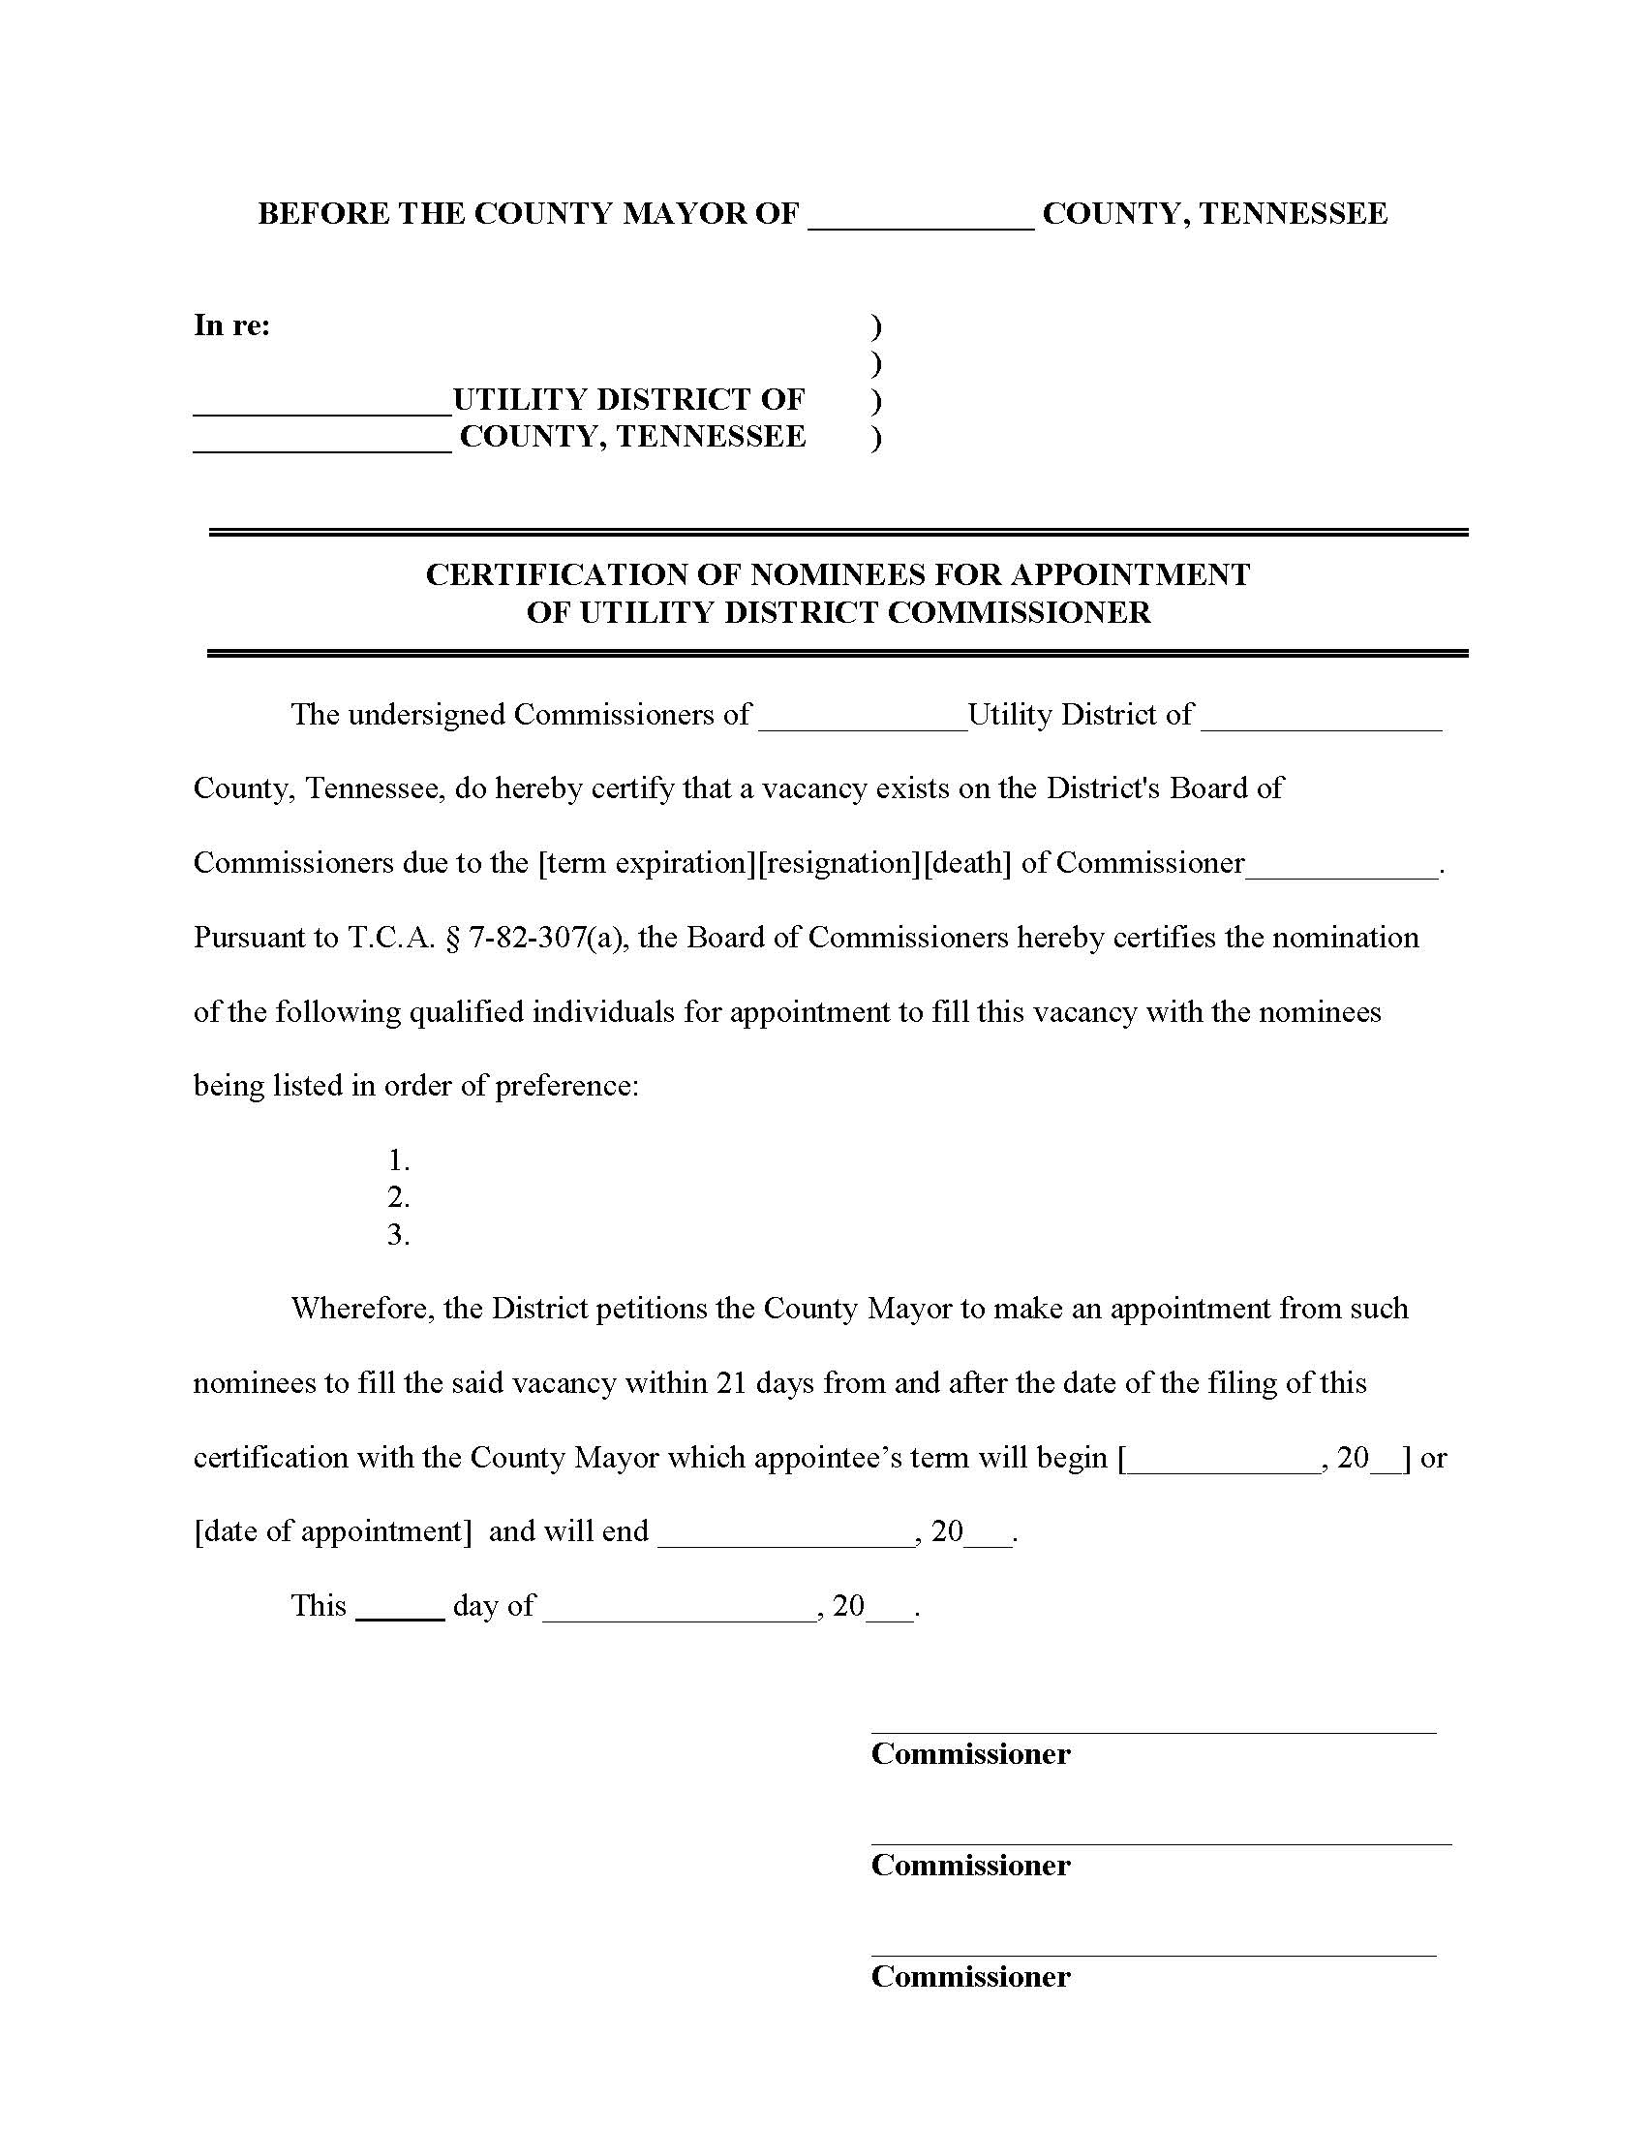

Slide 27
What happens oath of office is not signed or filed?
Does not affect the beginning or ending date of a commissioner’s term of office
Commissioner is a de facto commissioner until oath is taken
Votes and actions of commissioner are valid as to third parties and the public
Failure to take or file the oath is a class C misdemeanor

Slide 28
Contact Information
 |  | Don Scholes General Counsel Tennessee Association of Utility Districts Phone: (615) 896-9022 donscholes@taud.org

