Slide 1
Lead and Copper Rule Improvements
October 30, 2024
David Money- davidmoney@taud.org
931-477-0963

Slide 3
1991
Lead and Copper Rule (LCR) 1991, 2001, 2007
16 Oct. 2024
LCRR effective December 16, 2021. PWS must comply with rule on October 16, 2024
30 Nov.
LCRI- Proposed Rule Published November 30, 2023 Final rule issued 10/08/24
Oct. 2027
PWS must comply with LCRI in three years~ November 2027. And certain provisions of the LCRR in interim period of October 2024- October 2027.
Notes:
Rules would become effective 3 years October 16, 2024
Final rule is very detailed . A brief review of the major provisions follows

Slide 4
LCRI and Primacy Extension What do PWS have to comply with and when?
The LCRI will delay implementation of many parts of the LCRR.
TDEC has received an extension for adopting the LCRR/LCRI
Now that the LCRI is finalized (October 08, 2024) TDEC will begin to adopt rules and must complete primacy application by Dec 2025.
EPA will have primacy in this interim period.

Slide 5
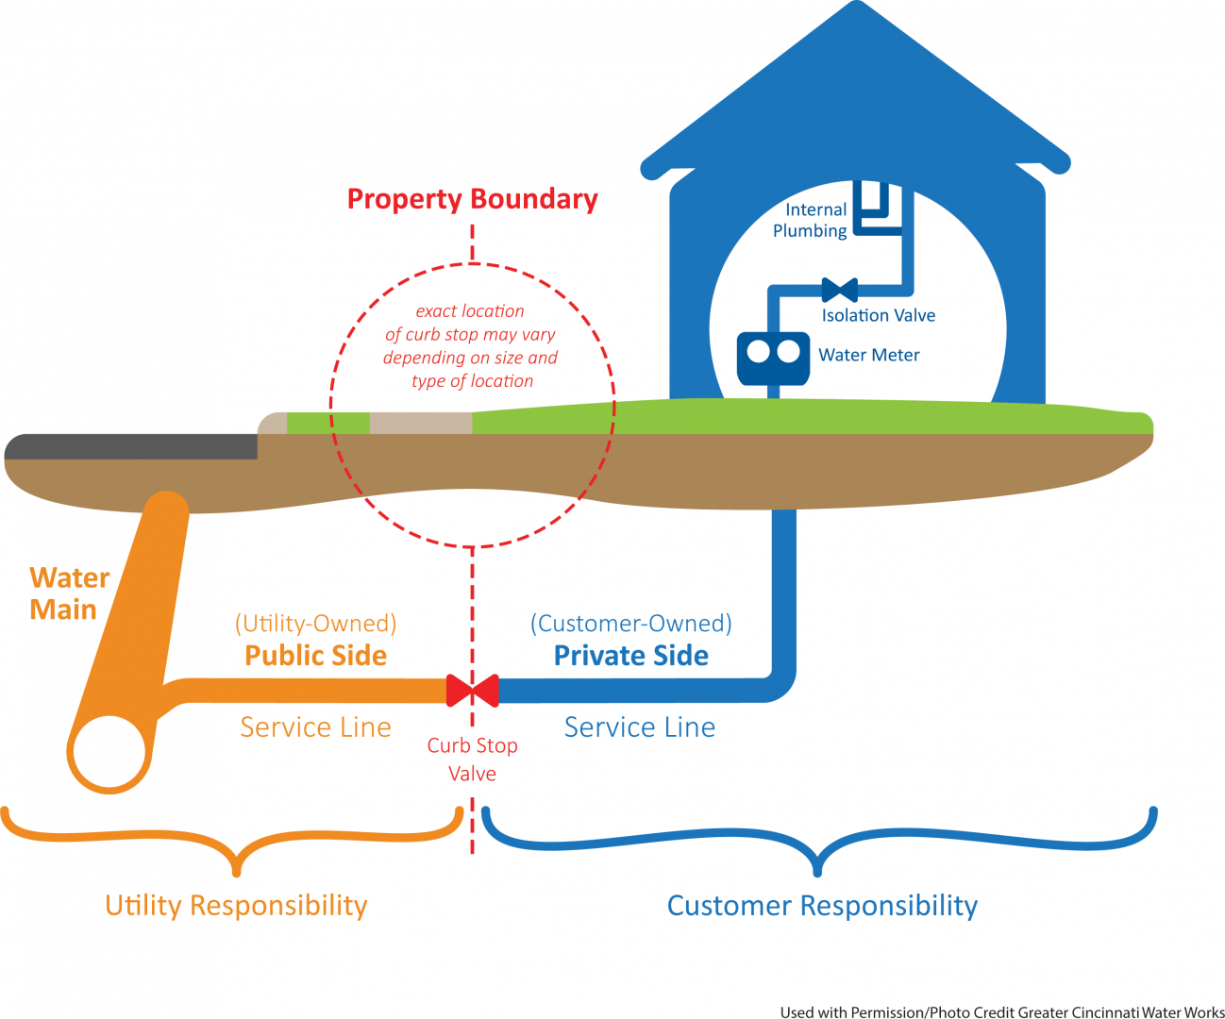
Lead and Copper Rule Revision
Service line Inventories Due -10/16/2024
https://www.tn.gov/environment/program-areas/wr-water-resources/water-quality/drinking-water-redirect/lead-and-copper-rule.html

Slide 6
LCRR compliance between 2024-2027
PWS develop and submit LSL inventory by October 16, 2024
PWS owned and customer owned, 4 categories
lead
non-lead (any service installed after July 1988)
lead status unknown
Galvanized requiring replacement (GL is or ever was downstream of a lead service line)
Inventories to be made available to public – can use street name of block number >50K available online. All systems note availability in CCR.
Update inventory annually to reflect removals or verification of unknowns
PE to customers served by LSL, GRR and Unknowns
Provide Tier1 PN for Action Level Exceedences (15 ppb)
Notes:
GL must be presumed to have been downstream if not known.

Slide 7
What do PWS have to comply with between now and 2027?
141 84(a) (1)-(6) Develop Service Line Inventory, report and update on schedule determined by the state( 141.90 e)
141.84(a)8- Inventory must be made publicly accessible- >50k online
141.84(a)9- if no Unk, GRR or lead – system may use statement in leu of providing inventory to public
141.84(a)10 statement of inventory availability must be provided in the CCR report.

Slide 8
What do PWS have to comply with between now and 2027?
141. 85 (e)- Notification to customers with lead, GRR and unknowns within 30 days of inventory completion and annually thereafter and to new customers until there is no lead, GRR, Unk. ( Nov 15)
141.90 ( e) (13)-Systems with lead service lines , Annually Certify to the state that the PWS has complied with the customer notification requirements of 141.85 e. providing the public notice and educational material to customers with lead GRR and Ukn.
141.201(c) (3)- A copy of the notice must also be sent to the primacy agency and the Administrator (as applicable) in accordance with the requirements of § 141.31(d).

Slide 9
What do PWS have to comply with between now and 2027?
141.202(a (10)- Provide Tier1 PN for Action Level Exceedences (15 ppb)
141.31(d) For Tier 1 notices for a lead action level exceedance, public water systems must provide a copy of any Tier 1 notice to the Administrator and the head of the primacy agency as soon as practicable, but not later than 24 hours after the public water system learns of the violation or exceedance.

Slide 10
What are the final requirements of the LCRI?

Slide 12
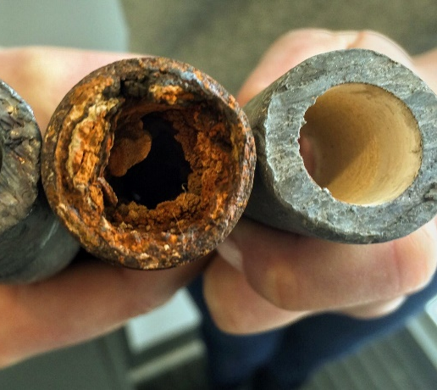
EPA Final Lead and Copper Rule Improvements
Major Changes include
Baseline inventories development
Validation of non-lead status services (7yrs)
Identify all unknowns and
Remove all lead, GRR (10yrs)
Revised Lead P90 AL of 10 ppb
Replacement plans if Lead, GRR or Unk
New Tier Designations
Revised Sample Siting Plans
Corrosion Control Treatment Changes
Tap Sampling Procedures
Public Education and Transparency Provisions
Distribution Site assessment samples > 10 ppb
Lead Sampling of Schools and Childcare Facilities
CCR reporting changes

Slide 13
LCRI Baseline Service Line Inventory
Requires water systems to develop an updated initial service line inventory, called the LCRI baseline inventory, which would be due by the compliance date of the LCRI (i.e., 3 years after the final LCRI is published). October 2027
The proposed LCRI would require water systems to review records for information on connector materials and include lead connector materials in the LCRI baseline inventory. System must consult records and records of inspections. All connectors are to be classified as
Lead
Replaced lead
Never lead
Unknown
No connector Present
Update inventory annually make customer notifications annually (lead, GRR unknowns)
Identify all service lines and connectors of unknown material by the replacement deadline. ( 10 years after final rule)

Slide 14
Connectors must be included in baseline inventory
Connector, also referred to as a gooseneck or pigtail, means a short segment of piping not exceeding three feet that can be bent and is used for connections between service piping, typically connecting the service line to the main. For purposes of subpart I, lead connectors are not considered to be part of the service line.

Slide 15
Validation of not lead status
Must develop a validation pool of non-lead sites for inventory validation.
To include All non lead service line inventory that were determined via a method other than
Records used to develop the inventory
Visual inspections of at least two points( excavation, meter box or inside home or were lead or GRR that was replaced)
From this pool, system must randomly select a % of sites to conduct a multipoint physical validation of at least two points.
Size of validation pool Number of validations required
<1,500 ............................. ..20 percent of validation pool.
1,500 to 2,000 .................. 322.
2,001 to 3,000 .................. 341.
3,001 to 4,000 ...... ……….351.
4,001 to 6,000 .................. 361.
6,001 to 10,000 .... ……….371.
10,001 to 50,000 ………… 381.
>50,000 .............................384. must be completed within 10 years of final rule pub.(7yrs-2034)
Notes:
Sites are to be selected from the pool by use of a random number generator or lottery method between .8 and 20% of pool to be validated

Slide 16
Replacing all Lead, GRR service lines within 10 years (2037)
Within 10 yrs. systems must replace all Lead, GRR and unknowns under their control, unless the replacement would leave in place a partial lead service line. ( cumulative annual average of 10%) extended time frame allowance for systems that must replace more than 3.9 % 39/1000 lines per year.
Pitcher or POU filters ( six months) must be provided to customers after a LSL replacement
PWS must offer to sample the tap of customer between 3 and 6 months after the replacement.

Slide 17
How does the proposed LCRI define “under the control” of the water system?
The LCRI requires water systems to replace lead and GRR service lines, and any lead connectors encountered, that are “under the control” of the water system.
EPA is proposing to treat a service line and lead connector as under the system’s control wherever a water system has adequate access (e.g., legal access, physical access) to conduct full service line replacement or replacement of the lead connector.
The LCRI requires the water system to identify in its service line replacement plan any State or local laws or water tariff agreement requirements pertaining to its ability to gain adequate access. TCA 7-35-401(c)
System would be required to make a reasonable effort to obtain property owner consent.
A reasonable effort includes a minimum of at least four attempts to engage the customer using at least two different methods. If the water system is unable to obtain customer consent when required, the water system would not be required to conduct full service line replacement because, under those circumstances, the full service line would not be “under the control” of the operator of the system.

Slide 18
New 90th % 10 ppb Action level exceedance
24 hour Tier 1 public notice
Public Education and outreach no later than 60 days after end of each tap sampling period
Revert to Standard monitoring –every 6 months
Evaluation of CCT- install or re-optimize
Systems that exceed the Lead AL 3 times in 5 years must;
Provide filters to all customers and test the tap water of any customer served by lead, GRR or an unknown service line upon request.
Notes:
PN has been elevated to a public health threat level equivalent to an e-coli or TT violation.

Slide 19
Lead Service Line replacement Plan
For systems with lead, GRR or unknown
Must be submitted by ~October 2027 and made publicly accessible
Strategy to prioritize replacement of LSL- most vulnerable populations, disadvantaged communities.
Strategy for determining status of unknowns
Procedures to contact customers and conduct full LSL replacement
Procedures to notify customers to flush lines
Customer outreach information , pitcher filters for six months
funding strategy to assist customers with customer LSLR
Citation of any state or local laws that affect ability to conduct full LSLR
Notes:
Components of the LSL replacement plan shall include

Slide 20
New Tier designations
T1- Single family structures with premise plumbing made of lead or served by LSL
T2- Buildings including multi-family residences with premise plumbing made of lead or served by LSL
T3 – Single Family structures that are served by a lead connector or galvanized service line or premise plumbing ever downstream of lead.)
T4- Single family structures with premise plumbing containing copper pipes and lead solder installed before the states lead ban (July 1988).
T-5 Sites that are representative of sites commonly found throughout the system.
Notes:
The big change here is the addition of Galvanized and the redefining of copper pipes and lead solder,

Slide 21
Lead and Copper Sample Siting Plans
PWS revise and submit Revised Sample siting or monitoring plans based on LSL inventory by the start of a systems first monitoring period after October 2027
Must include Highest Tier sites first ( LSL)
Must reevaluate plan based on inventory pool updates
Must include Water Quality Parameter Monitoring Locations
LCRR sample siting plans are much more comprehensive
Wide mouth bottles
Customer notification language
Ist and 5th liter samples for lead service lines
Systems with Lead, GRR or unknowns will revert to standard monitoring

Slide 22
Distribution System and Site Assessment (DSSA)
Triggered when any individual sample result >10 ppb
Step 1- Within 5 days collect a WQP sample within 0.5 miles of the customer, same pressure zone, same main size. Add site to WQP monitoring plan.
Step 2-within 30 days collect follow up samples for lead. May collect additional samples ( i.e. 5th liter or sequential ) to help identify plumbing contribution to lead. Results are not used for P90 calculations.
Step 3 –within 60 days of the end of the monitoring period, report findings and cause if known. Make recommendation for corrective action if water quality related.
Notes:
F&F or assessments- TDEC has required some form of follow up for years via policy, we have not developed a hard rule.

Slide 23
Corrosion Control Treatment (CCT) changes
Eliminates calcium carbonate equilibrium as a recognized CCT
Specifies *orthophosphate if a phosphate is used for CCT
exceed the 10 ppb action level
If you are not providing CCT – must install CCT
If you are providing CCT you must re-optimize
Notes:
EPA interprets existing corrosion control at a minimum to include adjusting pH or adding a phosphate. Exceedeing a trigger level requires CCT evaluation

Slide 24
Sampling at Schools and Childcare Facilities
Excludes building built after July 2015,
CWS develop lists of schools and childcares, provide communication about risks of lead annually beginning in October 2027.
Conduct sampling of elementary schools (k-6) and childcares one time during the first five years. 2027-2032 At least 20%/year. After 2032 sample any that request it.
(follow 3ts sampling protocol 8-18 hr. stagnation 250 ml sample.
5 samples per school , 2 samples per child -care facility- rule specifies locations
Results not included in 90th calculation and must be reported to the facility, TDEC and the local and state Health Departments.
State can waive facilities from the first 5 year sampling requirement if the school or childcare was tested under the (WIIN Grant after Jan 2021).
Notes:
(i) For schools: two drinking water fountains, one kitchen faucet used for drinking or
cooking, one classroom faucet or other outlet used to provide water for human consumption, and
one nurse’s office faucet, as available.
(ii) For child care facilities: one drinking water fountain, and one of either a kitchen
faucet used for drinking or cooking or one classroom faucet or other outlet used to provide water
for human consumption.

Slide 25
Water Quality Parameters
All systems > 50,000
All systems that exceed the Action Level 10 ppb
All systems > 10,000 that are not providing OCCT
The number of entry point and tap samples based on size.
All WQP monitoring site are to be monitored at least annually, two 6-month periods initially.
Calcium stabilization is being eliminated as a CCT along with the associated WQP Calcium hardness , conductivity and temp.
Notes:
Skip

Slide 26
Public Education and Notifications
Revised Health Effects Language to be used in all customer notifications
Any customer with L&C tap level results are to be notified of results within 72 hours
Initial and Annual notices to customers with LSL, Galvanized and unknowns. To include info on LSL replacement and funding opportunities.
Tier 1 24 hour notice to all customers if the 90th % 15ppb Action Level is exceeded until October 2027
Tier 1 24 hour notice to all customers if the 90th % 10ppb Action Level is exceeded after October 2027
Notes:
A summary of the PN requirements of the LCCR

Slide 27
Increased transparency
Revised health effects language for customer notifications
CCR to include revised language and includes 90th % compliance value, the range of lead results and number of samples above 10 ppb.
CCR information on how to obtain copies of all results.
CCR update on LSL inventories and availability for viewing.
Tier 1 public notice (24 hours) for lead 90th percentile 10 ppb exceedance .
72 hour notice of customer results regardless of values
Notes:
ASDWA is recommending extending notice to 72 hours

Slide 28
PWS action needed to comply with LCCR / LCRI 2024-2027
Provide customer notices and delivery certification for Lead, GRR and Unknowns by November 15, 2024. and annually thereafter by July 1.
Begin work on Baseline Inventory(add connectors status) Submit to state ~October 2027
Continue to identify unknowns and replace lead and GRR.
Develop Lead Service Line Replacement Plan (if you have lead, GRR or unknowns), and submit to state ~October 2027
Develop Revised LCR sampling plan and submit to state ~October 2027
Develop lists of childcare facilities and Schools constructed prior to July 2015 and submit to state ~October 2027
Notes:
Systems need to begin the LSL inventory now. Resources will be provided.

Slide 29
Recommended Actions
Engage Customers for assistance in identifying service line material.
Eliminate as many lead, GRR and unknowns as soon as possible.
Begin evaluating verification requirements
Develop transparency provisions- web sites etc.
Monitor water quality throughout distribution (develop baseline)
Conduct additional exploratory monitoring
Adopt lead level goals (0-10 ppb?) Set water quality goals for distribution
Evaluate CCT – use EPA OCCT guides and templates.
Optimize for corrosion control
Contact state and evaluate any treatment or chemical changes that might impact OCCT.

Slide 30
Funding is available
lead line replacement
galvanized line replacement
The Bipartisan Infrastructure Law (BIL) contains a historic $15 billion in dedicated funding through the DWSRF for LSL identification and replacement. The BIL also provided $11.7 billion over five years to enhance DWSRF base funding.
American Rescue Plan (ARP) TN is dedicating $1 billion of non-competitive funds for water and wastewater projects
The WIIN Voluntary School and Child Care Lead Testing and Reduction Grant Program provides funding to States for lead testing and remediation in schools and child care facilities. This funding is for States, not water systems.
Contact TDEC SRF or SWIG staff
https://www.tn.gov/content/tn/environment/program-areas/wr-water-resources/srfp/srf-home/i-need-funding/funding-dw-projects.html
https://www.tn.gov/environment/arp.html

Slide 31
The EPA Guidance for Developing and Maintaining a Service Line Inventory. Released August 4, 2022.
https://www.epa.gov/ground-water-and-drinking-water/revised-lead-and-copper-rule
Provides best practices for inventory development and communicating information to the public.
Includes a template for water systems, states, and Tribes to use or adapt to create their own inventory.
Contains case studies on developing, reviewing, and communicating about inventories.
Highlights the importance of prioritizing inventory development in disadvantaged communities and where children live and play.

Slide 32
LCRI Resources
EPA LCRI site
https://www.epa.gov/ground-water-and-drinking-water/lead-and-copper-rule-improvements
TDEC Lead and Copper Rule Web site
https://www.tn.gov/environment/program-areas/wr-water-resources/water-quality/drinking-water-redirect/lead-and-copper-rule.html
https://www.lslr-collaborative.org/preparing-an-inventory.html
https://www.asdwa.org/wp-content/uploads/2019/08/ASDWA_Developing-Lead-Service-Line-Inventories.pdf
https://www.awwa.org/Resources-Tools/Resource-Topics/Inorganic-Contaminants/Lead
https://www.blueconduit.com/lcr-revisions

