Slide 1
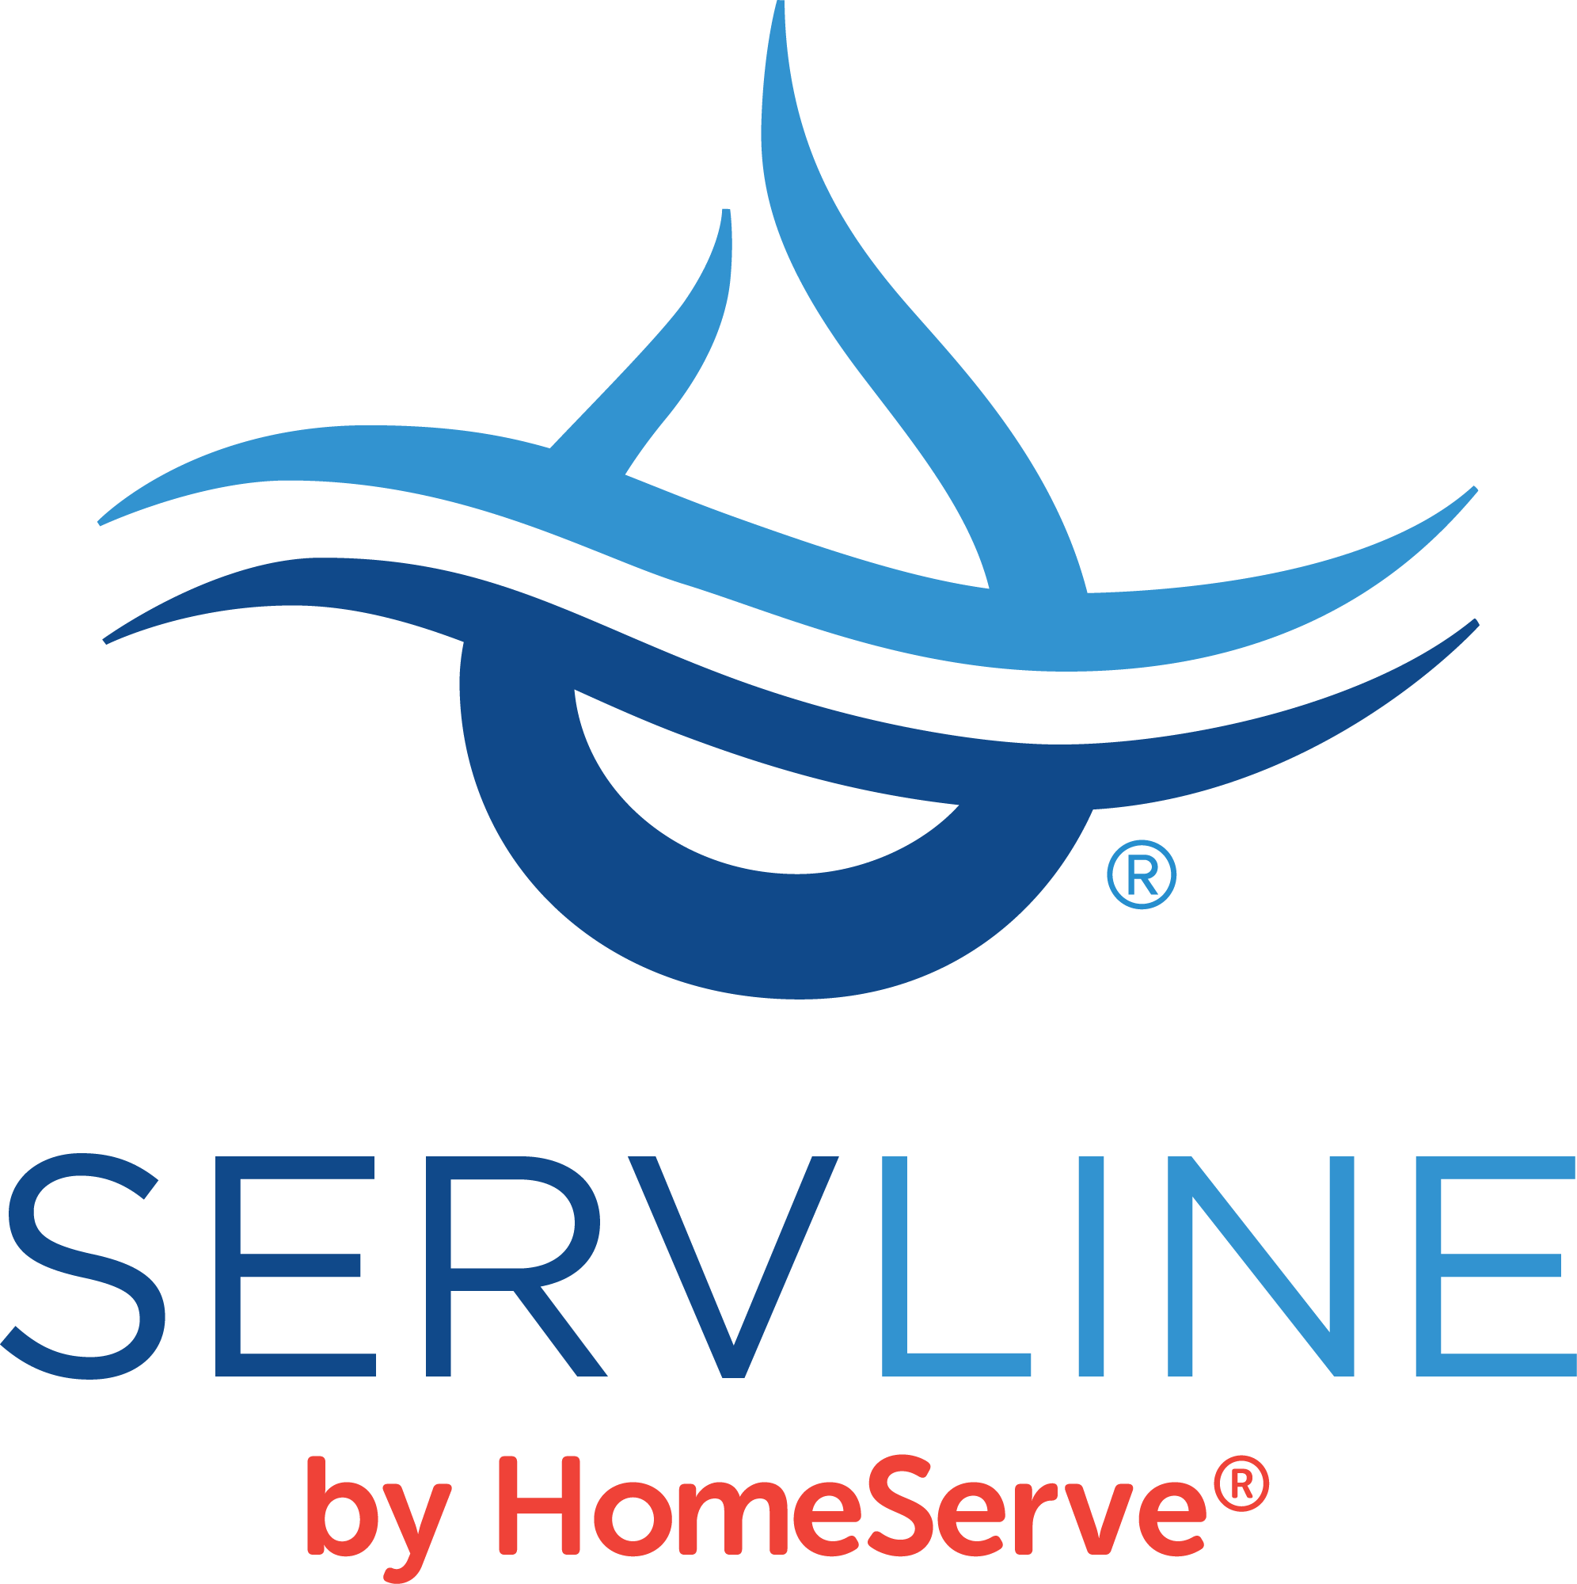
TAUD Leadership Presentation

Slide 2
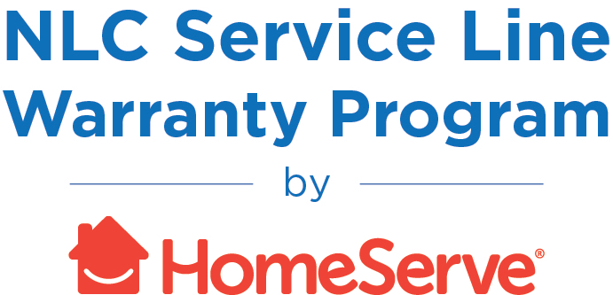
TOTAL SOLUTION FOR WATER LEAKS ServLine and NLC Service Line Warranty Program
Leak Protection
Covers the cost of a high-water bill due to a leak
Line Protection
Educates homeowners about their responsibility for service lines and offers optional coverage for repairs/replacements backed by local contractor network
These Solutions Allow the Utility or Municipality to Proactively Address Customer Pain Points, Resulting in Increased Customer Satisfaction.
Notes:
THIS IS AN OPENING GRAPHIC, REQUESTED BY WATER BDs TO EXPLAIN THE TWO PROGRAMS BEFORE GOING INTO A PRESENTATION.

Slide 3
ServLine and Homeserve Facts
Over a decade serving utilities/municipalities for leak adjustment and two decades for service contracts
1,200+ partner across the nation, 250+ ServLine
85 Partners in Tn, 82 ServLine
1,200+ partner across the nation, 250+ ServLine
Saved customers in TN over $20 Million in leak related issues
Employee of 600+ employees in TN
Partnered with many associations including TAUD, NRWA and NLC. These strategic partnerships are just that “Strategic” we are constantly trying to implement new strategies and ideas with our strategic partners.
ServLine as an opt-out hasn’t presented any challenges for our utility partners and putting the charge in-rates is also becoming more prevalent.
When HomeServe acquired ServLine, all major processes, customer service and people stayed the same… “if it ain’t broke, don’t fix it”
We are a National company with a lot of regional expertise especially in TN. We can be more expensive because we are compliant with how the TNDOI classifies these programs.
Notes:
The ServLine Leak Protection Program provides numerous benefits to utilities and their customers.
For customers, the program offers peace of mind that unexpected excess water bills will be fully covered with no deductibles or other charges. And claims are processed seamlessly with dedicated staff that will ensure an exceptional customer experience.
Utilities benefit by recapturing lost revenue from adjustments and bad debts. Our program also reduces utility staff workload, all while improving public perception and customer satisfaction.

Slide 4
ServLine Leak Protection Program A Win-Win Solution that Lowers Costs While Improving Customer Satisfaction
Utility benefits
Customer benefits
Recapture of lost revenue from adjustments and bad debt
Reduction of staff workload dedicated to leak adjustments
Increased customer satisfaction
Up to $2,500 in protection from excess water bill with no deductible
Seamless and simple claims process
Peace of mind that unexpected expense is covered
In the development of ServLine, the TN DOI stated that payment of leak adjustments with a charge to the customer is insurance. Doing so any other way when charging the customer is not approved. Setting the program up as insurance requires various licensing (recertified every 2 years) and requirements which is why we can be more costly.
Notes:
Mark

Slide 5
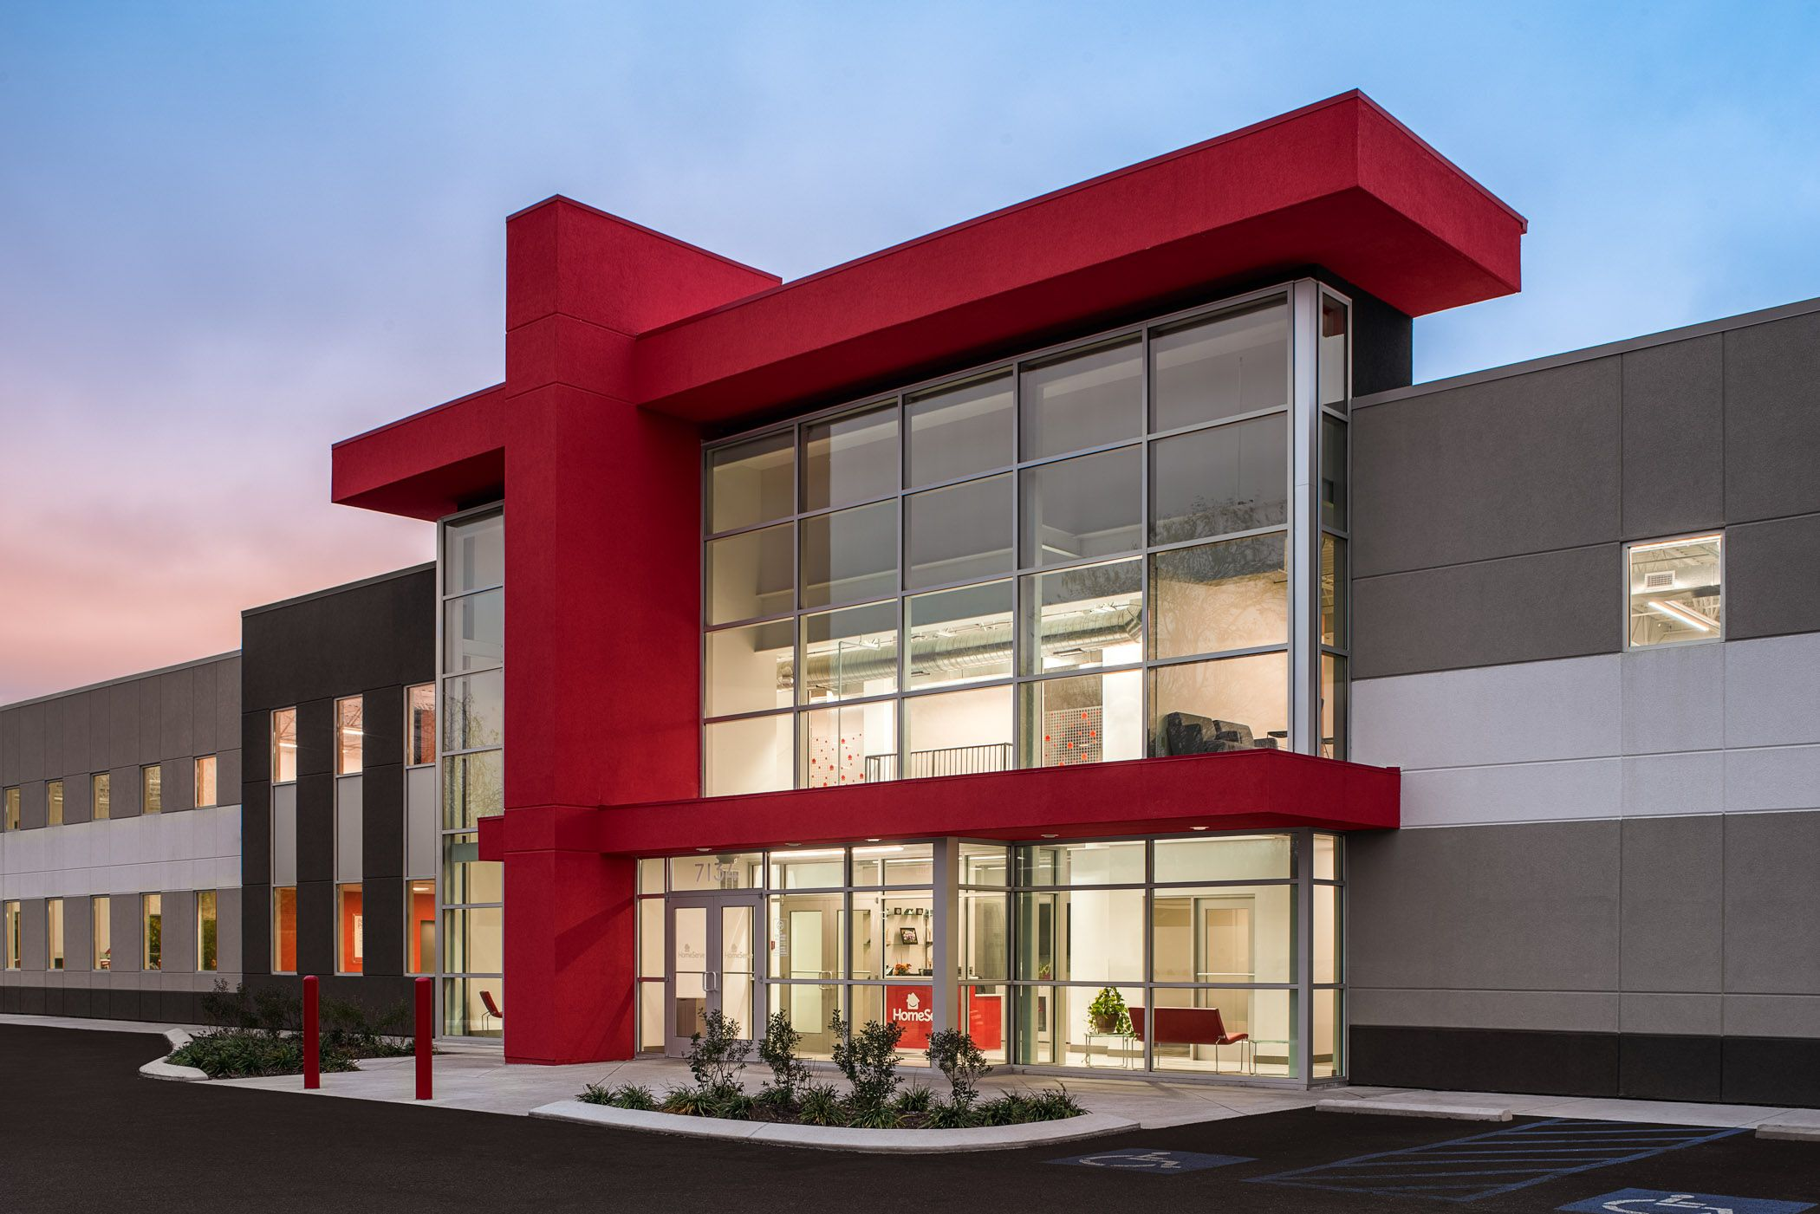
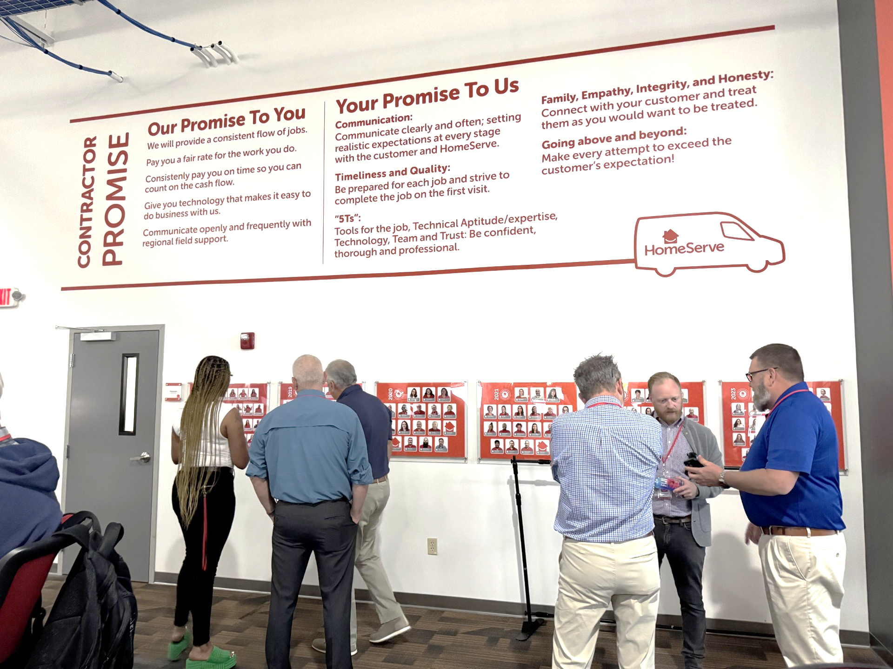
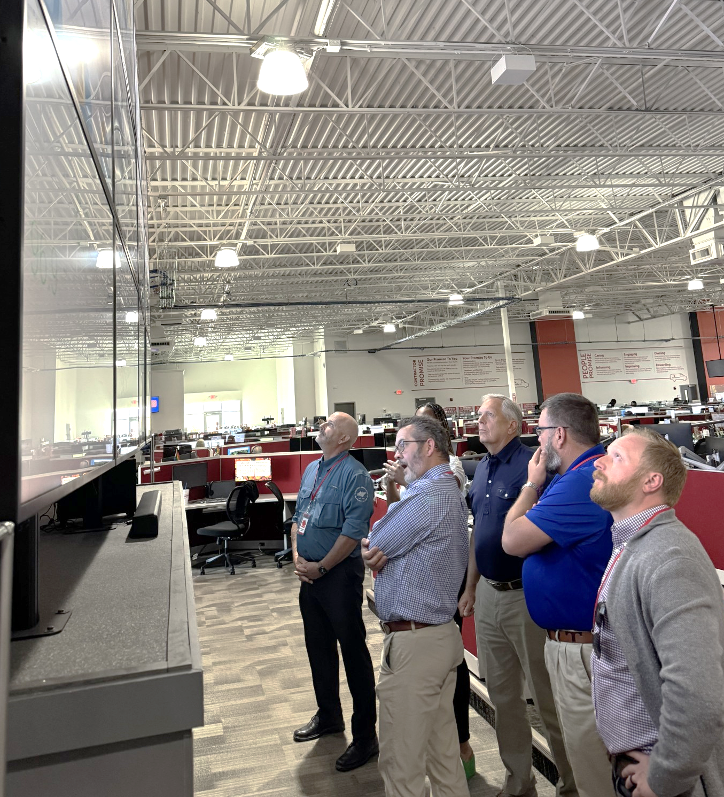
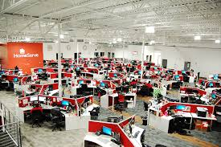
ServLine Founded in Chattanooga, TN…
What are they looking at?
…although acquired by HomeServe we are still Chattanooga based.
(Employee over 600 employees in TN)
Notes:
The ServLine Leak Protection Program provides numerous benefits to utilities and their customers.
For customers, the program offers peace of mind that unexpected excess water bills will be fully covered with no deductibles or other charges. And claims are processed seamlessly with dedicated staff that will ensure an exceptional customer experience.
Utilities benefit by recapturing lost revenue from adjustments and bad debts. Our program also reduces utility staff workload, all while improving public perception and customer satisfaction.

Slide 6
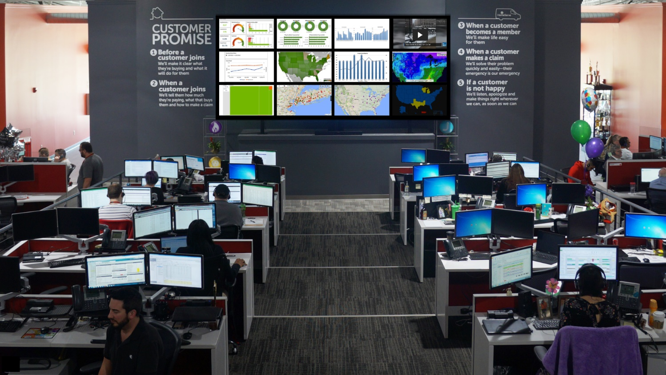
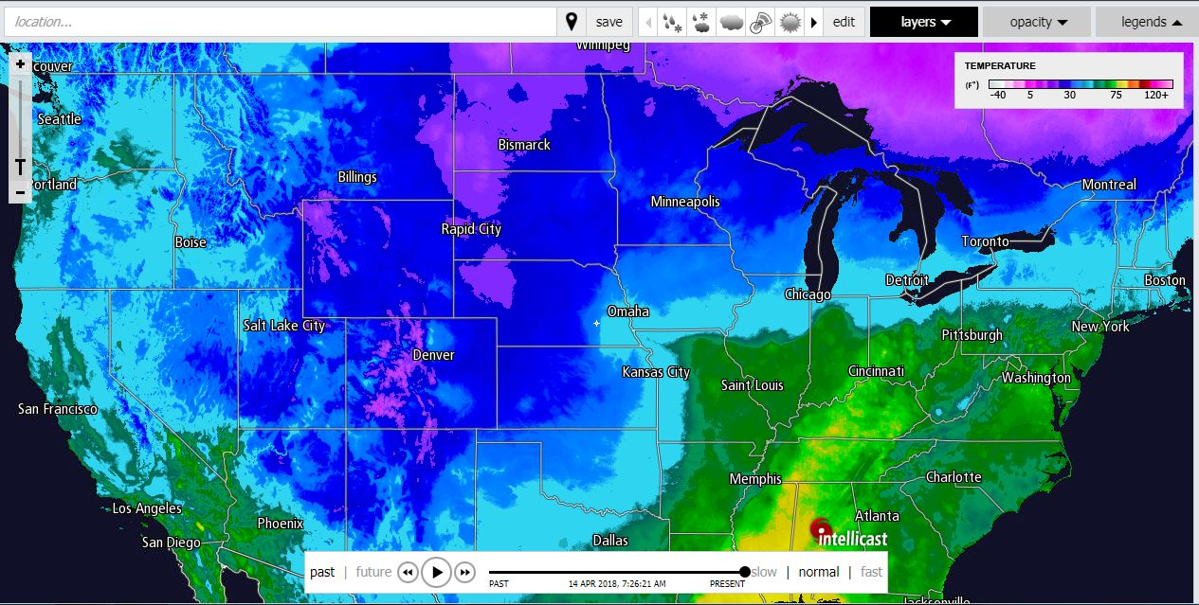
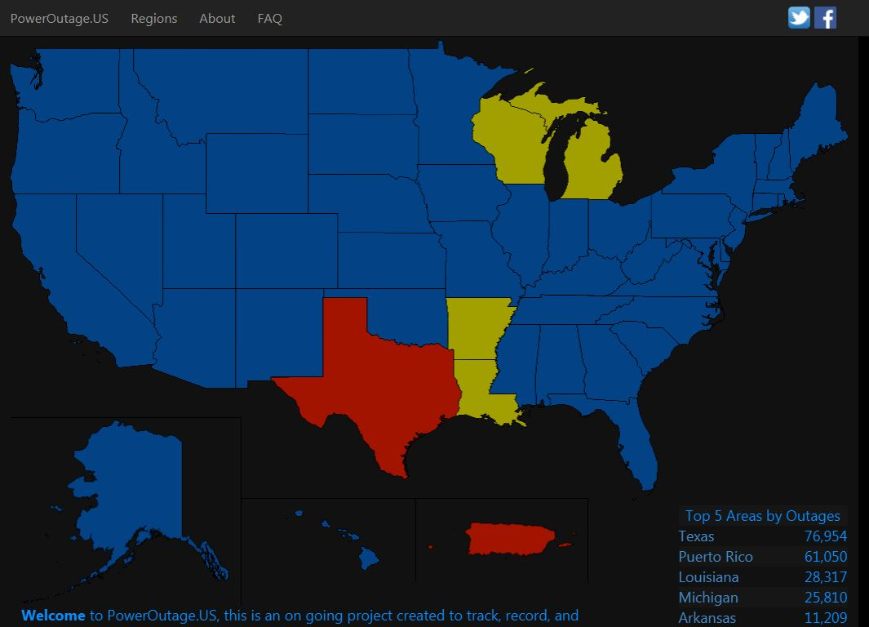
Network Operations Center
Provides the ability to manage all jobs in real time and take action before escalation is required
Monitors weather conditions, temperature and power outages across the country to stay ahead of spikes in job volume

Slide 7
Some say Leak Adjustments in house is a better solution for utility and customer
Utilities have been encouraged by Comptroller’s Office of Tennessee to outsource leak adjustments to focus on primary functions of utility.
U.S. Congress has also written language in recent bills for funding that utilities with 3rd party insurance leak adjustment programs can qualify for certain earmarks.

Slide 8
Recap of why SERVLINE by HOMESERVE
Best overall product/service for utilities and your customers.
Service contracts backed by the largest and best contractor network
HomeServe main operations is located in Chattanooga, TN with over 600 employed in state
Longstanding support of Tennessee utilities
Strategic and Financial support to TAUD and the NRWA
Over $20M savings of Tennessee customers
WE CARE AND ARE GOOD AT WHAT WE DO.
Please spend time to better understand how we can help – Jenna Hazelet (jenna.hazelet@homeserveusa.com and 714-321-5783)

Slide 9
Appendix

Slide 10
Exceptional Customer Service to Satisfy Every Customer
Significant investment in technology to enhance customer experience
Manage over 2,700 rigorously vetted independent contractors in network
640-seat call center in Chattanooga
Answered over 3.7 million calls in last 12 months
Maintain overall satisfaction rating over 4.8 of 5 stars*
*Data based on customers surveyed after receiving service between July 1, 2023, and December 31, 2023.

Slide 11
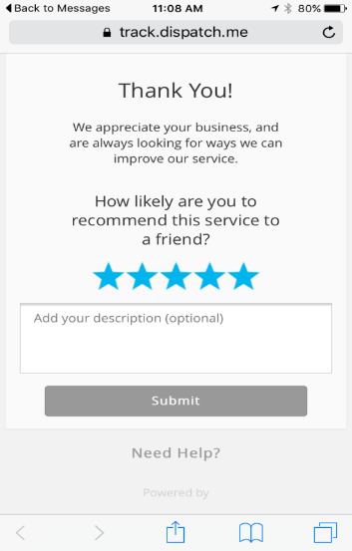
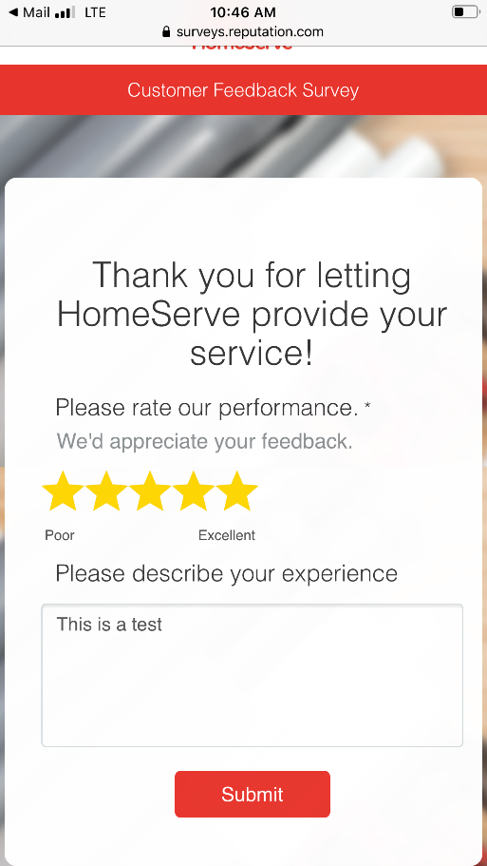
Outstanding Customer Satisfaction Scores
Post-claim
4.8 out of 5 stars*
Reputation.com
4.4 out of 5 stars**
Google
4.4 out of 5 stars**
BBB
4 out of 5 stars**
Measurement method:
Post-claim satisfaction survey sent via text message immediately following job completion and then again within a week via email
In the event of a negative review (1-3 stars), the customer receives a message apologizing for the service not meeting expectations
Real Time Insights team follows up with 100% of customers providing 1-3 stars to make the situation right
*Data based on customers surveyed after receiving service between Jan 1, 2024, and July 31, 2024
**As of July 2024

Slide 12
HomeServe Cares Foundation We take pride in giving back to communities and helping homeowners in need
750 HomeServe
Cares jobs completed
worth $1,200,000
$250,000 in funding distributed to
charities
$40,000 in funding distributed to veterans’ groups
76 organizations supported and 1,229 employee hours volunteered
The HomeServe Cares Foundation is a four-pillar corporate social responsibility program and includes pro-bono repair jobs for eligible citizens, funding for community-based projects, support for veterans, and employee charitable giving and volunteerism.

