Slide 1
TAUD Leadership Conference The Pursuit of Excellence: Tools to Continually Improve Your Utility October 31, 2024

Slide 2
Contact Information
Sarah Chandler, Principal
Email: Sarah.Chandler@JacksonThornton.com
Direct: 334-224-9783
Jim Marshall, Principal
Email: Jim.Marshall@JacksonThornton.com
Direct: 334-451-2196

Slide 3
About Jackson Thornton
Founded in 1919
Headquartered in Montgomery, AL
Five offices in Alabama & Tennessee
37 partners; 200+ on staff
Accounting, audit, tax, consulting
Myriad of specialized industry services and niche areas
Firm owns four additional companies

Slide 4
About Jackson Thornton Utilities
25+ employees dedicated to Utility focused work
120+ clients
Complete 80-100 Cost of Service, Rate Design and/or System Development Fee engagements annually
Average being in front of Boards/Councils about once a week

Slide 5
Overview of Session
Mission
Challenges
Tools
&
Solutions
Next Steps

Slide 6
Mission – What is Your Why?
To provide safe, reliable, and cost-effective water and wastewater services to our customers while ensuring the protection of public health and the environment.

Slide 7
Common Challenges
Financial Needs/Affordability
Succession Planning
Employee Retention
Ineffective Leadership
Clarity of Vision and Teamwork
Communication
Fear of Change
Silent Service
Community Engagement

Slide 8
Tools for Continual Improvement
Financial
Succession Planning
Employee Retention and Engagement
Leadership Development
Strategic Planning
Communication
Community Engagement

Slide 9
Financial
Financial Stability is key to fulfilling your mission.
A Capital plan must be accompanied by a financial plan.

Slide 10
Financial Tools/Best Practices
Financial Policies
Budgeting
Capital Improvement Plans
Cost of Service
System Development Fees

Slide 11
Succession Planning
According to the EPA between 30% and 50% of the water workforce is eligible to retire in the next 5 – 10 years.

Slide 12
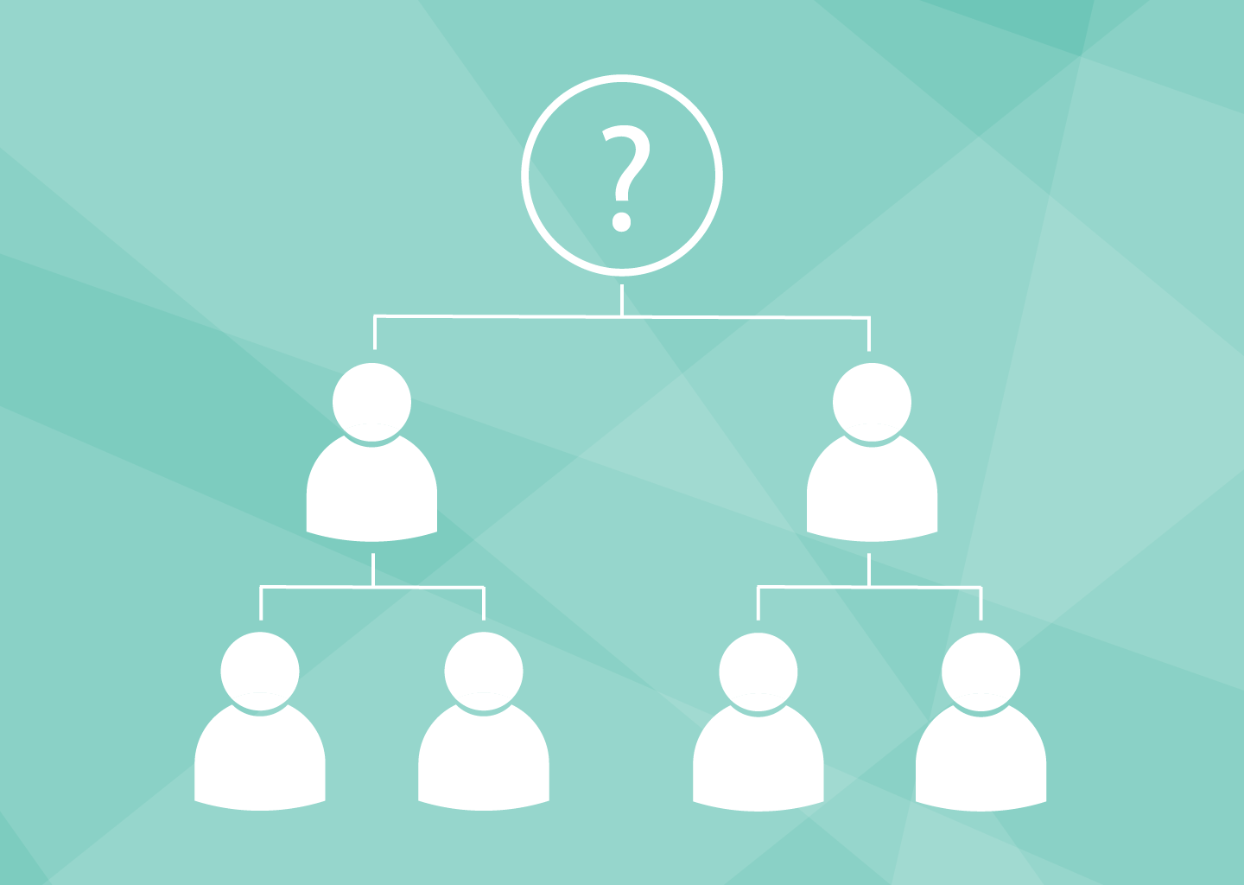
Succession Planning
Succession Planning
A proactive strategy for ensuring a smooth transition of leadership when leaders move on due to retirement, role changes or other reasons.
Necessary for all areas of the utility
Managers
Operations
Finance
Customer Service

Slide 13
Succession Planning – Tools/Best Practices
Proactive V. Reactive
Start Early and plan continually
Identify Critical Roles
Assess Talent pool
Develop high Potential Employees
Communicate Transparently
Diversify Your Bench (Cross Train)
Consider External Options
Evaluate and Adjust

Slide 14
Employee Retention and Engagement
AWWA 2024 State of the Industry Report lists worker shortages as one of the top ten concerns among leaders in the industry.

Slide 15
The Value of Employee Retention
Turnover Costs
Declination of Talent Pool
Institutional Knowledge
Productivity and Performance
Return on Investment

Slide 16
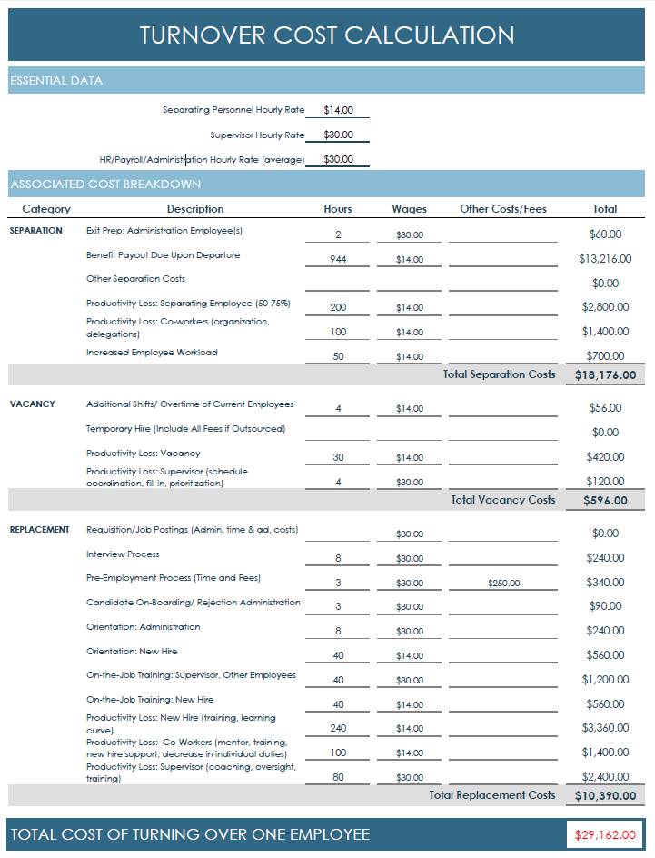
The Value of Employee Retention

Slide 17
Employee Engagement
“People will forget what you said, people will forget what you did, but people will never forget how you made them feel.”
-Dr. Maya Angelou

Slide 18
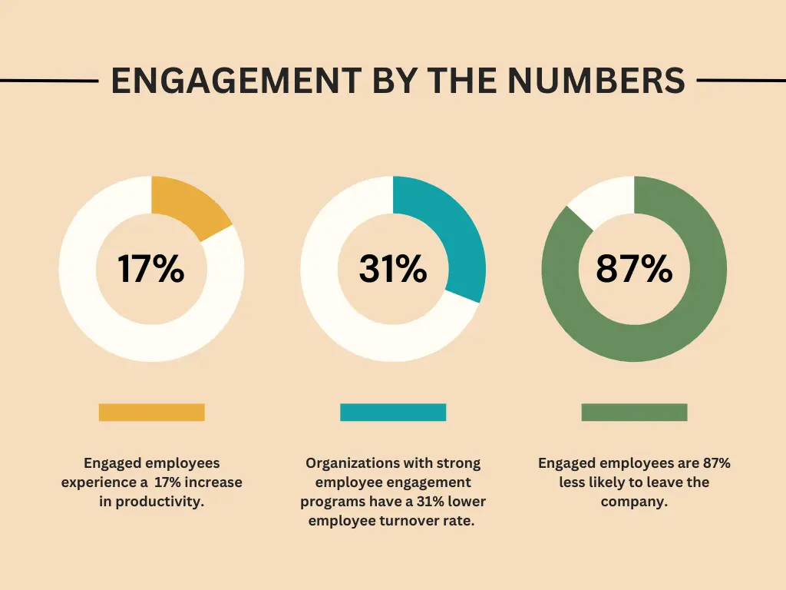
Employee Engagement
Benefits to the Employer
Increased Productivity
Lower Absenteeism
Higher Retention Rates
Improved Customer Satisfaction
Benefits to the Employee
Increased Job Satisfaction
Better Health and Well-being
Stronger Relationships
Job Security/Loyalty
Sources: Gallop, Officevibe, Harvard Business Review

Slide 19
Employee Engagement – Tools/Best Practices
Relational v. Transactional
People First Culture
Effective Communication
(LISTEN)
Work-Life Balance
Career Development and Coaching
Recognition and Rewards

Slide 20
Leadership Development is Critical
Navigating Industry Challenges
Emergencies/Disasters
Enhancing Operational Efficiencies
Managing Risks and Security

Slide 21
Leadership Development – Tools/Best Practices
Utility Specific Leadership Programs
Continuous Learning and Development
Mentoring
Coaching
Performance Management Systems
Build a Trusting Environment
Fostering Innovation

Slide 22
Next Steps and Resources
Start where you are!
Take advantage of Resources:
TAUD, NRWA, AWWA, WEF, Consultants and Experts
Talk with and Learn from each other

