Slide 1

$1.35B ROI: Results of ARPA Funding Infusion for Utilities
Vena Jones – Program Manager, ARP, State Water Infrastructure Grants, & State Revolving Fund
October 30, 2025

Slide 2
Agenda
TDEC American Rescue Plan (ARP) Water Infrastructure Grants
TN Infrastructure Scorecard Overview
TDEC American Rescue Plan (ARP) Water Infrastructure Grants Preliminary Results

Slide 3

TDEC ARP Water Infrastructure Grants
Notes:
Speaker: Jaamal

Slide 4
Water Infrastructure Investment Program (WIIP) Overview​
The Water Infrastructure Investment Plan (WIIP) outlines TDEC’s deployment of American Rescue Plan (ARP) Fiscal Recovery Fund dollars toward water infrastructure projects. Tennessee’s Financial Stimulus Accountability Group dedicated $1.35 billion of Tennessee’s Fiscal Recovery Funds from ARP for this purpose. TDEC’s State Water Infrastructure Grants ARP Program includes the following:
Non-Competitive Grants
$1 billion
State-Initiated Strategic Projects
$309 million
$200 million allocated to the Competitive Grant Program, focusing on regionalization, water reuse, and resource protection
Other highlighted areas of strategic funding:
  Enterprise-Scale Infrastructure Investments for TN State Parks and the TN Dept. of Transportation: $58 million
  Additional funding for state priorities in each Grand Division
Eligible entities include cities and counties
Formula-based allocations
Applications closed November 2022
Projects address critical needs identified in Tennessee Infrastructure Scorecard

Slide 5


TDEC Water Infrastructure Grants Timeline​
March 3, 2021
American Rescue Plan Signed Into Law
July 2023
All Non-Competitive Grant Contracts executed
March 2024
All Competitive Grant Contracts executed
September 30, 2026
All Grant Contract End
April 28, 2023
All Non-Competitive Grant Applications reviewed
May 1 – August 1, 2023
Competitive Grant Application Period
December 31, 2024
All grant funds must be obligated
Program Spend Timing
All grant contracts will have an effective date of March 3, 2021 and end on September 30, 2026
All funds must be obligated by December 31, 2024

Slide 6



Non-Competitive Grant Program Highlights
The program received 100% participation from counties and 98% participation by cities. This represents 329 unique grantees spread across 336 unique grants.
336
Total Contracts Executed
1,104
total projects proposed
across the state
247 Asset Management Plan projects
TDEC reached a diverse range of communities, both geographically and socio-economically. 66% of applicants represent disadvantaged communities.
$996m
Executed Funding
Stormwater
72
ATPI Score Breakdown:
51
39
43
41
34
Wastewater
412
32
22
26
22
Number of Grantees
15
11
Drinking Water
620
Applicant ATPI

Slide 7
Non-Competitive Grant Program Highlights
City of Oak Ridge ($3.2M)
The City of Oak Ridge will use ARP funds to address aging infrastructure, including the replacement of aging water lines with chronic and numerous failures which contribute to water loss. The city will replace approximately 5,150 linear feet of existing lines that feed a water tank and about 20 percent of the population of Oak Ridge. The city will also replace two existing suction pumps with two new submersible pumps and rehabilitate the existing wet well. Additional funds will be used to replace the city's existing water treatment plant with a new plant and waterlines.
Montgomery County ($5.44M)
Montgomery County, in collaboration with the Cunningham Utility District, Woodlawn Utility District, East Montgomery, and Cumberland Heights, will use ARP funds to develop Asset Management Plans and address critical needs and significant non-compliance. Projects include the installation of new water line, replacement of asbestos cement water lines, and the development of a new water treatment plant.
Blount County ($7.2M)
Blount County, in collaboration with the South Blount County Utility District, the City of Friendsville, and the Knox Chapman Utility District, will use ARP funds to improve infrastructure, increase water supply resilience, and eliminate susceptibility to source water contamination. Projects include water line, water main, the installation of new water meters, and a new water booster station.
City of Maryville ($2.98M)
The City of Maryville will use ARP funds to address critical needs and significant non-compliance. Projects include the construction of a new storage tank that will prevent microbiological contaminants from entering the public water system,, reduce pressure fluctuations, and provide reserves in the event of power outages and droughts. Maryville will also replace and rehabilitate sewer lines and manholes to reduce infiltration and inflow.
Overton County ($3.07M)
Overton County will use ARP funds to reinforce and integrate their drinking water system. Overton County’s projects include the installation and extension of a variety of waterlines throughout the community in order to increase system capacity, provide a safe water source to previously underserved residents, and protect against single-point failure in the system.

Slide 8
Competitive Grant Program Highlights
The competitive grant program contains $215 million in funding as part of Phase II of the State’s Water Infrastructure Investment Plan.
Applications closed August 8, 2023 and awards were announced in December 2023.
The $215 million in funding was awarded across three separate competitive grant types:
Regionalization
$100 million allocated
$145 million awarded
Water Reuse
$50 million allocated
$20 million awarded
Resource Protection
$50 million allocated
$50 million awarded
41 applications received
$325,836,289 in funding requested
9 applications received
$21,761,260 in funding requested
56 applications received
$108,800,272 in funding requested
Total funding requested: $483m+

Slide 9
Competitive Grant Program Highlights
Regionalization: City of Pigeon Forge ($19M)
The City of Pigeon Forge, in partnership with the City of Gatlinburg and Sevier County, will use ARP funds to address regional drinking water needs. The project will add a raw water line to enhance the current capacity of the raw water system, enabling the region to match growth by improving the reliability and capacity of the regional water system.
Regionalization: City of Gallatin ($19M)
The City of Gallatin, in partnership with the City of Portland, the City of Westmoreland, Castalian Springs Bethpage Water Utility District (CSBWUD), and Sumner County, will use ARP funds to address regional drinking water needs and protect against drought deficits. The project entails the construction of a singular 118,000 linear foot transmission main to supply water to CSBWUD, Portland, and Westmoreland. This collaboration enables a large infrastructure investment to be made while reducing the individual cost to each community.
Resource Protection: City of Sevierville Water and Sewer ($1.1M)
City of Sevierville Water and Sewer will use ARP funds to construct a new wastewater main line that will be installed below the Little Pigeon River bottom and bank stabilization on both sides of the river, enabling the restoration of the natural river bottom and reducing the potential for breaks due to impacts from debris.
Water Reuse: Cleveland Utilities ($2.47M)
Cleveland Utilities will use ARP funds to address non-potable water reuse needs. The project involves construction of a non-potable water reuse system at the Hiwassee River Wastewater Treatment Plant with the capacity to meet current peak demands and an anticipated future peak demand of 400 gallons per minute.
Resource Protection: Town of Selmer ($1.9M)
The Town of Selmer will use ARP funds to plan, design, and construct a stormwater infrastructure system that can handle structural and fill bearing pressures, decrease sediment discharge, and have a longer lifespan to help protect the community and its facilities from potential catastrophic events.

Slide 10
TN Infrastructure Scorecard

Slide 11
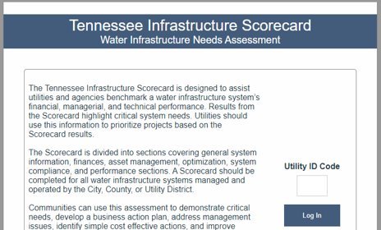
Tennessee Infrastructure Scorecard
TDEC partnered with the Tennessee Association of Utility Districts on developing the Scorecard.
  TAUD supported systems completing the Scorecard.
  TAUD supported data analysis of Scorecard results.
Assesses financial, managerial, operational, and environmental health of a system.
All water, wastewater, and stormwater systems were required to complete the Scorecard to apply for ARP grants.
Scorecard summaries for all systems included in ARP grant application were required to be submitted to TDEC with the grant proposal.
Five critical need areas reflected through the Scorecard.

Slide 12
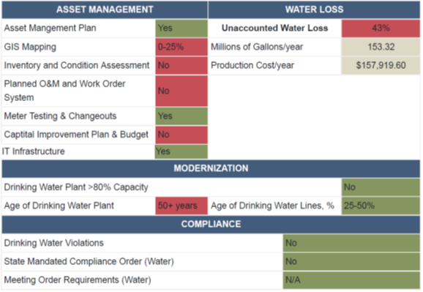
Identifying Critical Needs
Five “Critical Needs” identified
  Significant Non-Compliance
  Asset Management Planning
  Water Loss (for Drinking Water Systems)
  Inflow & Infiltration (for Wastewater Systems)
  Aging & At-Capacity Systems
The non-competitive grant program was built around addressing these “Critical Needs.”
Notes:
Critical Need Thresholds
Significant non-compliance – any
Asset management planning – need all boxes green
Water loss – over 40%
I/I – over 50%
Aging systems – over 50 years; plant capacity >80%
RED on the summary indicates that the critical need area exceeds thresholds
Addressing critical needs in the non-competitive grant proposal is required
Must address at least TWO critical need requirements per utility system on the grant contract
Systems may choose the critical need, other than significant non-compliance
Systems could demonstrate addressing critical needs through non-ARP funded strategies within the timeframe established

Slide 13
Example – Addressing Critical Needs (Drinking Water)
Critical Needs​ | Investigation and Planning​ | Investigation, Planning, and Design​ | Planning, Design, and Construction​ | Construction Only​
Significant Non-Compliance​ | Must establish a CAP/ER within 6 months of the grant award and/or meet the compliance schedule.​ | Must complete any documents (reports, manuals, and construction documents) as required in the Order or CAP/ER and/or must meet compliance schedule.​ | Must get approval of all required documents, including plans and specifications and a construction budget/schedule, that demonstrates all actions outlined in the Order or CAP/ER will be complete to the maximum extent possible within the grant timeline and compliance schedule.​ | Must get approval of all required documents, including plans and specifications and a construction budget/schedule, that demonstrates all actions outlined in the Order or CAP/ER will be complete to the maximum extent possible within the grant timeline and compliance schedule.​
Asset Management​ | Must establish an Asset Management Plan by the end of the grant award.​
Water Loss​ | Must develop a Water Loss Control Plan.​ | Must develop a Water Loss Control Plan and plans and specifications.​ | Must develop a Water Loss Control Plan, plans and specifications, and dedicate at least 25% of the construction budget to water loss OR reduce water loss to below 40% by the end of the grant award.​ | Must dedicate at least 25% of the construction budget to water loss OR reduce water loss to below 40% by the end of the grant award.​
Modernization​ | Must develop an Aging Infrastructure Replacement or Demand Reduction Plan.​ | Must develop an Aging Infrastructure Replacement or Demand Reduction Plan and plans and specifications.​ | Must develop an Aging Infrastructure Replacement or Demand Plan, plans and specifications, and dedicate at least 25% of the construction budget to asset replacement OR reduce plant demand to such a capacity that it doesn’t meet or exceed 80% for 5 years.​ | Must dedicate at least 25% of the construction budget to asset replacement AND/OR reduce plant demand to such a capacity that it doesn’t meet or exceed 80% for 5 years.​

Slide 14
Scorecard Preliminary Takeaways – Asset Management
463 utilities across the State of Tennessee submitted Scorecards
DRAFT
Does your system have a complete Asset Management Plan?
Does your system have an Inventory & Condition Assessment?
Does your system have a digital map?

Slide 15
Scorecard Preliminary Takeaways – Non-Compliance
DRAFT
Has your system had a drinking water violation in the last 5 years?
Is your system meeting all current requirements of the wastewater permit?
Notes:
3% of drinking water systems have mandated compliance orders in place.
99% of those systems under state mandated compliance orders are meeting the requirements
22% of wastewater systems have a mandated compliance order in place
97% of wastewater systems under state mandated compliance are meeting all requirements of the compliance order.

Slide 16
Scorecard Preliminary Takeaways – Drinking Water
463 utilities across the State of Tennessee submitted Scorecards
DRAFT
Does water loss exceed the 40% threshold?
Does the plant capacity exceed 80%?
What percentage of lines are over 50 years old?

Slide 17
Scorecard Preliminary Takeaways – Wastewater
463 utilities across the State of Tennessee submitted Scorecards
DRAFT
Does I/I exceed the 50% threshold?
Does the plant capacity exceed 80%?
What percentage of lines are over 50 years old?

Slide 18
TDEC ARP Water Infrastructure Grants
Preliminary Results

Slide 19
ARP Reporting Metrics
Grant Programs | Amount Allocated | Amount Obligated¹ |  | % of Projects Started² | Funds Available for Disbursement (approved procurements) |  | Funds Disbursed
Non-Competitive Grants | $995,862,283 | $995,862,283 | 100.0% | 99.3% | $854,641,090 | 85.8% | $360,012,320 | 36.2%
Competitive Grants | $214,626,911 | $214,626,911 | 100.0% | 90.0% | $160,659,150 | 74.9% | $24,396,303 | 11.4%
State Strategic Projects – State | $58,458,600 | $58,458,600 | 100.0% | 100.0% | $25,791,768 | 44.1% | $2,672,958 | 4.6%
State Strategic Projects – Local | $36,550,092 | $36,550,092 | 100.0% | 90.9% | $17,390,712 | 47.6% | $73,049 | 0.2%
Administration | $46,000,000 | $46,000,000 | 100.0% | 100.0% | $46,000,000 | 100.0% | $32,783,334 | 71.3%
TOTAL | $1,351,497,885 | $1,351,497,885 | 100.0% | 98.8% | $1,104,482,720 | 81.7% | $419,937,964 | 31.1%
Amount obligated includes all executed contracts
Percentage of all projects started includes all projects with a procurement submission
State Strategic Projects - State Grants include grants for TDOT and TSP
State Strategic Projects - Local Grants include grants for Duck River Utility Commission, Tipton County, Grundy County (2) and Erwin Utilities (approved 3/27/25)

Slide 20
ARP Grant Funds Distribution Status
1
Total Funds Obligated to Grantees
$1.3B
84% of obligated funds have an associated
procurement submitted
2
Total Procurements Submitted (Awarded Vendor Contract)
$1.1B
3
97% are approved
(2,481 procurements approved)
Total Procurements Approved (Awarded Contract)
$1.06B
Optional Pre-Award Reviews
4
42% of approved procurement dollars have submitted for reimbursement
Pre-Award Submitted | $41.9M
Pre-Award Approved | $23.9M
Submitted for Reimbursement
$447.6M
5
Total Paid
$387.2M
87% of requested reimbursements
*Does not include administrative expenses.

Slide 21
ARP Program Status Update
392 Grants
1470 Projects*
$387,154,630 Paid
Text
Text
Text
Construction Projects
Completed Projects*
Completed Grants
826
63
7
*Inclusive of grant admin, engineering, and construction projects
Notes:
Vena

Slide 22
Questions?
Notes:
Speaker: Jaamal

Slide 23
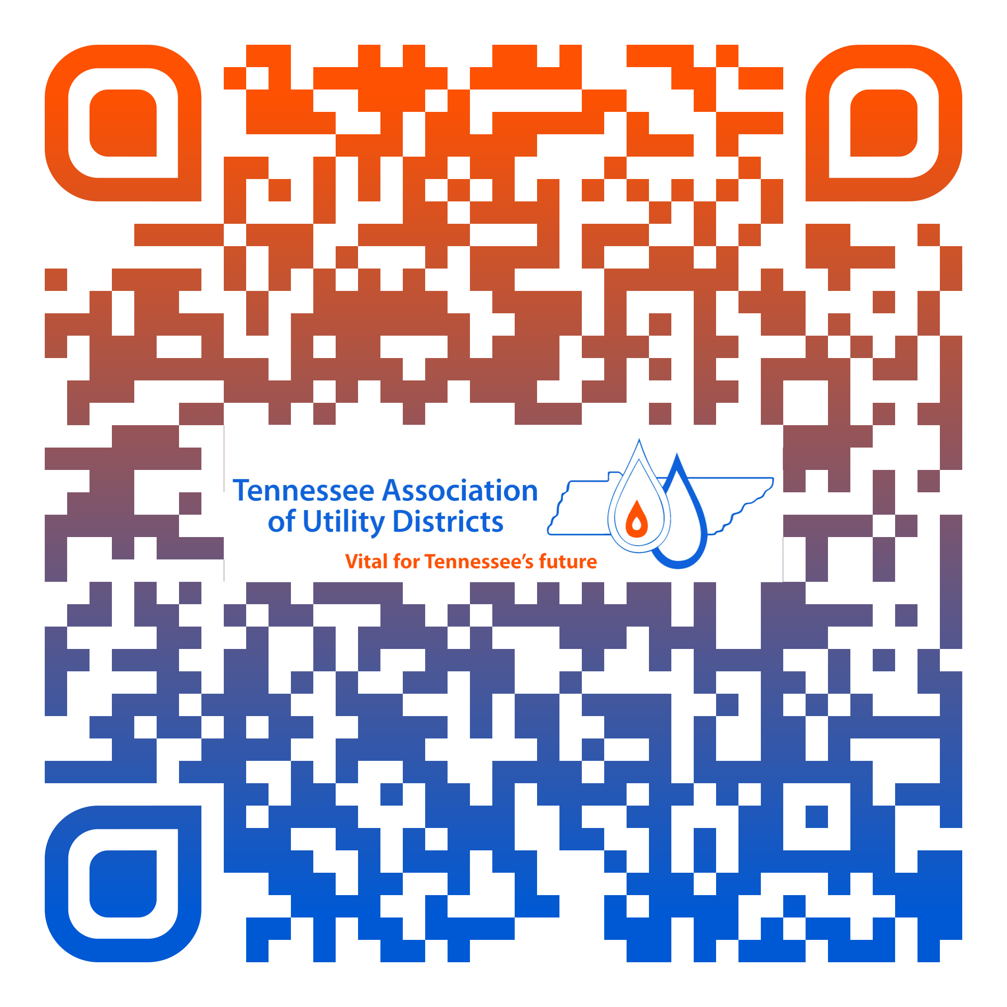
Scan QR for Credit

