Slide 1

Fraud, Waste, and Abuse in Utility Districts
Alan Dover
Chief Investigative Counsel

Slide 2
Disclaimer
The views expressed herein are solely those of the presenter, and not necessarily the views of Comptroller of the Treasury, or the Division of Investigations.
The information provided herein does not constitute legal advice and does not establish an attorney-client relationship. Adherence to the law remains the sole responsibility of each public agency and official, and the information contained in this presentation cannot be used as a defense to any civil or criminal violations that may occur from noncompliance with legal requirements or obligations.

Slide 3
About Our Team
The Comptroller’s Office is responsible for the audit of state and local governmental entities and participates in the general financial and administrative management and oversight of Tennessee state government.
The Tennessee Comptroller of the Treasury has a wide range of responsibilities to ensure fiscal integrity within the State of Tennessee. We are committed to our mission to Make Government Work Better.

Slide 4
Division of Investigations
The Division of Investigations was created in 2016 and supports the office’s audit function by investigating allegations of fraud, waste, and abuse in government and publicly-funded entities and by working closely with law enforcement and prosecutors on criminal allegations.
The division reports the results of its investigations, including significant internal control and compliance deficiencies noted during the investigations, to the appropriate parties and the public.

Slide 5
Division of Investigations
Comptroller investigations are generally limited to government and publicly-funded entities (such as public utility districts incorporated under Tenn. Code Ann. §§ 7-82-201 – 204)
However, the Comptroller’s Office also has purview over entities that contract with the government to provide services in some situations. We can also assist in the investigation of private businesses/private funds under certain situations at the request of a district attorney.

Slide 6
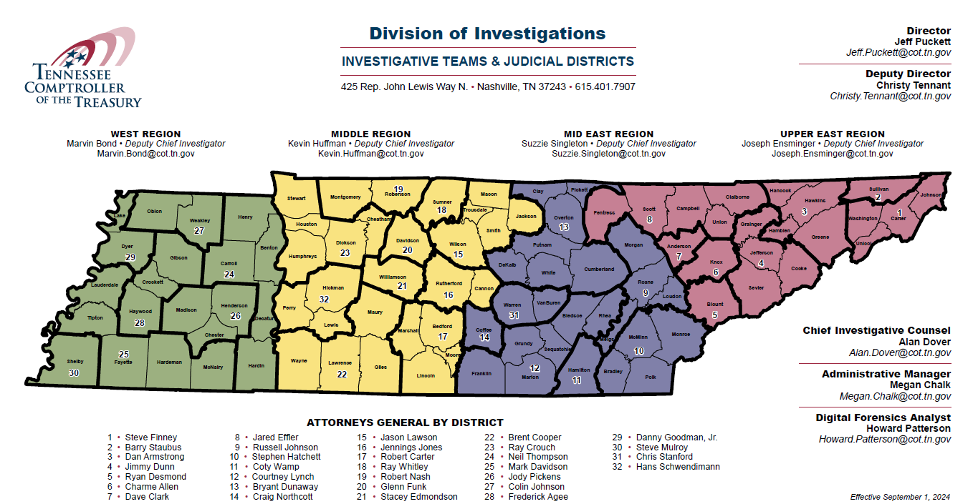

Slide 7
Fraud, Waste, and Abuse
Fraud – An intentional deception that violates a law or the public trust for personal benefit or the benefit of others.
Waste – Behavior involving the extravagant, careless, or needless use of government funds, property, and/or personnel.
Abuse – Behavior involving the use of government funds or property that a prudent person would not consider reasonable and necessary business practice given the facts and circumstances.

Slide 8
Examples
Each of these examples resulted in a public investigative report.
Some of these examples resulted in criminal charges.

Slide 9




Who Commits Fraud?

Slide 10
The Fraud Triangle
(Donald Cressey)
Pressure: debt, excessive financial obligations
Opportunity: lack of controls, easily removed assets
Rationalization: entity culture, personal justification

Slide 11
Misappropriation of Money and Time

Slide 12
Misappropriation of Money and Time
Clerk misappropriated over $400 in 1 year by pocketing cash collections. She concealed it by falsifying documentation or failing to document collections at all.

Slide 13
Misappropriation of Money and Time
  So what is the worst that can happen, it’s only $400.
  Theft under $1,000 (Class A Misdemeanor)
  Tampering or Fabrication of Government Records (Class E Felony)
  Forgery (Class E Felony)
  Official Misconduct (Class E Felony)
  Felony Convictions could also result in collateral consequences such as loss of professional licenses, and retirement benefits.

Slide 14
Misappropriation of Money and Time
Clerk misappropriated over $5,000 over seven months by abusing the clerk’s purchasing/requisitioning duties – buying purses, headphones, tools – and concealing it by deceptive entries on purchasing documents. A purse was called a “large utility tote,” for instance.
  Used utility’s tax exemption.

Slide 15
Baggallini Gold Provence Travel Purse & Cynthia Rowley Phone Wallet

Slide 16
Misappropriation of Money and Time
Possible Consequences:
  Theft Over $2,500 (Class D Felony)
  Falsification / Tampering with Government Records (Class E Felony)
  Forgery (Class D Felony) – Graded as Theft
  Official Misconduct
  Collateral Consequences including loss of professional license and retirement benefits.

Slide 17
Misappropriation of Money and Time
A payroll clerk was in charge of processing her own checks. She paid herself over $6,000 in unauthorized compensatory leave, annual leave, excess salary, and other payroll benefits.
  The clerk concealed her misappropriation by making conflicting statements to the district’s external accountant and its board chairman about why her paychecks were so large.
  This investigation resulted in criminal charges.

Slide 18
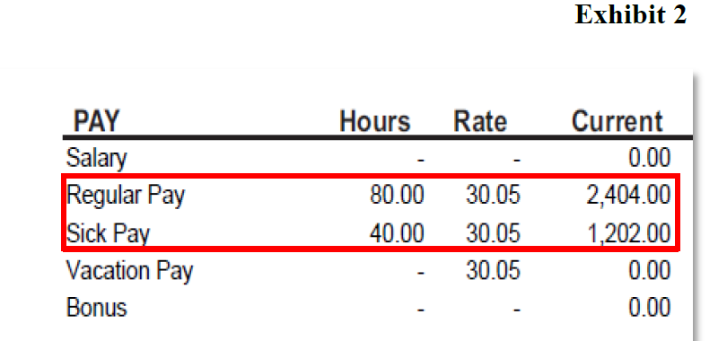
Misappropriation of Money and Time

Slide 19
Misappropriation of Money and Time
  Criminal Charges
  This investigation involved criminal charges including Theft of Property over $2,500, Destruction of and Tampering with Government Records, and Official Misconduct.

Slide 20
Misappropriation of Money and Time
Two employees misappropriated over $10,000 over 4 years by falsely reporting time they didn’t work.

Slide 21
Misappropriation of Money and Time
The employees’ actions could result in charges for Theft over $10,000, Falsification of Government Records, Forgery, and Official Misconduct.

Slide 22
Misappropriation of Money and Time
Department director created false invoices and cashed checks totaling over $1,000,000.00.
  Created over 300 false invoices to support the checks
  Forged signatures of board members and vendors
  Falsified budget-to-actual reports were given to the board

Slide 23
Misappropriation of Money and Time

Slide 24
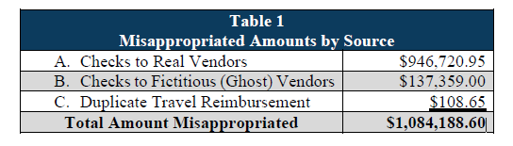
Total Misappropriation Breakdown

Slide 25
Misappropriation of Money and Time
Possible Charges:
  Theft of Property over $250,000 (Class A Felony)
  Tampering / Fabricating Government Records (Class E Felony)
  Forgery (Class A Felony)
  Official Misconduct

Slide 26
Use of utility resources for private purposes

Slide 27
Use of public resources for private purposes
District Manager used district equipment and supplies for work on personal property:
  shingles and gutter installation for own home
  concrete at a commissioner’s home
  used district’s compact track loader at a private worksite for pay
  district garage and equipment to work on personal vehicles
  This investigation resulted in criminal charges

Slide 28
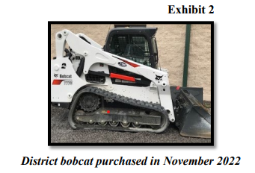
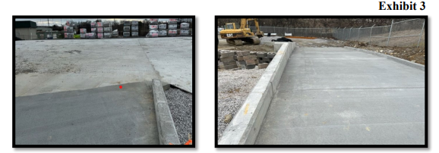
Use of public resources for private purposes

Slide 29
Use of public resources for private purposes
The resulting Criminal Charges were presented:
  Theft of Property over $10,000
  Theft of Property less than $1,000
  Three Counts of Official Misconduct

Slide 30
Use of public resources for private purposes
A technician purchased at least $1,900 in gas using district funds.
  This investigation resulted in criminal charges

Slide 31
Failure to Provide Oversight

Slide 32
Misappropriation of Money and Time
Bookkeeper misappropriated at least $685,404 by falsifying bank records.
  The original bank records were modified to conceal that funds were being taken.
  County became aware when payroll was not processing properly, and additional financial harm followed.
  This investigation resulted in criminal charges.

Slide 33
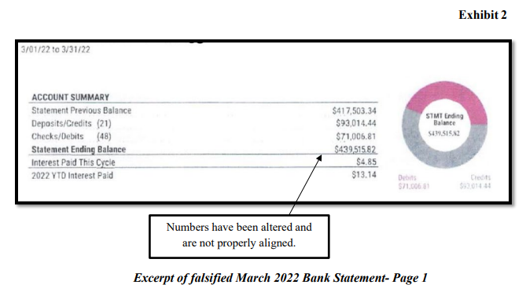

Slide 34
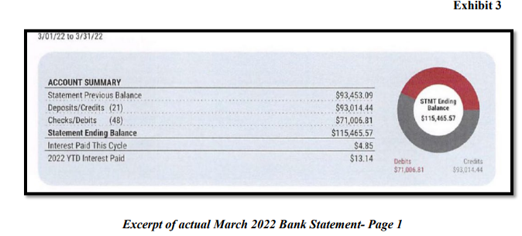

Slide 35
Misappropriation of Money and Time
The Bookkeeper was charged with one count of Theft of Property over $250,000, one count of Official Misconduct, and one count of Tampering with Government Records.
The Subject plead guilty and was sentenced to 15 years in TDOC.

Slide 36
Failure to Provide Oversight
Deficiency examples:
  Management did not provide adequate oversight regarding actual hours worked and hours reported
  The board did not sufficiently oversee projects, management decisions, and expenses
  District management did not adequately account for consumable assets
  The board and management failed to properly oversee district operations, which contributed to multiple purchasing deficiencies

Slide 37
Failure to Provide Oversight
  Deficiencies often include something like the following phrase:
  “Failure to provide proper oversight increases the risk that errors or misappropriations will occur without prompt detection.”

Slide 38
Failure to Provide Oversight
Separation of duties – allowing one individual to have complete control over the use and accounting of funds increases the risk of fraud.
Retain supporting documentation…
And regularly review the documentation – making sure that original records are reviewed regularly by multiple people is valuable prevention.
Require two signatures on checks

Slide 39
Reporting Requirements for Public Officials
T.C.A. § 8-4-503
Public officials with a reasonable belief that unlawful conduct has occurred shall report the information in a reasonable amount of time to the office of the comptroller of the treasury.
“Reasonable amount of time” means 5 days or less
“Unlawful conduct” means theft, forgery, credit or debit card fraud, or any other act of unlawful taking, waste, or abuse of, or official misconduct involving, public money, property, or services.

Slide 40
Fraud, Waste and Abuse Hotline
If you observe an agency director or employee engaging in any activity which you consider to be illegal, improper or wasteful, please call the State Comptroller's Toll-Free Hotline:
1.800.232.5454

Slide 41

Comptroller Website – Investigations https://www.comptroller.tn.gov/office-functions/investigations.html

Slide 42
Thank you for the work you do!
Alan Dover
Chief Investigative Counsel
Comptroller of the Treasury
Division of Investigations
425 Rep. John Lewis Way N.
Nashville, TN 37243
Alan.Dover@cot.tn.gov
Direct Line 865.685.5521
Cell 615.934.8843

Slide 43
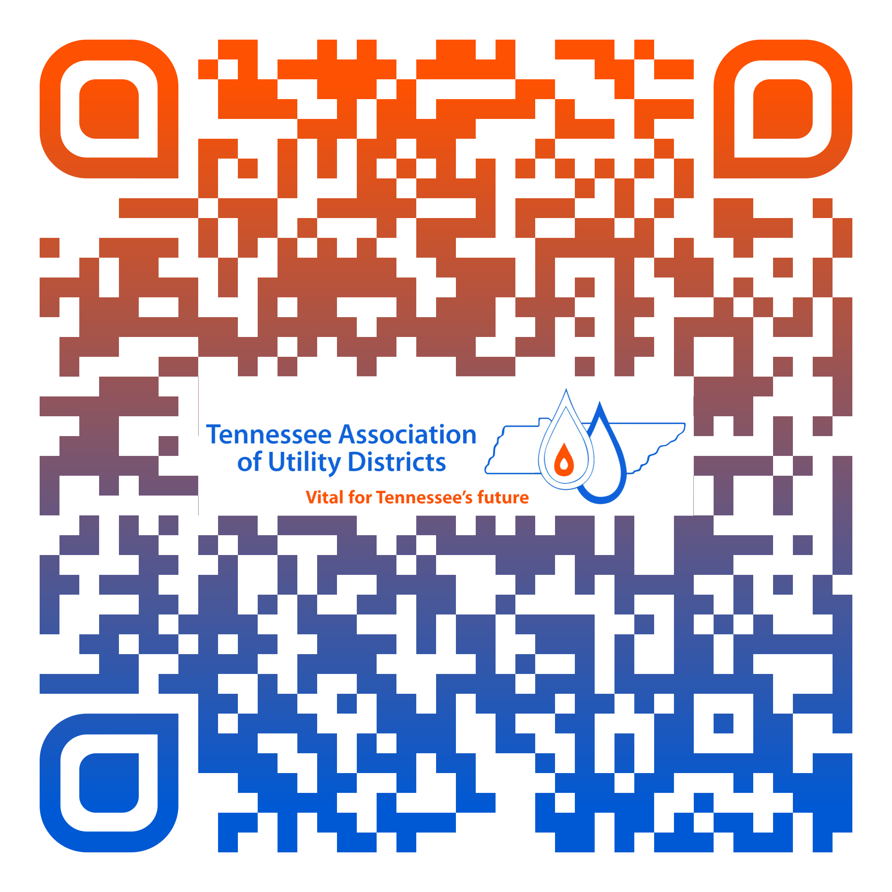
Scan the QR code for credit

