Slide 1
SRF 101: Why Debt is a Strategic Investment for Utilities
October 29, 2025

Slide 2
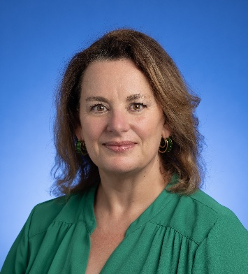
Vena Jones
Program Manager
State Revolving Fund &
State Water Infrastructure Grants
Notes:
Vena, we could not find the full-resolution image of your headshot. Please replace this image if appropriate

Slide 3
TDEC's Water Infrastructure Assistance Programs
The Division of Water Resources (DWR) has three primary water infrastructure funding assistance programs for drinking, waste, and stormwater projects
These programs assist utilities in meeting compliance requirements of the Safe Drinking Water Act, Clean Water Act, and TN statute and rules for water infrastructure
DWR provides water infrastructure grants and loans to public or private entities that provide public water and sewer services
State Revolving Fund Loan Program (SRF)
State Water Infrastructure Grant Program (SWIG)
American Rescue Plan (ARP) Competitive and Non-Competitive Grants
Notes:
Paula

Slide 4
SWIG and SRF
The Tennessee Department of Conservation (TDEC) works diligently to provide Tennessee communities with clean, safe, and reliable water systems. TDEC works to accomplish this through its Division of Water Resources, via their SRF Loan Program and SWIG Program.
The Clean Water (CW SRF) and Drinking Water State Revolving Fund (DW SRF) Loan Program is has provided billions in assistance since its inception.
Provides low-interest loans and assistance to cities, counties, utility districts, and stormwater authorities for planning, design, and construction phases of drinking water, wastewater and stormwater systems.
SRF is designed as a federal-state partnership to assist public water systems to remain compliant with federal-state requirements.
The State Water Infrastructure Grants (SWIG) office is a part of TDEC’s Division of Water Resources and supports the rollout of SRF funds, as well as ARP funds through grant programs.
This office promotes TDEC’s mission to protect and improve water quality across the state by helping communities afford compliant wastewater and stormwater systems.
SRF Loan Program
SWIG Program

Slide 5
Building the Case for Smart Investment

Slide 6
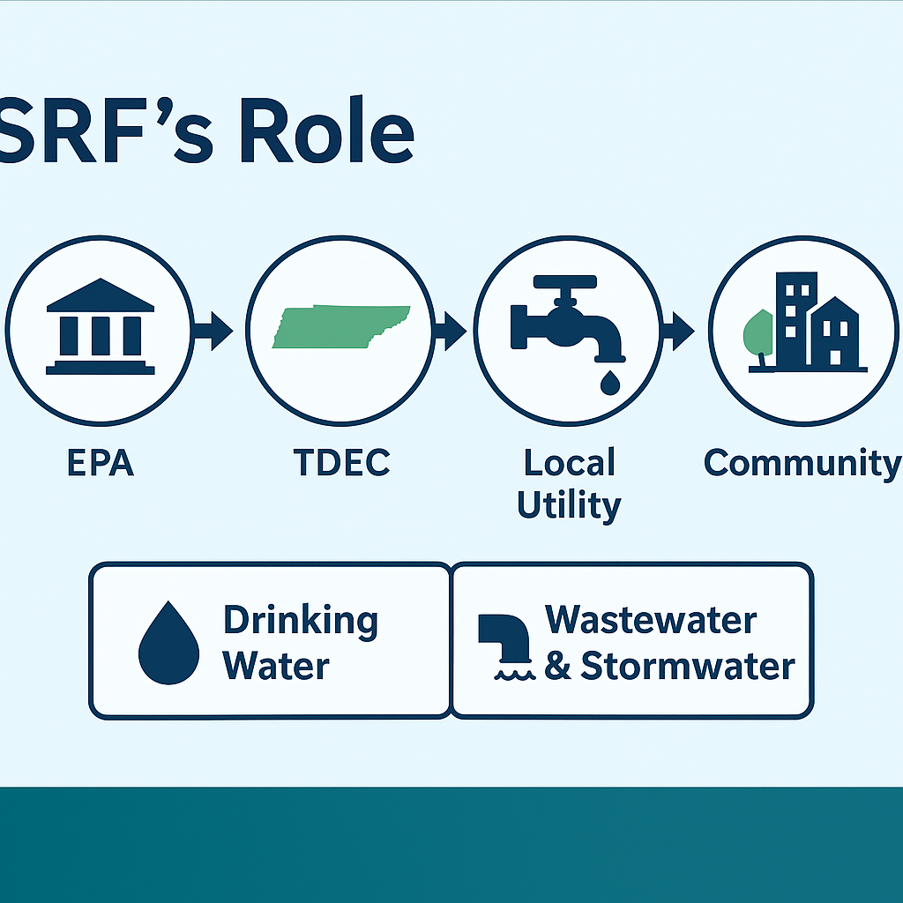
Purpose of Today’s Discussion
We’ll explore how SRF financing works, why structured debt benefits utilities, and how Tennessee’s utility can build infrastructure resilience with strategic funding

Slide 7
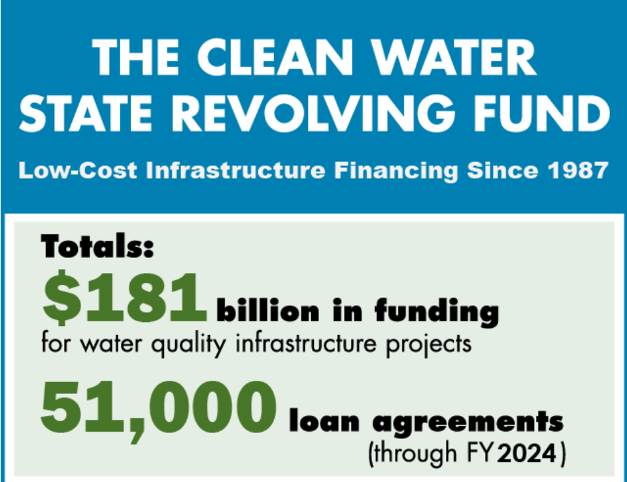
The Funding Challenge
Aging systems, inflation, and regulatory pressure have created a funding gap
Grants alone can’t sustain progress — SRF fills that space

Slide 8
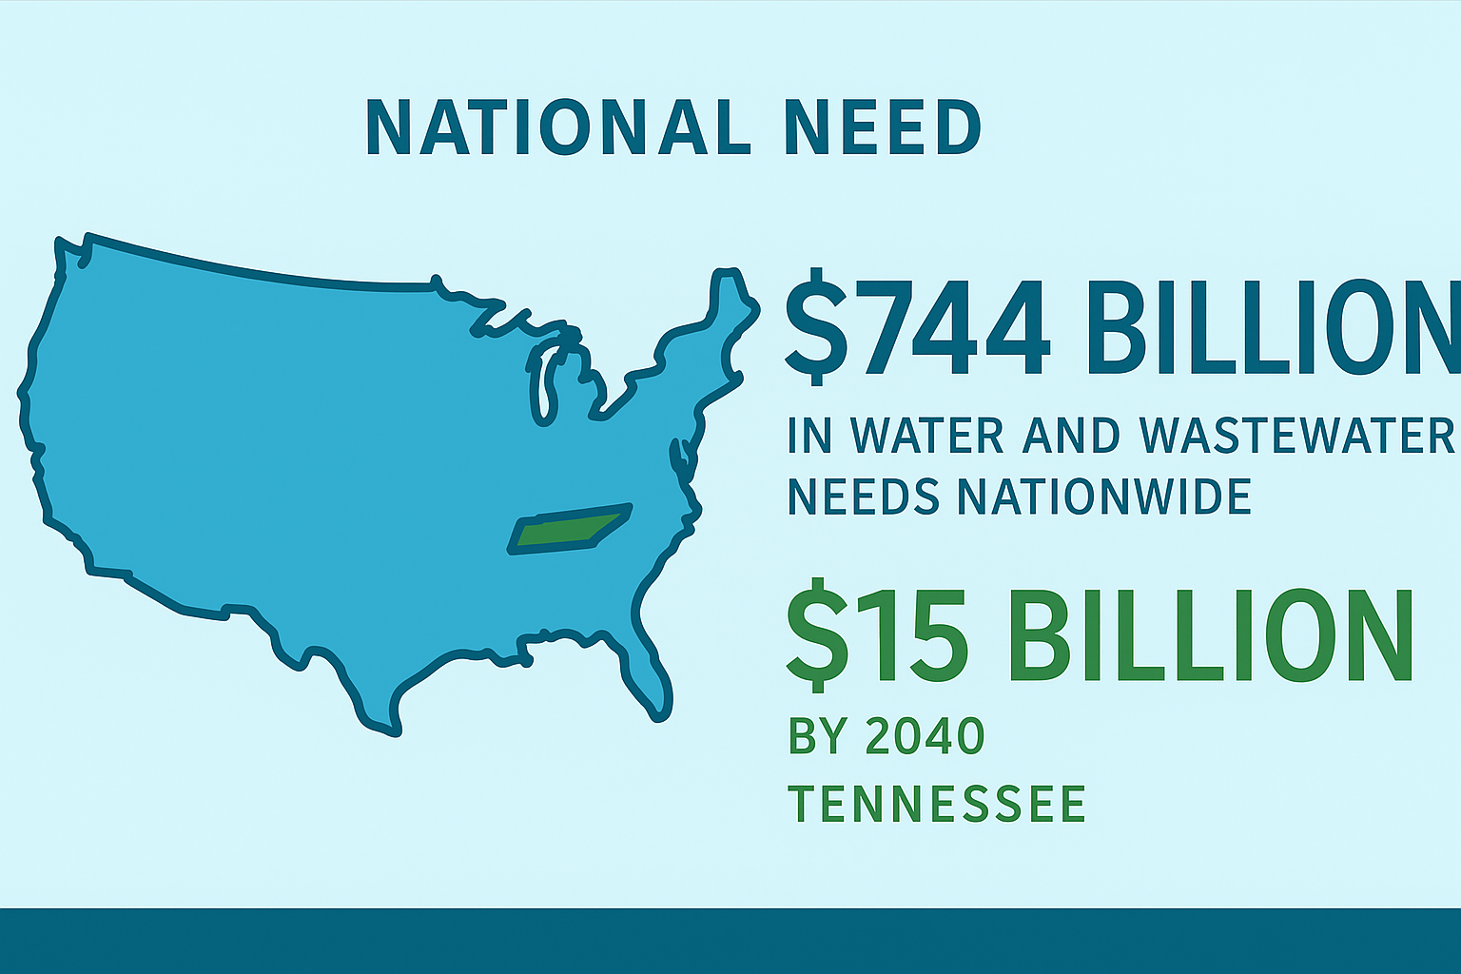
The National Need
EPA estimates $744 billion in water and wastewater needs nationwide
Tennessee’s share will exceed $15- 50 billion by 2040

Slide 9
Funding Strategy for Water Infrastructure
American Rescue Plan Grants
State Revolving Fund Loans
USDA Rural Development Grants and Loans
Community Development Block Grants
Infrastructure Investment and Jobs Act
State Water Infrastructure Grants
State Revolving Fund Loans

Slide 10

SRF’s Role in Tennessee
TDEC’s SRF program provides low-interest loans, long repayment terms, and principal forgiveness to support local infrastructure investments

Slide 11
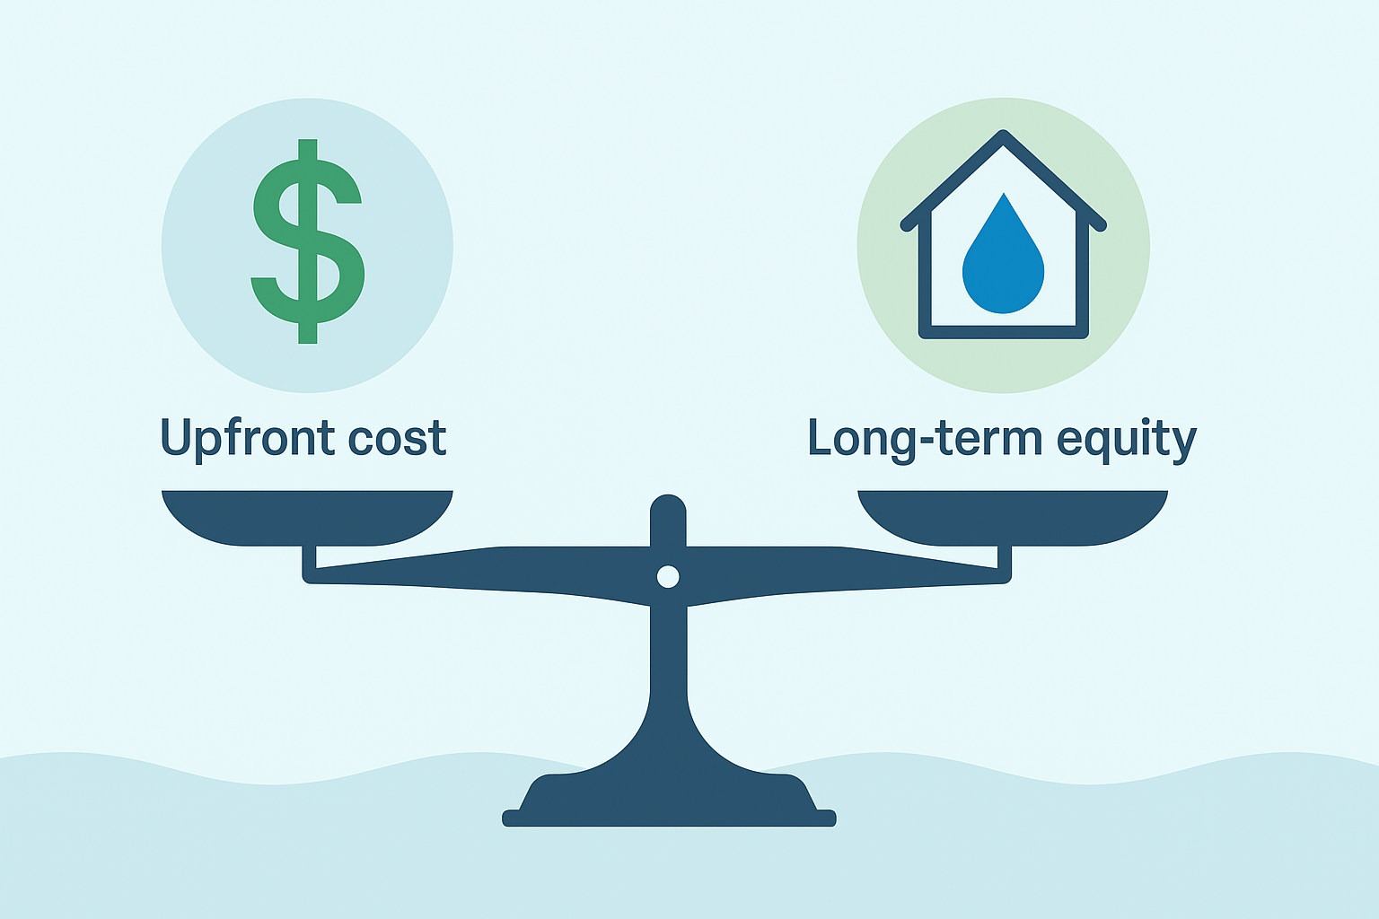
Use Strategic Debt
Strategic debt spreads infrastructure costs across generations — ensuring fairness and long-term system health

Slide 12
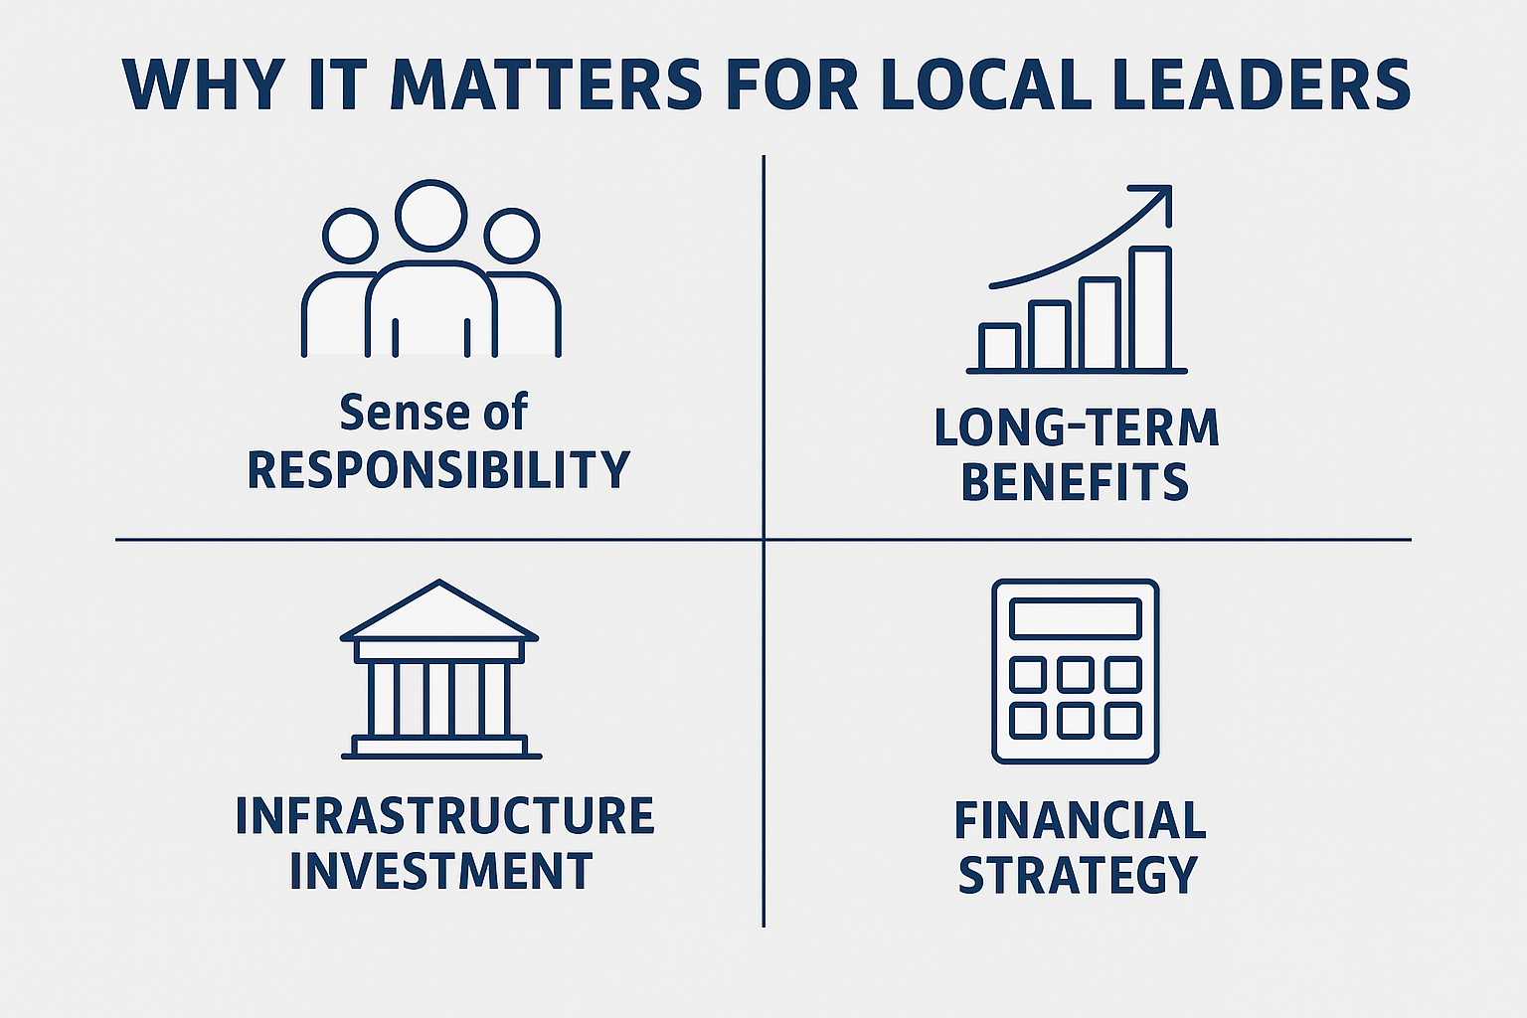
Why This Matters for Local Leaders
Every community must eventually invest in infrastructure. SRF makes it possible to do so responsibly, affordably, and sustainably

Slide 13
How the State Revolving Fund Works

Slide 14
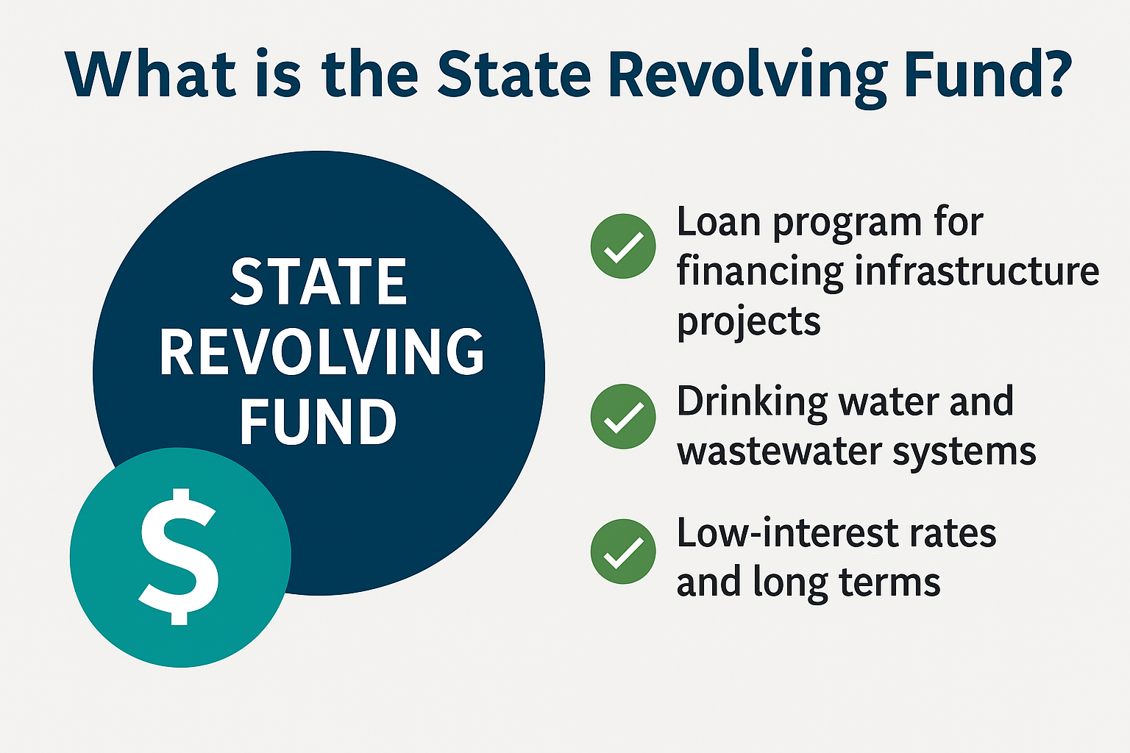
What is the State Revolving Fund?
A self-replenishing loan program that provides affordable financing for drinking water and wastewater infrastructure

Slide 15
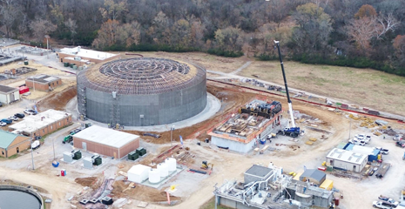
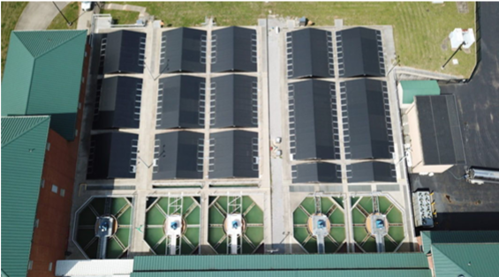
Tennessee’s Dual SRF Programs
CWSRF: Wastewater, stormwater, and reuse projects
DWSRF: Drinking water, treatment, and distribution projects

Slide 16
What SRF Funds: Drinking Water
Water Quality Issues
Compliance Issues
Source or Capacity Challenges
Water Storage
Leakage Problems
Pressure Issues
Replacement or Rehabilitation Needs
Water Line Extensions
Regionalization & Consolidation
New Drinking Water Systems
Projects and activities not eligible for funding and primarily intended for the following:
Future growth
Economic development
Fire protection
Laboratory fees for monitoring
Operation and maintenance expenses

Slide 17
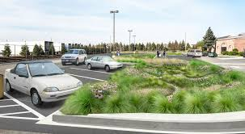
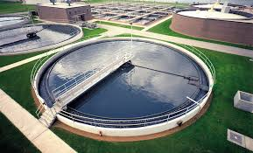
What SRF Funds: Wastewater & Stormwater
Compliance Issues
Construction of wastewater facilities
Control non-point source pollution
Decentralized wastewater treatment systems
Green infrastructure projects
Water quality projects
Stormwater management
Consolidation
Water reuse
Asset management
Capacity management

Slide 18
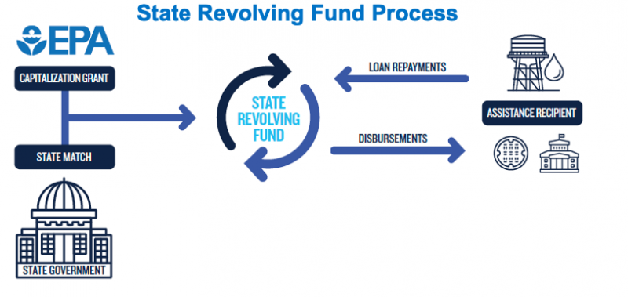
How SRF is Capitalized
Federal EPA grants + state match + repayments = a perpetual fund for Tennessee communities

Slide 19
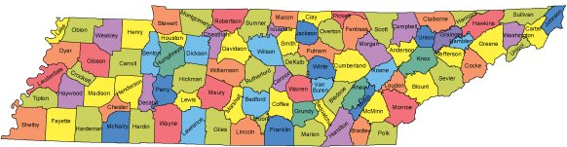
The Scale of Tennessee’s SRF
Over $2 billion invested across 400+ utilities statewide — from Memphis to Mountain City
$2,000,000,000

Slide 20
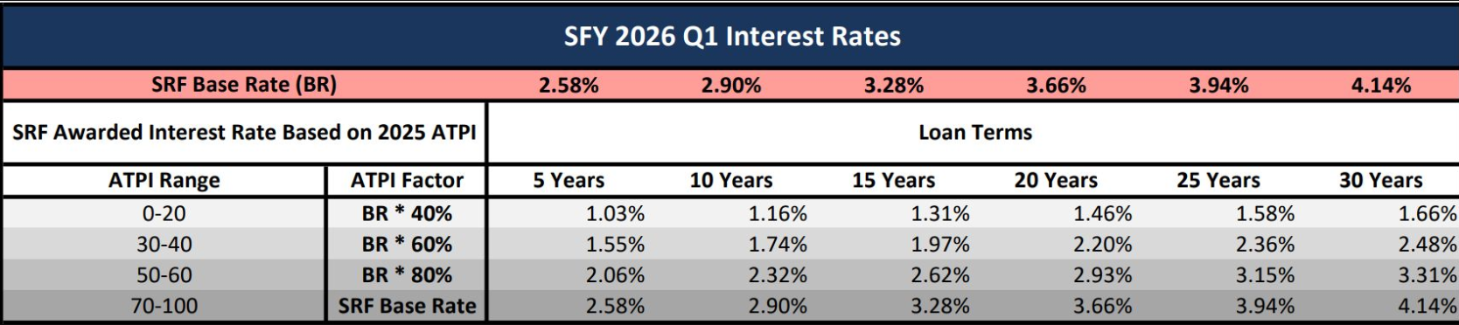
The SRF Interest Rate Advantage
Tennessee SRF interest rates: 1.0–3.0% vs. municipal bonds at 4–6%

Slide 21
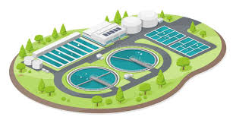
$10M Project Amortized over 20 Years
SRF Loan (1.5%) = $12.5M total
Bond (4.5%) = $18.2M
Savings: ~$6M in avoided interest

Slide 22
SRF Principal Forgiveness: Subsidy and Disadvantaged Communities Program
Low ATPI (0-10): very economically disadvantaged. Eligible for up to 50% in principal forgiveness
Mid-range (20–30): moderately economically disadvantaged. Eligible for up to 40% principal forgiveness
High-range (40-50): slightly economically disadvantaged. Eligible for up to 30% principal forgiveness
Financially disadvantaged economic status based on the SRF Ability to Pay Index (ATPI) scores of 50 or less

Slide 23
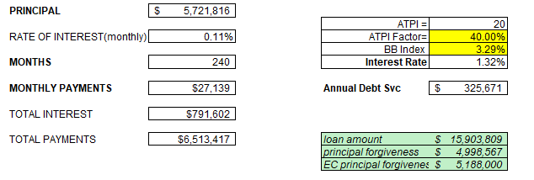
Clifton 1.5 MGD Drinking Water Treatment Plant
Currently Clifton is treating and selling about 0.4MGD
Clifton is in Wayne County
No active partners but has been identified as a regional source in near future for county

Slide 24

What Happens to Repayments: The Revolving Model
Loan repayments create new funding cycles — a self-sustaining investment structure
Allows SRF to provide additional, new loans to utilities
If managed well, SRF can operate in perpetuity for the benefit of TN utilities for years to come

Slide 25

Local Control, State Stewardship
Communities own and operate projects; TDEC ensures accountability and compliance
SRF evaluates local conditions
Low rates
Principal forgiveness
Help improve and maintain compliance

Slide 26
The Strategic Power of Debt

Slide 27

Why Debt Isn’t a Four-Letter Word
Structured debt builds infrastructure faster, fairly, and affordably

Slide 28

Intergenerational Fairness
Those who use the system tomorrow help pay for it — keeping today’s rates stable

Slide 29
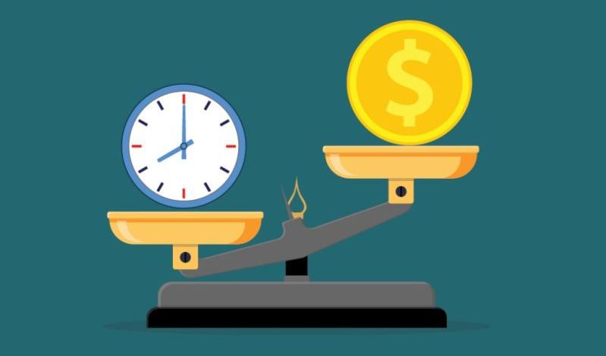
The Cost of Waiting
Deferring projects leads to emergency repairs, penalties, and inflationary costs

Slide 30
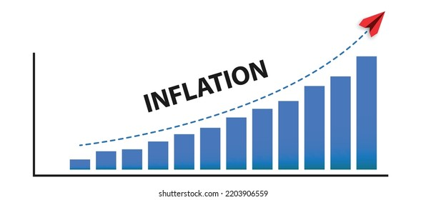

Deferred Cost: Can you afford it?
$5M project delayed five years = $6.8M total at 6% inflation
Harriman Utility Board Regionalization
ICE of $12M
Actual cost $20M
Columbia Power and Water
ICE of $125M
Actual cost $500M
Springfield wastewater
ICE of $15M
Actual cost $74M

Slide 31
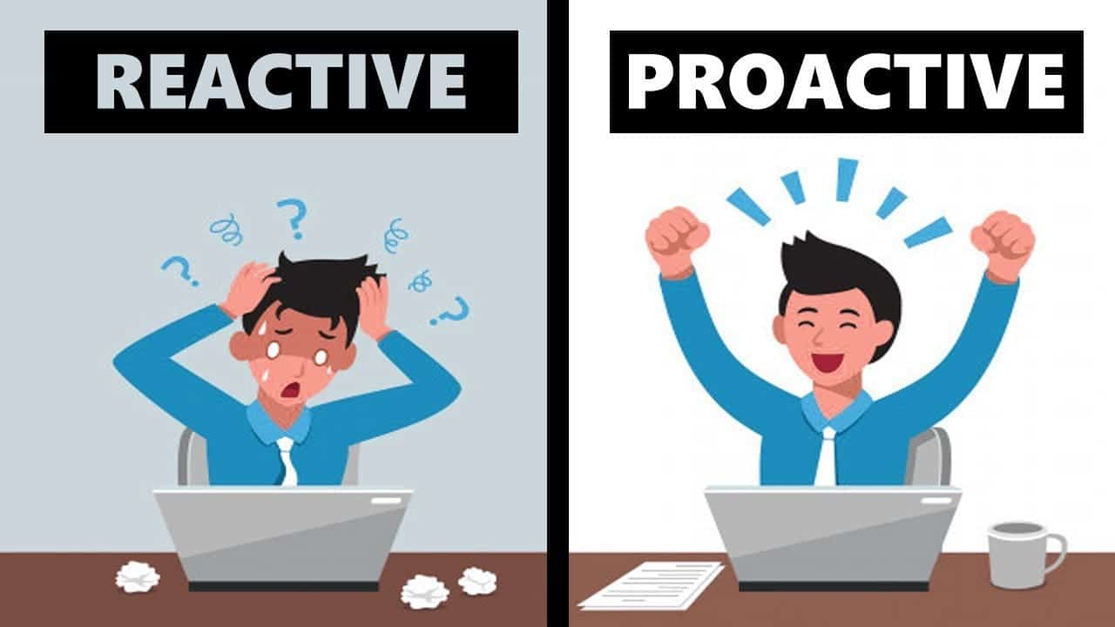
Strategic vs. Reactive Debt
Strategic = low-rate, planned, predictable, manageable costs
Reactive = emergency, high-cost, less flexible, fewer choices, larger financial burden

Slide 32
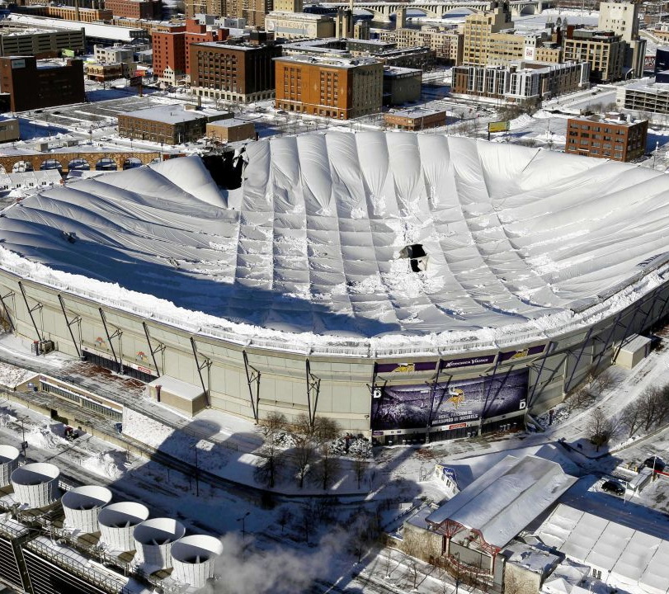
The True Cost of Avoiding Debt
Communities that avoid borrowing often pay more through reactive spending and inflation
Communities with degraded infrastructure struggle to maintain or improve economic conditions.
Failing infrastructure is not an economic driver
Notes:
Shows Metrodome roof collapse

Slide 33
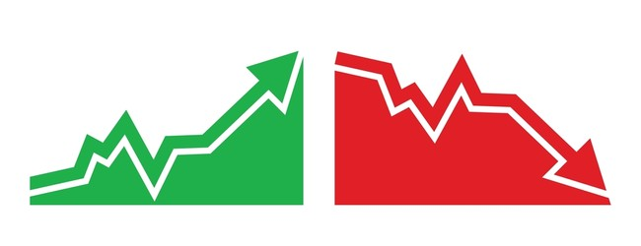

Fiscal Predictability
SRF loans are fixed-rate and long-term — protecting against market volatility
Super low interest
Loan forgiveness
Compatible with other funding programs strategies

Slide 34
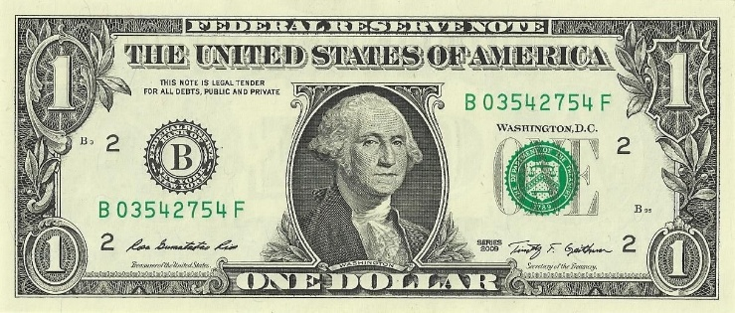
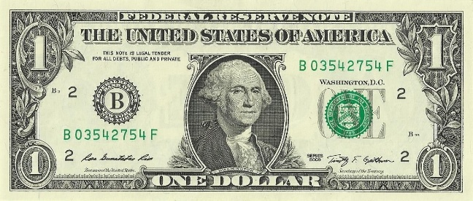
Economic Multiplier
Every $1 in SRF funding = $2–$3 in local economic activity

Slide 35

Debt as an Investment
Planned borrowing strengthens systems, creates jobs, and supports economic growth

Slide 36
Managing Debt with Confidence

Slide 37

Debt Management Principles
Borrow only for long-term assets
Match debt term to asset useful life
Maintain reserve funds
Always account for depreciation

Slide 38
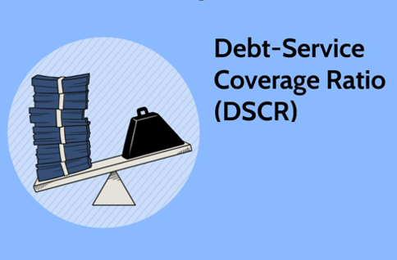
Key Financial Metrics
Debt Service Coverage Ratio (DSCR)
1.2
Depreciation
Annual debt service
Rate supported predictions
Security deposits
Lien position

Slide 39
Rate Planning
Rate Planning is a simple process of designing and adjusting utility rates
Recover costs
Meet regulatory requirements
Support policy goals
Typical action is a Cost-of-Service study to evaluate and allocate expenses across various customer classes
Use 5–10-year projections to manage both SRF repayments and future capital improvements

Slide 40
Forecasting a Future
Forecasting predicts future demand, costs, and revenues — essential for rate setting and long-term planning.
Load forecasting: Predicting energy or water demand (hourly, daily, seasonal, long-term).
Revenue forecasting: Estimating how rate changes or demand fluctuations affect revenues.
Cost forecasting: Anticipating energy prices, infrastructure costs, and regulatory compliance expenses.
Customer forecasting: Predicting growth or decline in customer numbers by class or region.

Slide 41
Rate Planning and Forecasting
 | Forecasting | Rate Planning
Data Collection | Historical usage, weather, population, and economic data | Identify rate base and cost drivers
Forecast Demand & Costs | Predict energy/water usage and expenses | Determine revenue requirement
Design Rates | Use forecasts to project customer impacts | Develop fair, balanced rate structures
Test & Adjust | Model scenarios (high/low demand) | Adjust rates for revenue stability
Regulatory Review | Provide forecasting evidence | Justify proposed rate adjustments

Slide 42

Communicating Debt Decisions
Explain why SRF debt supports rate stability and long-term reliability — not short-term fixes

Slide 43


Transparency Builds Trust
Open communication about debt improves ratepayer confidence and political stability

Slide 44
Funding Opportunities in SRF and SWIG

Slide 45
SWIG and SRF
The Tennessee Department of Conservation (TDEC) works diligently to provide Tennessee communities with clean, safe, and reliable water systems. TDEC works to accomplish this through its Division of Water Resources, via their SRF Loan Program and SWIG Program.
The Clean Water (CW SRF) and Drinking Water State Revolving Fund (DW SRF) Loan Program is has provided billions in assistance since its inception.
Provides low-interest loans and assistance to cities, counties, utility districts, and stormwater authorities for planning, design, and construction phases of drinking water, wastewater and stormwater systems.
SRF is designed as a federal-state partnership to assist public water systems to remain compliant with federal-state requirements.
The State Water Infrastructure Grants (SWIG) office is a part of TDEC’s Division of Water Resources and supports the rollout of SRF funds, as well as ARP funds through grant programs.
This office promotes TDEC’s mission to protect and improve water quality across the state by helping communities afford compliant wastewater and stormwater systems.
SRF Loan Program
SWIG Program

Slide 46
What Does SRF and SWIG Fund?
Lead Service Line inventories and replacements
Grants and loans
Stormwater master planning and construction projects
Grants and loans
Addressing PFAS, microplastics, and other emerging contaminants
Drinking water, wastewater, and stormwater utilities
Grants and loans
Planning and design for small or disadvantaged communities
Currently as loans, transitioning to grants
Traditional wastewater plant and pipe projects
Loans
Non-traditional wastewater and stormwater projects
Stream and wetland restoration

Slide 47
SRF Principal Forgiveness: Subsidy and Disadvantaged Communities Program
Low ATPI (0-10): very economically disadvantaged. Eligible for up to 50% in principal forgiveness
Mid-range (20–30): moderately economically disadvantaged. Eligible for up to 40% principal forgiveness
High-range (40-50): slightly economically disadvantaged. Eligible for up to 30% principal forgiveness
Financially disadvantaged economic status based on the SRF Ability to Pay Index (ATPI) scores of 50 or less

Slide 48
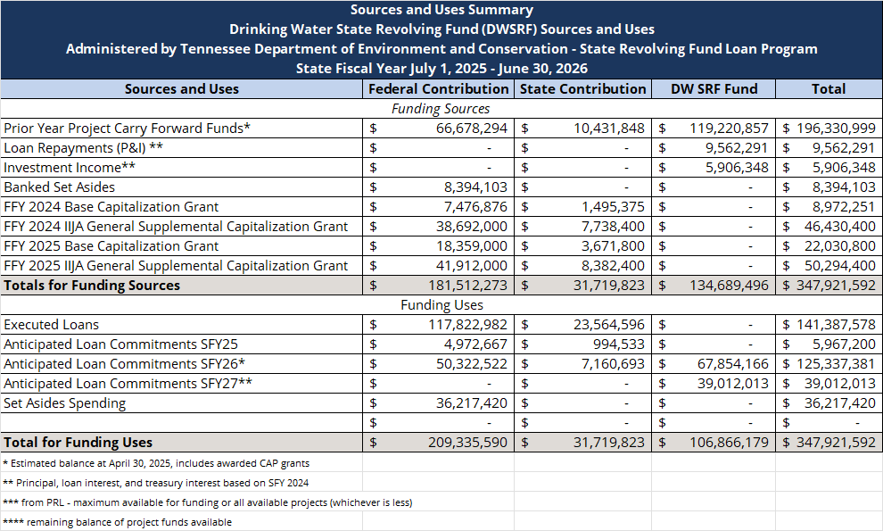
DWSRF IUP: Financial Status
Notes:
Federal Contribution column shows federal cap grant funds available. State contribution column shows state match funds available. SRF Fund column shows revolving fund balance.

Slide 49
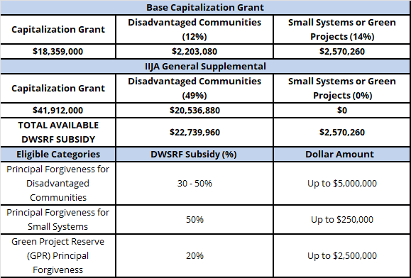
DWSRF Loan Forgiveness for Traditional Projects
30-50%

Slide 50
SRF Lead Service Line Replacement Funding
For entities seeking funding via a loan for lead service line replacement activities, the following applies:
$202M available
0.5% interest rates on LSL loans for ANY entity, large or small, disadvantaged or not
50% principal forgiveness for any disadvantaged community regardless of size
Funds are expiring soon!

Slide 51
Clean Water SRF: Financial Status

Slide 52
CWSRF Subsidy for Traditional Projects

Slide 53
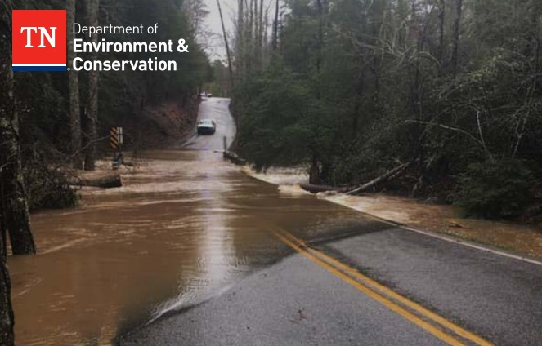
SRF Opportunities
November 17th – January 5th
Clean Water
Traditional and Non-traditional Projects
Helene Disaster Funding
$7.8 million to address wastewater and stormwater systems directly impacted by Hurricane Helene
Drinking Water
Traditional and Non-traditional Projects
Lead Service Line Replacement
Helene Disaster Funding
$42 million to address drinking water infrastructure directly impacted by Hurricane Helene

Slide 54
Applying and Making the List
SRF can only loan money to applicants with projects on a Priority Ranking List
Solicitation for SRF funding is November 17 – Jan 5th
Applicants seeking funding must submit a Questionnaire
Access to Questionnaires is through the grants management system (GMS) portal at TDEC
Applicants must meet rankability requirements to be scored and placed on the list of fundable projects.
Projects are scored based on multiple variables, including those that address reducing risks to human health or those working to maintain or improve compliance with SDWA or CWA

Slide 55
Proposed Projects, Rankability, and the PRLs
The term Rankablility refers to an applicant's ability to meet the following criteria:
Applicants must attest to:
The community submitted the last 3 fiscal years of audited financial statements to the comptroller’s office; and
A facilities plan or other planning document has been or is being developed for this project.

Slide 56
Ranked vs Unranked Projects
Ranked Projects
The PRL contains a list of all eligible projects that entities provided during the solicitation period. All projects that meet the definition of rankability were scored, ranked, and listed above the Ranking Line on the PRL
Unranked Projects
Did not meet the minimum rankability criteria
Projects not ranked are listed below the Ranking Line.
In the event ranked projects are bypassed and additional funds are available, SRF will reach out to unranked applicants and provide an opportunity to correct deficiencies, get ranked, and continue through the funding process.

Slide 57
Funding Projects
Scored projects are ranked based on the highest number of priority points awarded. Rankable projects appear on the SRF Priority Ranking List (PRL)
Applicants on the PRL will receive a notification letter via GMS about 120 days after submission
Applicants that do not respond to the funding notification letter within 30 days will be bypassed
Unranked projects will be invited to apply again the following fiscal year

Slide 58
Financial & Technical Capacity
SRF will assess the loan applicant’s managerial, technical, and financial capacity prior to recommending the loan for approval to the Tennessee Local Development Authority Board
SRF will not recommend approval of loans that cannot demonstrate sufficient capacity to operate, maintain, and manage assets
Entities must have enough revenue to cover requested debt or SRF will recommend rate adjustments to ensure debt is adequately covered

Slide 59

SWIG Opportunities
Four new funding opportunities opening November 17th
Support for drinking water infrastructure improvements across Tennessee
Designed to help small, underserved, and disadvantaged communities
Focused on SDWA compliance and emerging water quality challenges
Funding Programs:
Small, Underserved, and Disadvantaged Communities (SUDC) Grant
Emerging Contaminants in Small or Disadvantaged Communities (EC-SDC) Grant
Lead Service Line Inventory (LSLI) Grant
Helene Decentralized Systems Disaster Funding

Slide 60

SUDC Grant
Total Funding: $774,975
Maximum Award: $400,000
Construction Allowed
Purpose:
Bring small, underserved, and financially distressed community water systems into compliance with SDWA
Provide access to safe and reliable drinking water for the communities

Slide 61
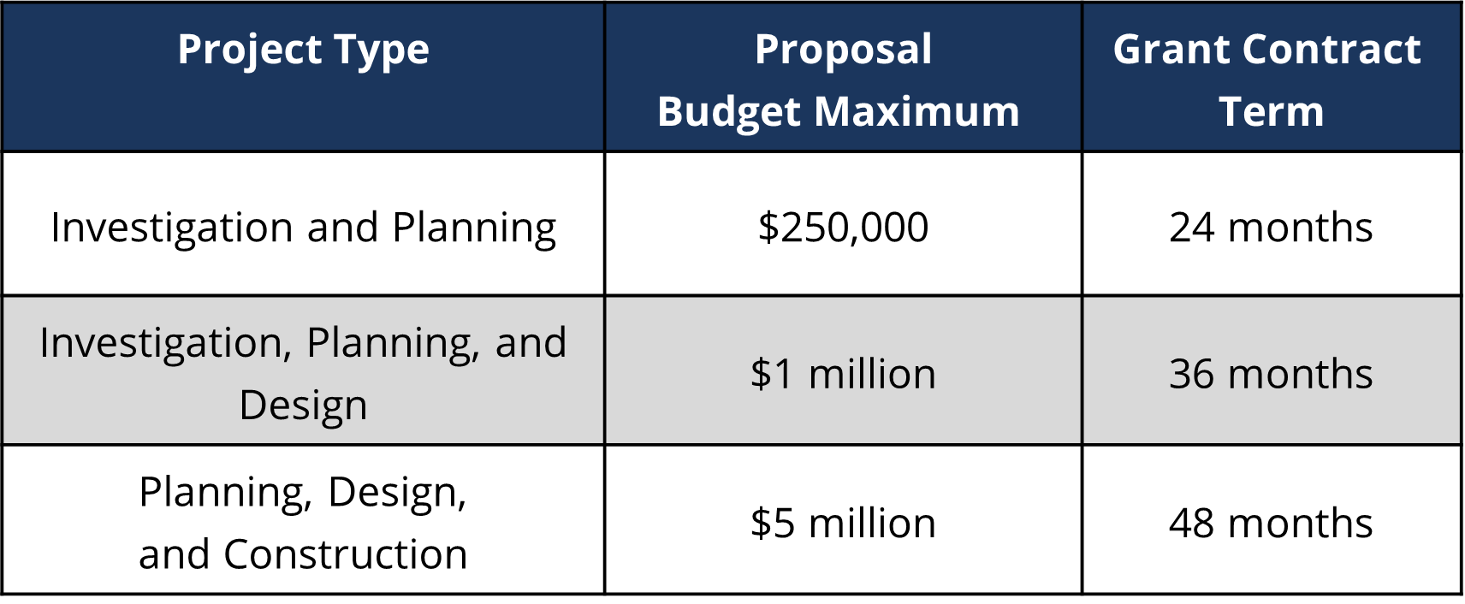

EC-SDC Grant
Total Funding: $39.8 million (PFAS/PFOA and CCLs)
Eligible Project Types:
Research and testing
Planning & design for EC projects
EC treatment systems
Source water EC activities
Storage improvements
Water system restructuring
Safe drinking water access
Public communication and outreach
Workforce development

Slide 62
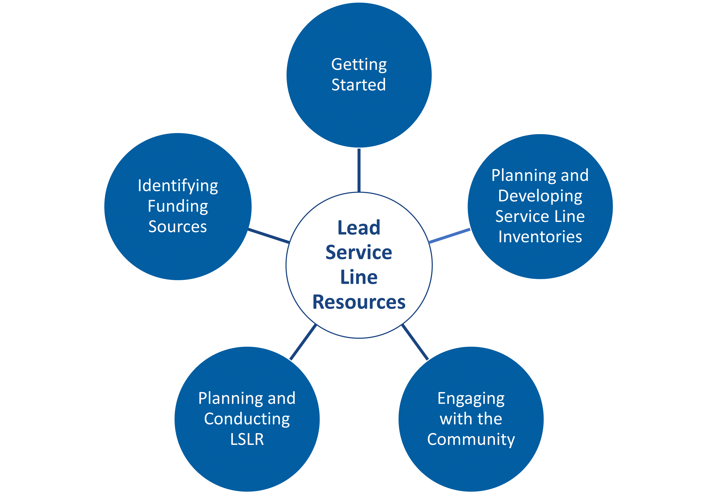
LSLI Grant
Total Funding: Approximately $6.14 million
Maximum Award: $500,000
No Replacement Activities Allowed
Eligible Activities:
Purchase equipment
Update service line inventories
Develop replacement plans
Prepare preliminary engineering reports (PERs)
Develop engineering plans and specifications

Slide 63
Funding Synergy Across Tennessee

Slide 64

Integrating SRF with SWIG
TDEC’s SRF and SWIG programs work together — grants fill gaps, SRF sustains momentum

Slide 65
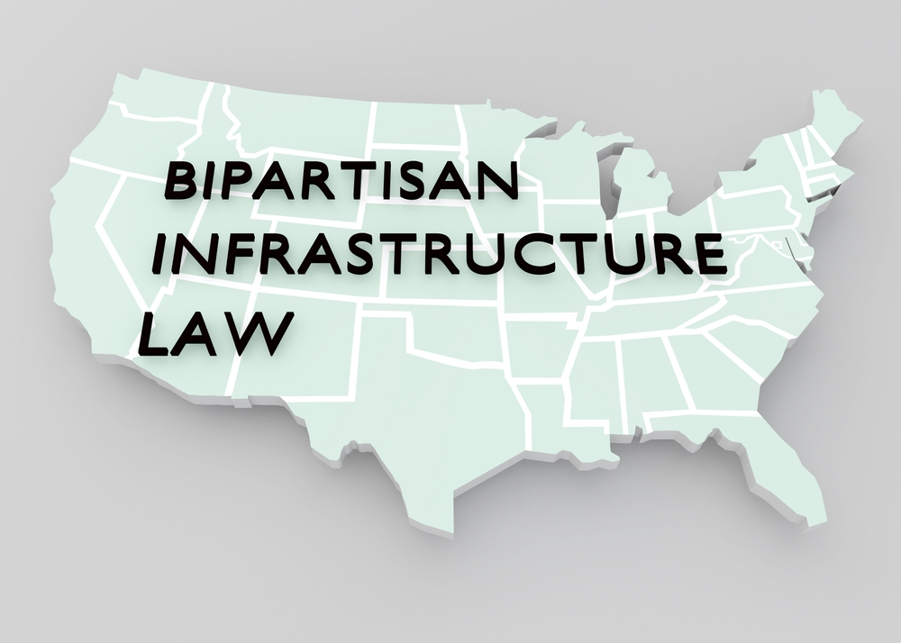
Infrastructure Investment and Jobs Act
Tennessee received $500M+ in supplemental SRF funds for traditional projects, lead service line replacements, and PFAS projects.
These funds are expiring in 2028

Slide 66
Leading for the Future

Slide 67
Recap of Core Concepts
SRF = sustainable, affordable, Tennessee-managed funding that empowers cities to act responsibly

Slide 68
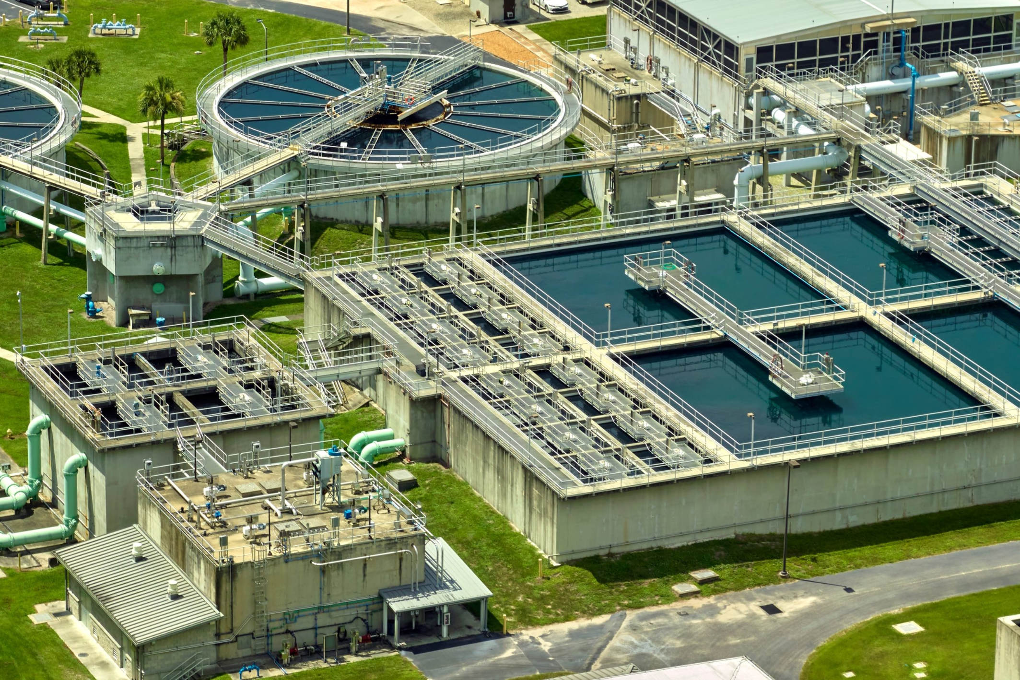
Call to Action
Evaluate your community’s needs now — SRF financing can help you modernize before costs escalate

Slide 69
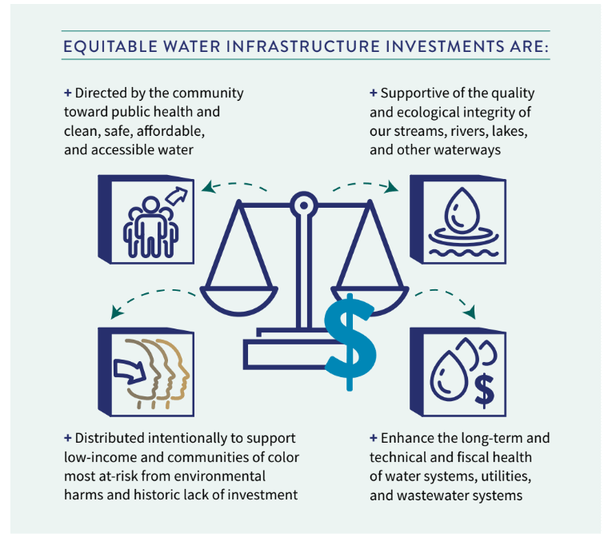
Final Message
Debt done right builds strong utilities

Slide 70

Questions?
Notes:
Speaker: Jaamal

Slide 71
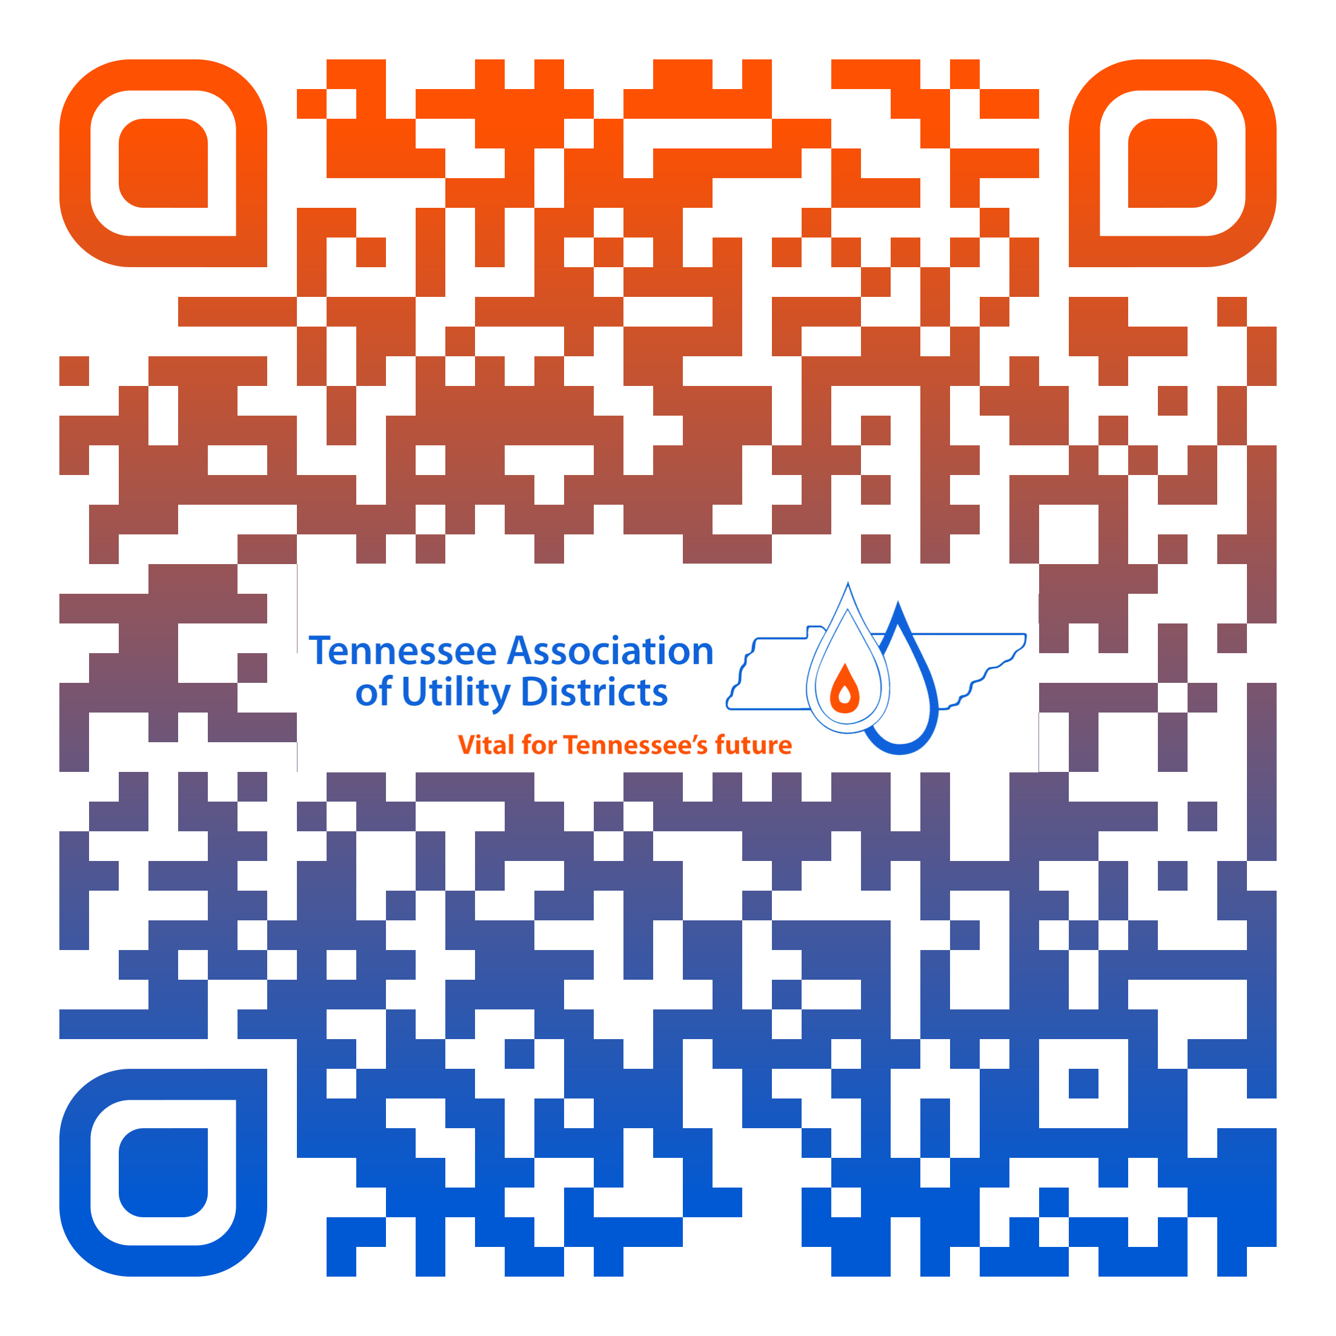
Scan QR for credit

