Slide 1


THE MEDIA CALLED.
NOW WHAT?
Brett McArdle
Communications Manager
bmcardle@cudrc.com

Slide 2
OVERVIEW
Build your foundation
Advice from media and PIOS
Managing your social media
Real-world examples

Slide 3
Build your foundation

Slide 4


Build your foundation
A NEW KIND OF
REPORT CARD
Developed at University of Wisconsin
A new effort to provide grades and metrics to the work of public utilities
Gaining notice and traction

Slide 5
Build your foundation
A NEW KIND OF
REPORT CARD
Developed at University of Wisconsin
Metrics established for ...
Water quality
Infrastructure
Finance
Communications

Slide 6


Build your foundation
DO YOU HAVE AN
EMERGENCY OPERATIONS PLAN?
More to the point,
does it have a Communications section?

Slide 7
Build your foundation
DO YOU HAVE AN
EMERGENCY OPERATIONS PLAN?
Furthermore, does it have a section with guidance about public-facing communications?

Slide 8
Build your foundation
PRESS RELEASE AND SOCIAL MEDIA TEMPLATES
safe water distribution
contamination
drought notice
boil water advisory
inclement weather

Slide 9
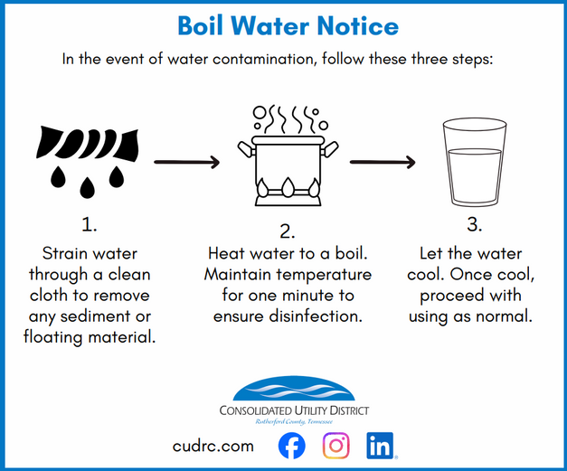
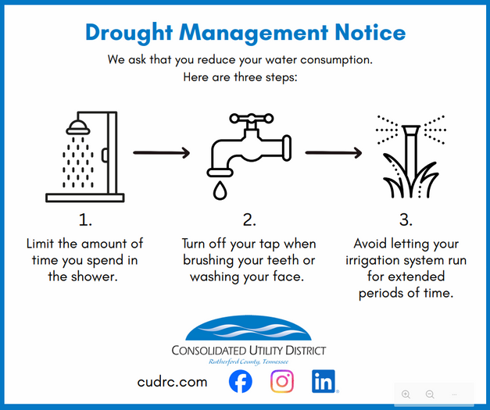
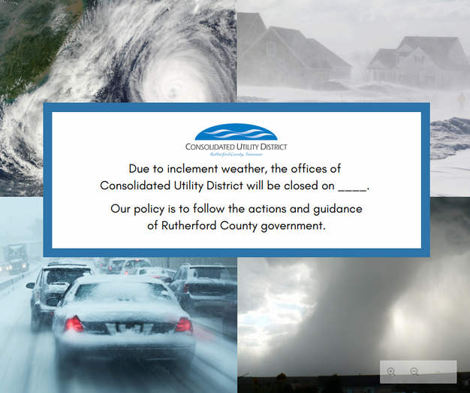

Build your foundation
WHY SOCIAL MEDIA TEMPLATES
MATTER
Ease of reaching your customers
Local media will check your page
Include logo for legitimacy
Provide general info in graphic and more in-depth in caption

Slide 10

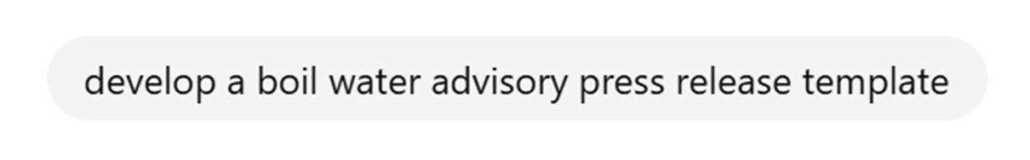
Busy? Don’t have time to write a full press release?
Here’s your workaround … Let’s ask chatGPT
STEAL THIS IDEA

Slide 11

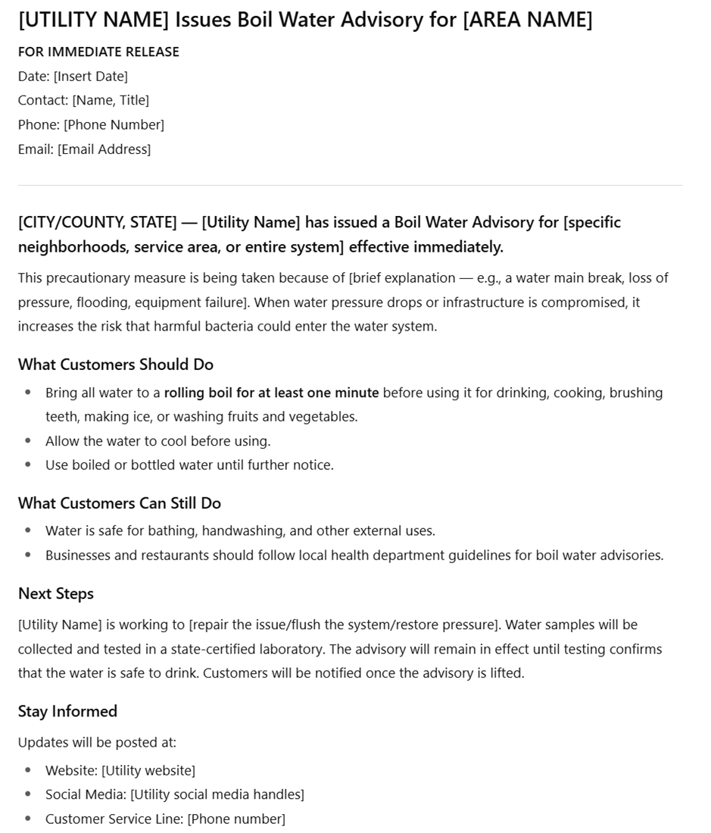
HERE’S THE RESULT
Time savings
Treat AI like your assistant
You’ll need to fill in the blanks with particulars

Slide 12
FUN FACT:
DON’T THANK CHATGPT ... HERE’S WHY

Slide 13


Slide 14
Advice from media and PIOS

Slide 15
Advice from media and PIOs
COACHING ABOUT MEDIA INQUIRIES FROM 3 EXPERTS
Ben: TV reporter from NewsChannel5 in Nashville
Sonia: Director of Communications at Nashville Metro Water Services
Ashley: Former PIO for Rutherford County

Slide 16

Advice from media and PIOs
What's the first question a spokesperson or PIO should ask when a journalist calls?
Ben: “First question could be, ‘What do you need from us? How can we help?’ Reporters are on deadlines. It helps just to know you got the message and are working on it. If you can't help, we can move on.”

Slide 17
Advice from media and PIOs
What's the first question a spokesperson or PIO should ask when a journalist calls?
Sonia: “Attempt to meet the deadline. Provide a statement that you are working to gather the information and let them know when you might have it. They will be reporting the story whether they receive input from you or not. Reporters often state: “We reached out but did not receive a response.”

Slide 18
Advice from media and PIOs
What's the first question a spokesperson or PIO should ask when a journalist calls?
Ashley: “If it's a phone call, I don't typically answer much over the phone. I'll ask if they mind sending me over the questions via email to review so I can make sure I have the most useful information prepared for their news story/interview.”

Slide 19

Advice from media and PIOs
Does a press release matter anymore — or does the media look to social posts more readily?
Ben: “They still have value. We definitely look at social media, but a well-timed, good news release can make a difference.”

Slide 20

Advice from media and PIOs
Is there anything spokespeople should avoid doing in their interactions with journalists?
Ben: “If you are going to send a press release, have someone available to talk about it. It does not help to have someone available next week.”

Slide 21
Advice from media and PIOs
Is there anything spokespeople should avoid doing in their interactions with journalists?
Sonia: “There is no such thing as “off record”. If you say it, they can use it. Sharing too much - answer the question, then wait for the next question. Reporters are looking for a short sound bite.”

Slide 22
Advice from media and PIOs
Is there anything spokespeople should avoid doing in their interactions with journalists?
Ashley: “Never forget the mic is always hot, and the camera is rolling. Another common mistake is not speaking in soundbites, and trying to fill an uncomfortable pause after a question is asked/answered with too much information.”

Slide 23
Advice from media and PIOs
To sum up ...
Ask what the reporter needs based on his/her deadlines
Ask if you can answer by email
They’ll check your social page first,
but press releases still have value
Nothing is truly off the record

Slide 24

Advice from media and PIOs
CRAFTING YOUR
MESSAGE
Care: Communicate and show compassion about the gravity of the situation.
Action: What steps you have taken or will take to address the issue.
Perspective: Provide information that puts the issue in context.
The CAP method

Slide 25
Advice from media and PIOs
CARING CONCERN: Name the concern with a caring attitude.
“I understand your concern about children’s health and lead in drinking water.”
Connect further using empathy. “The health of children is important to me and one of the reasons I work at/run a drinking water utility.”

Slide 26
Advice from media and PIOs
ACTIONS: “Our utility has an extensive treatment and monitoring program to ensure the water we produce and deliver protects your family from the risks of lead in drinking water.
Our monitoring findings are shared in an open and transparent way with our state regulators and summarized and shared with our community in our annual Consumer Confidence Report.”

Slide 27
Advice from media and PIOs
PERSPECTIVE: “Our community water meets every EPA drinking water standard. We pay close attention to emerging research and our concerns about drinking water are always focused on the health of you and your family.”

Slide 28
Advice from media and PIOs
WHAT HAPPENS IF WE’RE ADDRESSING A MISTAKE?

Slide 29
Advice from media and PIOs
Responsibility
1
THE 4 R’S
Regret
2
Leader takes responsibility, expresses regret, tells how the company will correct the issue, and offer to atone.
Research indicates the public will see the issue as an honest mistake and offer grace.
Source: Good Enough for Government Work by Amy Lerman, pg. 187
Reform
3
Restitution
4

Slide 30
Managing your social media

Slide 31

Managing your social media
UNFORTUNATE REALITIES OF SOCIAL MEDIA
Can amplify the worst of our emotions
As never before in human history, it provides a platform for people to instigate trouble.
The year 2009 changed our society: “like”, “follow”, and “repost/ share” buttons

Slide 32

Managing your social media
BUILD YOUR
POLICY
Create a social media policy for your employees. Google is a resource; so is ChatGPT.
Sometimes bad publicity on social media can start with employees.
Appropriate use of social media
Expectations for who can use your utility’s accounts
How to deal with customer information on social media

Slide 33

Managing your social media
Let’s ask ChatGPT ....
(Buckle up. There’s a lot.)

Slide 34
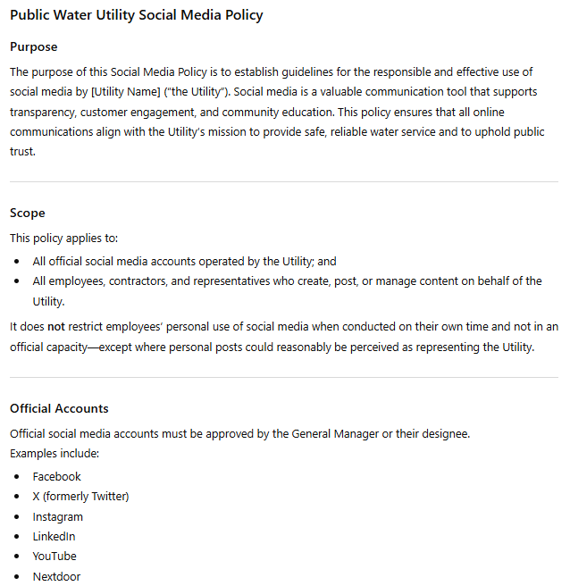
Managing your social media

Slide 35
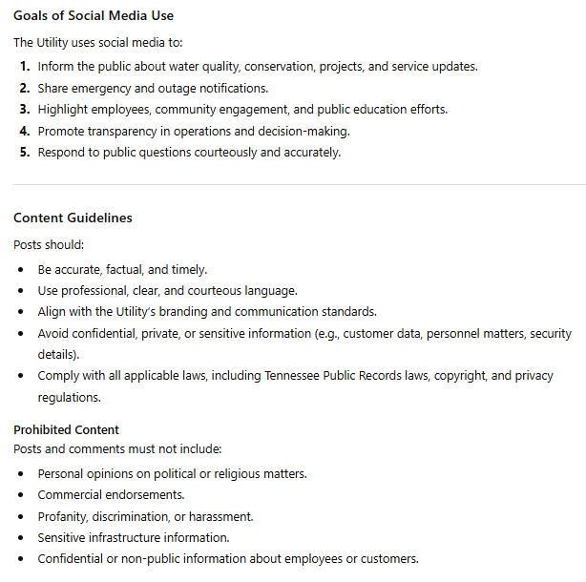
Managing your social media

Slide 36
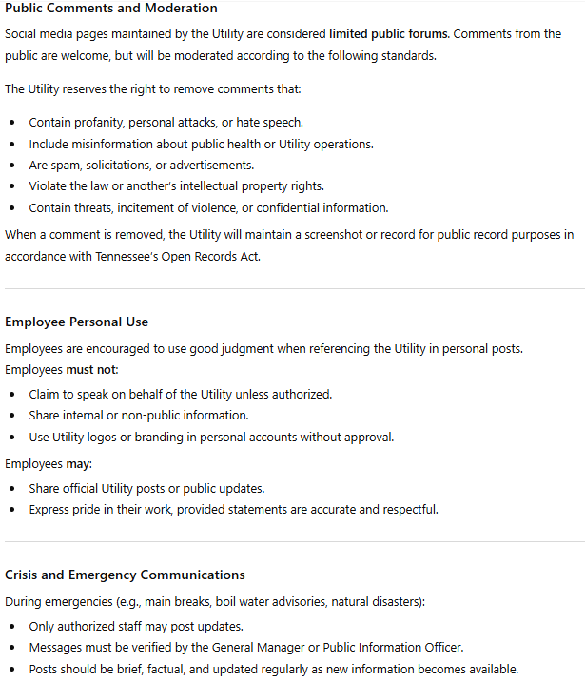
Managing your social media

Slide 37
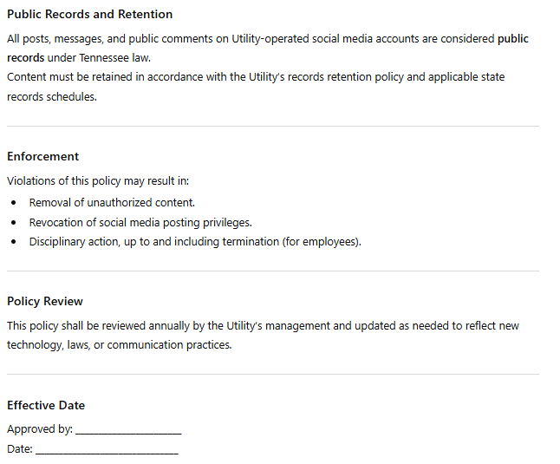
Managing your social media

Slide 38
Managing your social media
INCLUDE YOUR LOGO
IN SOCIAL POSTS.
WHY?

Slide 39

Managing your social media

Slide 40

Managing your social media
MUST WE RESPOND?
5 questions to answer ...
What information do you have available? Define the topic.
Is this a growing issue or an annoyance?
How concerned are your customers?
Are the interested parties part of a specific group?
Does someone else in the community have the lead on this one?

Slide 41
Managing your social media
Respond quickly – even if you must provide a “hold message”.
Use a human tone. “We are so sad to hear about…” sounds better than “A regrettable incident has occurred.”
Tailor your responses. It’s tempting to quickly respond to a complaint or concern with a link to your website.

Slide 42
Managing your social media
Take responsibility. If this is something under your control, be empathetic.
Be visible. Deleting or hiding comments will only anger the commenter, who will then turn to other channels.
Pause scheduled social media posts. If you schedule your posts in advance, stop them immediately. Nothing is worse than having a fun, quirky post pop up in the middle of a situation.

Slide 43
Managing your social media
Judgment calls ...
Is it a one-off comment, or is their sentiment gaining traction?
Take emotion out of your reply; just the facts
Did they “@ you” angrily – or is it a legit question?
You don’t have to answer everything

Slide 44

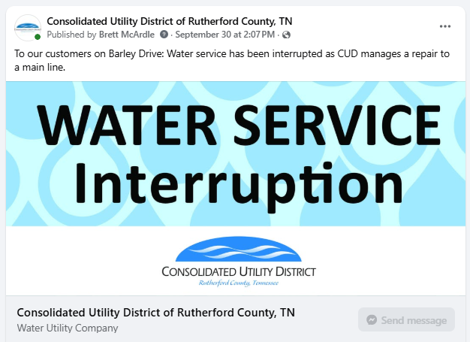
Managing your social media
Social media judo
“I’m glad you asked”
“You’re right!”
“We’re working on that now” (provide updates)
Agree – and offer a factoid
We’re our own customers

Slide 45
Real-world examples

Slide 46
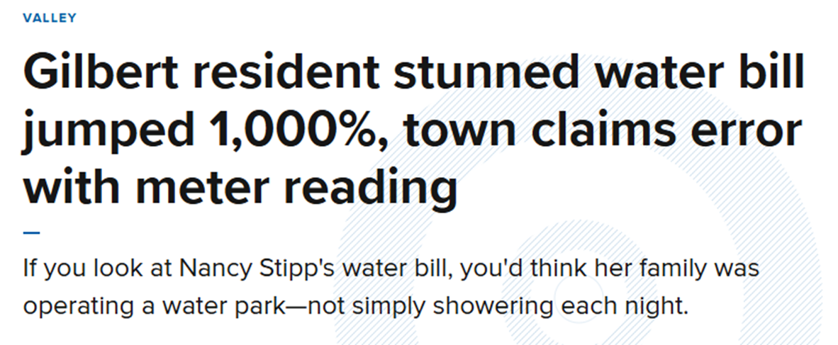
Real-world examples

Slide 47
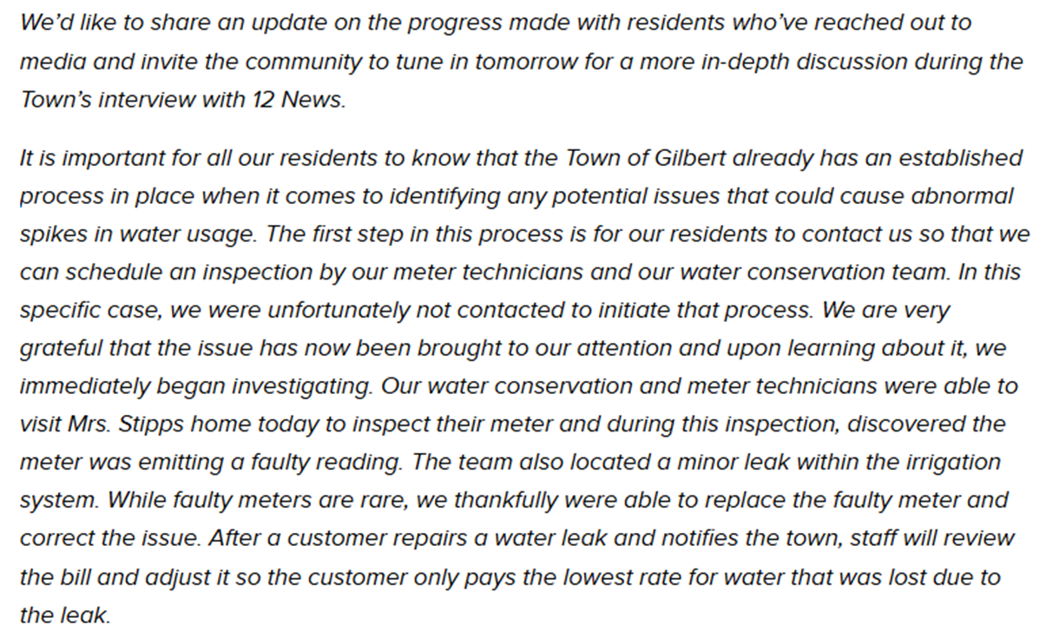
Nice!
Real-world examples

Slide 48
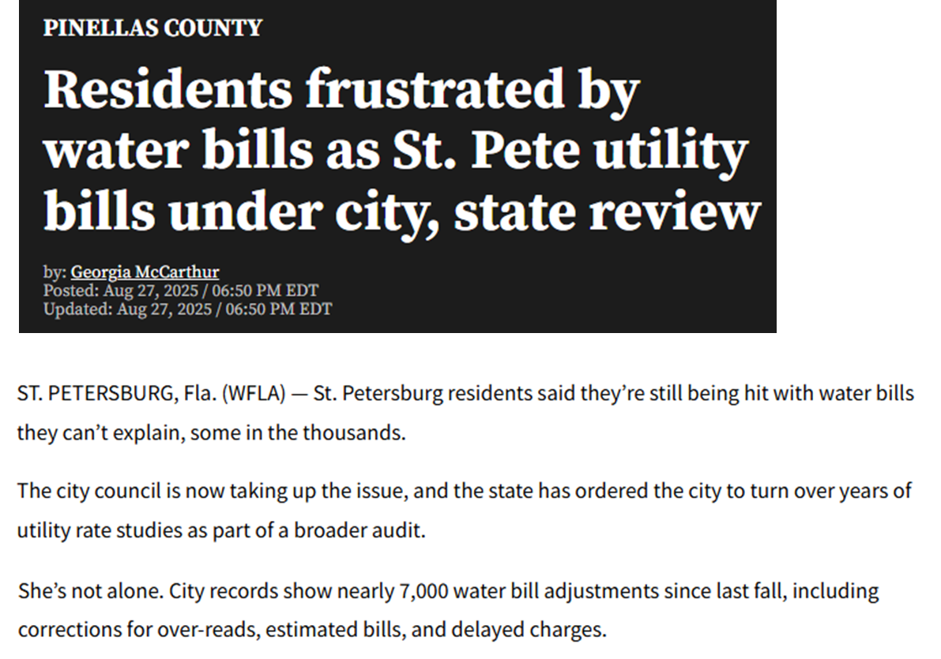
Real-world examples

Slide 49
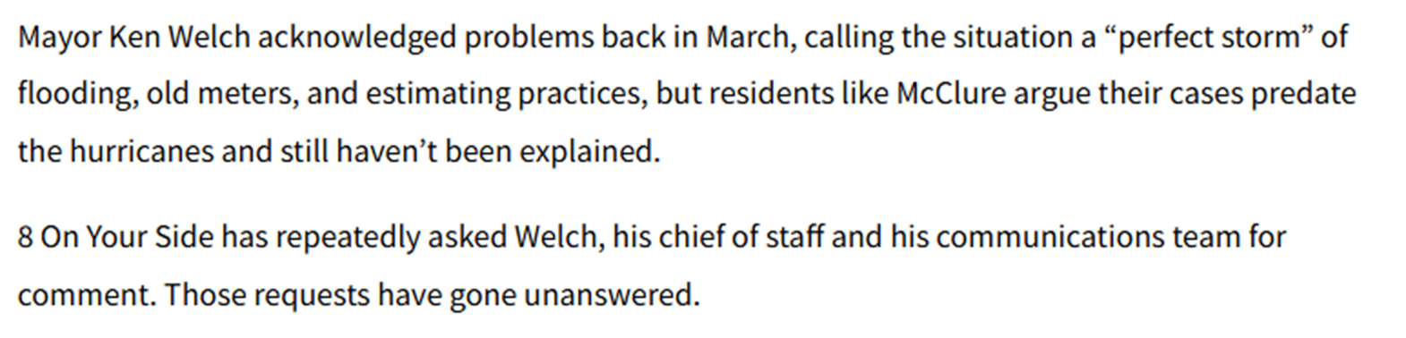
Real-world examples
Not good. Missed opportunity.

Slide 50
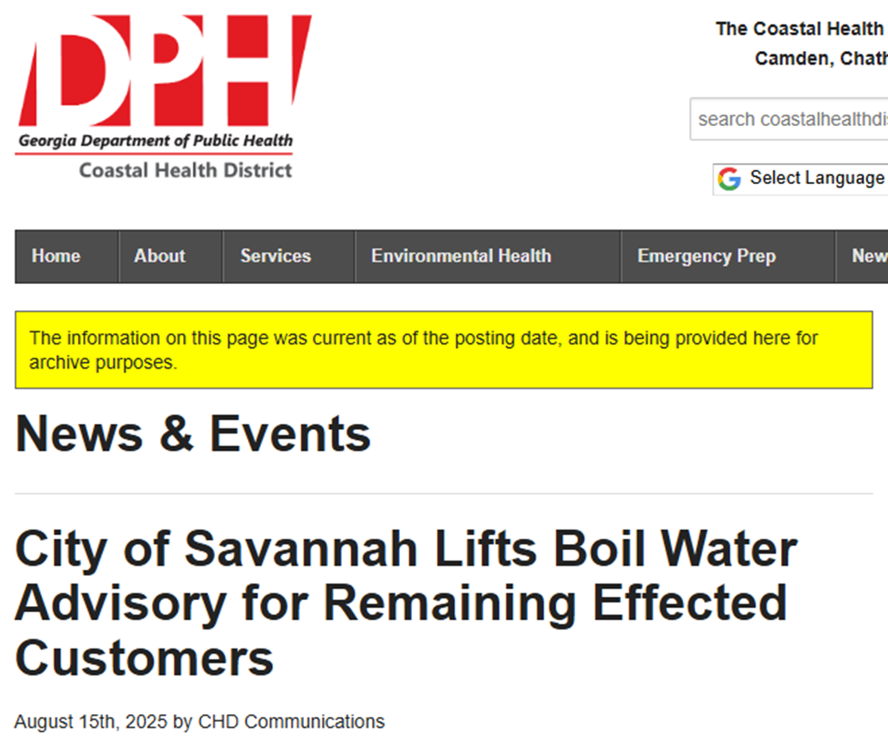
Real-world examples

Slide 51
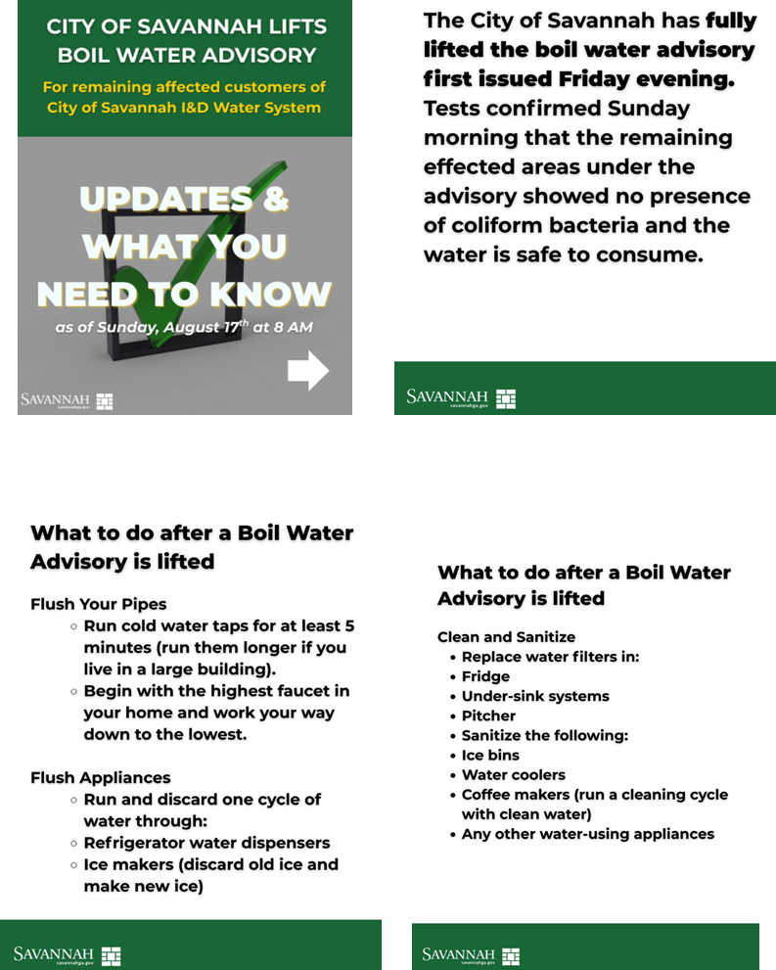
Real-world examples
Well done!

Slide 52
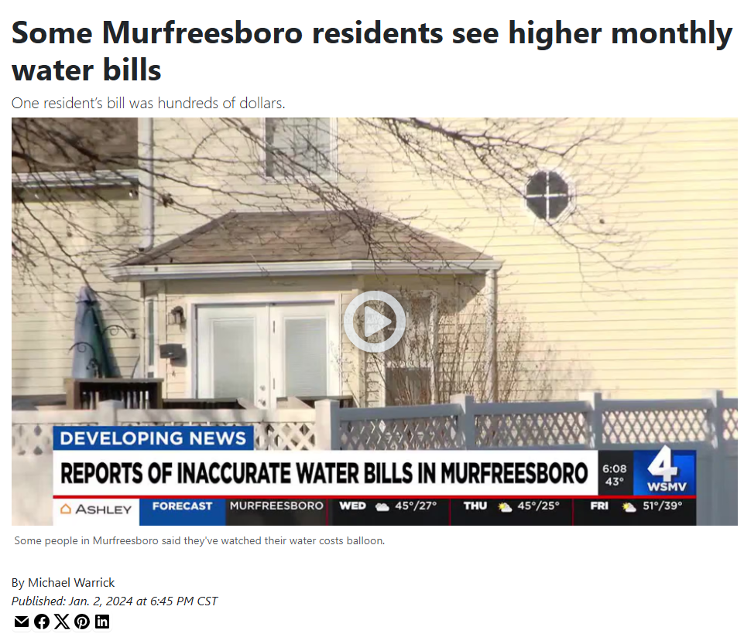
Real-world examples

Slide 53
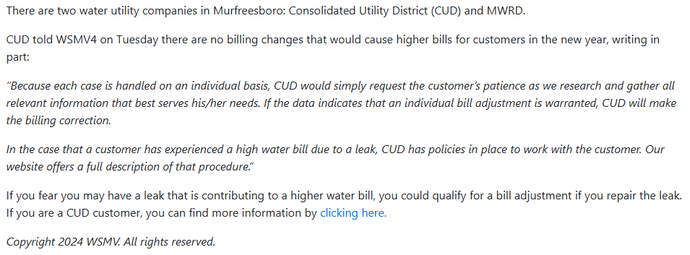
Real-world examples

Slide 54

THE MEDIA CALLED.
NOW WHAT?
Brett McArdle
Communications Manager
bmcardle@cudrc.com

Slide 55


