Slide 1
Utility Board Meetings: Before, During, and After
Don Scholes
General Counsel
Tennessee Association of Utility Districts
©2025. Tennessee Association of Utility Districts

Slide 2
B E F O R E

Slide 3

Public notice of board meeting must be given
Let the Sunshine in

Slide 4

Why must meetings be public?
The Tennessee General Assembly “declares it to be the policy of this state that the formation of public policy and decisions is public business and shall not be conducted in secret.”
Notes:
Describe continuum

Slide 5
What does the Tennessee Open Meeting Act say about public notice?
Governmental body must give “adequate public notice” of a regular meeting or special meeting
And that’s all it says!
Notes:
No specific number of days
No mandate be only in the newspaper

Slide 6
Here’s what Tennessee Supreme Court says:
“We think it is impossible to formulate a general rule in regard to what the phrase ‘adequate public notice’ means. However, ... adequate public notice means adequate public notice under the circumstances, or such notice based on the totality of the circumstances as would fairly inform the public.”
“Is sufficient as long as it gives interested citizens a reasonable opportunity to exercise their right to be present at a governing body's meeting

Slide 7
Adequate Notice – Three Considerations
Timing of public notice – Number of days before board meeting
Location of public notice
Local newspaper Local radio
Website Posting in utility office
Social media (Facebook) Posting in public places
Notes:
Newspaper still probably the safest

Slide 8
Adequate Notice – Three Considerations
Content of public notice
Regular meetings - purpose of meeting or agenda of meeting is not required for regular meetings
Special meetings – notice must “reasonably describe the purpose of the meeting or the action proposed to be taken”

Slide 9
Adequate Notice – Three Considerations
Content of public notice
A statute, ordinance, resolution, or requirement of third party may require publication of purpose of meeting in notice
Previously established rule or policy by utility requiring information in public notice – Rate increases
Notes:
Rural development loan
Other grants may require

Slide 10
What is a regular meeting?
A meeting previously scheduled by
Statute
Ordinance
Resolution
Bylaw
Notes:
In light of the available precedents and the language of the OMA itself, we conclude that the notice in this case was adequate. TCA 8–44–103 requires notice of the meeting itself and does not speak to notice of the content of the meeting. Cases requiring notice of items to be discussed at a meeting have all involved special meetings. We decline to adopt the trial court's reasoning that issues of public importance require notice of meeting content, even for regular meetings. Such requirements have been imposed only with regard to special meetings
Fisher v. Rutherford Cty. Reg'l Planning Comm'n, No. M2012-01397-COA-R3CV, 2013 WL 2382300, at *6 (Tenn. Ct. App. May 29, 2013)
Rural Development bond

Slide 11
New Pre-Meeting Notice Requirements
If a utility board requires a member of the public to give prior notice of desire to make comments on agenda items, notice for the meeting “shall indicate the manner in which a person may indicate the person's desire to provide public comment at the meeting”
Effective May 5, 2025, utility board must make the agenda for its meeting in a publicly accessible place at least 48 hours before board meeting – utility’s website counts

Slide 12
MILCROFTON UTILITY DISTRICT – NOTICE OF MONTHLY MEETING The Board of Commissioners of Milcrofton Utility District is held at 9:00 am on the fourth Wednesday of each month, unless otherwise scheduled at the District's office. The public is invited to attend. Any member of the public who desires to comment on matters relevant to the agenda during the public comment period must contact the General Manager, Mike Jones, by 4:00 pm the fourth Tuesday of each month…

Slide 13
Other Notice Issues
Utility district must give public 14 days notice of meeting at which it selects 3 nominees to submit to County Mayor to fill vacancy
Recessed meeting notice – AG Opinion 07-30 says:
Thus, we are of the opinion that the Board would have had to give “adequate public notice” as to when the meeting was to be reconvened”
Notes:
City recessed its meeting and reconvened it the next day

Slide 14
Board Member Preparation
Establishing the meeting agenda
Who prepares and/or approves the agenda
Who can add items to agenda
Establishing who has authority to change regular dates for board meetings and schedule special meetings

Slide 15
Board Member Preparation
Providing board members packets with information related to agenda items
Be careful with emails

Slide 16
Can a meeting of a committee created by a utility board be a public meeting?
Yes, when the following two tests are met:
Authority and origin of committee created by utility board action
Committee members have the authority to make decisions or recommendations on policy or administration affecting the conduct of utility business
Notes:
It is clear that for the purpose of this Act, the Legislature intended to include any board, commission, committee, agency, authority or any other body, by whatever name, whose origin and authority may be traced to State, City or County legislative action and whose members have authority to make decisions or recommendations on policy or administration affecting the conduct of the business of the people in the governmental sector. Dorrier v. Dark, 537 S.W.2d 888, 892 (Tenn. 1976).
Tenn. Op. Att'y Gen. No. 96-040 (Mar. 12, 1996)

Slide 17
D U R I N G

Slide 18
Attending Utility Board Meetings Electronically
Utility board members cannot attend meetings by electronic means
Who can?
Boards and commissions of state government
Emergency communications district board of directors
Members of county commissions and city legislative bodies for limited reasons

Slide 19
Establish Rules for Conduct of Board Meetings
Generally, enabling legislation allows utility boards to rules for conduct of business at board meetings
Utility districts – “Board has authority to make all needful rules, regulations and bylaws for…the conduct of the…the board”
Anderson County Water Authority (created by private act) – “[T]he board of directors shall establish its own rules of procedure”

Slide 20
Establish Rules for Conduct of Board Meetings
County Boards of Public Utilities – “The board shall establish its own rules of procedure”
Municipal Energy Authority – “Adoption of bylaws for the conduct of the business of the board”
Municipal Utility Boards – Check your own enabling laws or acts

Slide 21
Role and Duties of Presiding Officer
Designate presiding officer
Open meeting
Control debate and moving through the agenda
Responsible for seeing proper motions are made and votes are taken
Notes:
General Manager, President or Chairman, any board member

Slide 22
Role and Duties of Presiding Officer
Enforce public comment period timing and restrictions
Control public participation during meeting
Resolve any procedural issues or questions
Notes:
General Manager, President or Chairman, any board member

Slide 23
How the Utility Board Acts
Refer to enabling legislation
Utility districts – Board has the power and authority to “exercise by vote, ordinance or resolution all general and specific powers of the district” - TCA § 7-82-309(a)(1)
Watauga River Regional Water Authority (created by private act)- “[A]ction taken by the Board exercising its powers and authority … may be exercised by vote or resolution”

Slide 24
How the Utility Board Acts
Refer to enabling legislation
Municipal utility boards – Check the general act or private act under which board was created
Enabling legislation does not address – Establish methods by bylaws

Slide 25
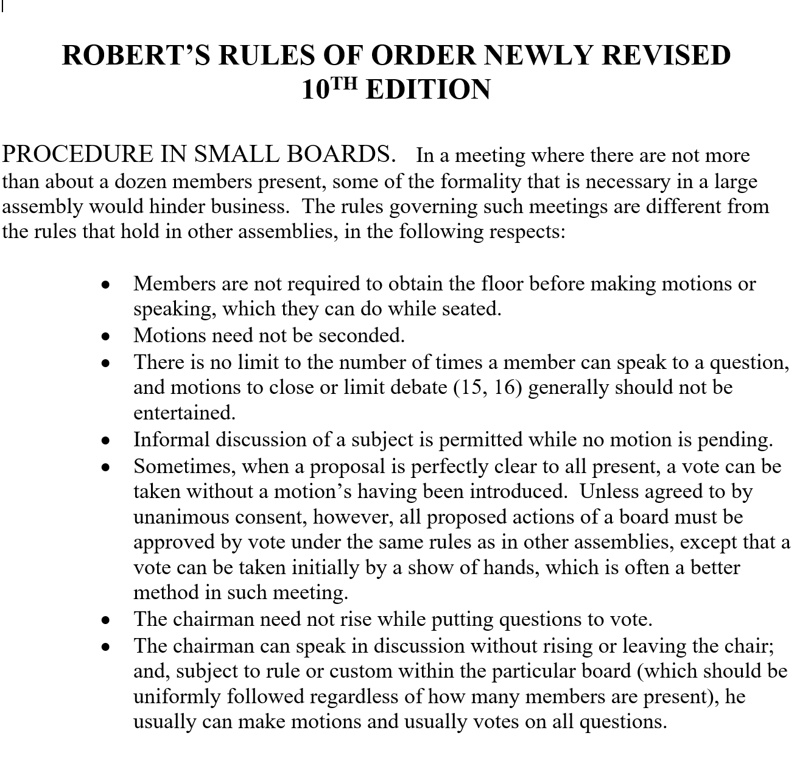

Slide 26
Public Attendance and Participation
Public attendance at board meetings
All meetings of any governing body are declared to be public meetings open to the public at all times
Electronic participation by public
A governing body may, but is not required to, allow participation by electronic means of communication
Public comment periods – New for 2025
Notes:
Explain rate increase

Slide 27
Public Comment Period at Board Meetings
Since July 1, 2023, governing boards of local governments must:
Reserve time for public to comment on matters which are germane to items on the agenda of a utility’s board meeting
Take all practicable steps to ensure that opposing viewpoints are represented fairly, if any, during a public comment period

Slide 28
Public Comments Period at Meetings
Governing boards of local governments may:
Require that any member of the public who wants to offer comments at meeting give advance notice of desire to offer comments
Place reasonable restrictions on comments period such as

Slide 29
Public Comments Period at Meetings
Length of period
Number of speakers
Length of time that each speaker may comment
If the utility requires advance notice, then the public notice of every meeting must indicate the how a person who wants to comment must give such advance notice.

Slide 30
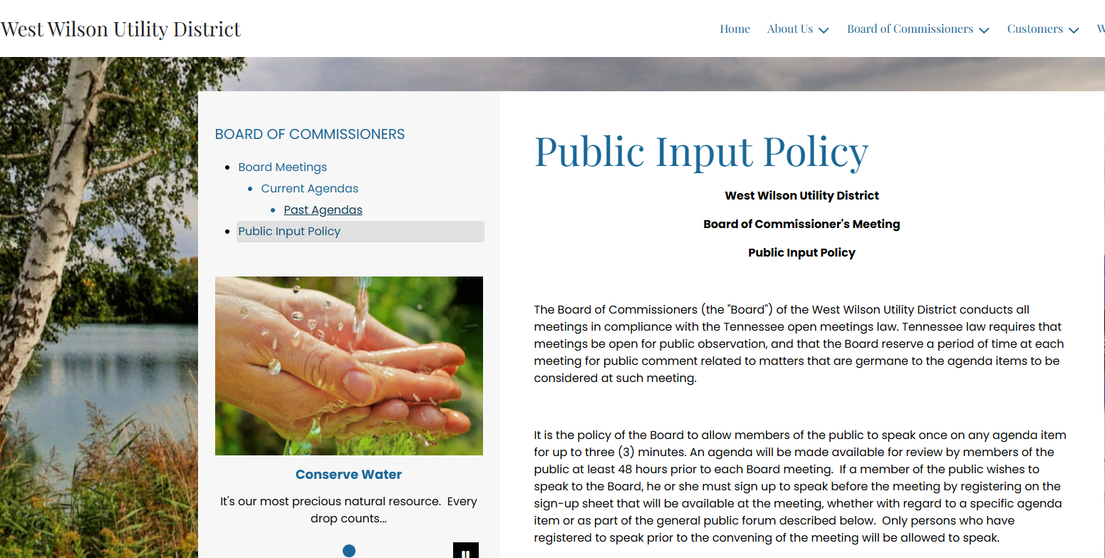
https://westwilsonutility.com/public-input-policy

Slide 31
Public Participation Outside Comment Period
Outside of public comment period, no statutory right for citizens right to speak or actively participate
Public officials are not required to depart from their agenda or to interrupt their business to accommodate the public's demands to be heard

Slide 32
Executive sessions and Exclusion of Public
Two very limited circumstances
First, advisory meetings with attorney on pending or threatened litigation
Second, meeting of Local Government Audit Committee and report to governing board
Deliberations and decisions still be made in public meeting
Notes:
Preserve attorney-client privilege

Slide 33
Can personnel matters and other sensitive matters be considered in executive session?
“If experience should prove that the public interest is adversely affected by open meetings involving…
disciplinary hearings
promotion and demotion decisions
prospective land purchases
labor negotiations, etc.,…
it is the Legislature, not the Judiciary, that must balance the benefits and detriments and make such changes as will serve the people
and express their will.”
Notes:
Pending or prospective litigation, disciplinary hearings, promotion and demotion decisions, prospective land purchases, labor negotiations, etc., - Lakeway Publishers, Inc. v. Civil Serv. Bd. for City of Morristown, No. 03A01-9401-CH-00003, 1994 WL 315919, at *3 (Tenn. Ct. App. July 5, 1994) – Decision on appeal of termination of police officer in closed meeting violated Act

Slide 34
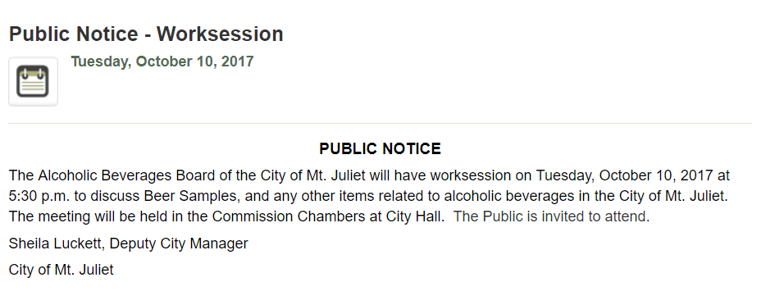
What about “work sessions?”
Notes:
Are public meetings
Usually held at times other than regular meeting
Notice should describe purpose of work session

Slide 35
Can any meeting of a governing body not be a meeting subject to the Sunshine Law?
Yes
On-site inspection of any project or program – TCA 8-44-102(b)(2)
Information only meetings
No deliberations or discussion about information can occur
Careful about public perception
Notes:
Discussion on positions or any attempt to reach consensus are deliberations
Have others present so is some witness that informational only
Johnson v. Metro – ordinance to implement a conservation zoning overlay in a neighborhood within the municipality – before council meeting members viewed information on the zoning issue in a non-public conference room – no violation
Survey data collected by Belmont-Hillsboro Neighbors, Inc. in room
A representative of BHN was present in the conference room to explain the survey and answer questions
Petitions requesting to opt out of the overlay,
Representatives of Metro Historic Zoning Commission were available to answer questions about overlays in general
Home designer with experience building in historic overlay areas was present

Slide 36
Can any meeting of a governing body not be a public meeting?
In 2024 the General Assembly enacted legislation which created two exclusions to meeting of a “governing body
Meeting for exchange of information and not deliberative; or
Member or members of legislature conduct meeting to discuss state matters

Slide 37
Can secret votes be taken in a public meeting?
No. Votes must be taken by
Public voice vote (yea or nay)
Public ballot
Public roll call vote

Slide 38
Can a member of the public videotape or record audio of a public meeting?
Probably, as long as such recording does not interfere with the conduct of the utility board’s business
Members of the public have no expectation of privacy in public meeting
Tennessee is a one-party consent state

Slide 39
A F T E R

Slide 40
Be Careful Of…
The informal meeting after the formal board meeting
Discussion of utility business if you eat afterward
No discussions of utility business between board meetings

Slide 41
Meeting Minutes - Purpose
Official written record of what occurs during public meeting
Ensures transparency of actions of utility board by documenting decisions
Accurate minutes protect utility board from disputes over past decisions made

Slide 42
Meeting Minutes - Sunshine Law Requirements
Minutes must include at least the following:
Record of persons present
All motions, proposals, and resolutions offered
Results of any votes taken
Record of individual votes of a roll call

Slide 43
Meeting Minutes – Comptroller Recommendations
Copies of all ordinances and resolutions adopted
Copies of the budget and any supplemental appropriations
Schedules of personnel appointments and salary rates and changes
Copies of bond and revenue anticipation resolutions

Slide 44
Meeting Minutes – Comptroller Recommendations
Authorizations of loans and transfers between funds
Copies of federal and state grant applications
Summaries of action taken on competitive bids
Copies of contracts entered into by officials

Slide 45
Meeting Minutes – Other Considerations
Include explanation of actions taken
Decision may be appealed to TBOUR
Choose a bidder other than lowest bidder
Controversial issue is resolved or decided
Notes:
Reason for termination of

Slide 46
Meeting Minutes – Other Considerations
Retention period for minutes?
Forever
Keep an electronic copy outside of the office
Record board meeting for preparation of minutes?
Recordings are public record
Establish a policy to erase recordings after certain date

Slide 47
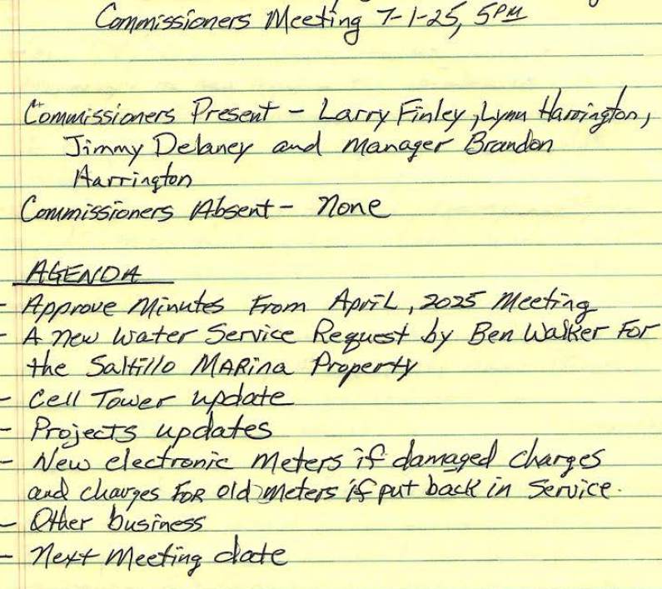
Meeting Minutes – Other Considerations
No handwritten minutes please

Slide 48

What happens when action is taken at public meeting which violates the Open Meetings Act?
Action is void and of no effect (except actions affecting public debt otherwise legal is not voided)

Slide 49
What happens when action is taken at public meeting which violates the Open Meetings Act?
Enforce Open Meeting Act violations by filing suit in circuit or chancery court
As of July 1, 2024, attorney fees and litigation expenses recoverable when violation is “willful”

Slide 50
What happens when action is taken at public meeting which violates the Open Meetings Act?
Violations provide fodder for:
Local media
Social media
Opponents of the utility district or its board members

Slide 51
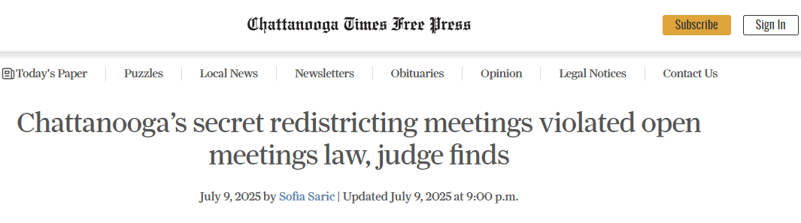

Slide 52
Can you “cure” action taken at public meeting held in violation of Open Meetings Act?
Reconsider action at properly noticed public meeting
New and substantial reconsideration of the issues
Public has ample opportunity to know be heard on the matters at issue

Slide 53

Contact Information
 |  | Don Scholes General Counsel Tennessee Association of Utility Districts Phone: (615) 896-9022 donscholes@taud.org

Slide 54

Scan for Credit

