Slide 1

IRS Designations: Distinguishing Between W-2 and 1099’s
Mastering the Puzzle
Melanie Sain- Accounting Specialist
Ethan Carter– Program Specialist
©2025. Tennessee Association of Utility Districts

Slide 2
Introduction
  Today we will be discussing several topics about employment issues and tax situations.
  Independent Contractors vs Employees
  Misclassification consequences
  Filing and reporting requirements (including W-2’s and 1099’s)
  One Big Beautiful Bill Act

Slide 3

Independent Contractor vs Employee

Slide 4
Confusion
There is often confusion between classification of employees and independent contractors.
Proper classification is crucial, as misclassification can lead to significant penalties for companies, including back pay, benefits, and fines.
Today we will talk about the differences and try and grasp a good understanding about these differences.

Slide 5
Why does this matter?
Employers like to use independent contractors when they can because doing so allows them to avoid expenses associated with employees — taxes, training, overtime, benefits, workers’ compensation insurance, paid vacation and holidays, and so on. They can plug gaps in their employee workforce by bringing in someone who has the necessary experience to hit the ground running.
The problem is, of course, that employers can come to over rely on independent contractors and, over time, begin to treat them as employees. When this happens, big problems can arise for the Company, including fines and backpay of payroll taxes.

Slide 6
Employees
CONTROL - The Utility controls what work is be done and how it is to be done. The employee is often trained by the company and works on an employer determined schedule.
PAY - Employees are paid an hourly rate or salary, and the employer withholds payroll taxes.
BENEFITS - Employees generally receive benefits such as health insurance and retirement.
DURATION - The job is more permanent.
TOOLS & EQUIPMENT - The employer provides the tools and equipment to perform the job.

Slide 7
Independent Contractor
CONTROL – The contractor is not controlled by the Utility. They operate their own independent business and sometimes have many clients.
PAY – Contractors are paid based on their contract or agreed upon price. This is normally a flat fee or project-based fee. However, it can be hourly. No taxes are withheld from contractor pay.
BENEFITS – Contractors do not receive any benefits from the Utility.
DURATION - The job is not as permanent.
TOOLS & EQUIPMENT – Contractors normally provide their own tools and equipment to perform the job.

Slide 8
What does the IRS say?
The IRS has a set of rules that can be used to determine status called common law rules, which have been condensed into three main categories to assess the degree of control and independence:
Behavioral Control
Financial Control
Type of Relationship.

Slide 9
Behavioral Control
Behavioral control refers to facts that show whether there is a right to direct or control how the worker does the work. A worker is an employee when the business has the right to direct and control the worker. The business does not have to actually direct or control the way the work is done – as long as the employer has the right to direct and control the work.
The behavioral control factors fall into the categories of:
Type of instructions given
Degree of instruction
Evaluation systems
Training

Slide 10
Financial Control
Financial control refers to facts that show whether the company has the right to control the economic aspects of the worker’s job.
The financial control factors fall into the categories of:
Significant investment
Unreimbursed expenses
Opportunity for profit or loss
Services available to the market
Method of payment

Slide 11
Type of Relationship
Type of relationship refers to facts that show how the worker and company perceive their relationship to each other.
The factors, for the type of relationship between two parties, generally fall into the categories of:
Written contracts
Employee benefits
Permanency of the relationship
Services provided as key activity of the business

Slide 12

The Remote Worker
An individual working remotely, for example, performing services for the Utility from a location other than an office operated by the Utility, is your employee, if you can control what will be done and how it will be done. This is so even if the worker can choose to work remotely. What matters is that you have the right to control the details of how the services are performed.

Slide 13
Bottom Line
Control is the biggest indicator the IRS will examine if there is an issue –
Some factors may indicate that the worker is an employee, while other factors indicate that the worker is an independent contractor.
There is no “magic” or set number of factors that “makes” the worker an employee or an independent contractor and no one factor stands alone in making this determination.
Also, factors which are relevant in one situation may not be relevant in another.
The KEY is to look at the entire relationship and consider the extent of the right to direct and control the worker. Finally, document each of the factors used in coming up with the determination.

Slide 14
Examples
Contractor or Employee?
John Doe has come to work at your Utility. There is no contract. There is an email that states he will perform landscaping services at the Utility office when the Utility calls him to request services. John Doe also does work with other companies. He has his own tools and mowers.

Slide 15
Examples
Contractor or Employee?
Jane Doe has come to work at your Utility. There is no contract. There is a verbal commitment to pay $20 per hour for landscaping services at the Utility office. The Utility requires her to come 3 days per week from 9 – 5 in June, July, August and September. Jane Doe will use the Utilities tools and mowers. Jane Doe also does work with other companies.

Slide 16
The IRS Can Help
If it is still unclear whether a worker is an employee or an independent contractor after reviewing the three categories of evidence, then Form SS-8, Determination of Worker Status for Purposes of Federal Employment Taxes and Income Tax Withholding, can be filed with the IRS.
The form may be filed by either the business or the worker. The IRS will review the facts and circumstances and officially determine the worker’s status.
Be aware that it can take at least six months to get a determination.

Slide 17

Misclassification Consequences

Slide 18
Uh Oh
If an independent contractor is misclassified as an employee, this is not really an issue for the employer.
BUT if an employee is misclassified as an independent contractor, this is a PROBLEM.
The employer could face legal and financial consequences, while the worker may be entitled to lost wages, overtime pay, and benefits.
The misclassified worker can take action by filing a complaint with the Department of Labor, the IRS, or the state, or by seeking legal guidance.

Slide 19
But I Didn’t Mean To -
Unintentional Misclassification Penalties
$50 fine per missing Form W-2
1.5% of the worker's wages
40% of unpaid employee FICA taxes
100% of the employer's FICA share
0.5% monthly failure-to-pay penalty (up to 25% total)

Slide 20
Yes, I Meant It -
Intentional/Fraudulent Misclassification Penalties
20% of the worker's wages
100% of both employee and employer FICA taxes
Criminal fines up to $1,000 per misclassified worker
Possible imprisonment up to one year

Slide 21


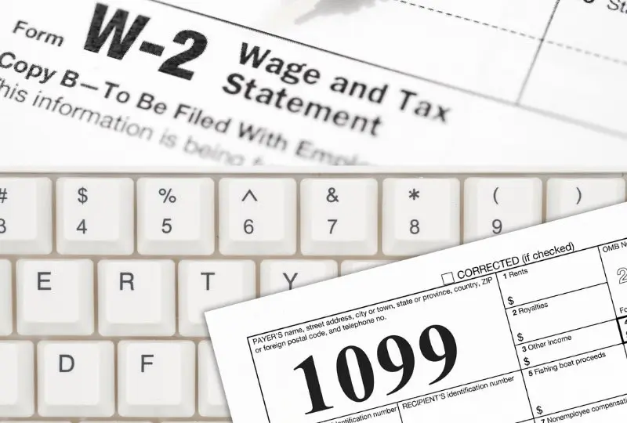
Filing and Reporting Requirements

Slide 22
Forms for Employees
When an employee is hired; they will fill out Form W-4 (Employees Withholding Certification) and Form I-9 (Employment Eligibility Verification) to keep at the Utility office. They should also fill out an employee information sheet that includes contact information, date of hire, starting hourly rate or salary amount, date of birth, plus 2 emergency contacts with phone numbers.
Employees wages are reported quarterly on Form 941 (Employer’s Quarterly Federal Tax Return) and sent into the IRS quarterly by the last day of the month following the end of the quarter
(April 30th, July 31st, October 31st, January 31st)
Form 941 (due quarterly) can be mailed into the IRS or electronically filed. A lot of software can electronically file this for you.

Slide 23
Forms for Employees
Employees wages and taxes are reported on Form W-2 (Wage and Tax Statement) annually to the SSA by January 31st
Form W-2’s are to be mailed to the employees by January 31st.
It is fine to hand deliver to the employees as well.
Form W-2 (due annually) can be mailed to the SSA (if less than 10 employees). They must be sent in electronically if 10 or more employees.
Again, a lot of software has capacity to file electronically.

Slide 24
Forms for Independent Contractors
When an Independent Contractor is used, there are several forms that you need to get before work commences–
Form W-9 – Request for Taxpayer Identification Number
Copy of their general liability/workers compensation
Clear contract or agreement for work to be performed and clear payment amount

Slide 25
Forms for Independent Contractors
Contractor Payments ($600 and over) are to be reported on Form 1099-NEC
(Non-Employee Compensation) annually to the IRS by January 31st
Form 1099-NEC are to be mailed to the contractor by January 31st. It is fine to hand deliver to the contractor as well.
Form 1099-NEC (due annually) can be mailed to the IRS (if less than 10 contactors). They must be sent in electronically if 10 or more contractors. Again, a lot of software has capacity to file electronically.

Slide 26
Caveat - Electronic Filing
IF you have 10 or more information returns (such as Forms 1099 and W-2 combined), you are generally required to file them electronically with the IRS or SSA. However, hardships can be granted by the IRS.
Examples –
9 -W-2’s and 1 -1099 = must file electronically
1 -W-2 and 12 -1099’s = must file electronically
5 W-2’s and 4 1099’s = can mail in
Filing electronically is better due to increased speed, enhanced security, built-in accuracy checks, and significant cost and time savings for both employers and employees.
Penalties may be assessed for failure to file electronically when required.

Slide 27
1099-NEC for Others
Are there others besides independent contractors that should get a 1099?
YES!
Consultants
Sole proprietorships and LLCs.
Partnerships
Attorneys and law firms receiving fees for legal services (even if incorporated).
Service providers like accountants, architects, engineers, graphic designers, landscapers, and others performing work for Utility.
When in doubt, just send it
CORPORATIONS (INC) do NOT require a 1099

Slide 28

One Big Beautiful Bill Act

Slide 29
Overview
The One Big Beautiful Bill Act was signed into law by the President on July 4, 2025, that
introduced some brand-new policies and expands, restricts, or ends others.
Today, we are going to talk about two of those policies that relate to our topics
Overtime and Form 1099 changes

Slide 30
Overtime
Eligible Individuals can deduct up to $12,500 in qualified overtime for single returns and up to $25,000 in qualified overtime for joint returns on their federal tax return each year from 2025 to 2028.
What is qualified overtime pay? The “half” in time-and-a-half of overtime for hours over 40 in a work week.
So, if someone’s regular hourly rate is $20 per hour, their overtime rate is $30 per hour. So, the difference of $10 is the part that is qualified overtime pay and hence deductible.

Slide 31
Overtime
The deduction is only for federal taxes and does not apply to FICA taxes (social security and medicare)
Deduction phases out for taxpayers with modified adjusted gross income over $150,000 and joint taxpayers over $300,000.
Employers must identify and separately report the qualified overtime pay on employee’s W-2’s, starting in 2025.
There will be penalties to the employer if this is not reported. However, the IRS has offered penalty relief for 2025.
This provision aims to provide tax relief to hourly workers who rely on overtime, providing incentives to work additional shifts due to increased pay.

Slide 32
What does the employer need to do?
Make sure you are tracking overtime in your payroll software service.
If an employee gets an hourly raise during the year, you will need to make sure and calculate the ½ of the time and a half is correctly calculated at the end of the year. Hopefully, payroll software systems can be updated to properly code and distinguish between regular pay and overtime premium pay.
The overtime provisions are a year-end deduction for the employee’s personal tax return, not an exclusion from wages on paychecks. This means the employer must continue to withhold federal and FICA taxes.

Slide 33
How will the qualified overtime be reported?
The IRS announced there will be no updates to the actual Form W-2 for 2025.
Then, how do employers report? One of three ways -
Include the amount of qualified overtime in Box 14 (Other)
Provide a separate written statement
Make the information available through online payroll portal (if you have this)
For 2026 Form W-2 - the IRS expects to revise the form to include on Box 12 -Code TT as overtime

Slide 34
Form 1099 Changes
This is HUGE NEWS!
Starting in 2026, the threshold for issuing a Form 1099-NEC and Form 1099- Miscellaneous increased from $600 to $2,000. This will be adjusted for inflation in subsequent years.
This aims at addressing prior years inflationary concerns plus reducing paperwork for companies that have contract labor.
NOTE: For 2025 1099’s (due January 31st, 2026) you still must report if $600 or over.
For 2026 1099’s (due January 31st, 2027) you can start only reporting if $2,000 or over.

Slide 35
But Remember -
It is important to note that all income remains taxable, regardless of whether a Form 1099 is issued. Contractors are still responsible for tracking and reporting all income on their personal tax returns.

Slide 36
Summary
  Today we learned how important it is to make sure the employees and independent contractors are classified correctly.
  We discussed misclassification consequences and what happens if you are wrong.
  We talked about filing and reporting requirements and due dates at it pertains to employee payroll taxes, forms, and independent contractor forms.
  Finally, we discussed a few items on these topics that the One Big Beautiful Bill Act addressed.

Slide 37

Any Questions?

Slide 38
Contact Information
  Thank you! We appreciate you!
TUA Office Phone. (615) 896-9022
Melaniesain@taud.org
p. 615-593-2697
EthanCarter@taud.org
p. 731-676-1258

