Slide 1
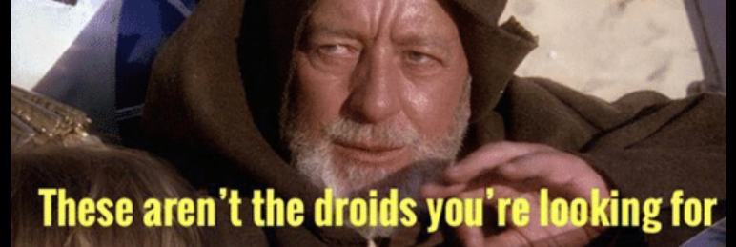


Jedi Mind Tricks
FOR CUSTOMER SERVICE
Brett McArdle: Communications Manager
Notes:
Notes for Brett – 11/5
1. How do you encourage behavior changes in customers?
__________________________________
💬 2. Make It Easy and Clear
People are more likely to change when the action feels simple and obvious.
● Remove friction (e.g., auto-enroll in eco-friendly billing)
● Offer step-by-step guides, visuals, or reminders
__________________________________
🌟 3. Use Social Proof
Show that others are already doing it.
● Share testimonials, community stats, or leaderboards
● Highlight social norms—people tend to follow the crowd.
__________________________________
● Celebrate small wins publicly or through personalized messages
__________________________________
❤️ 5. Connect Emotionally
People act when they feel something.
● Tell stories showing impact (“Your choice helped save 1,000 gallons of water”)
________________________________________
📊 6. Give Feedback and Reinforce Progress
Behavior sticks when people can see the results.
● Send updates or reports
● Use dashboards, apps, or visuals that make progress visible and satisfying.
__________________________________
🔁 7. Nudge, Don’t Lecture
Small “nudges” often work better than persuasion:
● Default options (e.g., automatic paperless billing)
● Timely reminders or prompts
● Gamification (progress bars, challenges, streaks)
2. What are some common questions our field service personnel hear from customers?
- Will we be charged for this?
- What is my bill amount? It is too high, and I did not use that much water
- What is my account number and customer number?
- What is the minimum that I need to pay just to keep the water on?
- Can I extend or possibly change my due date?
- How do I transfer or apply for a new service?
Use past issues/complaints to build content and FAQs
The CAP system (Care, Action, Perspective)
Education within the call
Welcome emails (weekly or monthly)
To effect recall and/or behavior influence, you need 5-10 impressions of a message
"How do you encourage ..." Ask ChatGPT
How does your utility equip your CSRs?
Use Facebook interactions to build content
"You're right!", "We're working on that right now", "I'm glad you asked"

Slide 2

WHERE I’M FROM ...
• Consolidated Utility District (CUD) of
Rutherford County was established in 1968
• Over 70k accounts, serving more than 220k residents
• Rutherford County: fastest growing in Tennessee
• Service area: over 1,700 miles of pipe (which equals the
distance from Murfreesboro to Phoenix, AZ)
• Adding over 2,000 customers each year

Slide 3
LET’S BE HONEST
  Public utilities – even the highest performers - seldom get compliments
  Google reviews of utilities are typically low and associated with complaints (this is a bad metric anyway)
  Our association with government work
    How do we change this perception?

Slide 4
SOME CONTEXT ...
  91% of consumers think companies should put more emphasis on customer service
  70% of customers prefer to call a company vs digital self-service experience
  43% of customers would rather clean a toilet than call customer support
Source: “The Key To An Unforgettable Customer Service Experience”, Forbes, May 2024 online article

Slide 5
BUILD AN ANTICIPATORY MINDSET
  If customers have low opinion of public works/government services, flip the script
  Develop communications about upcoming work (service line repairs, infrastructure upgrades)
  I’m the customer – how would I want to be treated?
Notes:
By putting yourself in your customer's shoes, you'll be able to create messages that get ahead of their questions
This builds trust, helps them understand you have their interests at heart, and shows that your utility has a high level of competence

Slide 6

OUR GOALS ...
  Answer questions with honesty, a positive spirit, and knowledge
    Promote your brand
  Provide the customer with a fact or two they didn't know
    Educate
  Turn them into your ally and maybe even the utility's advocate
    Behavior/Perception change
Notes:
Our goals:
answer questions with honesty, a positive spirit, and knowledge
-- provide the customer with a fact or 2 they didn't know
-- turn them into your ally and maybe even the utility's advocate

Slide 7

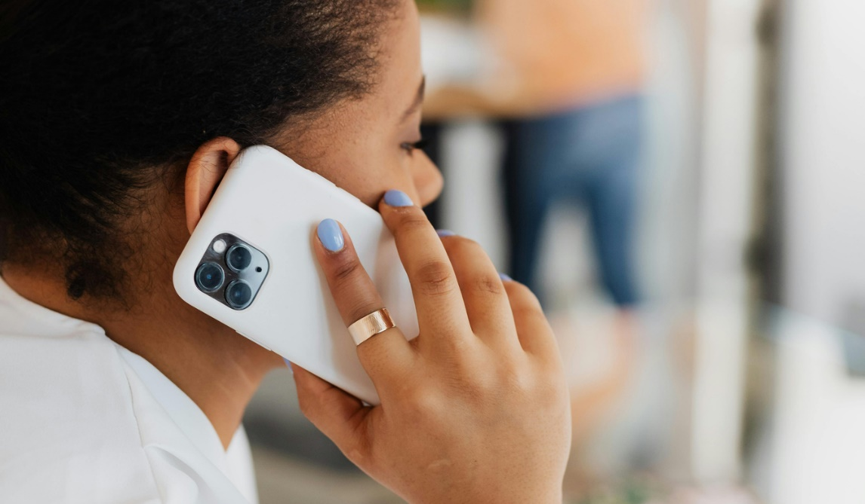


BUILD A TRIPOD
  Phone calls
  Social media/email
  Website
Notes:
This is about meeting customers where they are in terms of communications preferences
Our data shows people prefer email as their contact of first choice
Reaching out in more than 1 way shows you care -- and that you put effort into comms

Slide 8
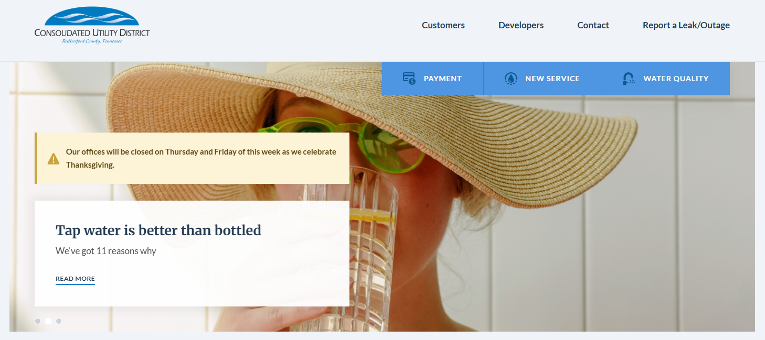
Your website is similar to a gas station (i.e. transactional) Banners and/or alerts are effective signage
Notes:
If your website has the capacity to show alerts, use that space

Slide 9
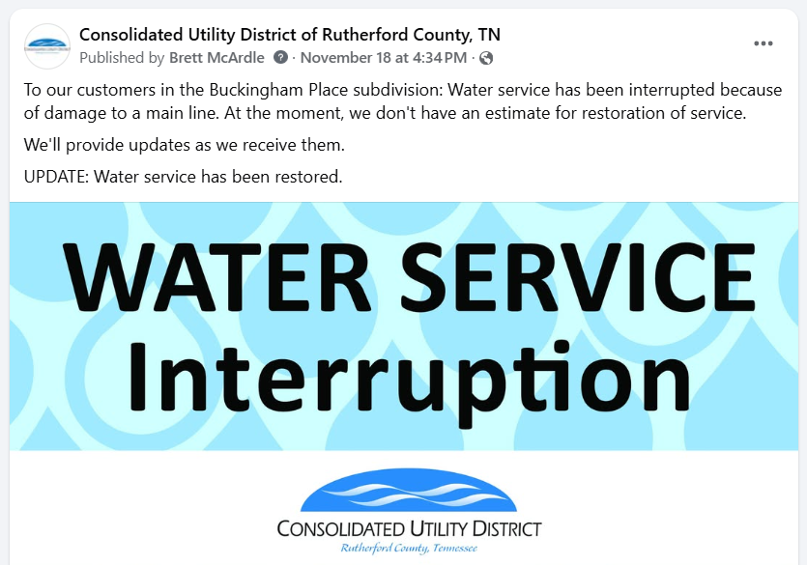
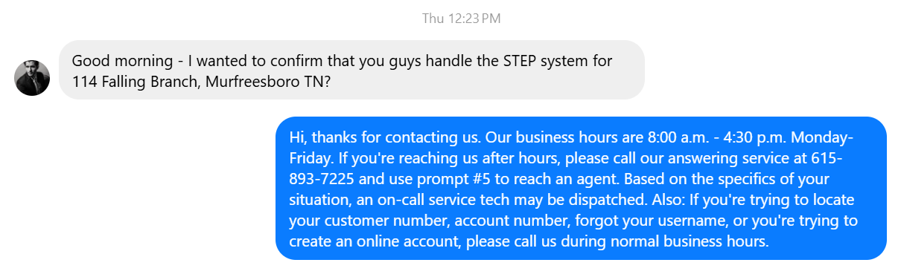
  Social posts for main line breaks and outages
  Social media autoresponse
Notes:
Your social pages are powerful messaging space for delivering "breaking news" from your utility

Slide 10

WHEN CUSTOMERS CALL
  Harvest information from phone conversations
  Do certain topics keep coming up?

Slide 11
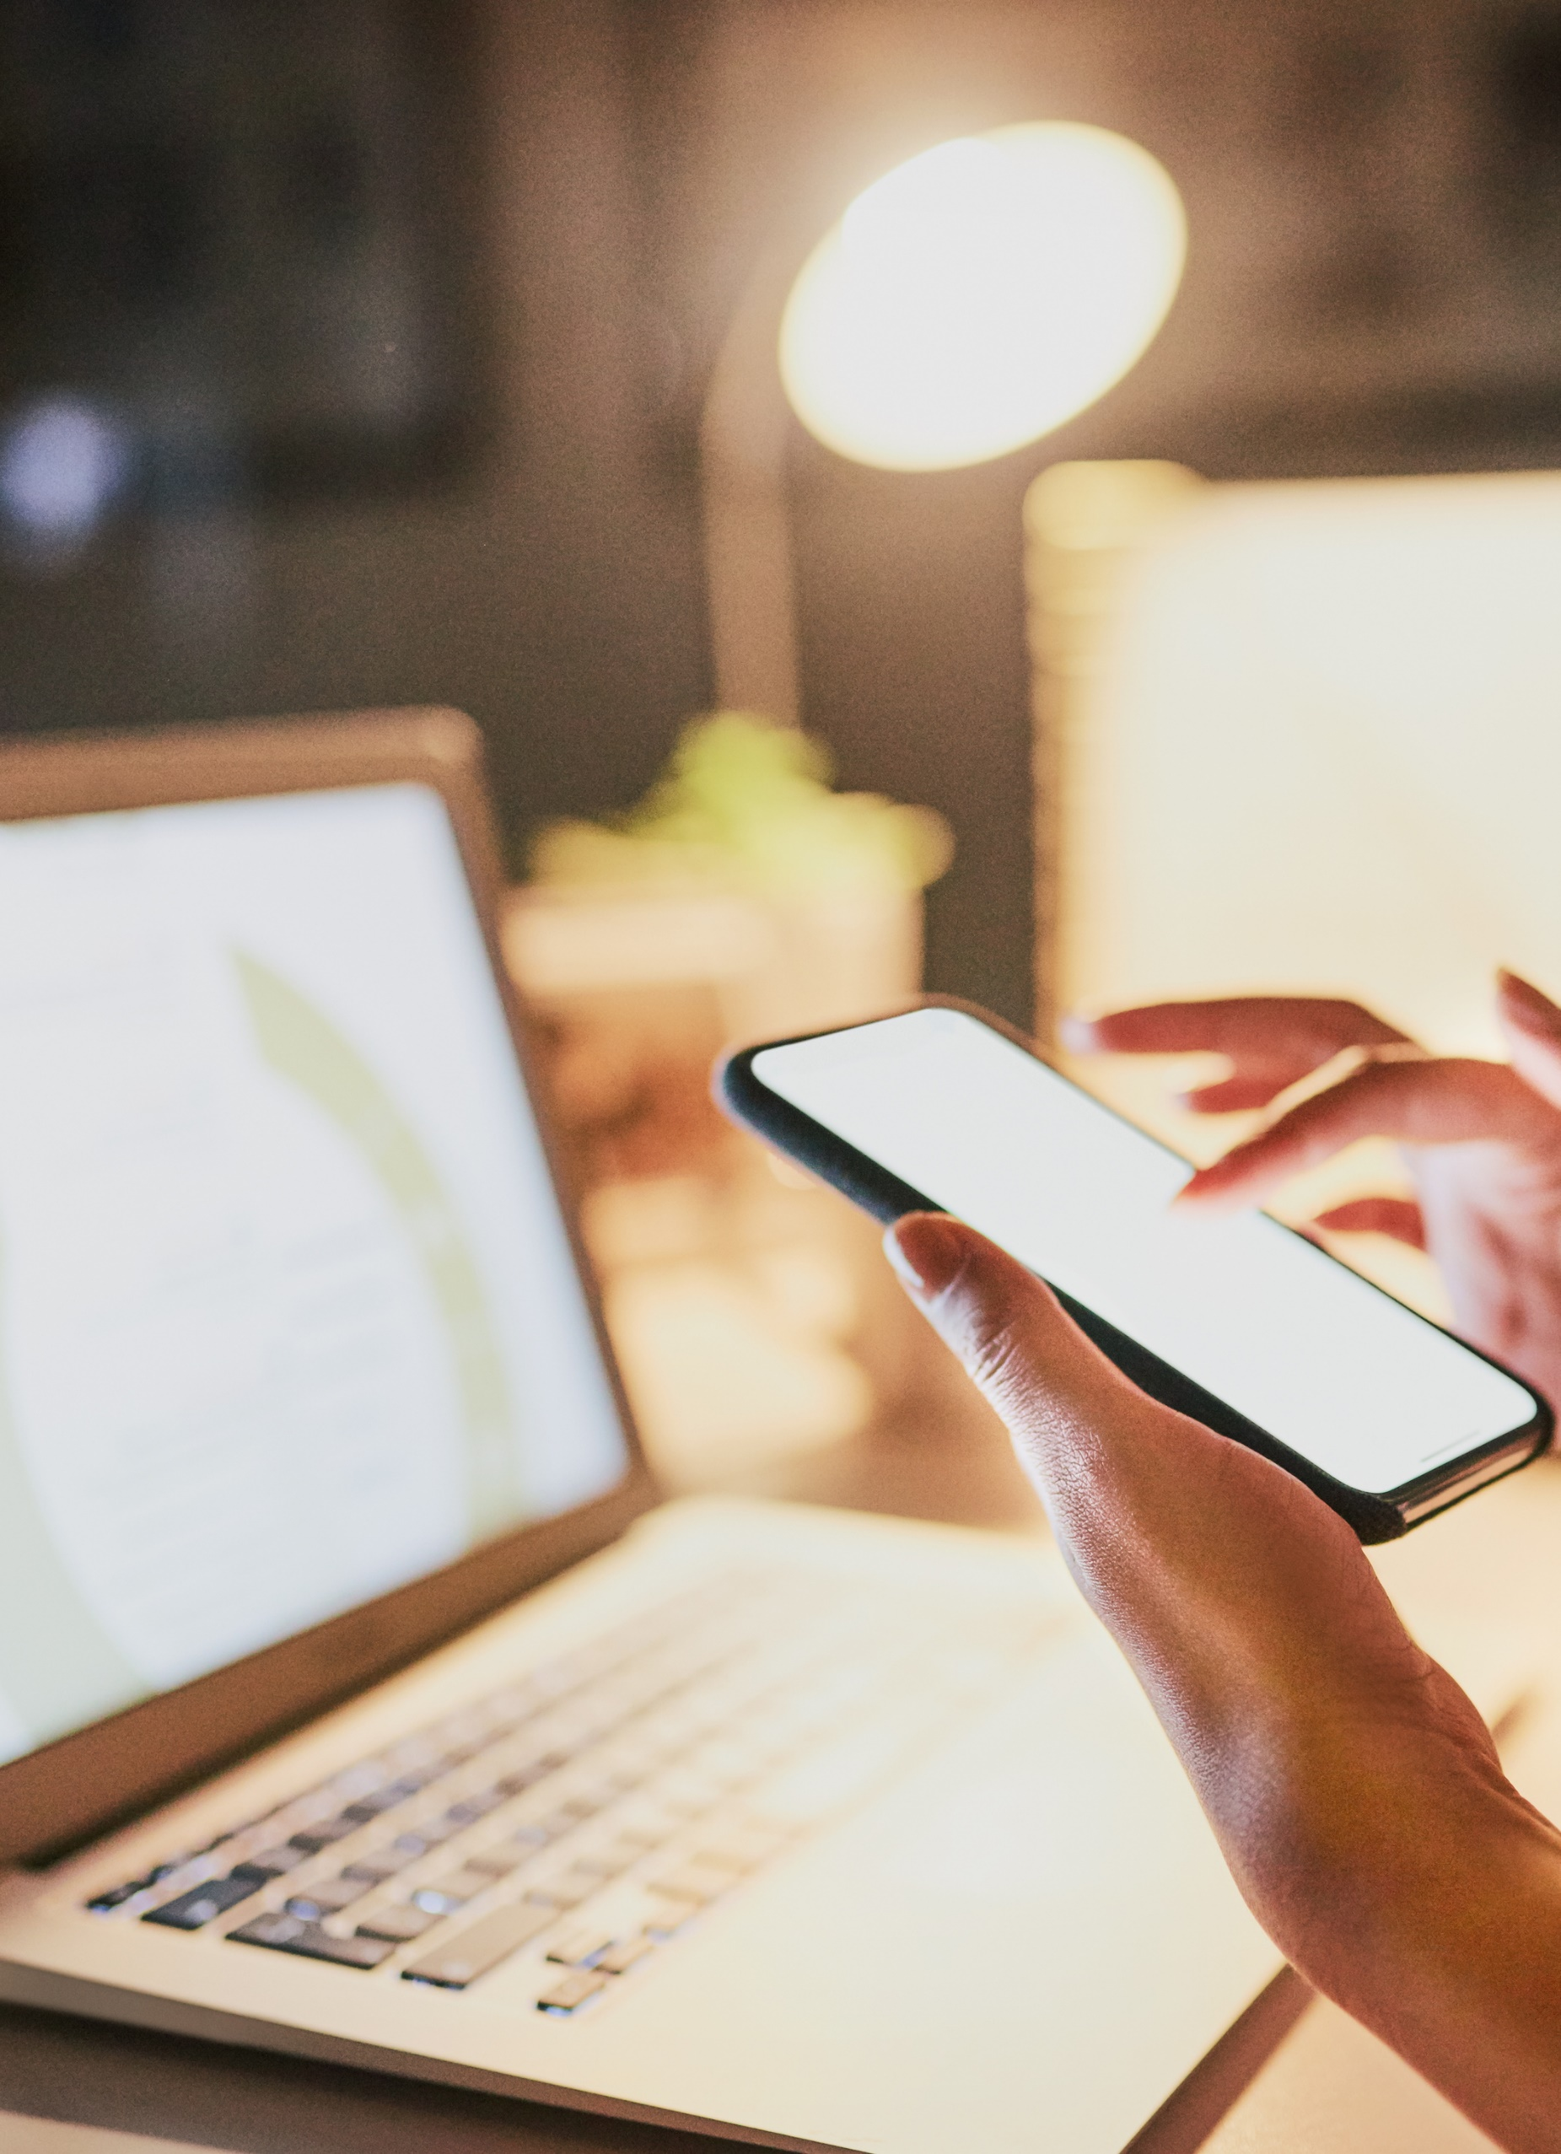
SOCIAL CONTENT
  Recurring topics from phone calls become opportunities for social posts
  You can condition your customers to answer questions for you online; the key is repetition
Notes:
With enough consistent messaging, you can enable your customers to answer other customers' questions when they occur on social media
We've seen this happen a number of times

Slide 12
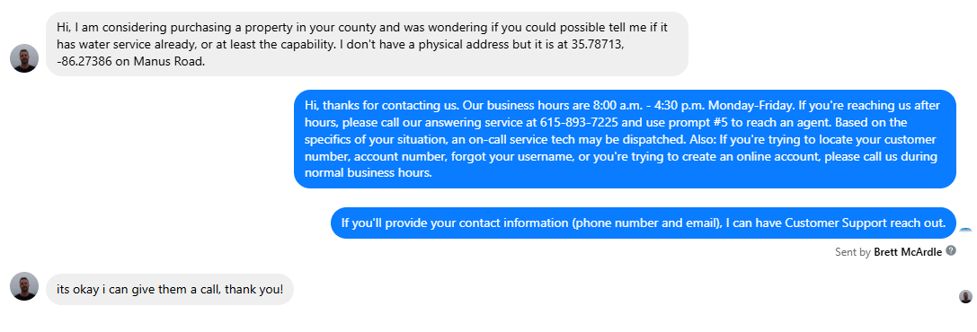
ON SOCIAL MEDIA ...
Close the loop: contact customers within 24 hours
The customer wants to know s/he was heard
Notes:
Even if you're unable to solve the need in that moment, responding to the customer tells him/her that they're being heard -- which is vital

Slide 13
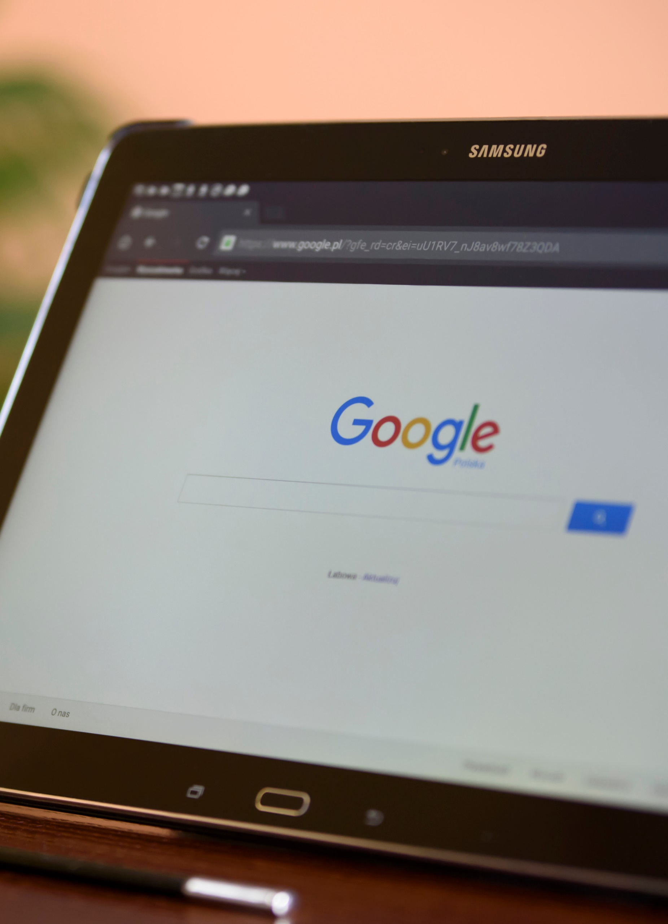
WEBSITE
  Common topics during phone calls become webpages
  Chances are, customers won’t seek out your webpage on a particular topic, but you can send the link
  Customer Service FAQ

Slide 14

YOU CAN TAG TEAM EMAIL & YOUR WEBSITE
Understand the customer’s “why” - What’s their motivation for contacting you?
If emailing the customer a response, include a brief message with the link to information.
Notes:
Sending a link with no context can be seen as dismissive and may appear to the customer like AI or a chatbot
They want a human connection
Even a single sentence, paired with a link, makes you sound more human

Slide 15
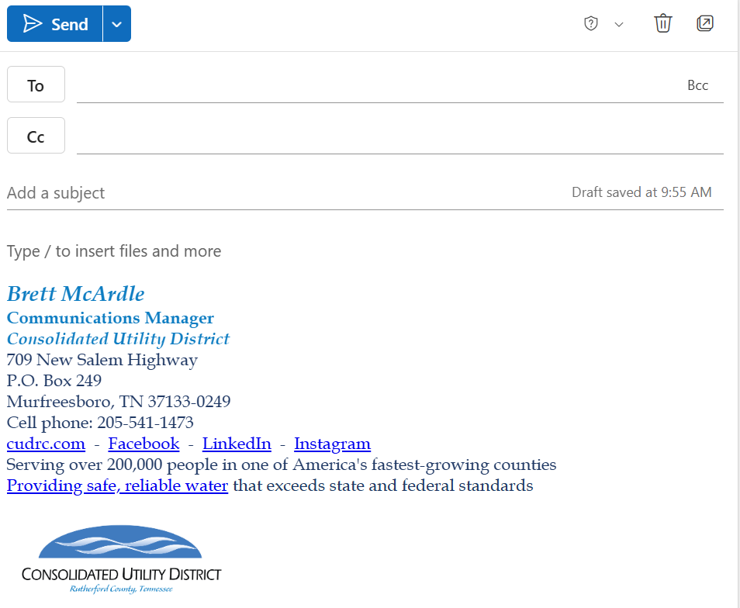
ABOUT EMAIL: KEEP THIS IN MIND
Tip: Never send an email you wouldn’t want screenshotted and sent to the press
Another tip: What information does your email signature provide?

Slide 16
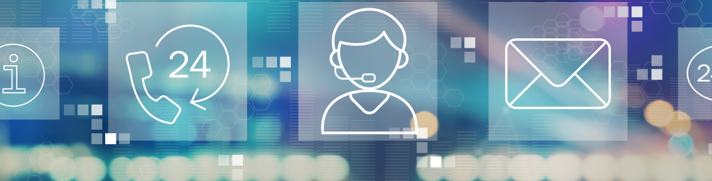
EMPOWER CUSTOMER SERVICE
  Allow CSRs to initiate work orders for pressure checks, meter inspections, or leak checks
  Train CSRs on basic water quality science (chlorine residual, hardness, taste/odor)
  Enable limited billing adjustments for verified leaks or meter misreads

Slide 17



LET’S GET EMOTIONAL
Notes:
All humans are emotional beings. The notion that one gender is moreso than the other is nonsense.
People are calling or emailing because of a need that impacts their emotions.
That's the baseline of interactions with customers.

Slide 18
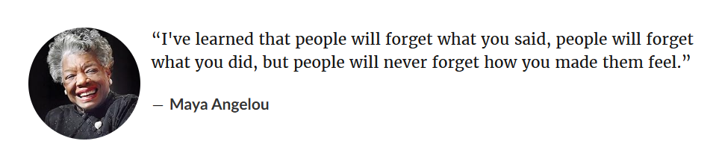
Notes:
1000% correct
Think about the times someone has truly helped you in a customer service situation.
And when were they less than helpful?
Our emotions -- and our ability to touch lives -- help to define us as beings.

Slide 19



HIRING, HELPING, AND HEROES
  Hire for empathy, curiosity, and problem-solving
  Create a customer-oriented culture
  Communicate performance goals clearly
  Celebrate wins: share real customer stories

Slide 20

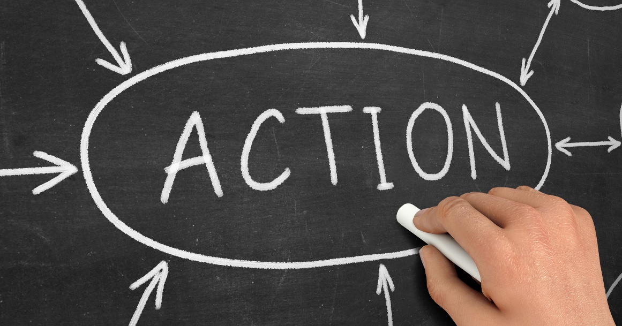

THE CAP SYSTEM
  Care
  Action
  Perspective

Slide 21

EXAMPLE OF CARE
•Communicate and show compassion about the gravity of the situation.
Name the concern with a caring attitude.
“I understand your concern about children’s health and lead in drinking water.”
Connect further using empathy. “The health of children is important to me and one of the reasons I work at/run a drinking water utility.”

Slide 22
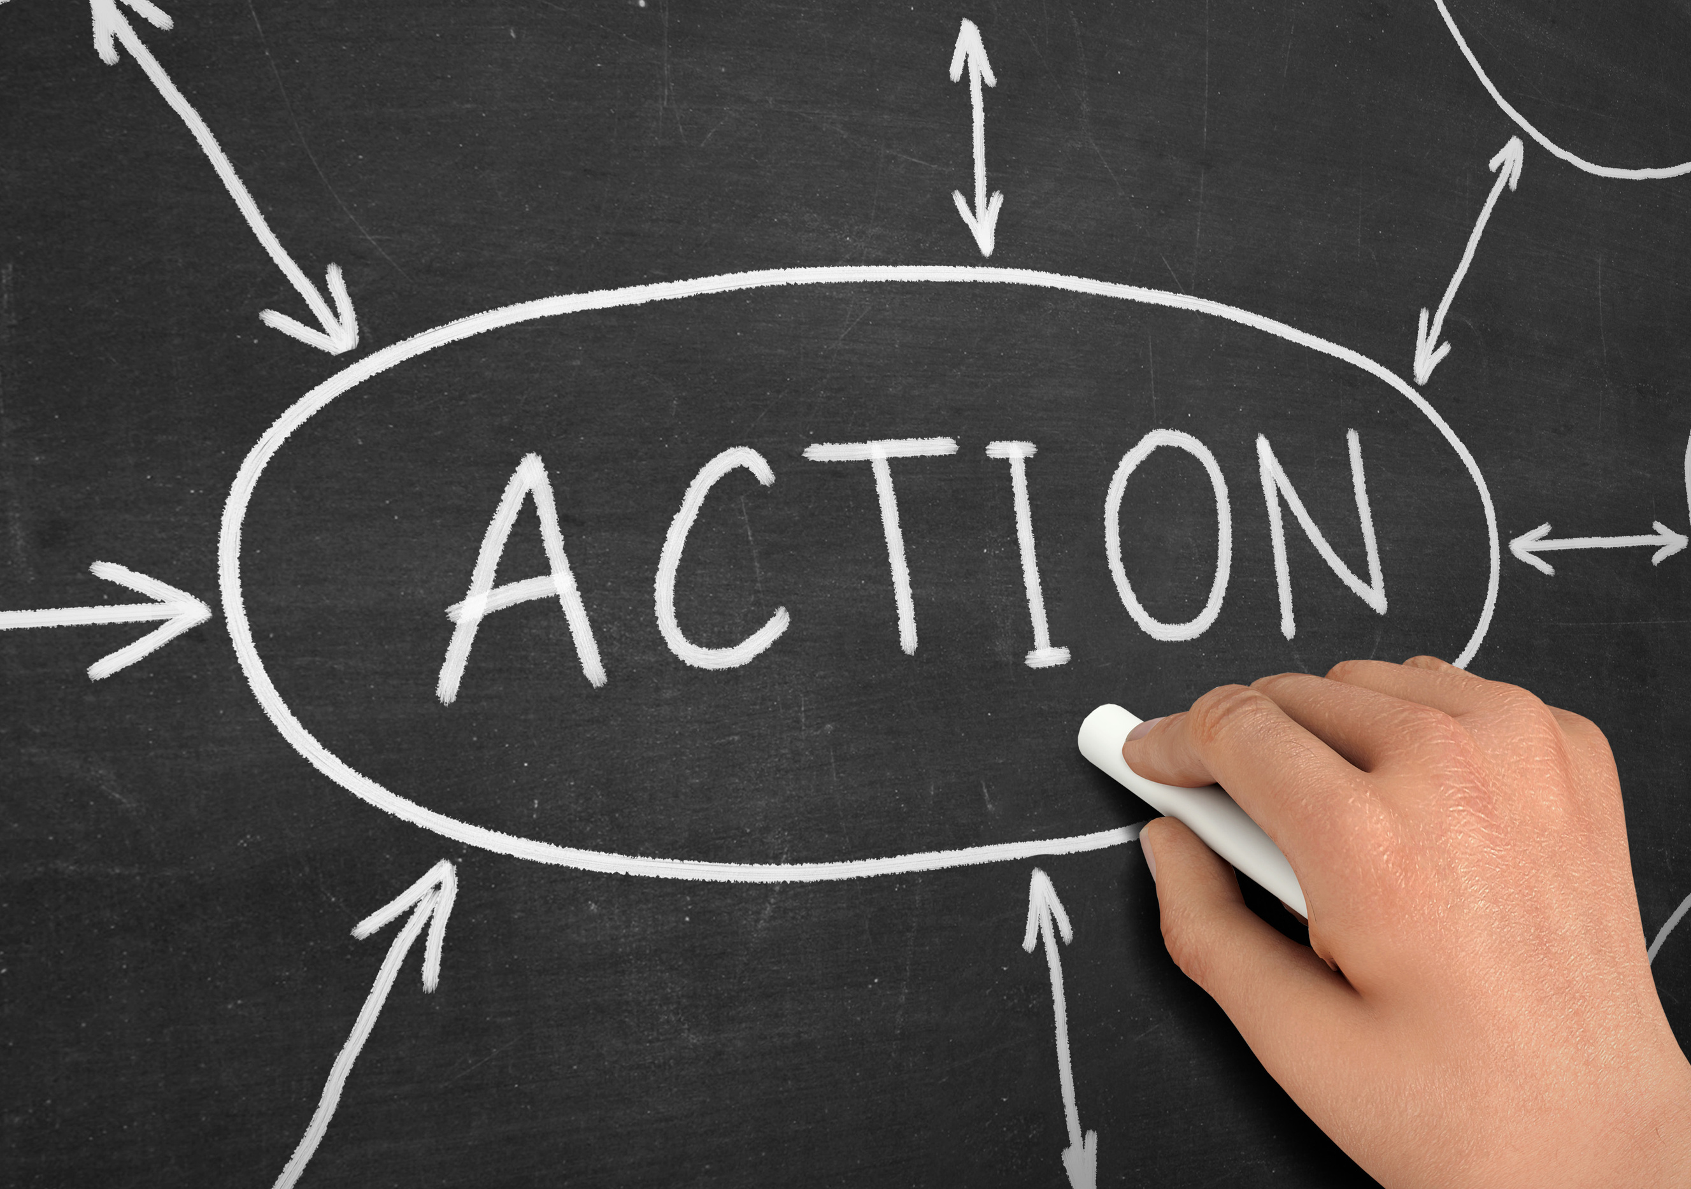
EXAMPLE OF ACTION
•What steps you have taken or will take to address the issue.
“Our utility has an extensive treatment and monitoring program
to ensure the water we produce and deliver protects your family
from the risks of lead in drinking water.
Our monitoring findings are shared in an open and transparent way with our state regulators and summarized and shared with our community
in our annual Consumer Confidence Report.”

Slide 23

EXAMPLE OF PERSPECTIVE
• Provide information that puts the issue in context.
“Our community water meets every EPA drinking water standard. We pay close attention to emerging research, and our concerns about drinking water are always focused
on the health of you and your family.”

Slide 24
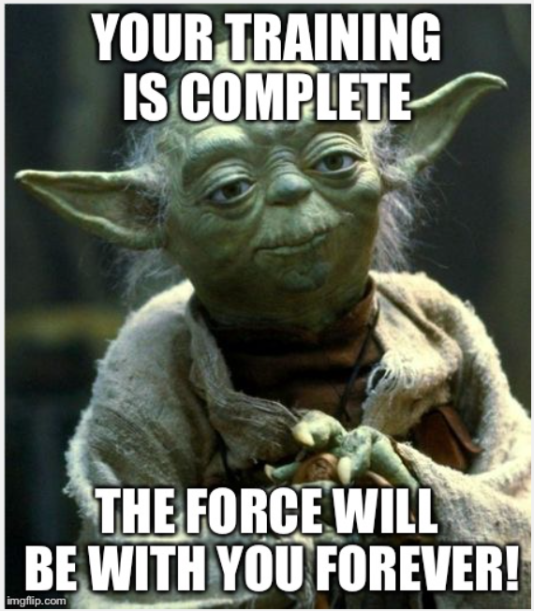
JEDI MOVES ...
Use “We” and “I” Language
Inclusive phrasing builds a sense of partnership.
Examples:
  “Let’s see what we can do together.”
  “I’ll personally make sure we get this sorted out.”
“Let’s take a look at what happened and figure out how to make it right.”

Slide 25
MORE JEDI MOVES ...
Restate the problem: paraphrase what the customer said to show understanding and accuracy.
“So the bill was higher than expected because of a leak you didn’t know about—is that right?”
Show ownership: empathy + action
“I’ll take responsibility for fixing this, and I’ll follow up with you by the end of the day.”

Slide 26
MORE JEDI MOVES ...
Customer: “This bill is double what I normally pay! You people always mess up my account.”
Rep:
  Acknowledge emotion.“I can see why you’re upset— that’s a big jump.”
  Clarify details. “Let’s look together at what might have caused it.”
  Offer next step. “I’ll check your usage history and get this sorted out.”

Slide 27
MORE JEDI MOVES ...
Customer: “Your technician never showed up! I wasted my afternoon!”
Rep:
  Validate feelings.
  “I understand why you’re frustrated. I’d be upset too.”
  Take ownership. “That’s not the experience we want for you—I’ll follow up.”
  Offer resolution. “Let’s get you rescheduled for the soonest available time.”

Slide 28
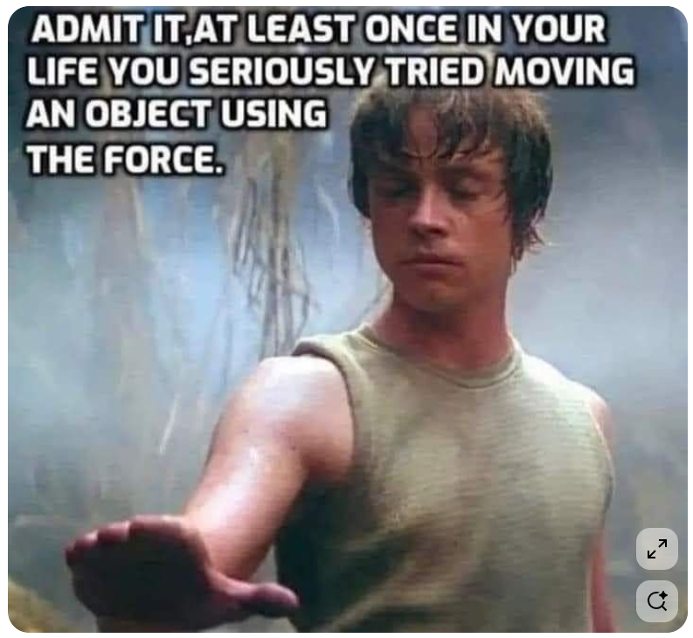
MORE JEDI
MOVES ...
  “I’m glad you asked”
  “You’re right!” (they don’t expect you to take their side
  “We’re working on that now” (provide updates)
  Agree – and offer a factoid
  We’re our own customers

Slide 29
BOUNDARIES
Being friendly, helpful, and knowledgeable doesn’t mean you’re a pushover.
You are not expected to simply absorb mean-spirited, abusive words.
Notes:
🧠 1. Stay Calm and Don’t Take It Personally
Why it works: Angry customers often just want to vent; reacting defensively escalates tension.
How to do it:
Take a breath before responding.
Lower your voice and slow your speech — people unconsciously mirror tone and pace.
Remind yourself: “They’re upset at the situation, not me.”
🗣️ 2. Use Active Listening
Why it works: Feeling unheard intensifies anger.
How to do it:
Let them finish speaking without interrupting.
Use short verbal nods (“I see,” “I understand”).
Paraphrase back: “So what I’m hearing is that you were charged twice this month — is that right?”
💬 3. Acknowledge and Empathize
Why it works: Validation reduces emotional intensity.
How to do it:
“I’d feel the same way if that happened to me.”
Avoid insincere or robotic empathy (“I’m sorry you feel that way”).
🧭 4. Apologize and Take Ownership
Even if it wasn’t your fault: “I’m really sorry you’ve had to deal with this.”
Shift to solution mode: “Let’s get this fixed right away.”
🔧 5. Offer Clear Next Steps
Why it works: Anger often stems from uncertainty or lack of control.
How to do it:
Be transparent: “Here’s what I can do for you…”
Outline timeframes: “You should see the adjustment on your next bill.”
Summarize the plan before ending the call.
🤝 7. End on a Positive Note
“I appreciate your patience while we worked through this.”
“I’m glad we could get this resolved for you.”
“If you have any issues at all, please reach back out — we’ll take care of it.”
🚫 Bonus Tip: Avoid Common Pitfalls
Don’t say “Calm down.” (It rarely works.)
Don’t overpromise or make excuses.

Slide 30
WHAT IF WE’RE ADDRESSING A MISTAKE?
  Responsibility
  Regret
  Reform
  Restitution
Notes:
When a utility takes responsibility, expresses regret, and corrects the issue, the public is overwhelmingly forgiving
Recognizing an honest mistake earns you grace
Source: Good Enough for Government Work (Amy Lerman, pg. 187)

Slide 31

GOT GOOD NEWS?
INCLUDE THAT IN THE CALL
  Opportunity to educate
  Build/Reinforce positive perceptions of your utility
Notes:
Anything to share from your CCR?
Any recent awards?

Slide 32

ENDING A PHONE CALL
“Thank you for choosing AT&T”
Notes:
Though you're likely a monopoly, a little gratitude goes a long way
AT&T used this line years ago to thank its customers

Slide 33
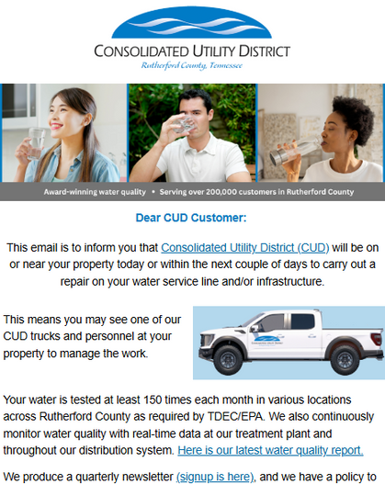
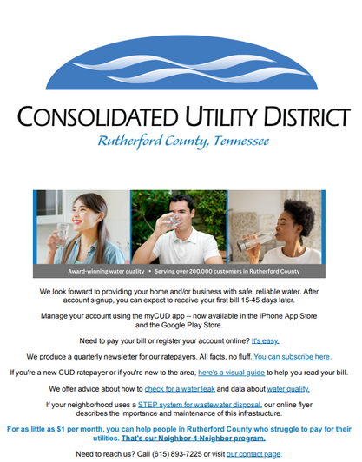
2 ANTICIPATORY STEPS
Notes:
Welcome emails to new customers and messages in advance of service line repairs

Slide 34
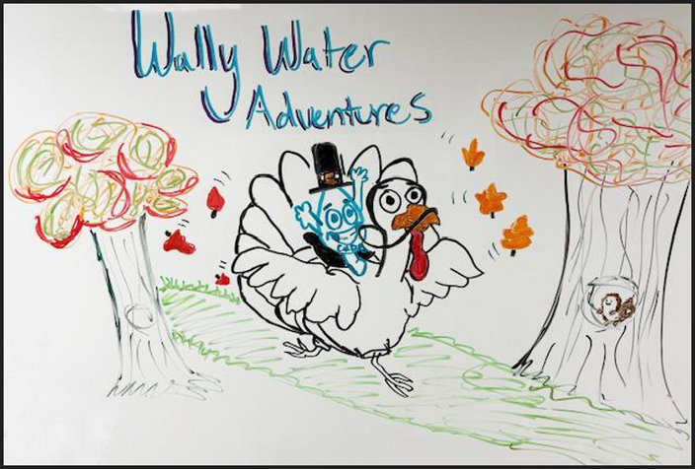
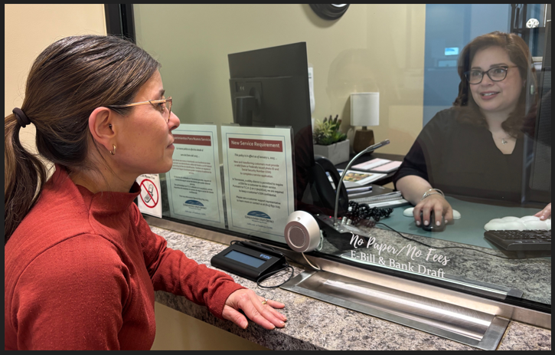
BEYOND CUSTOMER SERVICE SKILLS
  Bilingual
  Creative
  Culture building
Notes:
What other skills do your Customer Service members have?
Are those skills being engaged?

Slide 35

“In my experience, there is no such thing as luck.”
OBI WAN KENOBI
Brett McArdle: Communications Manager
Notes:
Luck is when preparation meets opportunity

Slide 36
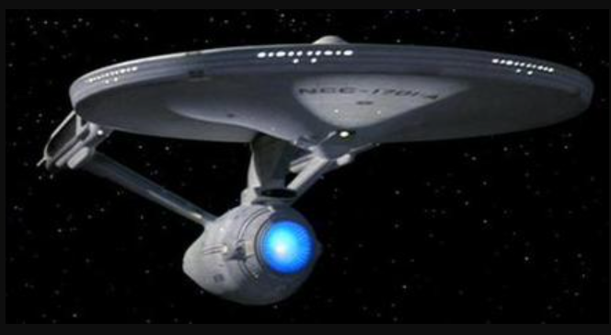
Live long and prosper

Slide 37

THANK YOU
Brett McArdle: Communications Manager
bmcardle@cudrc.com

