Slide 1
Don’t Get Railroaded by a Boring Project
2026 TAUD Business Conference​
Chris Strupp, P.E.
OHM Advisors - Nashville

Slide 2
Today’s Boring Agenda
How one improperly installed railroad crossing delayed a project by seven months and required engineering, legal, railroad, contractor, and owner coordination to resolve.
Project Scope and Need
The Initial Attempt
Where to go from here
Resolution
Lessons Learned

Slide 3
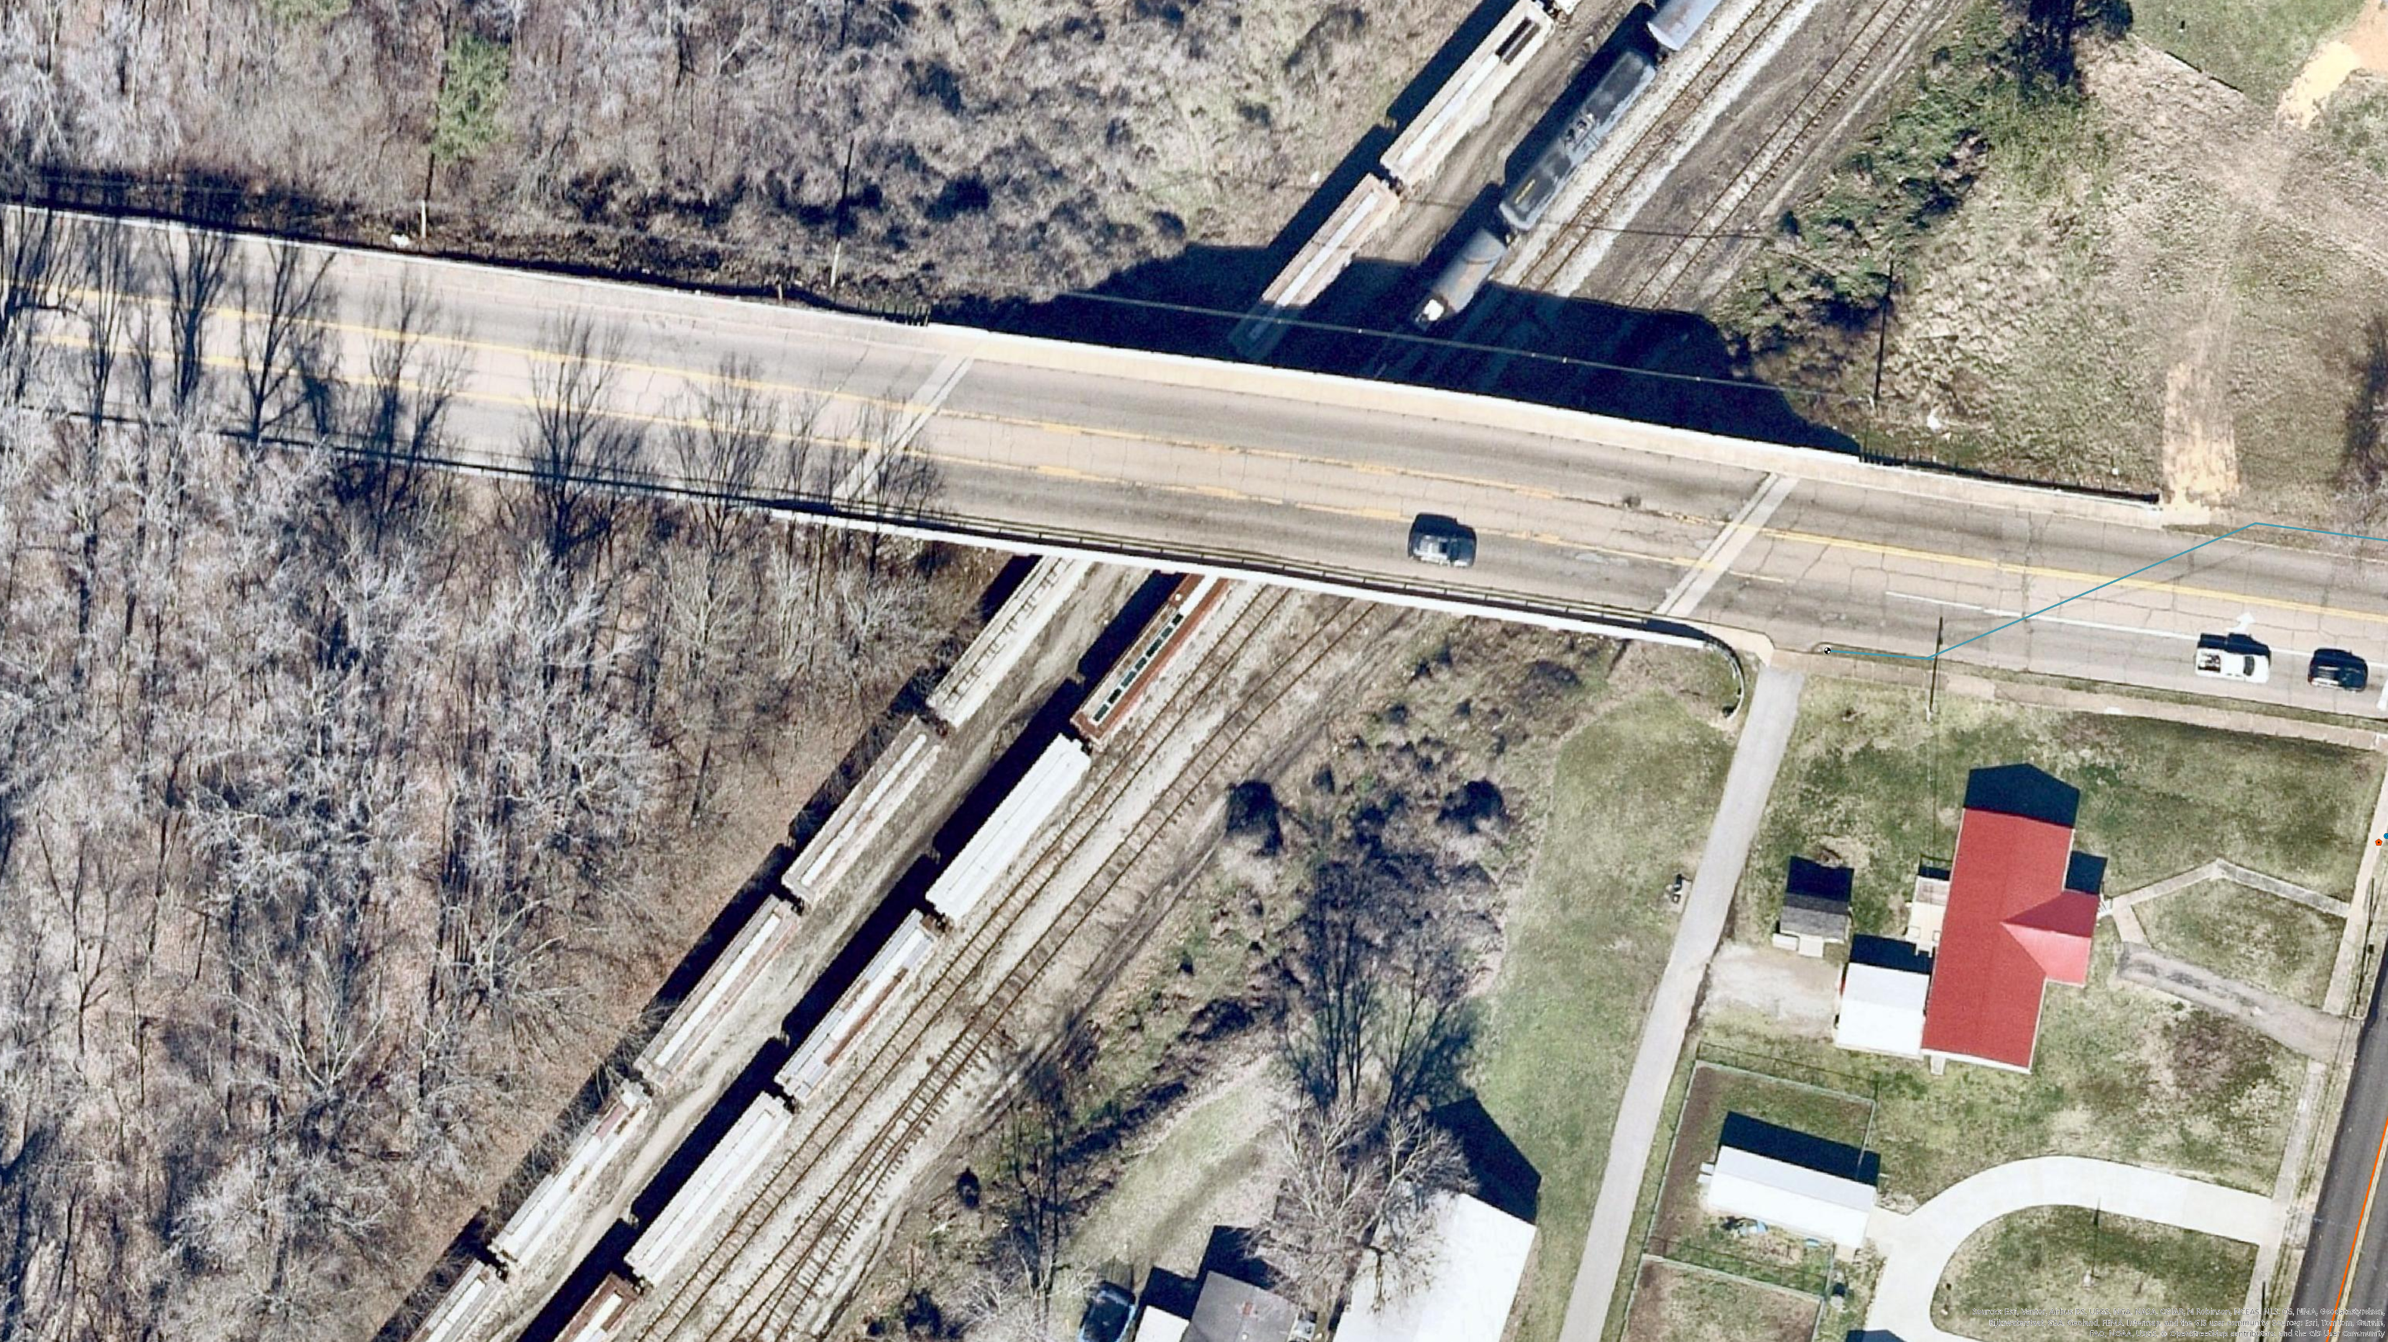
Initial bridge attachment proposal was rejected by TDOT
Final design routes the water line beneath the railroad via bore and jack.
Permit was obtained from RR. Responsible Party for RR Permit was Utility and only for that location.
Project Location: West TN
Project scope: Replace 21,000 LF of existing water main including 140 LF Bore & Jack

Slide 4
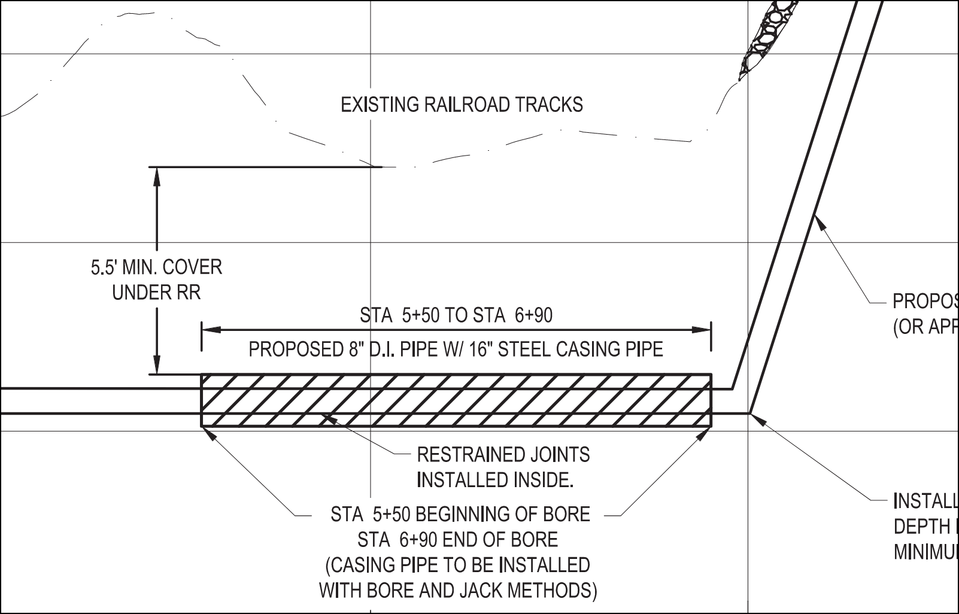
Let’s see how the first attempt went…

Slide 5
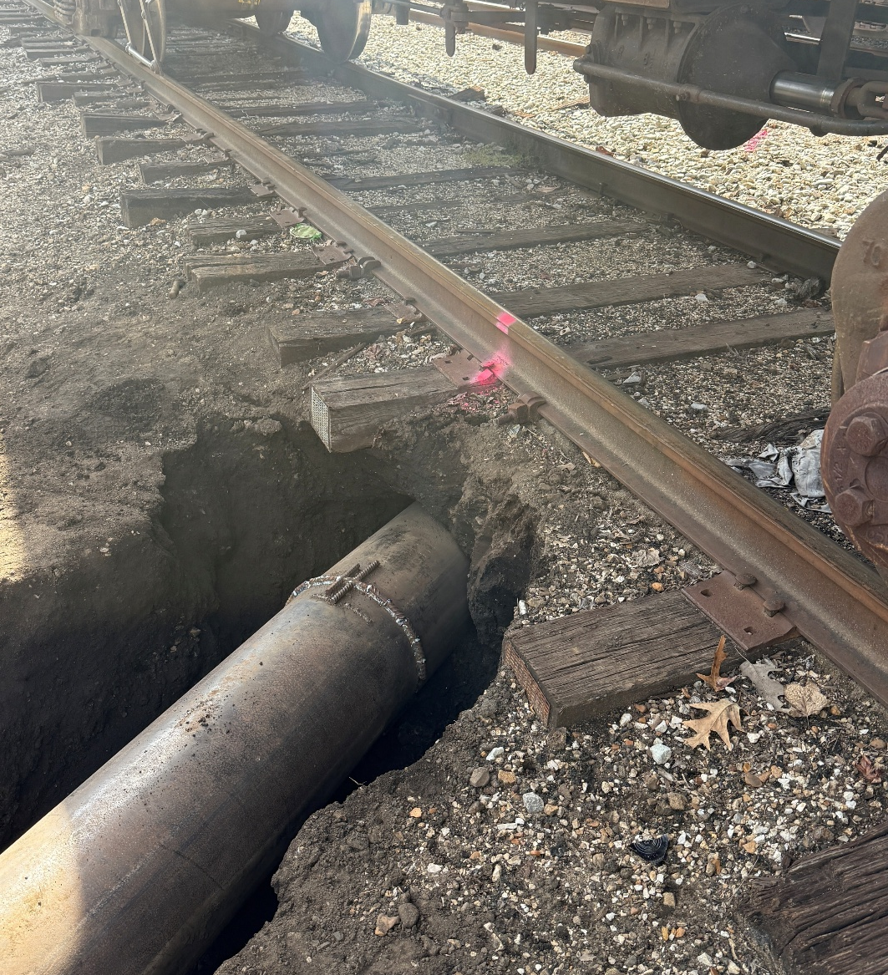
The First Bore Attempt
The subcontractor installed the bore and jack under the railroad with less than 18 inches of cover.
The contractor did not intentionally bore shallow—the deviation occurred during installation. The head of bore changed course in the final run and was not located as the bore progressed.
RR track and site appeared to be stable.
Work began as to how to best reconcile.

Slide 6
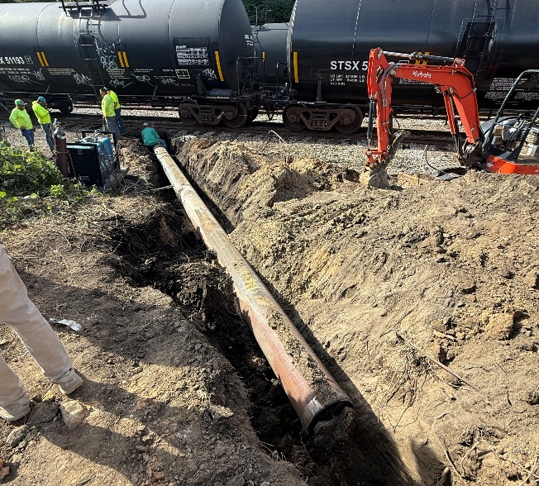
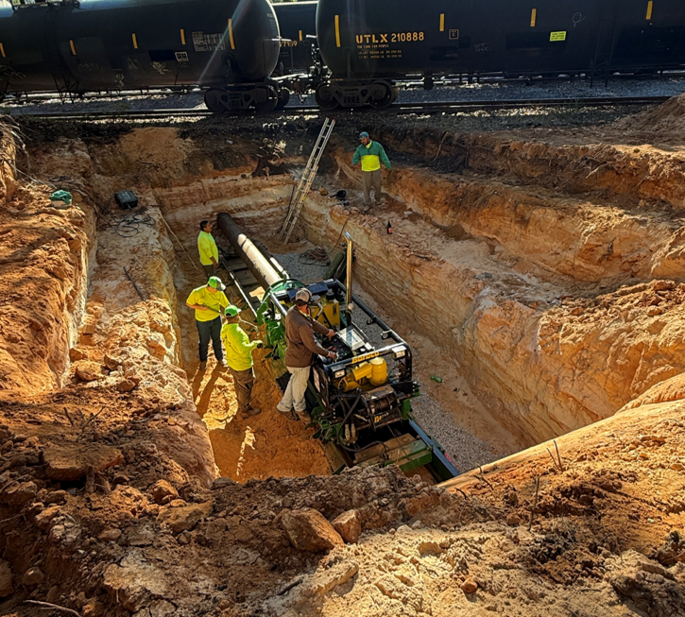
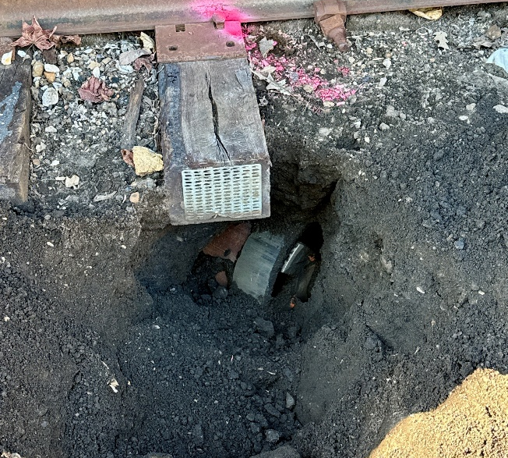
Bore Setup
18” of Cover under RR Tie
Overall View
Initial reaction from many was to move on…

Slide 7
A Boring Decision to be Made
Leave the 1st attempt and continue work
Advantages
No schedule delays
Limit added costs
Local RR Rep OK
Local Utility could work with it (not ideal)
Disadvantages
Long-Term Maintenance of water line
Long-Term integrity of RR
Funding Agency sign-off
Engineering Certification
Regulatory exposure (TDEC Min. Cover)
*Liability of all Stakeholders*
Costs for corrective action
Risks to local relationships

Slide 8
A Boring Decision to be Made
Make a 2nd Attempt
Disadvantages
Add months to the project schedule
More time from Utility / Engineering / Inspection can be costly
Potential abandonment costs
No certainty how other Stakeholders will react (Contractor, RR)
Risk exposure on 2nd attempt
Risk to local relationships
Advantages
Long-Term Maintenance of water line
Long-Term integrity of RR maintained
Funding Agency sign-off
Engineering Certification
Regulatory (TDEC Min. Cover) in Spec
Liability of all Stakeholders decreases
Costs for corrective action mitigated

Slide 9
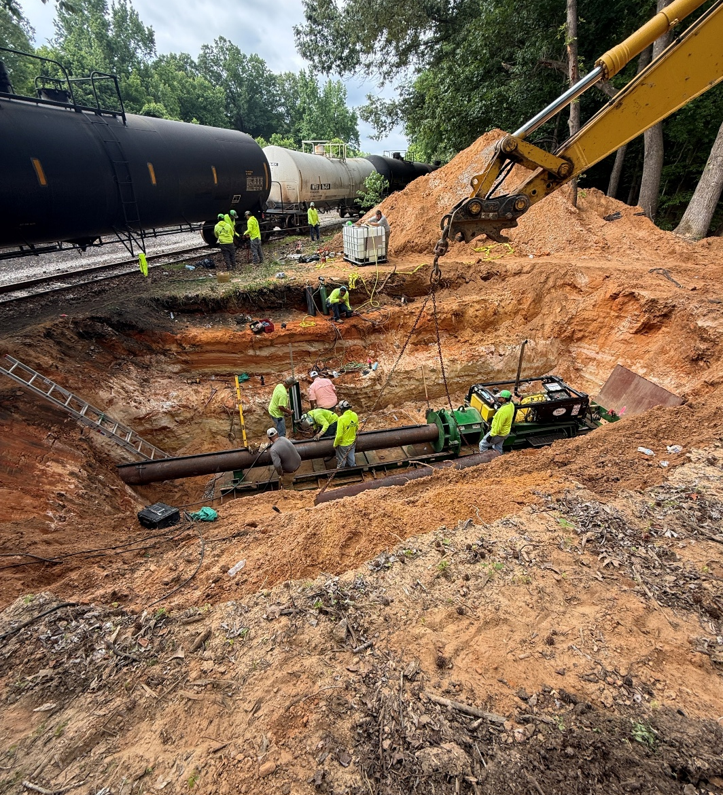
Outcome
Ultimately, the liability associated with a non-conforming installation was too great. Short term gains were not worth long-term disadvantages. Utility would pursue a 2nd bore attempt.
Next Steps
Ideally, coordination with the Utility and Railroad would have led to revised plans, a new permit, and construction resuming within 1–2 months.

Slide 10
7 Months Later…
October 9, 2025: Initial Bore Attempt
October 16, 2025: Notify Railroad of Non-Conformance
November 3, 2025: Revised Drawings to Railroad
April 30, 2026: Utility sends the RR an ultimatum by May 9. If no response, then proceed.
May 18, 2026: Contractor begins work on 2nd attempt
May 9, 2026: No response from Railroad – Engineer and Utility begin coordinating the second attempt
December 17, 2025: RR Amendment Rec’d (Not Signed, No Abandonment Procedure)
Jan-April 2026: Utility Legal counseled, multiple requests made to RR to revise – No reply

Slide 11
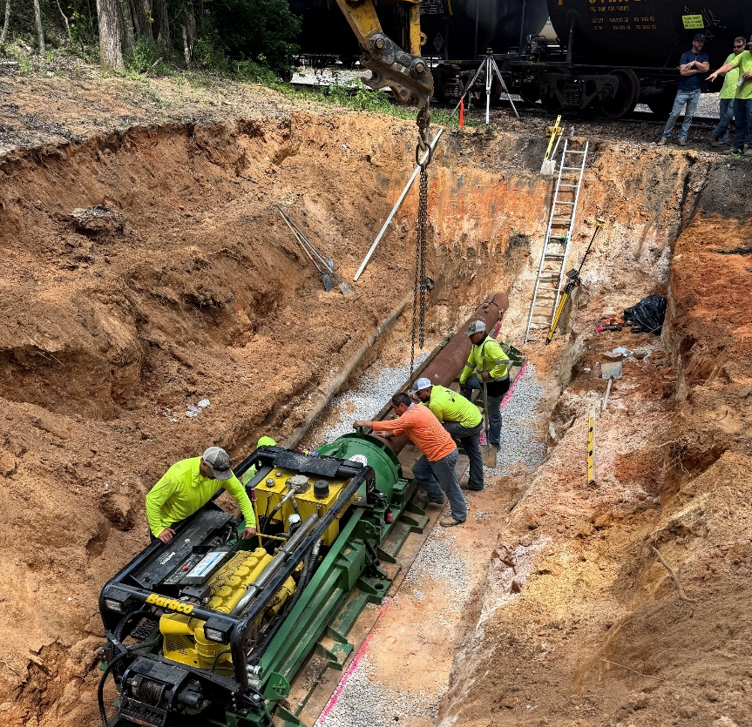
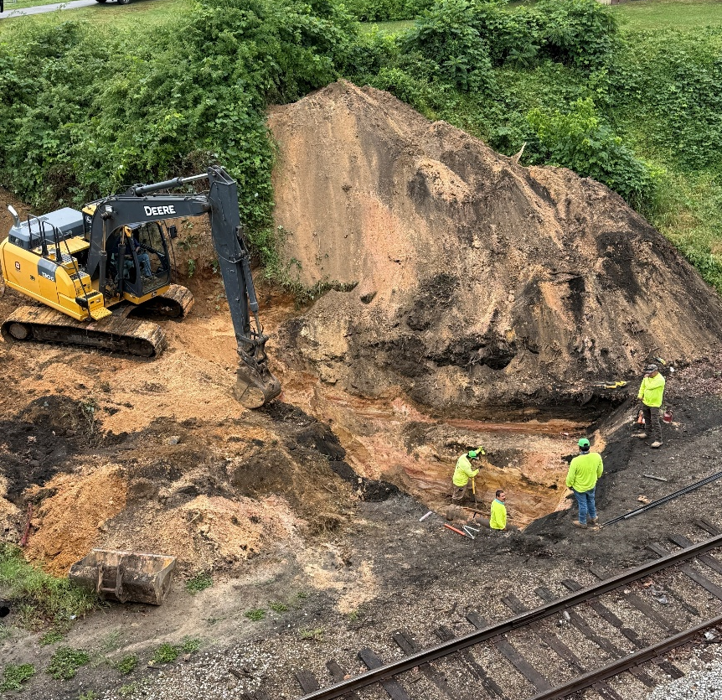
Railroaded No More
The second bore and jack was completed in late May 2026, 9 months after permit issuance, meeting the railroad’s 5.5’ minimum cover requirement.

Slide 12
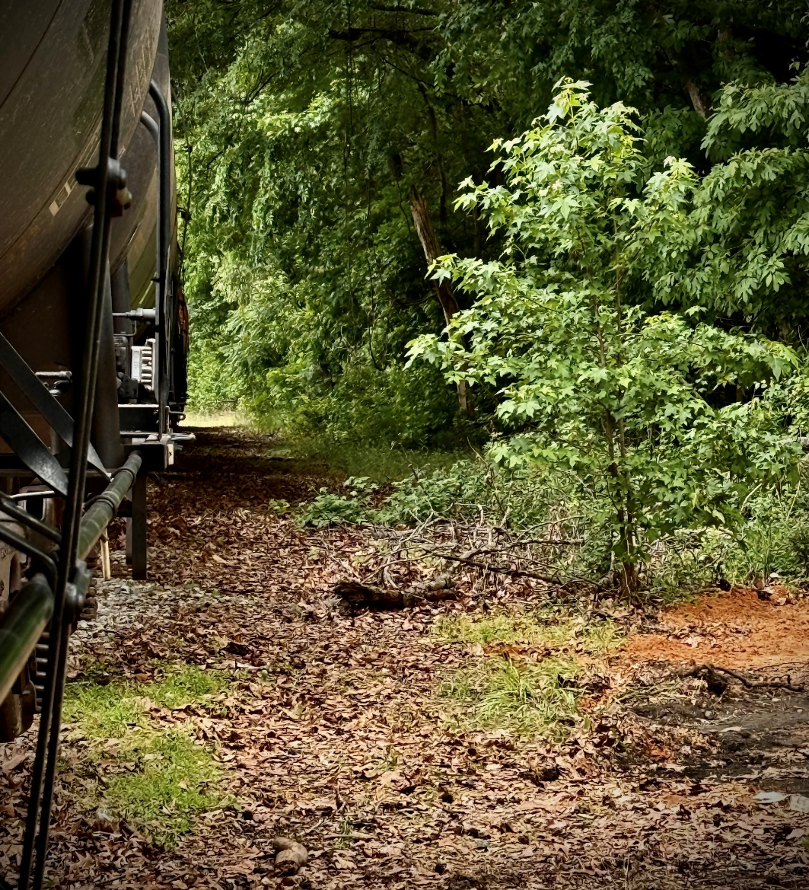
If this happens on your project…
Before work begins: Read through RR Specifications, Application, Contract to be aware of requirements.
Meet contractor immediately onsite and reasonably secure the site.
Explore liability / cost exposure and technical / operational risks before settling on a direction.
Contact RR and verify railroad expectations in writing; document attempted and actual interactions.
Engage legal early to provide counsel and set timetables.
Document every decision (internal team and external stakeholders).
Railroad issues likely won’t be solved quickly. Protect your long-term interests, even when the short-term fix is easier.

Slide 14
Zara ‘ZZ’ Hoch, P.E.
Project Manager
Knoxville, TN
zara.hoch@ohm-advisors.com
Chris Strupp, P.E.
Project Manager
Nashville, TN
chris.strupp@ohm-advisors.com

