Slide 1

May The Force (Account)
Be With You
Presented By:
Zara Hoch
OHM Advisors – Knoxville

Slide 2
What is a Force Account?
Method by which a Municipality/Utility District completes work using their own personnel, equipment, and resources
An alternative to traditional bid contracts
Applicable to projects that qualify for funding/reimbursement

Slide 3


Procurement Methods Comparison
Force Account
Traditional Bid-Contract
Work performed by Municipality/Utility using own personnel and resources
Work performed by consultant/contractor selected through competitive bidding process
Costs of labor, equipment, and materials are directly documented and paid for by the Municipality/Utility
Costs are determined by contract, usually using lump sum or unit prices
“Yoda’s Species.” Wookieepedia, Fandom, Inc., 2020, https://starwars.fandom.com/wiki/Yoda%27s_species. Accessed 11 Aug. 2026.
“Hover Pram.” Wookieepedia, Fandom, Inc., 2019, https://starwars.fandom.com/wiki/Hover_pram. Accessed 11 Aug. 2026.

Slide 4
Benefits of a Force Account
Project scope flexibility
Potential construction cost savings
Davis-Bacon Labor Compliance not typically required unless above a specific threshold
  May reduce administrative burden associated with bidding and managing a federally-funded contract
  Example: ARP requires Davis-Bacon on projects over $10M
Important to Note: Local and State minimum wage requirements will need to be followed

Slide 5

Benefits of a Force Account
Depending on funding source, internal labor can count as in-kind match
  Documented labor/equipment costs can go towards local match requirements
  In-kind match is not always included in the total funding reimbursement
“Stormtrooper Corps (Legends).” Wookieepedia, Fandom, https://starwars.fandom.com/wiki/Stormtrooper_Corps/Legends. Accessed 11 Aug. 2026.
.

Slide 6

Disadvantages of a Force Account
Greater administrative effort – the Utility/Municipality acts as the Prime Contractor
  Responsibilities include:
    Documentation
      Material cost estimates
      Equipment logs and usage
      Tracking internal and supplemental labor time
      Receipts
    Schedule
      Meeting funding source benchmarks and deadlines
      Coordinating and managing Subcontractors
    Audits
    Frequent communication/coordination between funding facilitator, utility/municipality, engineer, etc.
    Submissions to regulatory and funding agencies
    Organizing state required inspections based on funding source

Slide 7
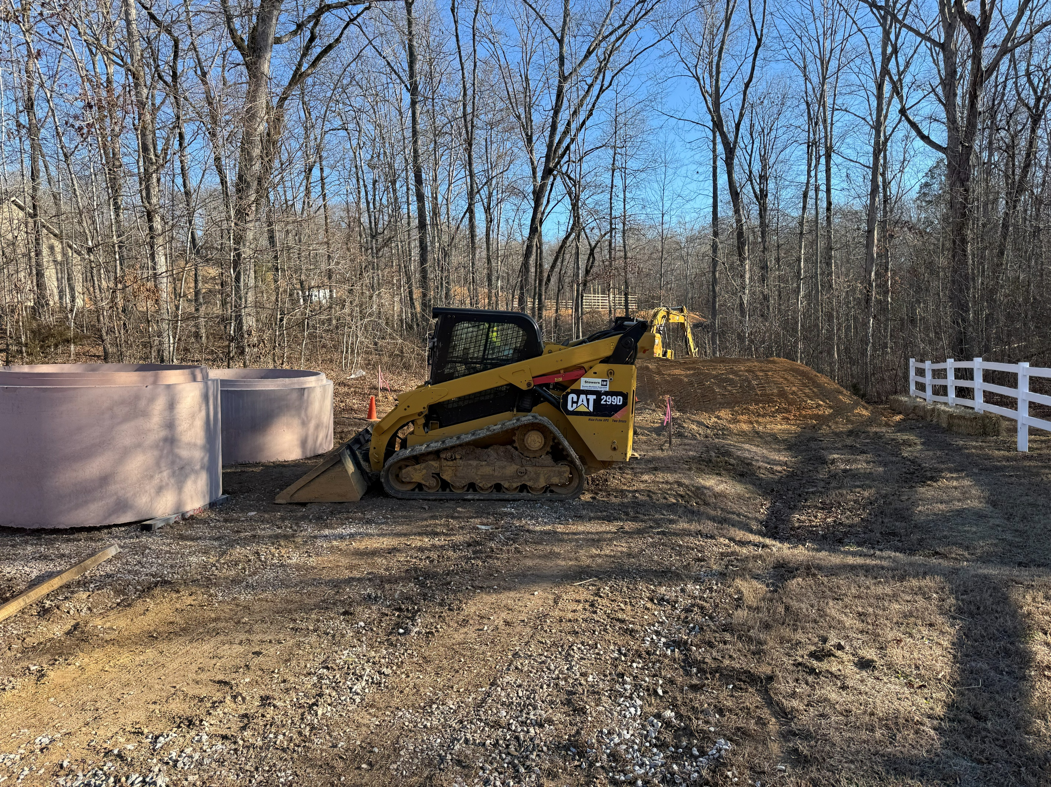
Disadvantages of a Force Account
Utility/Municipality manages procurement and vendors
  Purchasing or renting equipment
  Purchasing materials
  Potential for multiple material bid contracts
Scheduled routine maintenance and emergency response scenarios limit crew resources
Important to Note: Each of these steps will need to meet municipality/utility procurement policies and can add additional time to project schedule

Slide 8

Best Applications
Best Suited For
  Larger Utilities/Municipalities with dedicated maintenance/construction crews
  Organizations with strong internal project management and documentation

Slide 9
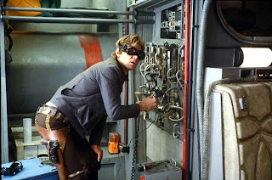
Best Applications
Ideal Project Types
  Equipment replacements (pumps, membranes, grinders, etc.)
  Smaller, less complex projects
  Construction that can be completed with existing equipment and staff
Aficionadofan. “Classic Image: Falcon Fine-Tuning!” Star Wars Aficionado, 24 Aug. 2013, https://starwarsaficionado.blogspot.com/2013/08/classic-image-falcon-fine-tuning.html.

Slide 10

Best Applications
When It Makes Sense
  Projects below procurement/bid thresholds
  When consultant involvement and engineering oversight can be minimized

Slide 11

Summary
Don’t jump before you look!
Evaluate your project before you select the procurement method
Understand the administrative effort required
Document, document, communicate, document!
Administrative/Engineering costs can often outweigh construction savings on large complex projects

Slide 12
Zara ‘ZZ’ Hoch, P.E.
Project Manager
Knoxville, TN
zara.hoch@ohm-advisors.com
Chris Strupp, P.E.
Project Manager
Nashville, TN
chris.strupp@ohm-advisors.com

