Slide 1
SRF Funding: 2027 & Beyond
August 13, 2026

Slide 2
Billy Dranes
Emily Royal
EPA Wastewater Specialist
Tennessee Association of Utility Districts
Special Projects Coordinator
State Revolving Fund
TDEC
Jordan Fey
TNPOP Program Consultant
TDEC

Slide 3
SRF Funding Overview

Slide 4
SRF & SWIG
The Tennessee Department of Conservation (TDEC) works diligently to provide Tennessee communities with clean, safe, and reliable water systems. TDEC works to accomplish this through its Division of Water Resources, via their SRF Loan Program and the State Water Infrastructure Grants program.
SRF
SWIG
The State Revolving Fund Loan Program encompasses both Clean Water SRF and Drinking Water SRF and has provided billions in assistance since its inception.
This program provides low-interest loans and assistance to cities, counties, utility districts, and stormwater authorities for the planning, design, and construction of drinking water, wastewater and stormwater systems.
SRF is a federal-state partnership which assists public water systems to remain compliant with both federal and state requirements.
The State Water Infrastructure Grants (SWIG) office supports the rollout of SRF funds and ARP funds from the federal government through non-competitive and competitive grant programs.
This office promotes TDEC’s mission to protect and improve water quality across the state by helping communities afford compliant wastewater and stormwater systems.
Notes:
TDEC’s mission is to protect and improve the quality of Tennessee’s natural resources while protecting human health and safety. SRF and SWIG both help the Division of Water Resources meet this mission. SRF provides low-interest loans and assistance to cities, counties, utility districts, and stormwater authorities for the planning, design, and construction of drinking water, wastewater and stormwater systems. Then SWIG supports the rollout of SRF and American Rescue Plan funds through non-competitive and competitive grant programs. I primarily work for SRF, so that will be the main focus today. However, if you have questions about grants, I can definitely point you in the right direction.

Slide 5
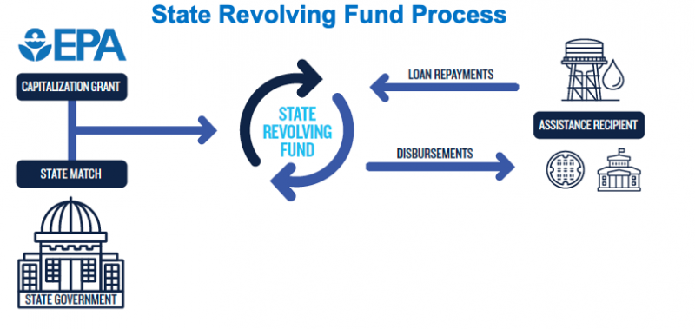
What is the State Revolving Fund?
A self-replenishing loan program that provides affordable financing for drinking water and wastewater infrastructure
Notes:
SRF is a grant and loan program that finances wastewater, stormwater, and drinking water infrastructure through low interest rates and long terms. Our fund receives federal grants through the EPA and the state matches a percent of those grants in order to receive the funds. Then repayments from loans come back into the fund, allowing it to revolve and fund new projects through repaid dollars.

Slide 6
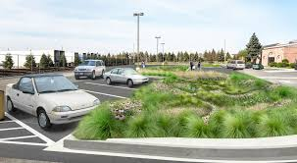
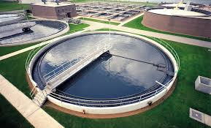
What Clean Water SRF Funds
Eligible Clean Water Project Categories
Construction of municipal wastewater facilities
Control non-point source pollution
Decentralized wastewater treatment systems
Green infrastructure projects
Water quality projects
Stormwater management
Brownfields
Consolidation
Water reuse
Asset management
Capacity management
Compliance Issues
Notes:
Projects must be an eligible category to received funding. For Clean Water, these categories include
Construction of wastewater facilities
Control non-point source pollution
Decentralized wastewater treatment systems
Green infrastructure projects
Water quality projects
Stormwater management
Brownfields
Consolidation
Water reuse
Asset management
Capacity management
And Compliance Issues

Slide 7
What Drinking Water SRF Funds
Eligible Drinking Water Project Categories
Water Quality Issues
Source or Capacity Challenges
Water Storage
Leakage Problems
Pressure Issues
Replacement or Rehabilitation Needs
Water Line Extensions
Regional Drinking Water Consolidation
New Drinking Water Systems
Projects and activities not eligible for funding and primarily intended for the following:
Future growth
Economic development
Fire protection
Laboratory fees for monitoring
Operation and maintenance expenses
Notes:
Eligible drinking water projects include
Water Quality Issues
Source or Capacity Challenges
Water Storage
Leakage Problems
Pressure Issues
Replacement or Rehabilitation Needs
Water Line Extensions
Regional Drinking Water Consolidation
New Drinking Water Systems
Non eligible projects include future growth and economic development, fire protection, lab fees for monitoring, and O&M expenses.

Slide 8
SRF Basics
Application Period: November 17 – January 6
  Virtual & In-person Application Workshops (TBA)
  Ask.SRF@TN.gov
Applicants seeking funding must submit a Questionnaire (Application)
On the Questionnaire, Applicants must attest that:
  The community submitted the last 3 fiscal years of audited financial statements to the comptroller’s office; and
  A facilities plan or other planning document has been or is being developed for this project.
Notes:
Our Program only has one application window right now – so all entities must apply from Mid November to Early January.
SRF can only loan money to applicants with projects on a Priority Ranking List. Utilities must complete an SRF application through the Grants Management System to get on that List.
We’ve historically hosted a virtual workshop to help walk applicants through the process. This year, we’re also considering infiltrating the regional TAUD meetings to provide in-person assistance. Either way, information about this solicitation window and the associated workshops will be sent to everyone on our mailing list. If you would like to be added to this email blast, please email ask.srf@tn.gov to receive those emails.
Applicants must meet rankability requirements to be scored and placed on the list of fundable projects. The rankability requirements are
attesting that you have submitted the last 3 years of audited financials to the comptroller and
attesting that a facilities plan is being developed for the project – it does not have to be complete at the time you’re applying.
Last year we had 67 applications in total, not counting the ones that were left in draft status and not submitted. Out of these, 55 were ranked on the PRL – leaving 12 unranked.

Slide 9
SRF Ability to Pay Index (ATPI)
Using the Ability To Pay Index ​:
  Create a threshold for Principal (Loan) Forgiveness​
  Set SRF Interest Rates​
  Award Subsidy
https://utextensionced.tennessee.edu/ability-to-pay-index/
Notes:
Our program, with the help of the University of Tennessee, has created an ability to pay index. This is a single number that represents nine factors unique to each community across the state. Those factors include the median household income, unemployment, food stamp dependence, families in poverty, community assets, revenues, debt, expenditures, and changes in population. We use the ATPI to determine limitations for subsidies, to set interest rates, and to award loan forgiveness. Having a high or a low ATPI does not automatically impact your eligibility for a loan.
To see your community’s ATPI, you can google TDEC ATPI or use this link.

Slide 10
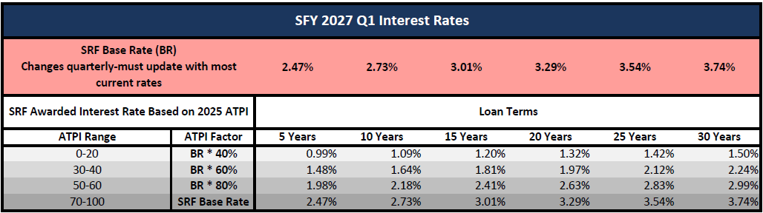
SRF Interest Rates
Notes:
Interest rates are set on a quarterly basis and published to the SRF website on the first Monday of the quarter. A community’s interest rate will be based on its ATPI and the length of the loan. For projects that service more than one county, the assigned ATPI will be based on the service area benefiting most from the project. Here you’ll see how we tier our interest rate reductions. ATPIs of 20 or less will be awarded a 0.40 multiplier on the base interest rate. ATPI scores ranging from 30–40 will be awarded a 0.60 multiplier, 50-60 will be awarded a 0.80 multiplier, and ATPIs of 70 or greater get the standard reported interest rates. Then SRF interest rates are further stratified by the term of the loan.

Slide 11
SRF Budget
EPA Capitalization Grants
FFY 2025 Lead Service Line: $48,423,000
FFY 2026 Clean Water SRF: $10,481,000
FFY 2026 Drinking Water SRF: $6,468,000
FFY 2026 Drinking Water IIJA: $41,896,000
Notes:
These are the cap grants that funded last year’s solicitation – we don’t know what the next grants look like yet. Clean water and Drinking water both require the state to provide a 20% match to accept the funds. State leadership refused to provide that match for the Clean Water Infrastructure Investment and Jobs Act money, so we could not accept that grant for FFY2026. Last year we also advertised supplemental funding for Helene-impacted communities. We will not be soliciting more projects for that funding, because we received more applications than we have funding. We’ll be using our base program funds to cover the additional funding needed for those communities.
Now, these are the annual totals that are being added to the revolving fund. The revolving clean water fund has about $455M available for projects and the drinking water fund has about $161M.

Slide 12
Principal Forgiveness
Low ATPI (0-10): very economically disadvantaged.
Eligible for up to 50% in principal forgiveness.
Mid-range (20–30): moderately economically disadvantaged.
Eligible for up to 40% in principal forgiveness.
Financially disadvantaged economic status based on the SRF Ability to Pay Index (ATPI) scores of 50 or less
High-range (40–50): moderately economically disadvantaged.
Eligible for up to 30% in principal forgiveness.
*Must include construction*
Notes:
All loan forgiveness is awarded on a “first-come-first-serve" basis for disadvantaged communities. To be considered disadvantaged, a Community must have an ATPI of 50 or below. Communities with an ATPI of 10 or below are eligible for 50% forgiveness, Communities with an ATPI of 20-30 are eligible for 40% forgiveness, and Communities with an ATPI of 40-50 are eligible for 30% forgiveness. For most projects, forgiveness is capped at $5 million. These numbers may change before the next solicitation depending on the demand and federal funding received.

Slide 13
SRF Timeline: Application to Loan Agreement
PHASE I
•
SRF opens solicitation
~45 days
01
Questionnaire
•
Applicants submit questionnaires
90 days
•
Questionnaires are reviewed, scored, and ranked
30 days
•
Draft IUPs & PRLs are public noticed
45 days
Ends with ranked / unranked projects
•
Response to comment; final IUPs & PRLs
30 days
PHASE II
•
Applicant initiates GMS Phase II
30 days
02
Financial Sufficiency & Initial Environmental Review
•
SRF reviews for financial sufficiency
30 days
•
SRF initiates interdisciplinary environmental review
45 days
•
SRF notifies applicant of financial sufficiency and next steps for Phase III
Within 2 weeks after IER cross-cutter review
Ends with notification of financial sufficiency and next steps
PHASE III
•
Applicant provides facilities plan documents
60 days
03
Environmental Determination
•
SRF review and environmental determination
90 days
•
SRF sends encumbrance letter
At least 2 weeks after CE or FNSI
Ends with encumbrance letter
PHASE IV
•
SRF drafts loan documents after issuing an encumbrance letter
After encumbrance letter
04
Loan Application
•
Public meeting information and authorizing resolution
60 days / local policy
Ready for TLDA board meeting
•
Complete loan documents; prepare for TLDA board meeting
60 days before TLDA board
Notes:
We know our timeline is the least enticing part about the program. It takes about 600 days from application to loan agreement. This can be reduced by applicants quickly responding to our requests for information. The first few months after application can be a little quiet, but once you’re ranked on the PRL, it’s a more active process.
So November to January, you’re submitting applications and SRF will hold an application workshop. After the window closes, we review, score and rank those projects to create the priority ranking list. We also draft our intended use plans which explain how we’re going to use the federal cap grants. Phase 1 ends with us sending out the ranked or unranked letters. Applicants then come back into the grants management system to complete the Phase 2 activity which then allows SRF to review the applicant’s financial sufficiency and start the interdisciplinary environmental review. If an applicant is financially sufficient, we move to the environmental determination. Then we send the encumbrance letter and draft the loan documents. The loan documents are presented to the board of the Tennessee Local Development Authority for approval and final signature.
Extra:
Phase I: Questionnaire
SRF opens Solicitation
Approximately 45 days
Applicants submit Questionnaires
Questionnaires reviewed, scored and ranked
90 days
Draft IUPs & PRLs public noticed
30 days
Response to Comment and Final IUPs & PRLs published
45 days
SRF sends Ranked and Unranked letters to entities on the Final PRL (by state fiscal year)
30 days – End of Phase I
Phase II: Financial Sufficiency Review & Initial Environmental Review
Applicant initiates GMS Phase II activity (Financial & Environmental Review)
30 days
SRF reviews for financial sufficiency
30 days
SRF initiates Interdisciplinary Environmental Review
45 days
SRF sends notification of financial sufficiency and next steps for Phase 3
Sent within 2 weeks of the IER crosscutter review completion – End of Phase II
Phase III: Environmental Determination
Applicant provides facilities plan documents
60 days
SRF Review and Environmental Determination
90 days
SRF sends Encumbrance Letter
dispatched no less than 2 weeks after the issuance of a CE or FNSI – End of Phase III
Phase IV: Loan Application
SRF drafts loan documents immediately after issuing an Encumbrance Letter
Applicants initiate Phase IV when they provide public meeting information and Authorizing Resolution
60 days or as otherwise required by local policies.

Slide 14
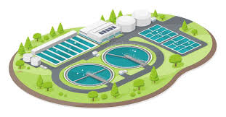
$10M Project Amortized over 20 Years
SRF Loan (1.5%) = $12.5M total
Bond (4.5%) = $18.2M
Savings: ~$6M in avoided interest
Notes:
This is the benefit of the SRF program over the bond market. If you’re a community with an atpi of 30 or 40, and you’re trying to do a loan with a 5 year term (like planning and design loans), you’d have an interest rate of 1.48% right now. If you have an atpi of 0-20, you’d have an interest rate of 1.5% for a 30 year term. Compare that rate to the bond rate of 4.5% over a 20 year term – and that’s $6 million saved in interest. This doesn’t even take principal forgiveness into consideration.

Slide 15
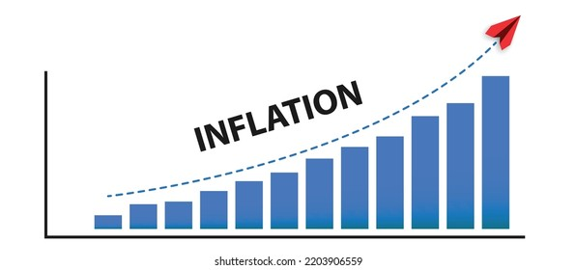

Can you afford to wait?
$5M project delayed five years = $6.8M total at 6% inflation
Harriman Utility Board Regionalization
  Initial Construction Estimate of $12M
  Actual cost $20M
Columbia Power and Water
  Initial Construction Estimate of $125M
  Actual cost $500M
Springfield Wastewater
  Initial Construction Estimate of $15M
  Actual cost $74M
Notes:
We all know SRF takes time, but we should all be thinking about the long term needs of our systems, even if you’re not considering SRF funding. A $5M project delayed 5 years will increase by $1.8M at 6% inflation. And these are real examples of times that we’ve seen waiting and inflation impact project costs.

Slide 16
Plans vs. Plans vs. Plans
Asset Management Plans (or Fiscal Sustainability Plans)
  Required by Water Resources Reform and Development Act (WRRDA) and Clean Water Act (CWA)
  Workshops & the Grant Manual available on TDEC’s Website
    https://www.tn.gov/environment/program-areas/wr-water-resources/srfp/srf-home/swig/amp-grant.html
Capital Improvement Plans
  Part of a good Asset Management Plan
  Referenced during the Drinking Water Infrastructure Needs Survey and Assessment (DWINSA)
Facilities Plans (Lite & Regular)
  Required by the SRF Program
  Guidance available in GMS (Resources Tab – SRF Resources)
Notes:
So are you just waiting, or are you planning? My program references so many different types of plans, so I thought it might be helpful to clarify.
Asset management plans are federally required. In the past, these have also been referred to as fiscal sustainability plans. This should be a living document that supports a utility’s technical, managerial, and financial (TMF) capacity. The AMP must be completed and in place by the “Notice to Proceed” for an SRF project and made available for review by the first construction inspection.
Capital improvement plans are part of an asset management plan. EPA often references these when the Clean or Drinking Water Needs Survey occurs. They should describe
Future projects to add new assets to the system that upgrade or improve existing capacity. And
Renewal projects to restore an existing asset to its original capacity.
Facilities Plans are project-specific and required by SRF. Depending on the breadth of the project, we might recommend a regular facilities plan or a lite facilities plan. Guidance for both is available in the resources tab of the grants management system. A facilities plan should explore the purpose and need for a proposed project. This include future conditions, the alternatives that were considered, project costs, environmental impacts, and other general information about the project.
Extra if needed:
At a minimum, an AMP should include
an inventory of critical assets that are part of the treatment works;
An evaluation of the condition and performance of those assets;
A certification that the assistance recipient has evaluated and will implement water and energy conservation efforts as part of the plant; and
A plan to maintain, repair, and, as necessary, replace the treatment works and a plan to fund such activities
Capital improvement planning determines a system’s short- and long-term asset rehabilitation and replacement projections, based on the asset inventory and O&M data.
The asset management plan should include all projects within a 5-year timeframe, at minimum. However, a 20-year timeframe is preferred to accurately assess and plan for improvements. If a system has already developed a Capital Improvement Plan (CIP), the asset management plan can reference it, specifically the timing and cost of the rehabilitations and replacements. Because the expected needs of the system will change, the CIP projects listed in the asset management plan should be updated as necessary to reflect those changes.

Slide 17
Tennessee Plant Optimization Program (TNPOP)
Notes:
Handoff to Jordan

Slide 18
TNPOP Program: An Overview
  TNPOP: Tennessee Plant Optimization Program
  Definition:
  Optimization is targeted improvement of effluent parameters via operational changes rather than large capital and construction projects.
  TNPOP’s focus is on nutrients,
  Nitrogen and Phosphorus
  Driving Motivations:
  Federal Hypoxia Task Force
  Local Nutrient Impaired Watersheds

Slide 19
TNPOP Program: An Overview
  Goal: Wastewater Operations Excellence
  Raise Expectations and Empower Operators
  Expectation: Sustainably Cleaner Rivers and Lakes
  Tons fewer Nutrients
  Significant Electrical Savings
  Approach: Free Resources
  Easy access to Reference Materials (videos, webinars, white papers)
  In-plant support from a team of TDEC employees and private consultant
  Loaner field-testing equipment

Slide 20
Approach
  Operator Training & TDEC Staff Resource Materials
  TNPOP website
  Nutrient Training Academy – online training videos
    Loaner Field-Testing Equipment for use by Plant Operators
    Regulatory Support
    Technical assistance, not compliance instructions
    Enforcement discretion
    Cooperation with Field Office and Central Office staff
Plant visits
    Repeat visits to modify strategies, offer support & celebrate successes
    Quarterly on-site, non-regulatory visits
    For at least one year
Remote support
Group emails and video calls
  Individual emails, phone calls, and video calls

Slide 21
Results
Year 1 (2025-2026): 10 participating plants
  Nitrogen: 430 tons reduced (70,000 bags of fertilizer)
  Phosphorus: 12.5 tons reduced
  Energy: >20,000 kWh per day (700 homes)
  Operating costs: $750,000 in annual electrical and chemical costs
Year 2 (2026-2027): 15 participating plants
  Nitrogen: 100 tons (16,000 bags of fertilizer)
  Phosphorus: 5 tons
  Energy: 3,200 kWh per day (100 homes)
  Operating costs: $90,000 in annual electrical costs
  Capital expense: $1.2 million project avoided

Slide 22
The TAUD & SRF Contract

Slide 23
Contract Requirements
Drinking Water Infrastructure Needs Survey & Assessment (DWINSA) Assistance
Compile & Target Opportunities List
General Topics
  Water loss priorities
  Inflow and infiltration reduction
  Drinking water or wastewater capacity challenges
  Cybersecurity
  Health-based and environmental compliance
  Managerial and operational sustainability
  System consolidation
  Optimization and modernization
  Regionalization and sustainable development
  Sourcewater protection
  Green infrastructure and system resilience
  Develop methods to identify, coordinate, and address regionalization or consolidation efforts where requested by the State as consistent with the Contractor’s mission.
Notes:
These are the overarching requirements of the contract. TAUD:
assists TDEC and communities with the Drinking water needs survey,
Creates an opportunities list of communities that could benefit from SRF funding or technical assistance
And then TAUD hosts technical assistance workgroup meetings that help steer the technical assistance that they’ll then provide to communities. We met in June to kick off this contract-renewal, and we’ll have another meeting in January to solidify the topics that TAUD will focus on.
So let us know if there are specific topics that you would like to see expanded in future trainings. We can also take questions now, because the next slide is just some resources.
Business Action Plans
Getting SRF Ready
Using the AMP to get ahead in SRF
Talk about importance of DW and CW needs survey

Slide 24
Resources
TN WARN
  https://www.tnwarn.org/Default.aspx
TAUD Regional Meetings
  https://taud.org/region-meetings/#region-events
SRF Website
  https://www.tn.gov/environment/program-areas/wr-water-resources/srfp.html
EPA Cybersecurity Self Evaluation
  https://www.epa.gov/cyberwater/forms/epas-water-sector-cybersecurity-evaluation-program
TNPOP
  https://www.tn.gov/environment/program-areas/wr-water-resources/fleming-training-center/tnpop.html

Slide 25

Questions?

